Slide 1
FILE (I/O)

Slide 2
Table of content
1
Introduction
2
File in Computer
3
File by C Program
4
(Write/Read) Characters
5
(Write/Read) String
6
Record Data
7
Binary Mode
8
(Write/Read) Record In Binary Mode
9
Read from a Random-Access file

Slide 3
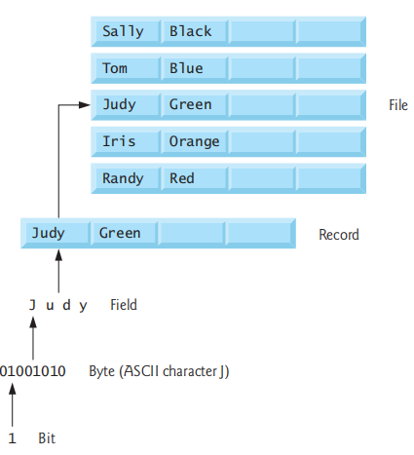
Introduction
What is File?
File: is a Collection of bytes that is given name to store Data .
file can contain characters or numbers or special symbols
Example :
Name Mahmoud Gharib
Age 24
( $, @, %, &, *, (, ), -, +)
Each Characters or Number take one Byte.
Why we use File to store data ?
Storage of data in variables and arrays is temporary such data is lost when a program terminates. Files are used for permanent retention of data.

Slide 4

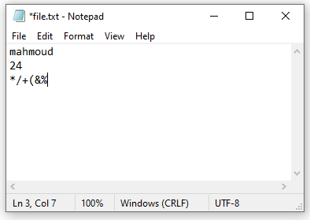
File in Computer
Dealing with File In Computers :
1) if you have not file you can Create it .
2) Then you Can Open the File
3) Then you can make Process
/* Read Data from file */
/* Write Data To File */
/* Update Data To File */
4) Then you Can Close the File

Slide 5
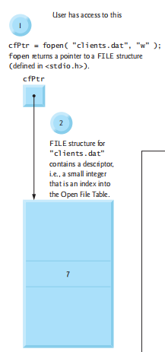
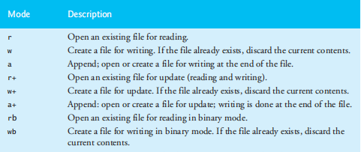
File by C Program
Dealing with File by using C program :
1) Create Pointer to File to refer to the file
Example : FILE *cfptr;
2) Open file using fopen() function
cfptr = fopen(fileName/Path,Mode);
Example : cfptr = fopen(“clients.dat”,”w”);
3) Close file using fclose() function
Example : fclose(cfptr);

Slide 6
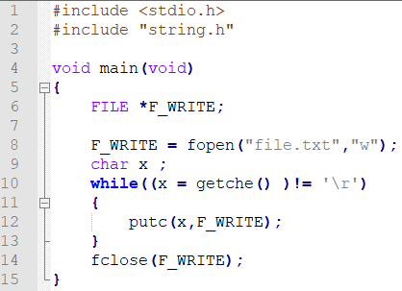
Write Characters
Explain Code :
1) make pointer to file to refer to file
FILE *F_WRITE;
2) open file by using fopen function
F_WRITE = fopen("file.txt","w");
open file in write mode if file not exist it will be create
3) get character by using getche() function then store in variable x ,then check if equal enter key ‘\r’ or not
while((x = getche() )!= '\r')
4) if x not equal enter key ‘\r’ ,store value of x in file.txt by using putc() function
putc(x,F_WRITE);
5) if x equal enter key ‘\r’ go out from while loop and close file by fclose() function
fclose(F_WRITE);
Note :
Replace write mode by Append mode to avoid overwrite problem

Slide 7
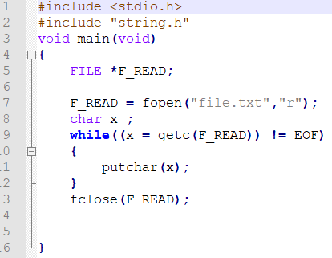
Read Characters
Explain Code :
1) make pointer to file to refer to file
FILE *F_READ;
2) open file by using fopen function
F_READ = fopen("file.txt","r");
open file in read mode
3) get character from file by using getc() function then store in variable x ,then check if equal end of file EOF or not while((x = getc(F_READ)) != EOF)
4) if x not equal end of file EOF ,Display value of x by using putchar(); function
putchar(x);
5) if x equal end of file EOF go out from while loop and close file by fclose() function
fclose(F_READ);

Slide 8
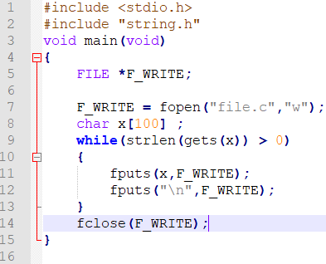
Write String
Explain Code :
1) make pointer to file to refer to file
FILE *F_WRITE;
2) open file by using fopen function
F_WRITE = fopen("file.c","w");
open file in write mode if file not exist it will be create
3) get string by using gets() function then store in variable x ,then check if length of it Bigger than zero or not while(strlen(gets(x)) > 0)
4) if length of string Bigger than zero ,store value of x in file.c by using fputs() function
fputs(x,F_WRITE);
5)if length of string not Bigger than zero go out from while loop and close file by fclose() function
fclose(F_WRITE);
Note :
Replace write mode by Append mode to avoid overwrite problem

Slide 9
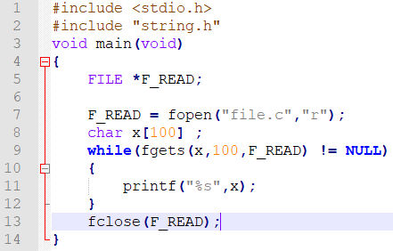
Read String
Explain Code :
1) make pointer to file to refer to file
FILE *F_READ;
2) open file by using fopen function
F_READ = fopen("file.c","r");
open file in read mode
3) get String from file by using fgets() function then store in variable x ,then check if equal NULL or not while(fgets(x,100,F_READ) != NULL)
4) if x not equal NULL ,Display value of x by using printf(); function
printf("%s",x);
5) if x equal NULL go out from while loop and close file by fclose() function
fclose(F_READ);
Note :
fgets() function take 3 parameters array of characters ,size of array characters,pointer to file

Slide 10
Record Data
What is Record ?
Record : (i.e., a struct in C) is composed of several fields. In a payroll system.
Example :
1) record for a particular employee might consist of the following fields :
* Name (alphabetic field)
* Address (alphanumeric field)
* Salary (numeric field)
2) record for a particular Student might consist of the following fields :
* ID (numeric field)
* Name (alphabetic field)
* Grade (numeric field)

Slide 11

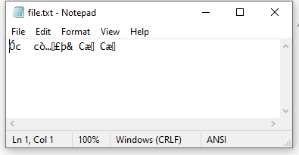
Binary Mode
What is Binary Mode?
Binary Mode : is a Normal mode like write and read mode but it has two Features :
1) Save Memory
2) make Protection for Data
Save Memory
in Normal Read And Write mode Numbers Store each number take 1 Byte
Example :
12345 5 Bytes
25 2 Bytes
in Binary Mode Numbers Store By its size in C program
Example :
12345 2 Bytes Integer
25 1 Bytes Char
make Protection for Data
in Binary Mode if you write Numbers to file and then open it by click to file you can not read it , you must read data by using Binary Mode

Slide 12
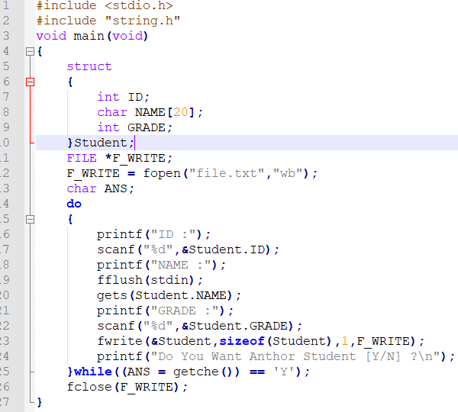
Write Record In Binary Mode
Explain Code :
1) make Struct to Record Student Data
2) make pointer to file to refer to file
FILE *F_WRITE;
3)open file by using fopen function
F_WRITE = fopen("file.c","wb");
open file in write Binary mode if file not exist it will be create
4) make dowhile loop to enter Data of Student
ID by using scanf() function
Name by using gets() function
Grade by using scanf() function

Slide 13
Write Record In Binary Mode
Explain Code :
5) write Data to file by using fwrite() function
fwrite(&Student,sizeof(Student),1,F_WRITE);
6) Check if you enter ‘Y’ go out from while loop and close file by using fclose() function
fclose(F_WRITE);

Slide 14
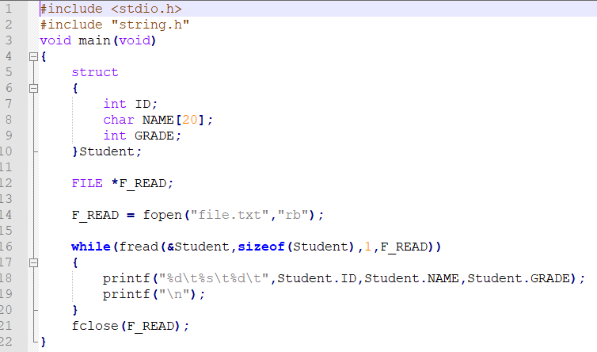
Read Record In Binary Mode
Explain Code :
1) make Struct to Record Student Data
2) make pointer to file to refer to file
FILE *F_READ;
3)open file by using fopen function
F_READ = fopen("file.c","rb");
open file in readBinary mode if file not exist it will be create
4) make while loop to read Data of Student by using fread() function
while(fread(&Student,sizeof(Student),1,F_READ))
5) close file by using fclose() function
fclose(F_READ);

Slide 15
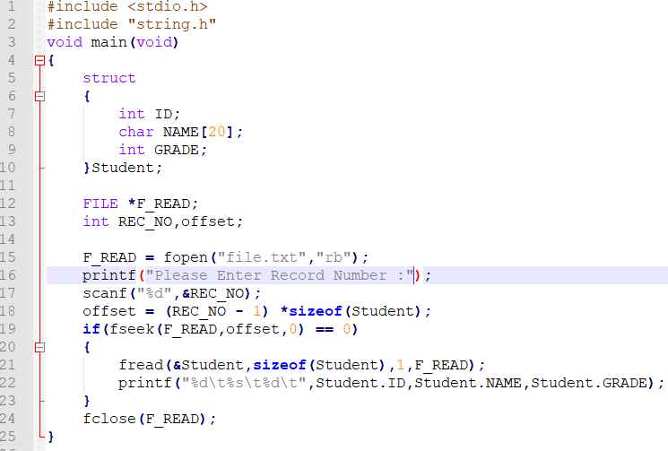
Read from a Random-Access file
Explain Code :
1) make Struct to Record Student Data
2) make pointer to file to refer to file
FILE *F_READ;
3)open file by using fopen function
F_READ = fopen("file.c","rb");
open file in read Binary mode
4) Enter Number of Record that you want to Read by using
scanf() function
5) Calculate offset value to determine the Position that you will Read from it
offset = (REC_NO - 1) *sizeof(Student);
6) read Data of Student by using fread() function
fread(&Student,sizeof(Student),1,F_READ);
7) close file by using fclose() function
fclose(F_READ);

Slide 16


