Slide 1
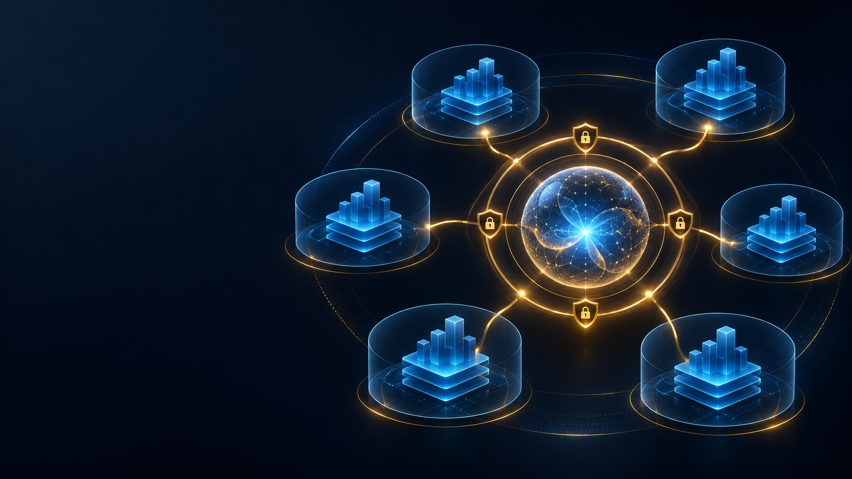
PRODUCT PITCH
ATLAS
Governed multi-tenant RAG
Secure organizational knowledge, role-aware access, and auditable AI controls in one shared platform.
Product Overview
Team 5
Multi-Tenant RAG Assistants

Slide 2
Enterprise AI breaks at the boundaries
02
Generic assistants answer quickly, but organizations need control over what they can see, say, and retain.
The gap
Unsupported answers
Trust requires more than a capable model
Fluent output can exceed the organization’s approved evidence.
Cross-tenant exposure
A missing retrieval or data filter can reveal another customer’s content.
Atlas treats identity, tenant isolation, approved evidence, and incident response as product requirements.
Policy drift
Different teams need different topics, models, retention rules, and refusal language.
Weak accountability
Security teams need actor, tenant, policy version, evidence, and response history.

Slide 3
One platform with tenant-specific control
03
A shared execution core lowers duplication while trusted context keeps knowledge and authority separated.
HR
InfoSec
ATLAS
SHARED CORE
Policies and employee services
Controls and incident guidance
Technology
Operations
Trusted tenant context
The model never chooses its tenant, permissions, sources, or role.
Support and technical knowledge
Procedures and service delivery

Slide 4
Role-based product experiences
04
Each workspace exposes only the capabilities permitted by the authenticated user and active tenant policy.
01
02
03
Employee assistant
Tenant manager
Platform administrator
Ask questions in the tenant domain
Receive cited, evidence-based answers
Review source excerpts
Manage active sessions
Use the assistant with broader scopes
Manage tenant members and roles
Submit knowledge for approval
Triage tenant security reports
Create and activate tenants
Manage signed domain contracts
Approve documents and accounts
Review incidents across tenants
A trusted security context connects identity, tenant, role, scopes, capabilities, and policy version on every request.

Slide 5
Current Product Capabilities
05
The current product covers the governed answer path from tenant onboarding through security response.
Tenant onboarding
Inactive-by-default setup with a signed draft policy
Knowledge governance
Validation, quarantine, approval, versioning, and revocation
Tenant-aware RAG
Mandatory tenant filters plus PostgreSQL authorization checks
Grounded answers
Evidence-only prompts, citations, and deterministic abstention
Threat detection
Prompt and retrieved-content screening before generation
Incident response
Actor attribution, tenant visibility, acknowledgment, and resolution

Slide 6
Tenant Domain Contract
06
A versioned, signed policy makes tenant behavior configurable without changing shared application code.
Knowledge
Models
SIGNED POLICY
Approved sources and file policy
Approved chat and embedding routes
TDC
Domain
Retention
Versioned, validated, auditable
Allowed topics and refusal wording
Audit, interaction, and source periods
Every answer, refusal, document action, and audit record carries the active contract version.
Roles
Isolation
Scopes and capabilities
Pool, bridge, or silo by resource
Draft
Approved
Active
Superseded

Slide 7
Governed answer flow
07
Deterministic controls decide whether the model receives a request and whether its response may leave the backend.
1
2
3
4
5
6
Authenticate
Load policy
Screen
Retrieve
Generate
Validate
Validate the server-side session
Resolve tenant, role, scopes, and TDC
Block suspicious or malformed input
Apply tenant filters before search
Use authorized evidence only
Require citations or abstain
Blocked request
Security report + denied audit
Insufficient evidence
Abstain or clarify

Slide 8
Security detection becomes an actionable report
08
Atlas blocks suspicious content before generation and records enough context for tenant-level response.
1
2
3
4
5
Detect
Block
Report
Triage
Resolve
Prompt injection, tenant escape, exfiltration, poisoning, or hidden text
The LLM does not receive flagged content
Actor, email, tenant, time, policy version, source, and indicators
Tenant manager or platform admin acknowledges the incident
Responder identity and timestamp remain visible
Tenant managers see only their tenant. Platform administrators see the full incident portfolio.

Slide 9
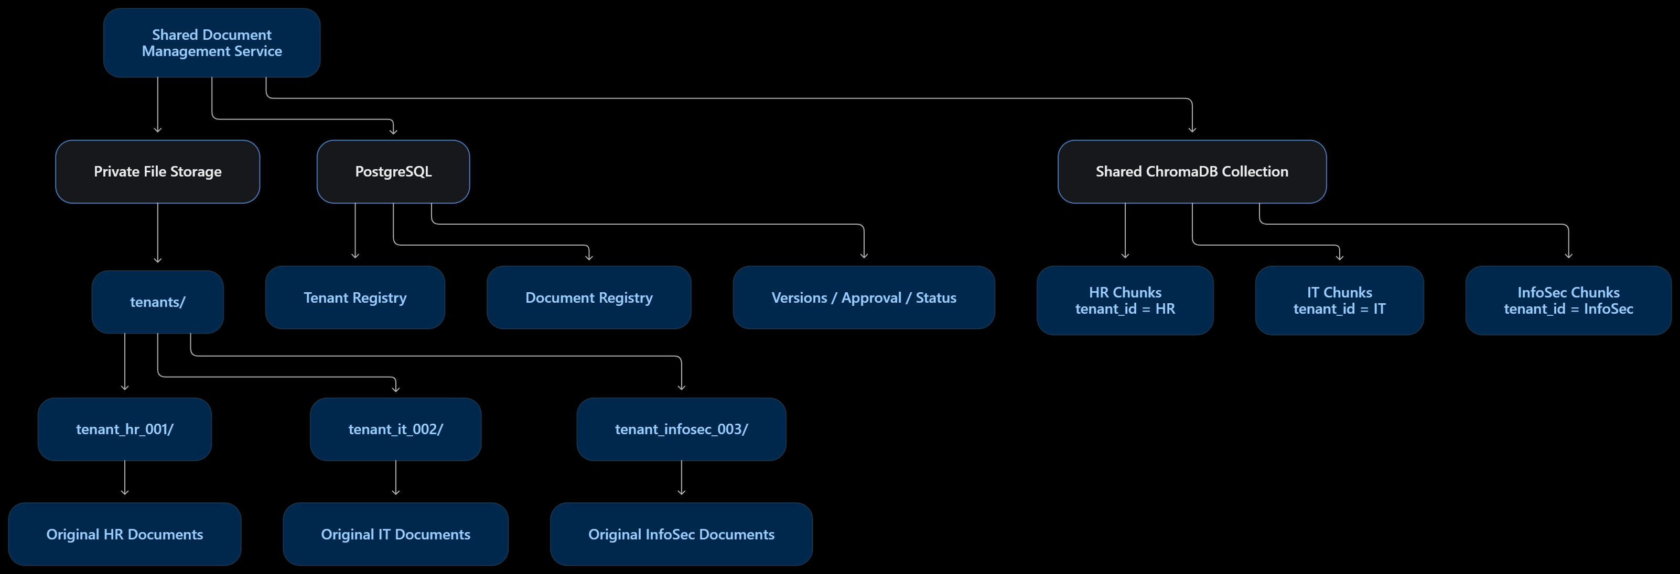
Shared architecture with tenant boundaries
09
PostgreSQL remains authoritative while file storage and vector search carry trusted tenant metadata.
Private originals
Authoritative registry
Shared vector collection
Generated storage keys keep tenant files separated
Ownership, approval, versions, status, and contract history
Server-built tenant filters plus database revalidation

Slide 10
Phase 2 readiness and product roadmap
10
The governed answer path is implemented. Advanced analytics and production durability form the next expansion.
AVAILABLE NOW
NEXT EXPANSION
Signed tenant policy
Tenant-filtered RAG
Document approval and versioning
Hardened sessions and role controls
Security incident triage
Audit records and citations
Metric-first manager BI
Governed aggregate reporting
Controlled natural-language analytics
Hosted and local model routing
Durable ingestion workers
Migration-managed operations
Phase 2 provides a credible controlled prototype without overstating production durability or BI completion.

Slide 11
ATLAS PRODUCT OPPORTUNITY
Secure organizational AI that scales across tenants
Control
Confidence
Separation
Accountability
Policy and permissions stay outside the model
Answers use approved evidence and visible citations
Tenant and role boundaries apply before retrieval
Audits and incidents identify the responsible context
ATLAS GOVERNED MULTI-TENANT RAG
Product pitch, Phase 2

