Slide 1
V8 Validation using T32L75
Overview & summary of class detection
Truth_summary | Value | Percentage(%)
Truth Length | 2259 | 100
Correct Detection | 1866 | 83
Incorrect Detection | 393 | 17
class | recall | precision | f1_score
complete | 0.55 | 0.59 | 0.57
hair | 0.5 | 1 | 0.67
blurry.complete | 0.52 | 0.98 | 0.68
blurry.incomplete | 0.35 | 0.01 | 0.01

Slide 2
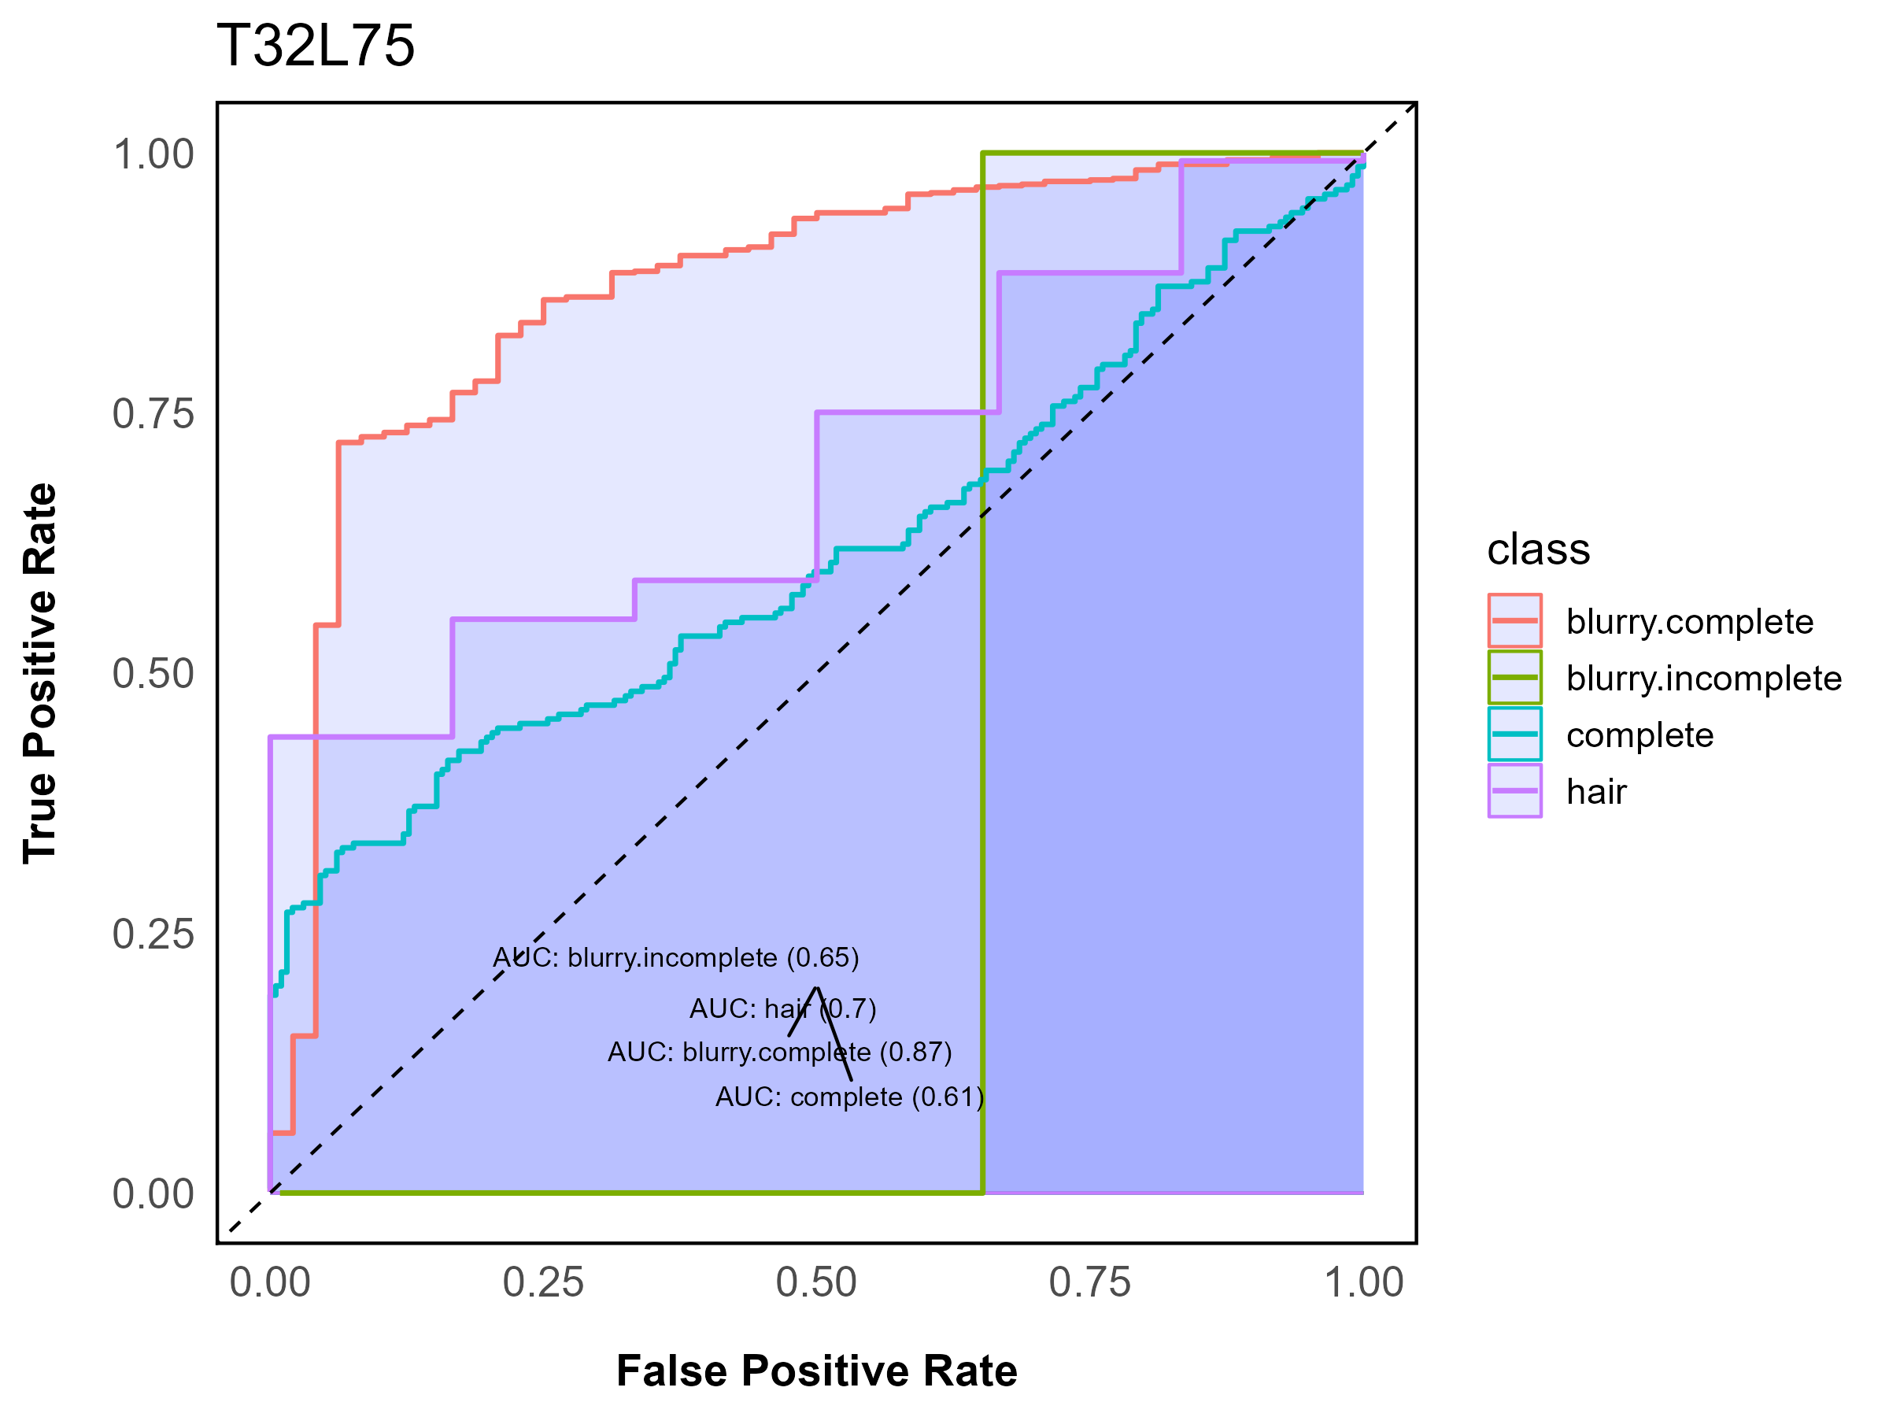
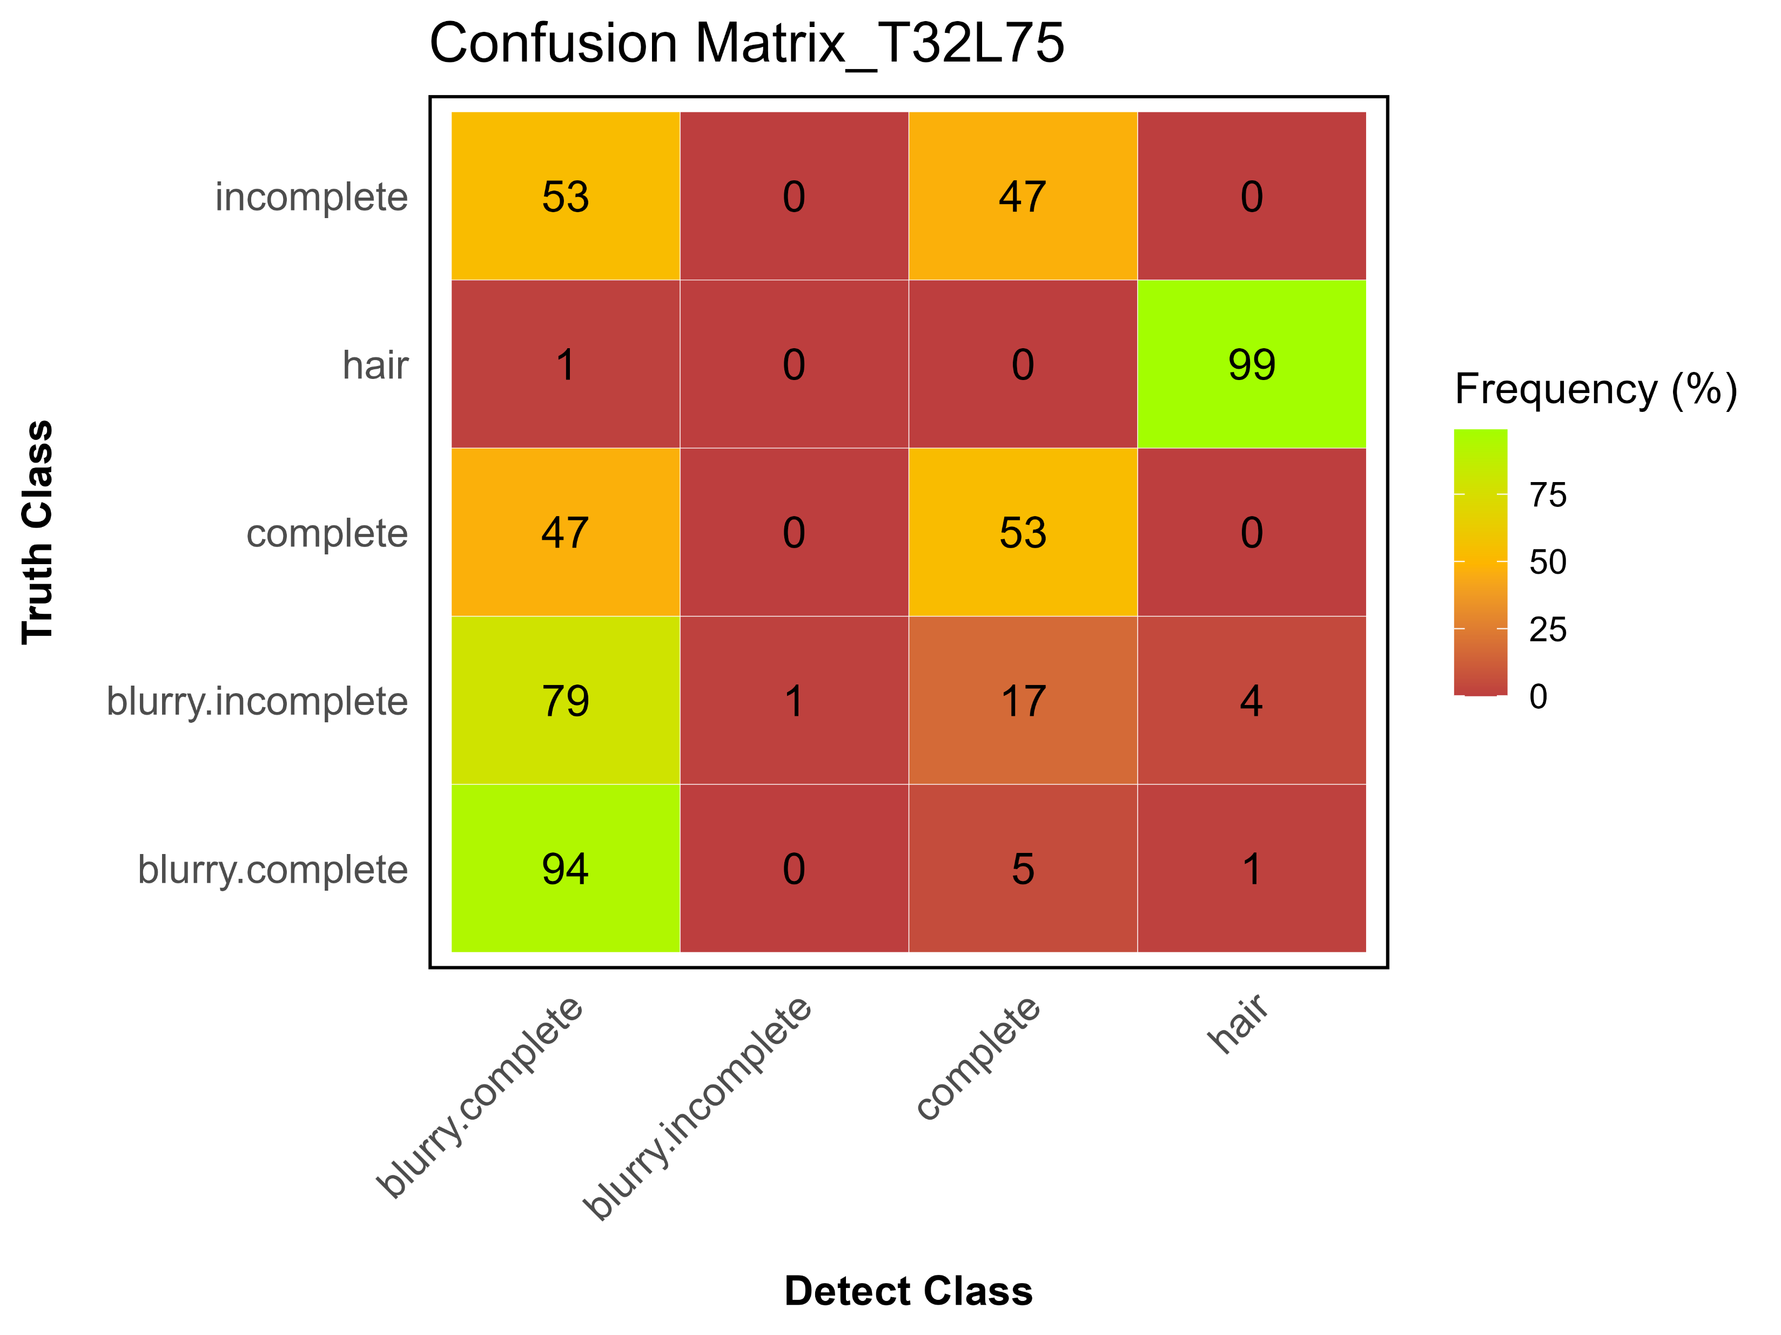
V8 Validation using T32L75

Slide 3
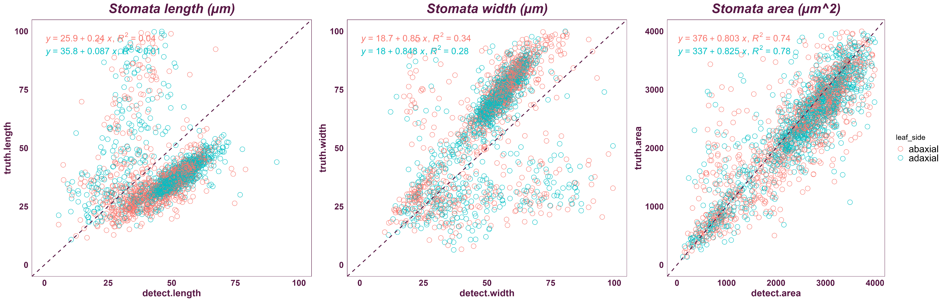
V8 Validation using T32L75
Stomata traits

