Slide 1
Schema
IN SQL

Slide 2
Schema
Schema in databases represents a set of things related to data, such as tables, displays, procedures, etc., and it provides an organized way to organize and group objects within the database

Slide 3
Schema plays an essential role in dividing and organizing data, avoiding name collisions, and managing security and permissions.
“
”
.

Slide 4
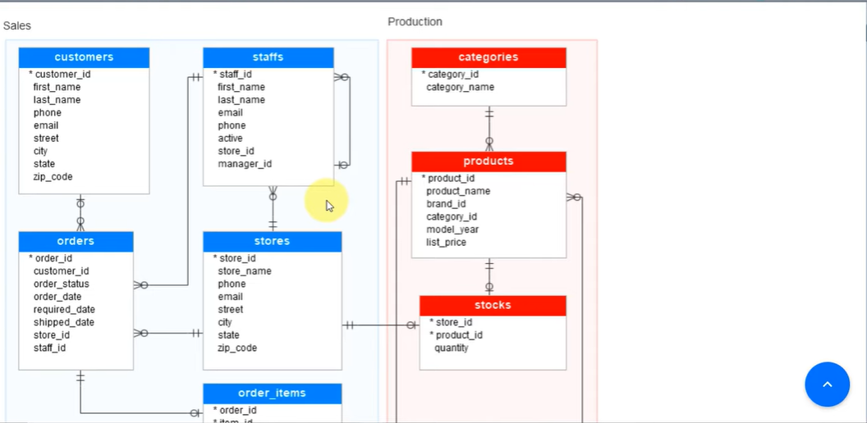
.
.

Slide 5
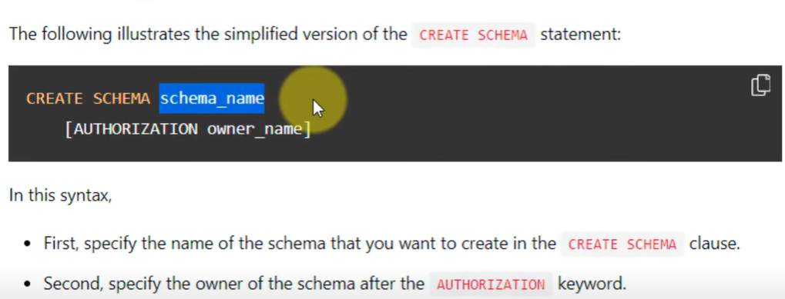
CRAETE SCHEMA For example, CREATE SCHEMA for sales and we put everything related to sales in it
This line is optional to add. The person responsible for it is the person who can modify and add to it
.

Slide 6

CRAETE SCHEMA AND DROP IT
After creating it, we can add its tables
.

Slide 7
Summary FOR Schema
1Logical grouping:
Schema allows related objects to be grouped together, such as tables, views, procedures, etc., into a single logical unit.
2Define security and permissions:
Schema provides a way to specify security and permissions on groups of objects, making it easier to apply permissions and control security centrally.
3Separating and organizing data:
Schema is used to divide data into logical units or groups, making it easier to organize and manage.

Slide 8
THANK YOU
MAHMOUD AL-BAWAIEH
30-12-2023

