Slide 1
BOOK SHOP SYSTEM

Slide 2
Team Members
محمود كمال محمد
محمود شاكر محمد حسن
محمد محمد عبد السلام
محمود عادل عبد الحميد ابراهيم
محمود سعيد عبد الرحمن
محمود رضا حسنين محمود

Slide 3
It is an application for managing book stores, in which an addict can, after logging in, add a category to the application, author, or book, as well as delete and modify them It can also know all visitors or add a new visitor You can know all the sales that took place in the store, know who bought and buy what Finally, it is possible to know the reports of the system, where it can know how many visitors there are or how many classes or books and so on
Project idea

Slide 4
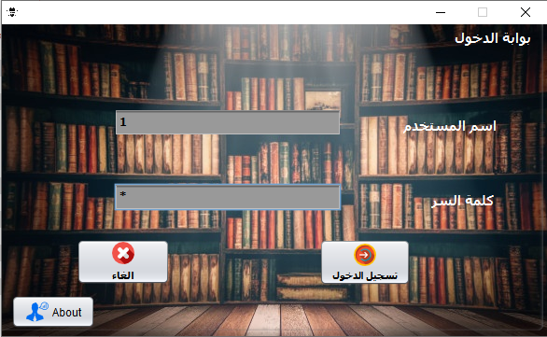
LOGIN PAGE :
The admin starts by entering his name and the password is set from Database
In the event that they were assigned, it moves to the home page
In case of an error, an error message appears in the username or password
.

Slide 5
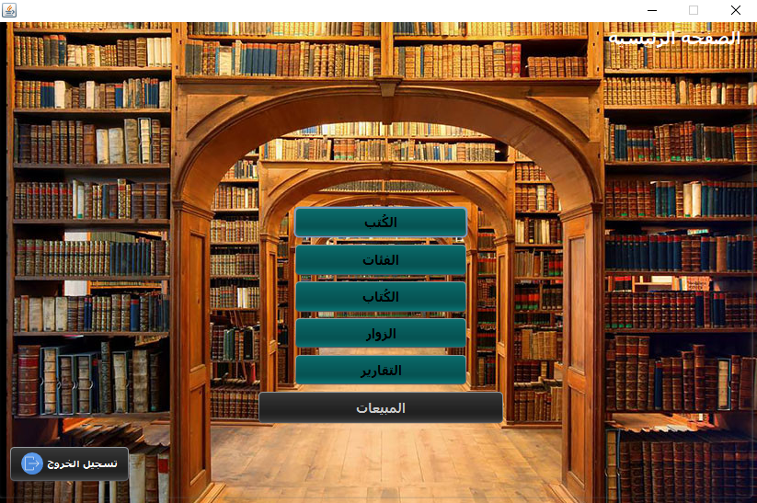
HOME PAGE :
From it, choose the page that the admin will open or log out of the program

Slide 6
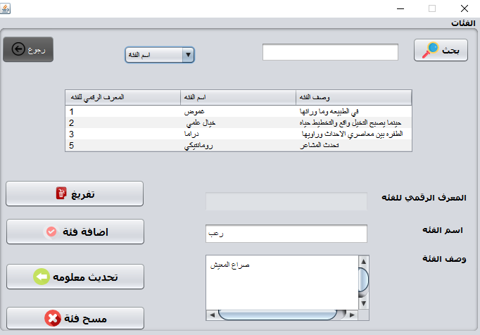
CATEGORY PAGE :
In it, the category name and description are entered, and when adding each category, it gets its own identification number
The following was used on the page
Function to delete a specific category
Function to update category information
Function to add a category
Function to delete all categories
Finally, Function to do a search, and that happens by comparing the entered name with all the existing names

Slide 7
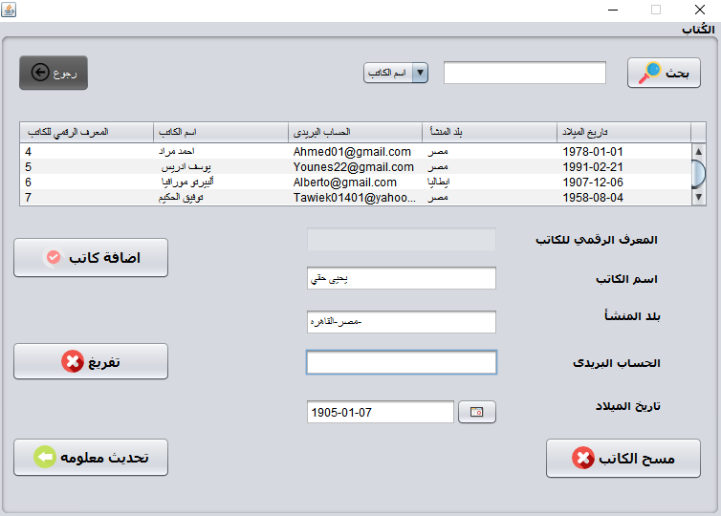
Author PAGE :
In it, the author name and his inforamtion are entered, and when adding each author, it gets its own identification number
The following was used on the page
Function to delete a specific author
Function to update author information
Function to add a author
Function to delete all authors
Finally, Function to do a search, and that happens by comparing the entered name with all the existing names

Slide 8
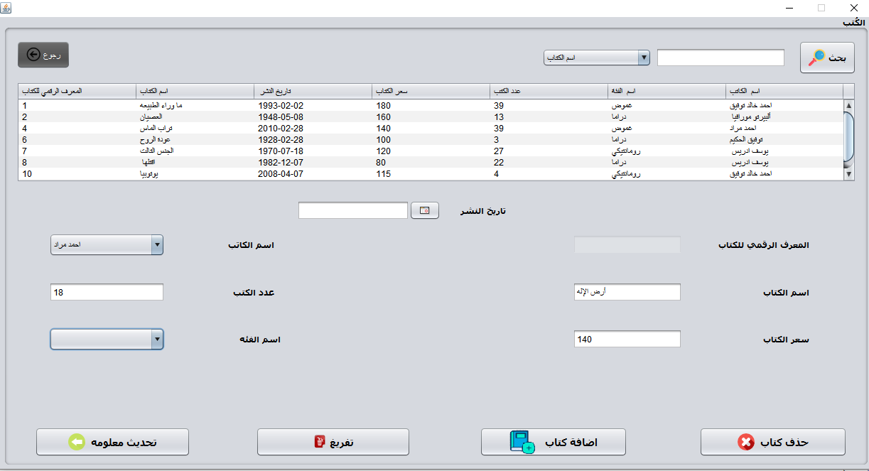
BOOK PAGE :
In it, the book name and it inforamtion are entered, and
when adding each book, it gets its own identification number
The following was used on the page
Function to delete a specific book
Function to update book information
Function to add a book
Function to delete all books
Finally, Function to do a search,
and that happens by comparing the entered name with
all the existing names

Slide 9
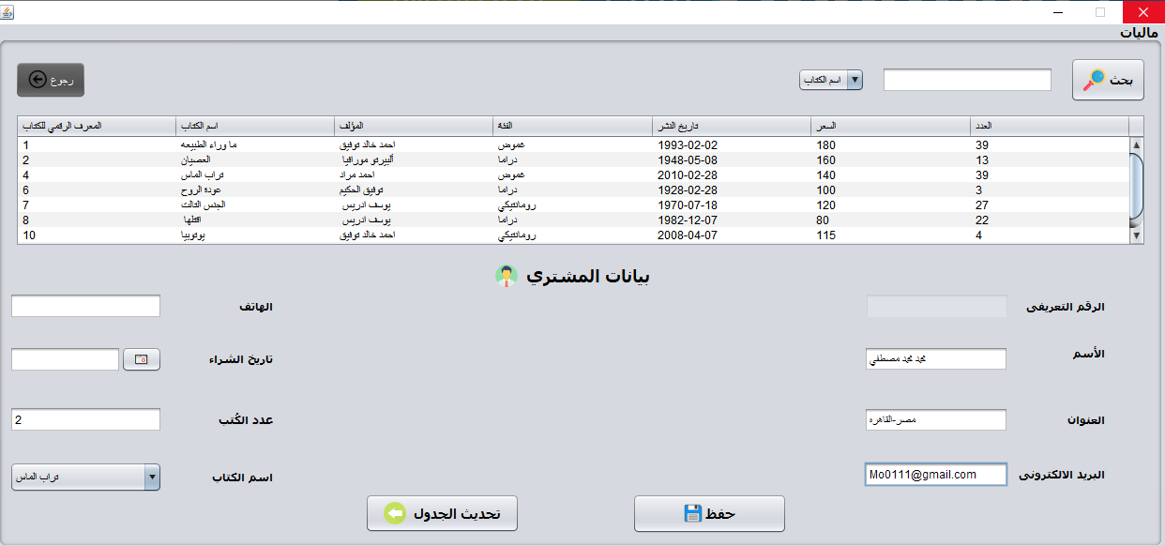
SELLS :
In this page you can see every thing about data in the app
Number of book which add or sell
Number of customers
Number of authors
Number of categories
And earning of books
You just need to select the date for the data which you want and the program will show you what added in this time

Slide 10
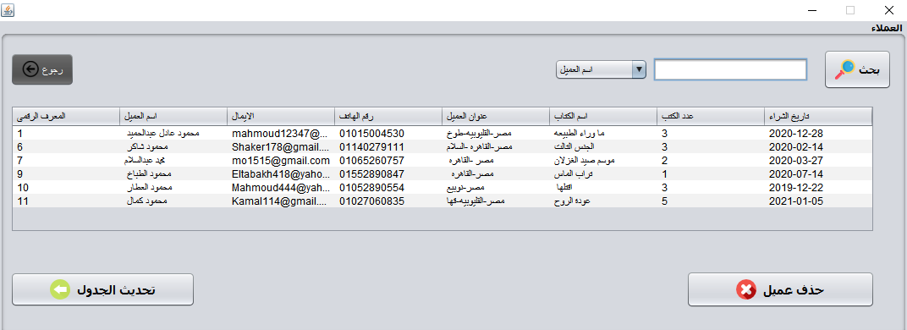
CLIENTS PAGE
In it the admin can search for clients which buy any books
And he can make update any time to see the new clients
Or search for specific one

Slide 11
SELLS PAGE
From here you can see all books which sold for any client And he can make update any time to see the new clients
Or search for specific one

Slide 12
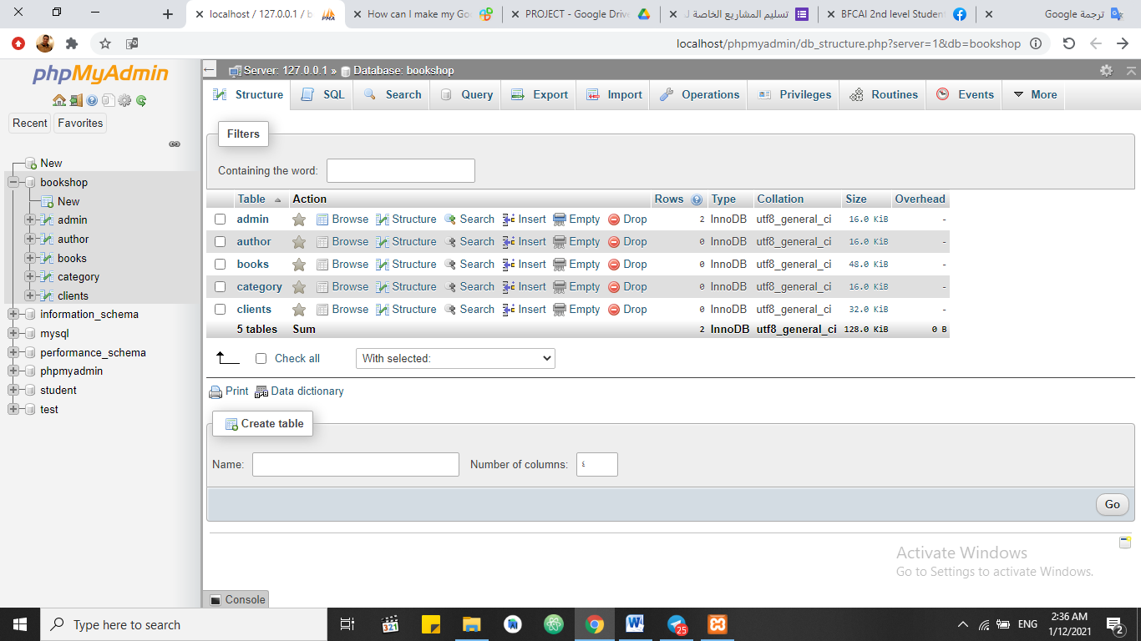
DATABASE :
In it we made 5 tables admin , author , book ,category and clients

Slide 13
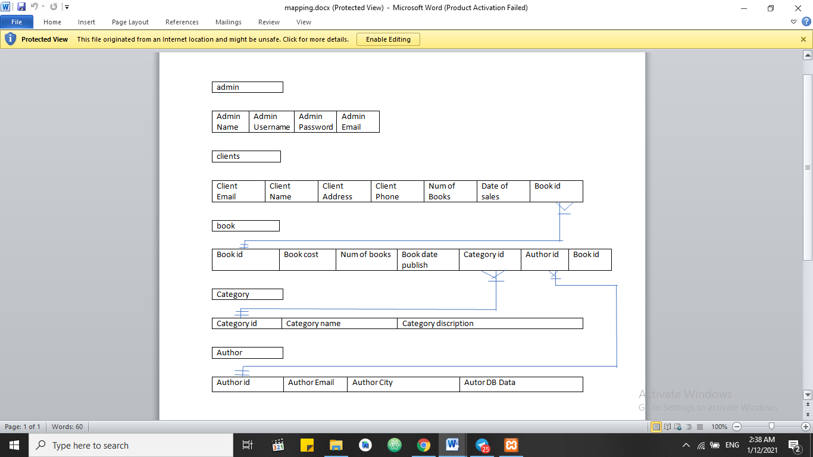
Mapping :
In it you can see the relations between tables

Slide 14
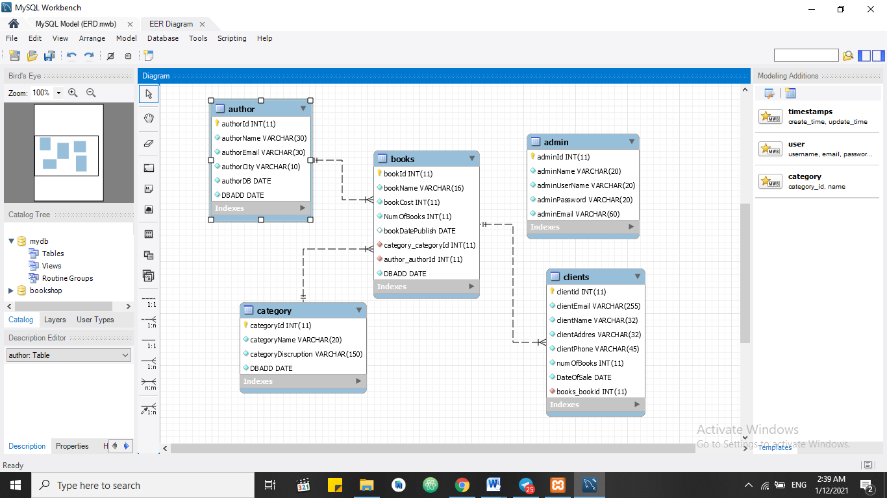
ER DIAGRAM

Slide 15
Thank you !

