Slide 1


Slide 2
Chapter 1: Introduction

Slide 3
Chapter 1: Introduction
What Operating Systems Do
Computer-System Organization
Computer-System Architecture
Operating-System Structure
Operating-System Operations
Process Management
Memory Management
Storage Management
Protection and Security
Kernel Data Structures
Computing Environments
Open-Source Operating Systems

Slide 4
Objectives
To describe the basic organization of computer systems.
To provide a grand tour of the major components of operating systems.
To give an overview of the many types of computing environments.
To explore several open-source operating systems.

Slide 5
What is an Operating System?
A program that acts as an intermediary between a user of a computer and the computer hardware.
Operating system goals:
Execute user programs and make solving user problems easier.
Make the computer system convenient to use.
Use the computer hardware in an efficient manner.

Slide 6
Computer System Structure
Computer system can be divided into four components:
Hardware – provides basic computing resources
CPU, memory, I/O devices
Operating system
Controls and coordinates use of hardware among various applications and users.
Application programs – define the ways in which the system resources are used to solve the computing problems of the users.
Word processors, compilers, web browsers, database systems, video games
Users
People, machines, other computers.

Slide 7
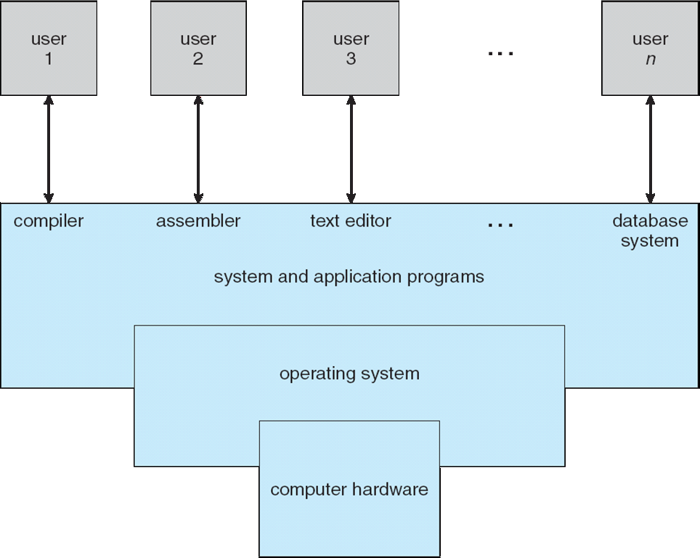
Four Components of a Computer System

Slide 8
What Operating Systems Do
Depends on the point of view:
Users want convenience, ease of use and good performance.
Don’t care about resource utilization.
But shared computer such as mainframe or minicomputer must keep all users happy.
Users of dedicate systems such as workstations have dedicated resources but frequently use shared resources from servers.
Handheld computers are resource poor, optimized for usability and battery life.
Some computers have little or no user interface, such as embedded computers in devices and automobiles

Slide 9
Operating System Definition
OS is a resource allocator
Manages all resources.
Decides between conflicting requests for efficient and fair resource use.
OS is a control program
Controls execution of programs to prevent errors and improper use of the computer.

Slide 10
Operating System Definition (Cont.)
No universally accepted definition.
“Everything a vendor ships when you order an operating system” is a good approximation
But varies wildly.
“The one program running at all times on the computer” is the kernel.
Everything else is either
a system program (ships with the operating system) , or
an application program.

Slide 11
Computer Startup
bootstrap program is loaded at power-up or reboot
Typically stored in ROM or EPROM, generally known as firmware.
Initializes all aspects of system.
Loads operating system kernel and starts execution.

Slide 12
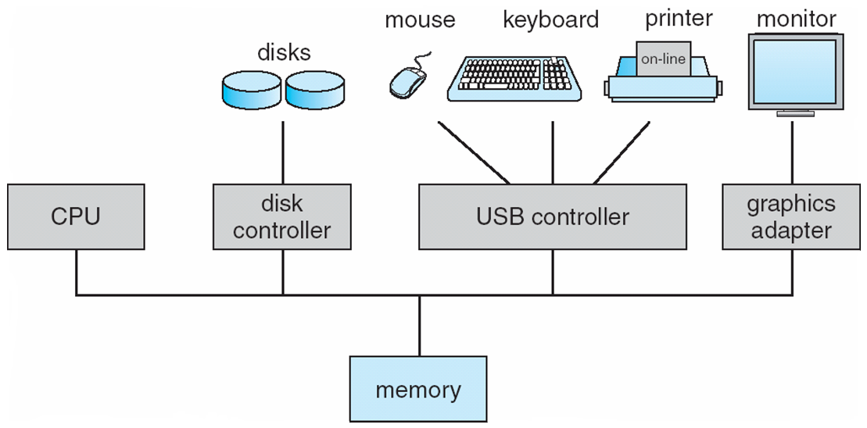
Computer System Organization
One or more CPUs, device controllers connect through common bus providing access to shared memory.
Concurrent execution of CPUs and devices competing for memory cycles.

Slide 13
Computer-System Operation
I/O devices and the CPU can execute concurrently.
Each device controller is responsible for a particular device type.
Each device controller has a local buffer.
CPU moves data from/to main memory to/from local buffers.
I/O is from the device to local buffer of controller.
Device controller informs CPU that it has finished its operation by causing an interrupt.

Slide 14
Common Functions of Interrupts
Interrupt transfers control to the interrupt service routine generally, through the interrupt vector, which contains the addresses of all the service routines.
Interrupt architecture must save the address of the interrupted instruction.
A trap or exception is a software-generated interrupt caused either by an error or a user request.
An operating system is interrupt driven.

Slide 15
Interrupt Handling
The operating system preserves the state of the CPU by storing registers and the program counter.
Determines which type of interrupt has occurred.
Separate segments of code determine what action should be taken for each type of interrupt.

Slide 16
Interrupt-driven I/O cycle

Slide 17
I/O Structure
After I/O starts, control returns to user program only upon I/O completion:
Wait instruction idles the CPU until the next interrupt.
Wait loop (contention for memory access).
At most one I/O request is outstanding at a time, no simultaneous I/O processing.
After I/O starts, control returns to user program without waiting for I/O completion:
System call – request to the OS to allow user to wait for I/O completion.
Device-status table contains entry for each I/O device indicating its type, address, and state.
OS indexes into I/O device table to determine device status and to modify table entry to include interrupt.

Slide 18
Storage Definitions and Notation Review
The basic unit of computer storage is the bit. A bit can contain one of two values, 0 and 1. All other storage in a computer is based on collections of bits. Given enough bits, it is amazing how many things a computer can represent: numbers, letters, images, movies, sounds, documents, and programs, to name a few. A byte is 8 bits, and on most computers it is the smallest convenient chunk of storage. For example, most computers don’t have an instruction to move a bit but do have one to move a byte. A less common term is word, which is a given computer architecture’s native unit of data. A word is made up of one or more bytes. For example, a computer that has 64-bit registers and 64-bit memory addressing typically has 64-bit (8-byte) words. A computer executes many operations in its native word size rather than a byte at a time.
Computer storage, along with most computer throughput, is generally measured and manipulated in bytes and collections of bytes.
A kilobyte, or KB, is 1,024 bytes
a megabyte, or MB, is 1,024² bytes
a gigabyte, or GB, is 1,024³ bytes
a terabyte, or TB, is 1,024⁴ bytes
a petabyte, or PB, is 1,024⁵ bytes
Computer manufacturers often round off these numbers and say that a megabyte is 1 million bytes and a gigabyte is 1 billion bytes. Networking measurements are an exception to this general rule; they are given in bits (because networks move data a bit at a time).

Slide 19
Storage Structure
Main memory – only large storage media that the CPU can access directly.
Random access.
Typically volatile.
Secondary storage – extension of main memory that provides large nonvolatile storage capacity.
Hard disks – rigid metal or glass platters covered with magnetic recording material
Disk surface is logically divided into tracks, which are subdivided into sectors.
The disk controller determines the logical interaction between the device and the computer.
Solid-state disks – faster than hard disks, nonvolatile
Various technologies.
Becoming more popular.

Slide 20
Storage Hierarchy
Storage systems organized in hierarchy
Speed
Cost
Volatility
Caching – copying information into faster storage system; main memory can be viewed as a cache for secondary storage.
Device Driver for each device controller to manage I/O
Provides uniform interface between controller and kernel

Slide 21
Storage-Device Hierarchy

Slide 22
Caching
Important principle, performed at many levels in a computer (in hardware, operating system, software)
Information in use copied from slower to faster storage temporarily
Faster storage (cache) checked first to determine if information is there
If it is, information used directly from the cache (fast).
If not, data copied to cache and used there.
Cache smaller than storage being cached
Cache management important design problem.
Cache size and replacement policy.

Slide 23
Direct Memory Access Structure
Used for high-speed I/O devices able to transmit information at close to memory speeds.
Device controller transfers blocks of data from buffer storage directly to main memory without CPU intervention.
Only one interrupt is generated per block, rather than the one interrupt per byte.

Slide 24
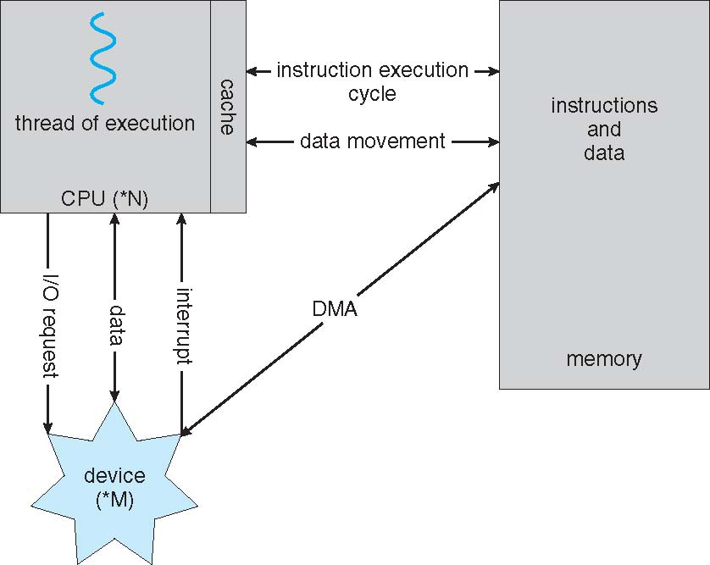
How a Modern Computer Works

Slide 25
Computer-System Architecture
Most systems use a single general-purpose processor
Most systems have special-purpose processors as well.
Multiprocessors systems growing in use and importance
Also known as parallel systems, tightly-coupled systems
Advantages include:
Increased throughput.
Economy of scale.
Increased reliability – graceful degradation or fault tolerance
Two types:
Asymmetric Multiprocessing – each processor is assigned a specie task.
Symmetric Multiprocessing – each processor performs all tasks

Slide 26
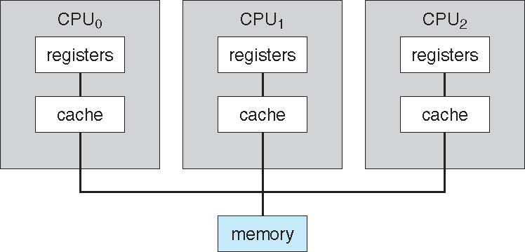
Symmetric Multiprocessing Architecture

Slide 27
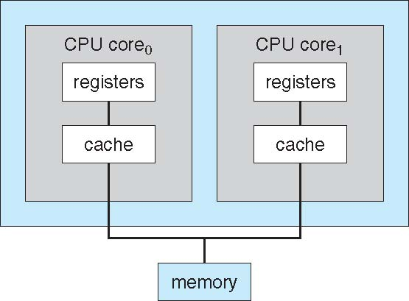
A Dual-Core Design
Multi-chip and multicore
Systems containing all chips
Chassis containing multiple separate systems

Slide 28
Clustered Systems
Like multiprocessor systems, but multiple systems working together
Usually sharing storage via a storage-area network (SAN).
Provides a high-availability service which survives failures.
Asymmetric clustering has one machine in hot-standby mode.
Symmetric clustering has multiple nodes running applications, monitoring each other.
Some clusters are for high-performance computing (HPC)
Applications must be written to use parallelization
Some have distributed lock manager (DLM) to avoid conflicting operations.

Slide 29
Clustered Systems

Slide 30
Operating System Operation
Multiprogramming (Batch system) needed for efficiency
Single user cannot keep CPU and I/O devices busy at all times.
Multiprogramming organizes jobs (code and data) so CPU always has one to execute.
A subset of total jobs in system is kept in memory.
One job selected and run via job scheduling.
When it has to wait (for I/O for example), OS switches to another job.
Timesharing (multitasking) is logical extension in which CPU switches jobs so frequently that users can interact with each job while it is running, creating interactive computing
Response time should be < 1 second.
Each user has at least one program executing in memory process.
If several jobs ready to run at the same time  CPU scheduling.
If processes don’t fit in memory, swapping moves them in and out to run.
Virtual memory allows execution of processes not completely in memory.

Slide 31
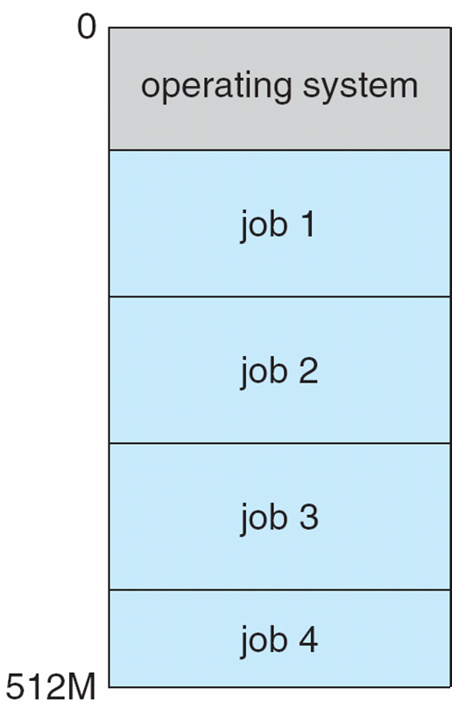
Memory Layout for Multiprogrammed System

Slide 32
Operating-System Operations
Interrupt driven (hardware and software)
Hardware interrupt by one of the devices
Software interrupt (exception or trap):
Software error (e.g., division by zero)
Request for operating system service
Other process problems include infinite loop, processes modifying each other or the operating system

Slide 33
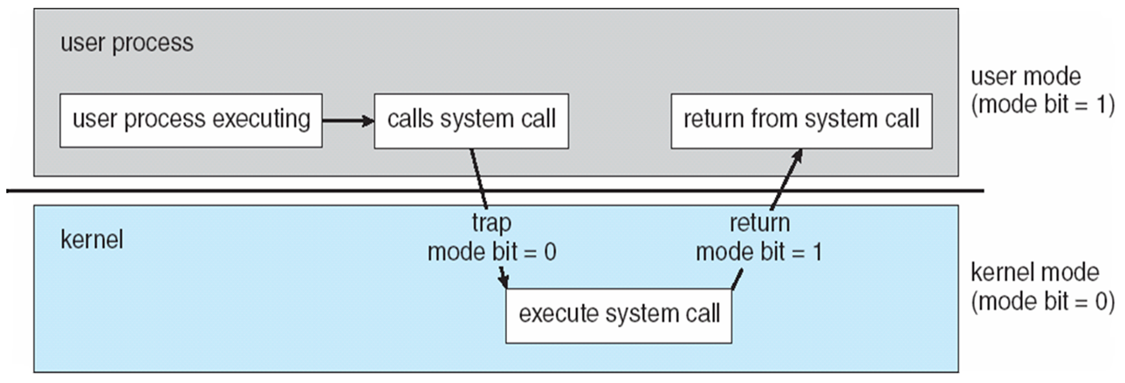
Operating-System Operations (cont.)
Dual-mode operation allows OS to protect itself and other system components:
User mode and kernel mode (supervisor mode, system mode).
Mode bit provided by hardware.
Provides ability to distinguish when system is running user code or kernel code.
Some instructions designated as privileged (machine instructions that may cause harm), only executable in kernel mode.
System call changes mode to kernel, return from call resets it to user.
Increasingly CPUs support multi-mode operations
i.e. virtual machine manager (VMM) mode for guest VMs.

Slide 34
Transition from User to Kernel Mode
Timer
We must ensure that the operating system maintains control over the CPU.
We cannot allow a user program to get stuck in an infinite loop or to fail to call system services and never return control to the operating system. To accomplish this goal, we can use a timer.
A timer can be set to interrupt the computer after a specified period.
Timer to prevent infinite loop / process hogging resources
Timer is set to interrupt the computer after some time period.
Keep a counter that is decremented by the physical clock.
Operating system set the counter (privileged instruction).
When counter zero generate an interrupt.
Set up before scheduling process to regain control or terminate program that exceeds allotted time.
Instructions that modify the content of the timer are privileged.

Slide 35
Process Management
A process is a program in execution. It is a unit of work within the system. Program is a passive entity, process is an active entity.
Process needs resources to accomplish its task
CPU, memory, I/O, files
Initialization data
Process termination requires reclaim of any reusable resources.
Single-threaded process has one program counter specifying location of next instruction to execute
Process executes instructions sequentially, one at a time, until completion.
Multi-threaded process has one program counter per thread.
Typically, system has many processes, some user, some operating system running concurrently on one or more CPUs
Concurrency by multiplexing the CPUs among the processes / threads.

Slide 36
Process Management Activities
The operating system is responsible for the following activities in connection with process management:
Creating and deleting both user and system processes.
Suspending and resuming processes.
Providing mechanisms for process synchronization.
Providing mechanisms for process communication.
Providing mechanisms for deadlock handling.

Slide 37
Memory Management
To execute a program all (or part) of the instructions must be in memory.
All (or part) of the data that is needed by the program must be in memory.
Memory management determines what is in memory and when
Optimizing CPU utilization and computer response to users
Memory management activities:
Keeping track of which parts of memory are currently being used and by whom
Deciding which processes (or parts thereof) and data to move into and out of memory
Allocating and deallocating memory space as needed

Slide 38
Storage Management
OS provides uniform, logical view of information storage.
Abstracts physical properties to logical storage unit - file (a collection of related information defined by its creator).
Each medium is controlled by device (i.e., disk drive, tape drive)
Varying properties include access speed, capacity, data-transfer rate, access method (sequential or random).
File-System management
Files usually organized into directories.
Access control on most systems to determine who can access what.
OS activities include.
Creating and deleting files and directories.
Primitives to manipulate files and directories.
Mapping files onto secondary storage.
Backup files onto stable (non-volatile) storage media.

Slide 39
Mass-Storage Management
Usually, disks used to store data that does not fit in main memory or data that must be kept for a “long” period of time.
Proper management is of central importance.
Entire speed of computer operation hinges on disk subsystem and its algorithms.
OS activities
Free-space management.
Storage allocation.
Disk scheduling.
Some storage need not be fast
Tertiary storage includes optical storage, magnetic tape.
Still must be managed – by OS or applications.
Varies between WORM (write-once, read-many-times) and RW (read-write).

Slide 40
Performance of Various Levels of Storage
Movement between levels of storage hierarchy can be explicit or implicit.

Slide 41
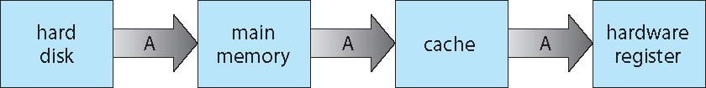
Migration of data “A” from Disk to Register
Multitasking environments must be careful to use most recent value, no matter where it is stored in the storage hierarchy.
Multiprocessor environment must provide cache coherency in hardware such that all CPUs have the most recent value in their cache.
Distributed environment situation even more complex
Several copies of a datum can exist.

Slide 42
I/O Subsystem
One purpose of OS is to hide peculiarities of hardware devices from the user.
I/O subsystem responsible for:
Memory management of I/O including buffering (storing data temporarily while it is being transferred), caching (storing parts of data in faster storage for performance), spooling (the overlapping of output of one job with input of other jobs).
General device-driver interface.
Drivers for specific hardware devices.

Slide 43
Protection and Security
Protection – any mechanism for controlling access of processes or users to resources defined by the OS.
Security – defense of the system against internal and external attacks
Huge range, including denial-of-service, worms, viruses, identity theft, theft of service
Systems generally first distinguish among users, to determine who can do what
User identities (user IDs, security IDs) include name and associated number, one per user.
User ID then associated with all files, processes of that user to determine access control.
Group identifier (group ID) allows set of users to be defined and controls managed, then also associated with each process, file.
Privilege escalation allows user to change to effective ID with more rights.

Slide 44
Kernel Data Structures
Many similar to standard programming data structures
Singly linked list
Doubly linked list
Circular linked list
Lists are sometimes used directly by kernel algorithms. Frequently, though, they are used for constructing more powerful data structures, such as stacks and queues.

Slide 45
Kernel Data Structures
A tree is a data structure that can be used to represent data hierarchically. Data values in a tree structure are linked through parent–child relationships.
In a general tree, a parent may have an unlimited number of children. In a binary tree, a parent may have at most two children. A binary search tree additionally requires an ordering between the parent’s two children in which left child <= right child.
Search performance is O(n)
Balanced binary search tree is O(lg n)

Slide 46
Kernel Data Structures
A hash function takes data as its input, performs a numeric operation on the data, and returns a numeric value. This numeric value can then be used as an index into a table (typically an array) to quickly retrieve the data. Whereas searching for a data item through a list of size n can require up to O(n) comparisons, using a hash function for retrieving data from a table can be as good as O(1).
Hash function can create a hash map.
Bitmap – string of n binary digits representing the status of n items.
Linux data structures defined in
include files <linux/list.h>, <linux/kfifo.h>, <linux/rbtree.h>

Slide 47
Computing Environments - Traditional
Stand-alone general purpose machines.
But blurred as most systems interconnect with others (i.e., the Internet).
Portals provide web access to internal systems.
Network computers (thin clients) are like Web terminals.
Mobile computers interconnect via wireless networks.
Networking becoming ubiquitous – even home systems use firewalls to protect home computers from Internet attacks.

Slide 48
Computing Environments - Mobile
Handheld smartphones, tablets, etc
What is the functional difference between them and a “traditional” laptop?
Extra feature – more OS features (GPS, gyroscope)
Allows new types of apps like augmented reality.
Use IEEE 802.11 wireless, or cellular data networks for connectivity
Leaders are Apple iOS and Google Android

Slide 49
Computing Environments – Distributed
Distributed computing
Collection of separate, possibly heterogeneous, systems networked together
Network is a communications path, TCP/IP most common
Local Area Network (LAN)
Wide Area Network (WAN)
Metropolitan Area Network (MAN)
Personal Area Network (PAN)
Network Operating System provides features between systems across network
Communication scheme allows systems to exchange messages.
Illusion of a single system.

Slide 50
Computing Environments – Client-Server
Client-Server Computing
Many systems now servers, responding to requests generated by clients.
Compute-server system provides an interface to client to request services (i.e., database)
File-server system provides interface for clients to store and retrieve files

Slide 51
Computing Environments - Peer-to-Peer
Another model of distributed system
P2P does not distinguish clients and servers.
Instead, all nodes are considered peers.
May each act as client, server or both.
Node must join P2P network
Registers its service with central lookup service on network, or
Broadcast request for service and respond to requests for service via discovery protocol.
Examples include Napster and Gnutella, Voice over IP (VoIP) such as Skype.

Slide 52
Computing Environments - Virtualization
Allows operating systems to run applications within other OSes
Vast and growing industry
Emulation used when source CPU type different from target type (i.e. PowerPC to Intel x86)
Generally slowest method.
When computer language not compiled to native code – Interpretation.
Virtualization – OS natively compiled for CPU, running guest OSes also natively compiled.
Consider VMware running WinXP guests, each running applications, all on native WinXP host OS.
VMM (virtual machine Manager) provides virtualization services.

Slide 53
Computing Environments - Virtualization
Use cases involve laptops and desktops running multiple OSes for exploration or compatibility
Apple laptop running Mac OS X host, Windows as a guest.
Developing apps for multiple OSes without having multiple systems.
QA testing applications without having multiple systems.
Executing and managing compute environments within data centers.
VMM can run natively, in which case they are also the host
There is no general purpose host then (VMware ESX and Citrix XenServer)

Slide 54
Computing Environments - Virtualization

Slide 55
Computing Environments – Cloud Computing
Delivers computing, storage, even apps as a service across a network.
Logical extension of virtualization because it uses virtualization as the base for its functionality.
Amazon EC2 has thousands of servers, millions of virtual machines, petabytes of storage available across the Internet, pay based on usage
Many types
Public cloud – available via Internet to anyone willing to pay.
Private cloud – run by a company for the company’s own use.
Hybrid cloud – includes both public and private cloud components.
Software as a Service (SaaS) – one or more applications available via the Internet (i.e., word processor)
Platform as a Service (PaaS) – software stack ready for application use via the Internet (i.e., a database server).
Infrastructure as a Service (IaaS) – servers or storage available over Internet (i.e., storage available for backup use).

Slide 56
Computing Environments – Cloud Computing
Cloud computing environments composed of traditional OSes, plus VMMs, plus cloud management tools.
Internet connectivity requires security like firewalls.
Load balancers spread traffic across multiple applications.

Slide 57
Computing Environments – Real-Time Embedded Systems
Real-time embedded systems most prevalent form of computers
Vary considerable, special purpose, limited purpose OS, real-time OS.
Use expanding.
Many other special computing environments as well
Some have OSes, some perform tasks without an OS.
Real-time OS has well-defined fixed time constraints
Processing must be done within constraint.
Correct operation only if constraints met

Slide 58
Open-Source Operating Systems
Operating systems made available in source-code format rather than just binary closed-source.
Counter to the copy protection and Digital Rights Management (DRM) movement.
Started by Free Software Foundation (FSF), which has “copyleft” GNU Public License (GPL).
Examples include GNU/Linux and BSD UNIX (including core of Mac OS X), and many more.
Can use VMM like VMware Player (Free on Windows), Virtualbox (open source and free on many platforms -http://www.virtualbox.com)
Use to run guest operating systems for exploration

Slide 59
Run Linux on a Windows (or other) system
Download the free Virtualbox VMM tool from
https://www.virtualbox.org/
and install it on your system.
2. Choose to install an operating system from scratch, based on an installation image like a CD, or choose pre-built operating-system images that can be installed and run more quickly from a site like.
http://virtualboxes.org/images/
These images are preinstalled with operating systems and applications and include many flavors of GNU/Linux.
3. Boot the virtual machine within Virtualbox.

Slide 60
End of Chapter 1

