Slide 1
Chapter 3: Processes

Slide 2
Chapter 3: Processes
Process Concept.
Process Scheduling.
Operations on Processes.
Interprocess Communication.
Examples of IPC Systems.
Communication in Client-Server Systems.

Slide 3
Objectives
To introduce the notion of a process -- a program in execution, which forms the basis of all computation.
To describe the various features of processes, including scheduling, creation and termination, and communication.
To explore interprocess communication using shared memory and message passing.
To describe communication in client-server systems.

Slide 4
Process Concept
An operating system executes a variety of programs:
Batch system – jobs.
Time-shared systems – user programs or tasks.
Textbook uses the terms job and process almost interchangeably.
Process – a program in execution; process execution must progress in sequential fashion.
Multiple parts
The program code, also called text section.
Current activity including program counter, processor registers.
Stack containing temporary data
Function parameters, return addresses, local variables.
Data section containing global variables.
Heap containing memory dynamically allocated during run time.

Slide 5
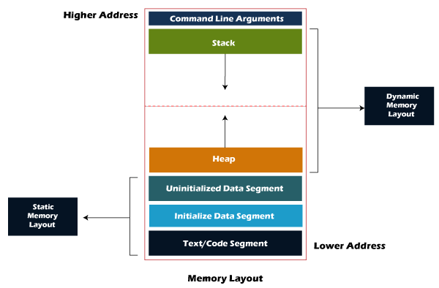
Process Memory Layout

Slide 6
Process Concept (Cont.)
Program is passive entity stored on disk (executable file), process is active.
Program becomes process when executable file loaded into memory.
Execution of program started via GUI mouse clicks, command line entry of its name, etc.
One program can be several processes
Consider multiple users executing the same program.

Slide 7
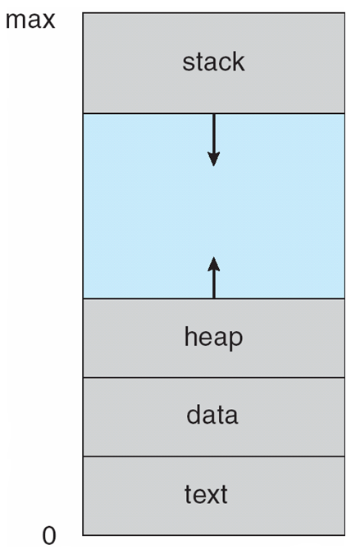
Process in Memory

Slide 8
Process State
As a process executes, it changes state
new: The process is being created.
running: Instructions are being executed.
waiting: The process is waiting for some event to occur.
ready: The process is waiting to be assigned to a processor.
terminated: The process has finished execution.

Slide 9
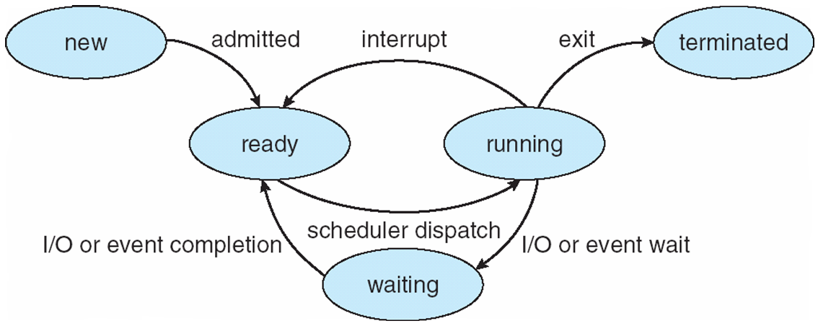
Diagram of Process State

Slide 10
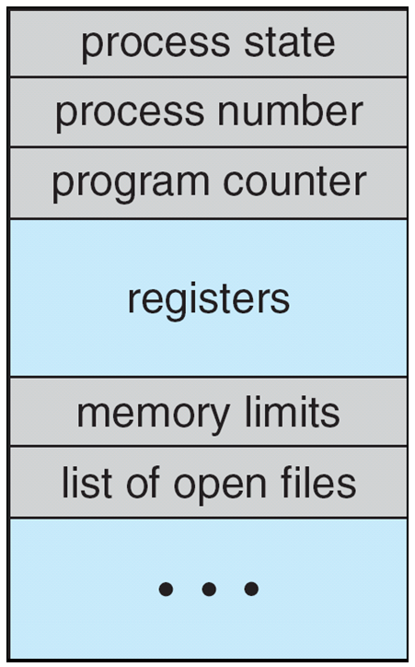
Process Control Block (PCB)
Information associated with each process
(also called task control block).
Process state – running, waiting, etc.
Program counter – location of instruction to next execute.
CPU registers – contents of all process-centric registers.
CPU scheduling information- priorities, scheduling queue pointers.
Memory-management information – memory allocated to the process.
Accounting information – CPU used, clock time elapsed since start, time limits.
I/O status information – I/O devices allocated to process, list of open files.

Slide 11
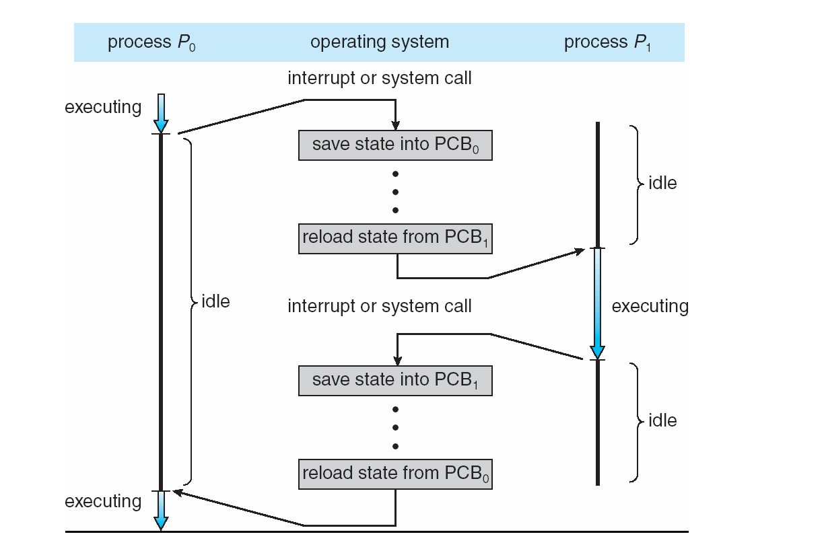
CPU Switch From Process to Process

Slide 12
Threads
So far, process has a single thread of execution.
Consider having multiple program counters per process.
Multiple locations can execute at once.
Multiple threads of control -> threads.
Must then have storage for thread details, multiple program counters in PCB.

Slide 13
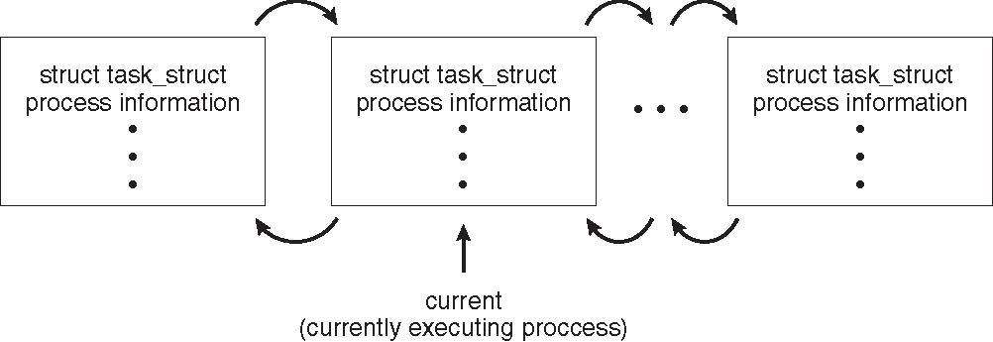
Process Representation in Linux
Represented by the C structure task_struct
pid t_pid; /* process identifier */ long state; /* state of the process */ unsigned int time_slice; /* scheduling information */ struct task_struct *parent; /* this process’s parent */ struct list_head children; /* this process’s children */ struct files_struct *files; /* list of open files */ struct mm_struct *mm; /* address space of this process */

Slide 14
Process Scheduling
Maximize CPU use, quickly switch processes onto CPU for time sharing.
Process scheduler selects among available processes for next execution on CPU.
Maintains scheduling queues of processes:
Job queue – set of all processes in the system.
Ready queue – set of all processes residing in main memory, ready and waiting to execute.
Device queues – set of processes waiting for an I/O device.
Processes migrate among the various queues.

Slide 15
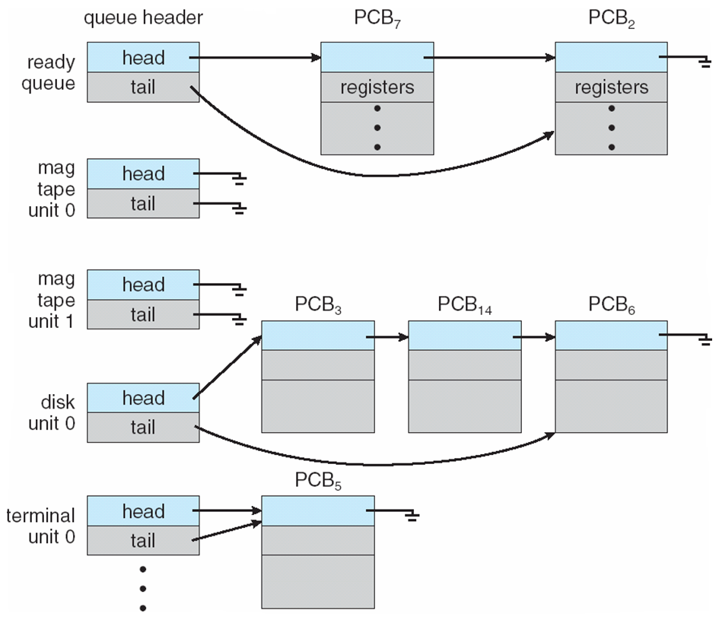
Ready Queue And Various I/O Device Queues

Slide 16
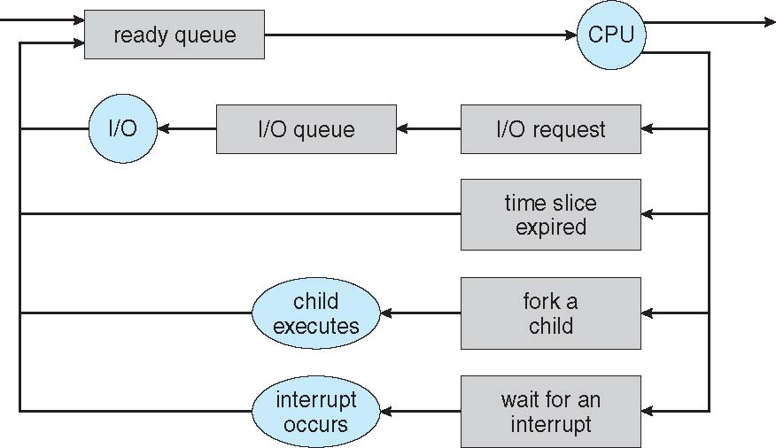
Representation of Process Scheduling
Queueing diagram represents queues, resources, flows

Slide 17
Schedulers
Short-term scheduler (or CPU scheduler) – selects which process should be executed next and allocates CPU
Sometimes the only scheduler in a system.
Short-term scheduler is invoked frequently (milliseconds) ⇒ (must be fast).
Long-term scheduler (or job scheduler) – selects which processes should be brought into the ready queue
Long-term scheduler is invoked infrequently (seconds, minutes) ⇒ (may be slow).
The long-term scheduler controls the degree of multiprogramming.
Processes can be described as either:
I/O-bound process – spends more time doing I/O than computations, many short CPU bursts.
CPU-bound process – spends more time doing computations; few very long CPU bursts.
Long-term scheduler strives for good process mix.

Slide 18
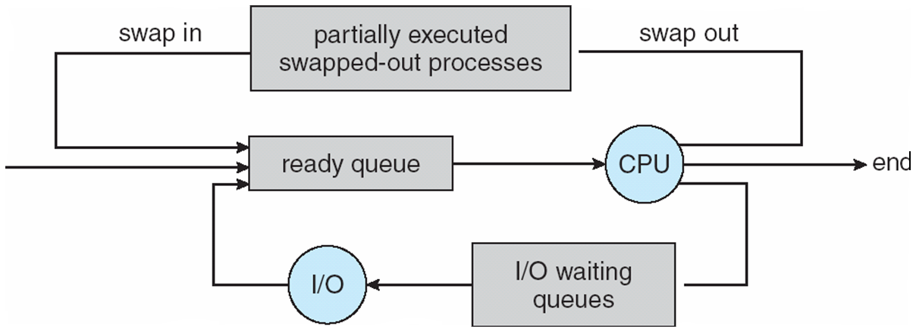
Addition of Medium Term Scheduling
Medium-term scheduler can be added if degree of multiple programming needs to decrease.
Remove process from memory, store on disk, bring back in from disk to continue execution: swapping.

Slide 19
Multitasking in Mobile Systems
Some mobile systems (e.g., early version of iOS) allow only one process to run, others suspended.
Due to screen real estate, user interface limits iOS provides for a
Single foreground process- controlled via user interface.
Multiple background processes– in memory, running, but not on the display, and with limits.
Limits include single, short task, receiving notification of events, specific long-running tasks like audio playback.
Android runs foreground and background, with fewer limits
Background process uses a service to perform tasks.
Service can keep running even if background process is suspended.
Service has no user interface, small memory use.

Slide 20
Context Switch
When CPU switches to another process, the system must save the state of the old process and load the saved state for the new process via a context switch
Context of a process represented in the PCB
Context-switch time is overhead; the system does no useful work while switching.
The more complex the OS and the PCB ➔ the longer the context switch
Time dependent on hardware support
Some hardware provides multiple sets of registers per CPU ➔ multiple contexts loaded at once.

Slide 21
Operations on Processes
System must provide mechanisms for:
process creation,
process termination,
and so on as detailed next

Slide 22
Process Creation
Parent process create children processes, which, in turn create other processes, forming a tree of processes.
Generally, process identified and managed via a process identifier (pid).
Resource sharing options:
Parent and children share all resources.
Children share subset of parent’s resources.
Parent and child share no resources.
Execution options:
Parent and children execute concurrently.
Parent waits until children terminate.

Slide 23
A Tree of Processes in Linux

Slide 24
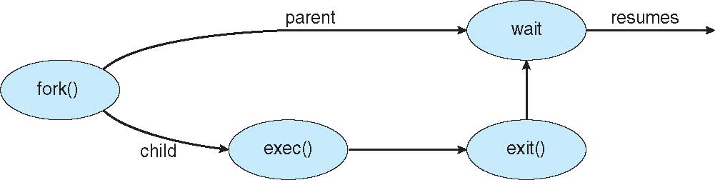
Process Creation (Cont.)
Address space
Child duplicate of parent.
Child has a program loaded into it.
UNIX examples
fork() system call creates new process.
exec() system call used after a fork() to replace the process’ memory space with a new program.

Slide 25
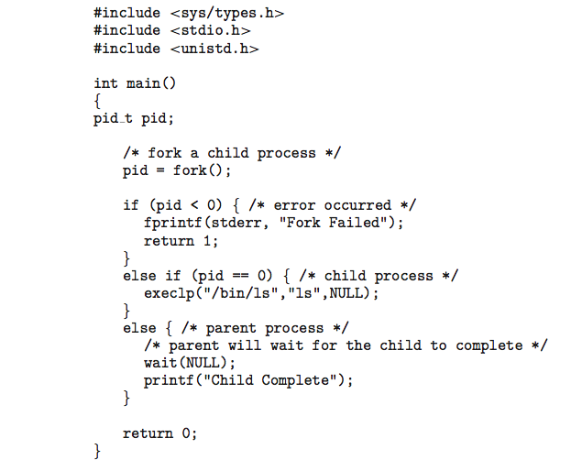
C Program Forking Separate Process

Slide 26
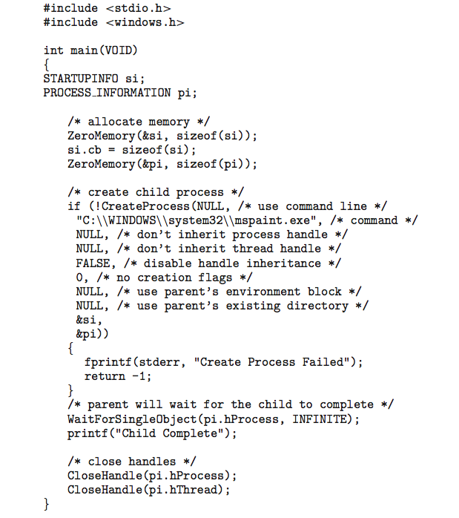
Creating a Separate Process via Windows API

Slide 27
Process Termination
Process executes last statement and then asks the operating system to delete it using the exit() system call.
Returns status data from child to parent (via wait()).
Process’ resources are deallocated by operating system.
Parent may terminate the execution of children processes using the abort() system call. Some reasons for doing so:
Child has exceeded allocated resources.
Task assigned to child is no longer required.
The parent is exiting and the operating systems does not allow a child to continue if its parent terminates.

Slide 28
Process Termination
Some operating systems do not allow child to exists if its parent has terminated. If a process terminates, then all its children must also be terminated.
cascading termination. All children, grandchildren, etc. are terminated.
The termination is initiated by the operating system.
The parent process may wait for termination of a child process by using the wait()system call. The call returns status information and the pid of the terminated process
pid = wait(&status);
If no parent waiting (did not invoke wait()) process is a zombie
If parent terminated without invoking wait , process is an orphan

Slide 29

Multiprocess Architecture – Chrome Browser
Many web browsers ran as single process (some still do)
If one web site causes trouble, entire browser can hang or crash
Google Chrome Browser is multiprocess with 3 different types of processes:
Browser process manages user interface, disk and network I/O.
Renderer process renders web pages, deals with HTML, Javascript. A new renderer created for each website opened.
Runs in sandbox restricting disk and network I/O, minimizing effect of security exploits.
Plug-in process for each type of plug-in.

Slide 30
Interprocess Communication
Processes within a system may be independent or cooperating.
Cooperating process can affect or be affected by other processes, including sharing data.
Reasons for cooperating processes:
Information sharing.
Computation speedup.
Modularity.
Convenience.
Cooperating processes need interprocess communication (IPC)
Two models of IPC
Shared memory
Message passing

Slide 31
Communications Models
(a) Message passing. (b) shared memory.

Slide 32
Cooperating Processes
Independent process cannot affect or be affected by the execution of another process.
Cooperating process can affect or be affected by the execution of another process.
Advantages of process cooperation
Information sharing.
Computation speed-up.
Modularity.
Convenience.

Slide 33
Producer-Consumer Problem
Paradigm for cooperating processes, producer process produces information that is consumed by a consumer process
unbounded-buffer places no practical limit on the size of the buffer.
bounded-buffer assumes that there is a fixed buffer size.

Slide 34
Bounded-Buffer – Shared-Memory Solution
Shared data
#define BUFFER_SIZE 10
typedef struct {
. . .
} item;
item buffer[BUFFER_SIZE];
int in = 0;
int out = 0;
Solution is correct, but can only use BUFFER_SIZE-1 elements.

Slide 35
Bounded-Buffer – Producer
item next_produced;
while (true)
{
/* produce an item in next produced */
while (((in + 1) % BUFFER_SIZE) == out) ; /* do nothing */
buffer[in] = next_produced;
in = (in + 1) % BUFFER_SIZE;
}

Slide 36
Bounded Buffer – Consumer
item next_consumed;
while (true)
{ while (in == out) ; /* do nothing */ next_consumed = buffer[out];
out = (out + 1) % BUFFER_SIZE;
/* consume the item in next consumed */
}

Slide 37
Interprocess Communication – Shared Memory
An area of memory shared among the processes that wish to communicate
The communication is under the control of the users processes not the operating system.
Major issues is to provide mechanism that will allow the user processes to synchronize their actions when they access shared memory.
Synchronization is discussed in great details in Chapter 5.

Slide 38
Interprocess Communication – Message Passing
Mechanism for processes to communicate and to synchronize their actions.
Message system – processes communicate with each other without resorting to shared variables.
IPC facility provides two operations:
send (message)
receive (message)
The message size is either fixed or variable.

Slide 39
Message Passing (Cont.)
If processes P and Q wish to communicate, they need to:
Establish a communication link between them
Exchange messages via send / receive
Implementation issues:
How are links established?
Can a link be associated with more than two processes?
How many links can there be between every pair of communicating processes?
What is the capacity of a link?
Is the size of a message that the link can accommodate fixed or variable?
Is a link unidirectional or bi-directional?

Slide 40
Message Passing (Cont.)
Implementation of communication link
Physical:
Shared memory.
Hardware bus.
Network.
Logical:
Direct or indirect.
Synchronous or asynchronous.
Automatic or explicit buffering.

Slide 41
Direct Communication
Processes must name each other explicitly:
send (P, message) – send a message to process P
receive(Q, message) – receive a message from process Q
Properties of communication link
Links are established automatically
A link is associated with exactly one pair of communicating processes
Between each pair there exists exactly one link.
The link may be unidirectional, but is usually bi-directional

Slide 42
Indirect Communication
Messages are directed and received from mailboxes (also referred to as ports).
Each mailbox has a unique id.
Processes can communicate only if they share a mailbox.
Properties of communication link
Link established only if processes share a common mailbox.
A link may be associated with many processes.
Each pair of processes may share several communication links.
Link may be unidirectional or bi-directional.

Slide 43
Indirect Communication
Operations:
create a new mailbox (port).
send and receive messages through mailbox.
destroy a mailbox.
Primitives are defined as:
send(A, message) – send a message to mailbox A.
receive(A, message) – receive a message from mailbox A.

Slide 44
Indirect Communication
Mailbox sharing
P₁, P₂, and P₃ share mailbox A.
P₁, sends; P₂ and P₃ receive.
Who gets the message?
Solutions
Allow a link to be associated with at most two processes.
Allow only one process at a time to execute a receive operation.
Allow the system to select arbitrarily the receiver. Sender is notified who the receiver was.

Slide 45
Synchronization
Message passing may be either blocking or non-blocking.
Blocking is considered synchronous.
Blocking send -- the sender is blocked until the message is received.
Blocking receive -- the receiver is blocked until a message is available.
Non-blocking is considered asynchronous.
Non-blocking send -- the sender sends the message and continue.
Non-blocking receive -- the receiver receives:
A valid message, or
Null message.
Different combinations possible
If both send and receive are blocking, we have a rendezvous.

Slide 46
Synchronization (Cont.)
Producer-consumer becomes trivial
message next_produced;
while (true)
{ /* produce an item in next produced */
send(next_produced);
}
message next_consumed;
while (true)
{
receive(next_consumed);
/* consume the item in next consumed */
}

Slide 47
Buffering
Queue of messages attached to the link.
implemented in one of three ways
Zero capacity – no messages are queued on a link. Sender must wait for receiver (rendezvous)
Bounded capacity – finite length of n messages. Sender must wait if link full.
Unbounded capacity – infinite length. Sender never waits.

Slide 48
Examples of IPC Systems - POSIX
POSIX Shared Memory
Process first creates shared memory segment shm_fd = shm_open(name, O CREAT | O RDWR, 0666);
Also used to open an existing segment to share it
Set the size of the object
ftruncate(shm_fd, 4096);
Now the process could write to the shared memory
sprintf(shared memory, "Writing to shared memory");

Slide 49
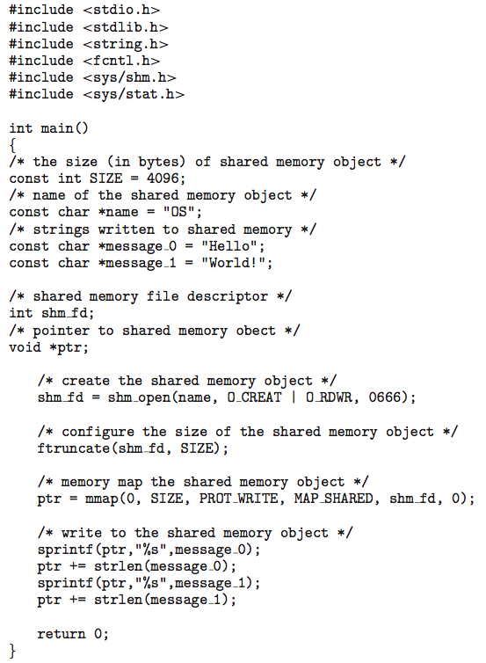
IPC POSIX Producer

Slide 50
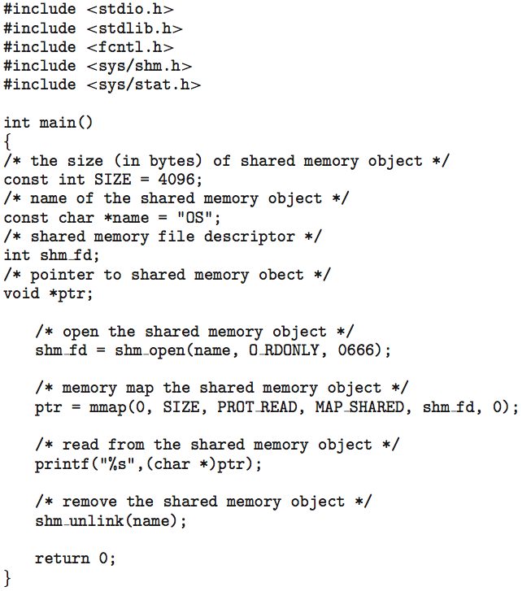
IPC POSIX Consumer

Slide 51
Examples of IPC Systems - Mach
Mach communication is message based
Even system calls are messages.
Each task gets two mailboxes at creation- Kernel and Notify
Only three system calls needed for message transfer
msg_send(), msg_receive(), msg_rpc()
Mailboxes needed for commuication, created via
port_allocate()
Send and receive are flexible, for example four options if mailbox full:
Wait indefinitely.
Wait at most n milliseconds.
Return immediately.
Temporarily cache a message.

Slide 52
Examples of IPC Systems – Windows
Message-passing centric via advanced local procedure call (LPC) facility
Only works between processes on the same system.
Uses ports (like mailboxes) to establish and maintain communication channels.
Communication works as follows:
The client opens a handle to the subsystem’s connection port object.
The client sends a connection request.
The server creates two private communication ports and returns the handle to one of them to the client.
The client and server use the corresponding port handle to send messages or callbacks and to listen for replies.

Slide 53
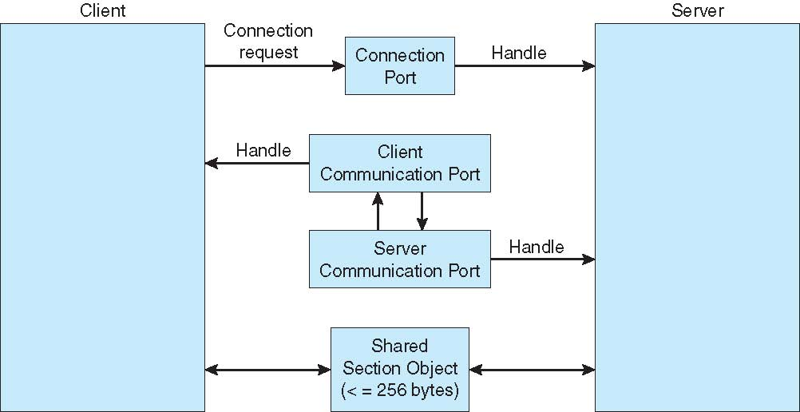
Local Procedure Calls in Windows

Slide 54
Communications in Client-Server Systems
Sockets
Remote Procedure Calls (RPC)
Pipes
Remote Method Invocation (Java)

Slide 55
Sockets
A socket is defined as an endpoint for communication.
Concatenation of IP address and port – a number included at start of message packet to differentiate network services on a host.
The socket 161.25.19.8:1625 refers to port 1625 on host 161.25.19.8
Communication consists between a pair of sockets.
All ports below 1024 are well known, used for standard services.
Special IP address 127.0.0.1 (loopback) to refer to system on which process is running.

Slide 56
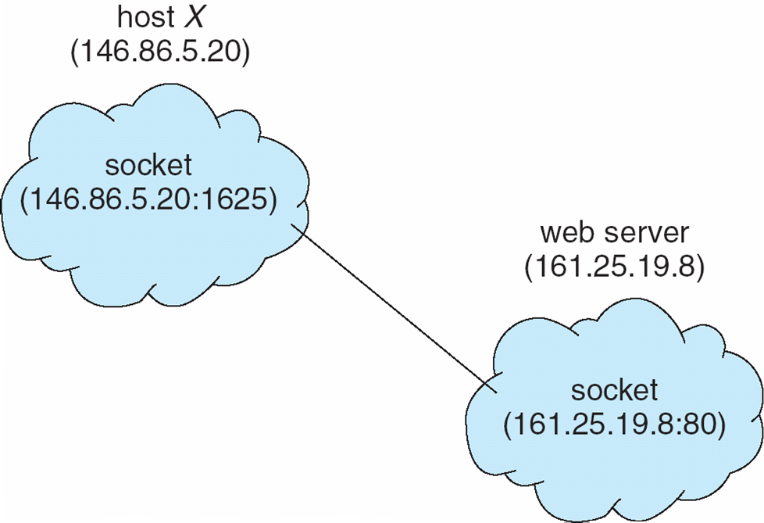
Socket Communication

Slide 57
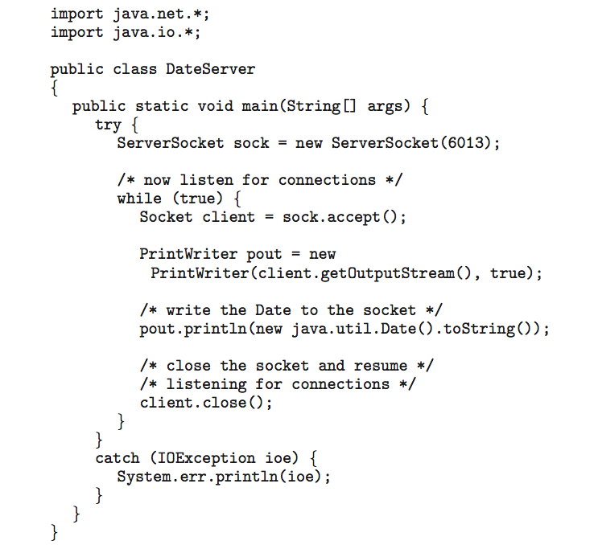
Sockets in Java
Three types of sockets
Connection-oriented (TCP)
Connectionless (UDP)
MulticastSocket class– data can be sent to multiple recipients
Consider this “Date” server:

Slide 58
Remote Procedure Calls
Remote procedure call (RPC) abstracts procedure calls between processes on networked systems
Again, uses ports for service differentiation.
Stubs – client-side proxy for the actual procedure on the server.
The client-side stub locates the server and marshals the parameters.
The server-side stub receives this message, unpacks the marshalled parameters, and performs the procedure on the server.
On Windows, stub code compile from specification written in Microsoft Interface Definition Language (MIDL)

Slide 59
Remote Procedure Calls (Cont.)
Data representation handled via External Data Representation (XDL) format to account for different architectures:
Big-endian and little-endian
Remote communication has more failure scenarios than local
Messages can be delivered exactly once rather than at most once.
OS typically provides a rendezvous (or matchmaker) service to connect client and server.

Slide 60
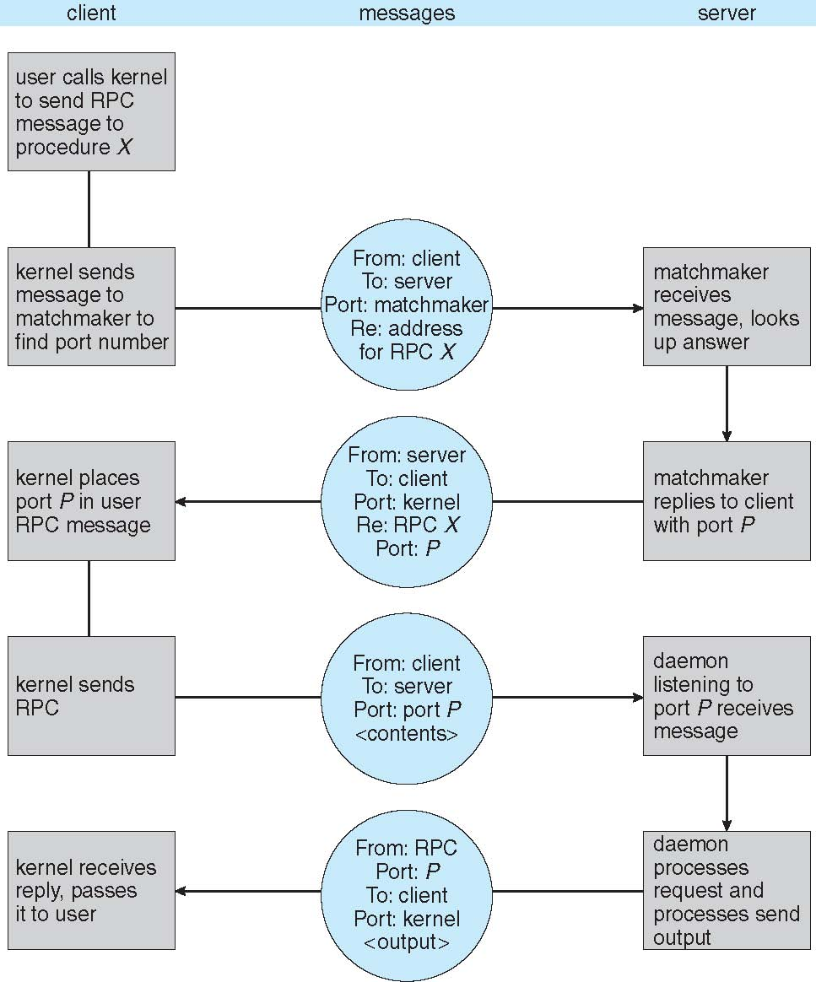
Execution of RPC

Slide 61
Pipes
Acts as a conduit allowing two processes to communicate
Issues:
Is communication unidirectional or bidirectional?
In the case of two-way communication, is it half or full-duplex?
Must there exist a relationship (i.e., parent-child) between the communicating processes?
Can the pipes be used over a network?
Ordinary pipes – cannot be accessed from outside the process that created it. Typically, a parent process creates a pipe and uses it to communicate with a child process that it created.
Named pipes – can be accessed without a parent-child relationship.

Slide 62
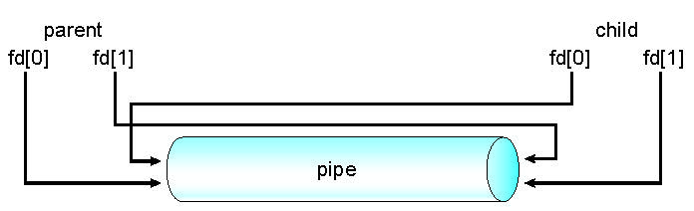
Ordinary Pipes
Ordinary Pipes allow communication in standard producer-consumer style.
Producer writes to one end (the write-end of the pipe).
Consumer reads from the other end (the read-end of the pipe).
Ordinary pipes are therefore unidirectional.
Require parent-child relationship between communicating processes.
Windows calls these anonymous pipes.
See Unix and Windows code samples in textbook.

Slide 63
Named Pipes
Named Pipes are more powerful than ordinary pipes.
Communication is bidirectional.
No parent-child relationship is necessary between the communicating processes.
Several processes can use the named pipe for communication.
Provided on both UNIX and Windows systems.

Slide 64
End of Chapter 3

