Slide 1







computer vision
Faculty of Computer Science Assiut university
Mahmoud Salah Mahmoud 162021306
Mahmoud Anwar Osman 162021264
Mohamed Abdelaleem Ahmed 162021282

Slide 2




Table of Contents
1. Task description........…………………………………………………………………………….……………………………………………………………. 3
2. Contribution…....………….…………………………………………………………………………………………………………………………………… 4
3. Data …..………………………………………………………………………………………………………………………………………………………… 5
4. Project Architecture …..…………………………..…………………………………………………………………………………………………………… 6
5. Methods….…………………………………………………………………………………………………………………………………………………….. 7
6. Results ......…………………………………………………………………………….…………………………………………………………….………. 9

Slide 3
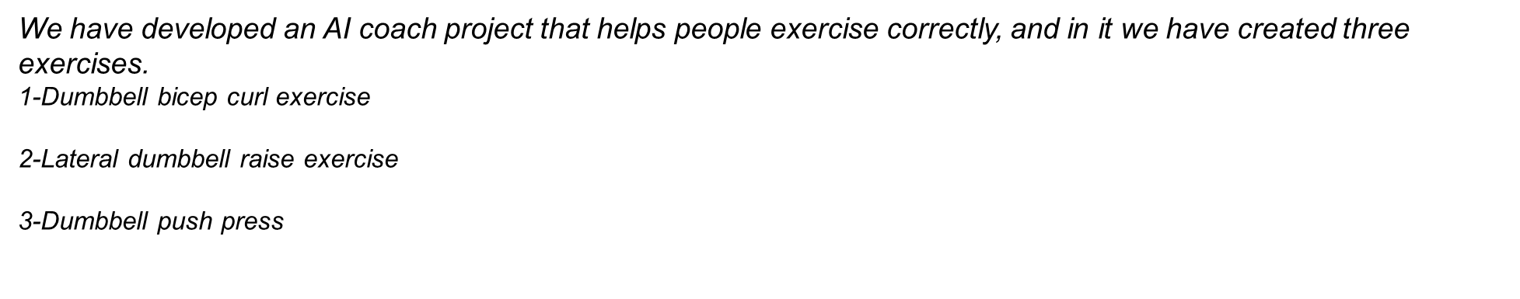
Task description:-

Slide 4
Contribution:-
-The main structure of the application:- including setting up video capture, handling user inputs, and integrating the pose estimation functionality.
- Now we go to details :-
1-We downloaded all the libraries we will need for the project
2- We used a video on the YouTube platform in which the presenter creates AI coach
3- We watched the video and understood all the details that the presenter did in the video.
4- we used this code and made some adjustments to it to suit our project, such as the interface at the beginning of the project, which will help you enter any exercise you need
5- we adjusted the angles to suit each exercise we performed.
6- We did three exercises and each team member did one of them.
-.

Slide 5
Data:-
BlazePose:
The training dataset consists of 60K images with a single or few people in the scene in common poses and 25K images with a single person in the scene performing fitness exercises. All of these images were annotated by humans.
GHUM:
GHS3D consists of over 60,000 photo-realistic dynamic human body scans and also uses over 4,000 full-body scans from the Caesar dataset.

Slide 6
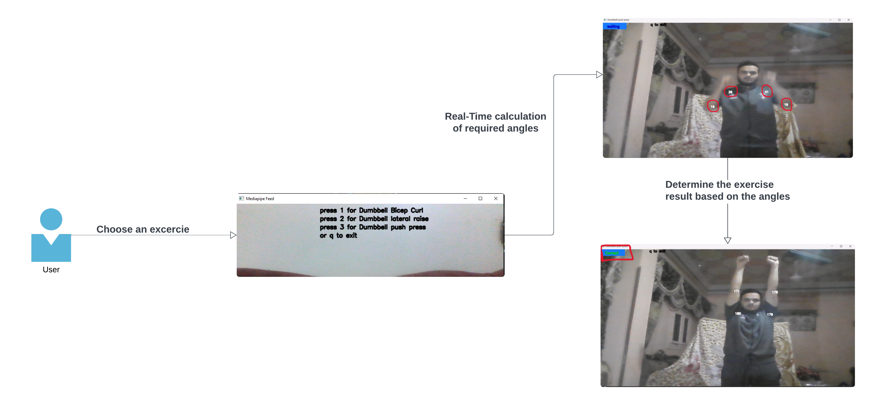
Project Architecture:-
Figure 1. Project Architecture

Slide 7
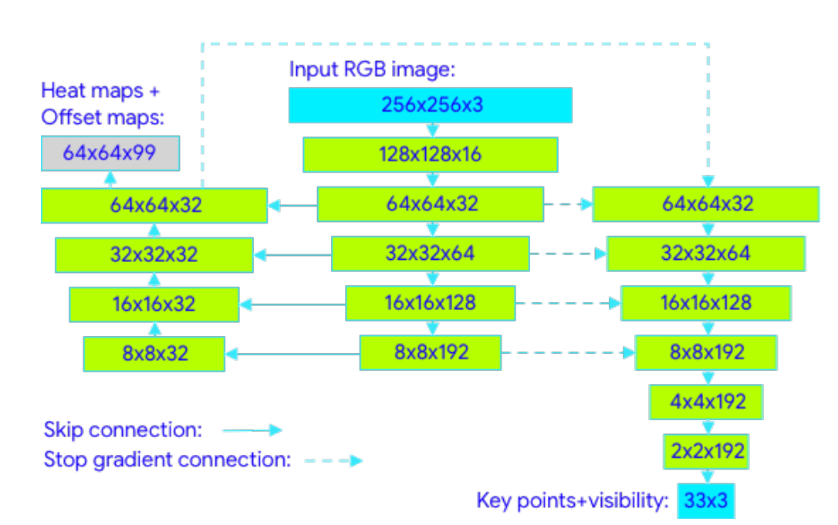
Methods:-
Architecture Overview:
The BlazePose GHUM 3D model consists of three main components: a body pose estimation network, a depth estimation network, and post-processing.
The body pose estimation network takes an RGB image of a person as input and outputs 2D keypoint coordinates representing the individual's body joints.
this network extracts features from the input image and produces 2D heatmaps indicating the probability of each joint's presence at various locations in the image.
The depth estimation network takes the RGB image and 2D keypoint coordinates as input and outputs three-dimensional coordinates representing the position of each joint in 3D space.
Another CNN architecture is employed in the depth estimation network to estimate the depth of each joint relative to the camera.
Post-processing involves filtering and smoothing the joint positions over time to reduce noise and jitter, thereby improving accuracy and stability of the estimated poses.
Fig. 2 Blazepose model architecture

Slide 8
Metrics :
The model use a PDJ, Average percentage of detected joints Model Performance Measures .
consider a keypoint to be correctly detected if predicted visibility for it matches ground truth and the absolute 2D Euclidean error between the reference and target keypoint normalized by the 2D torso diameter projection is smaller than 20%. This value was determined during development as the maximum value that does not degrade accuracy in classifying pose / asana based solely on the key points without perceiving the original RGB image.

Slide 9
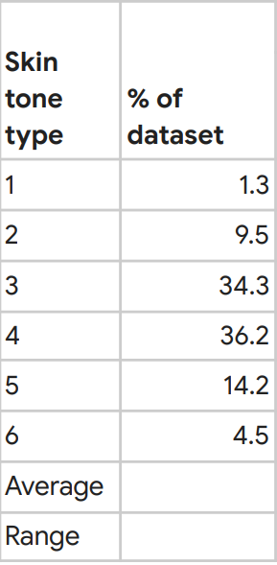

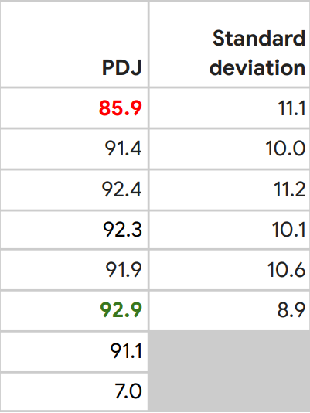
Results:-
Evaluation on smartphone back-facing camera photos dataset results in an average performance of 91.1% with a range of [85.9%, 92.9%] across all skin tones
Fig. 3 Results table

Slide 10
Github repo :
https://github.com/Mahmoud0-0Salah/Gym-Coach.git

