Slide 1
Bridging Gaps Analyzing Differences Between Casual and Annual Members
Created by: Mahmoud Samy Creation date: Dec, 13th, 2023

Slide 2
Table of Contents
01
Purpose Statement
02
Tell Our Story
03
Conclusion
What are we talking about?
Presenting our story using data.
Our recommendation to answer the business task.

Slide 3
01
Purpose Statement
What are we talking about?

Slide 4
The Problem
Examine and compare the distinct behaviors and factors influencing Cyclistic bike usage between Casual users and annual members. Consider factors such as ride frequency, trip duration, preferred locations, and peak usage times to identify differences in user behavior.

Slide 5
02
Tell Our Story
Presenting our story using data.

Slide 6
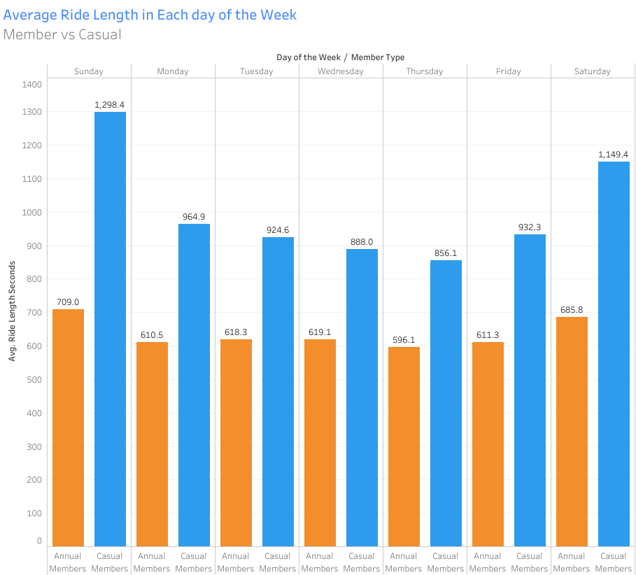
TRIP DURATION
Casual users generally have longer rides than annual members.
Workday ride lengths for annual members suggest nearby commuting patterns.
Despite a higher ride count, annual members tend to have shorter ride durations.
Notes:
Average Ride Duration (in seconds) per Member Type, categorized by Day of the Week. Member Type details are represented by color, and the marks are labeled with the average Ride Duration in seconds. The visualization highlights that casual users tend to have longer rides compared to annual members. This may be attributed to annual users use the app regularly to commute to work, possibly residing near frequent destinations. Consequently, annual members have more rides, but they tend to be shorter in duration.

Slide 7
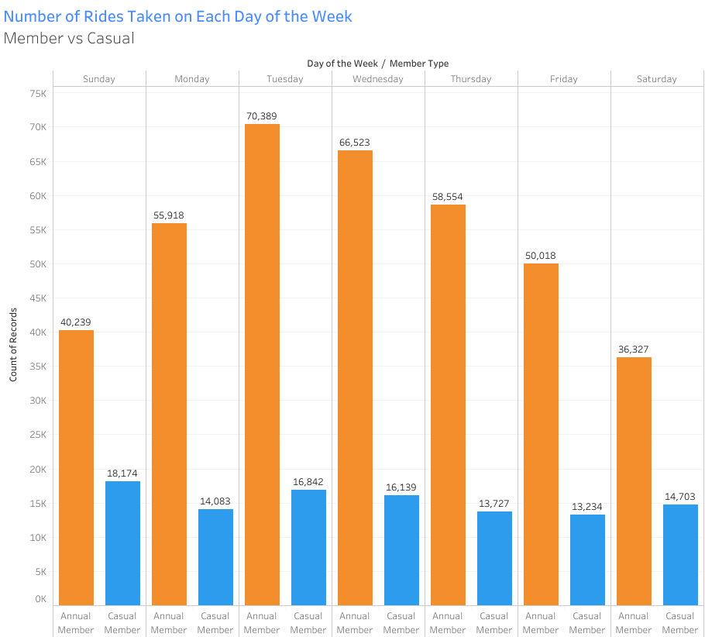
TRIP FREQUENCY
The workday rides of annual members exceed those on weekends, unlike casual members.
Weekends see a huge drop in rides from annual members.
Sunday records the most casual member rides.
Notes:
Record Counts per Member Type, segmented by Day of the Week. Member Type distinctions are indicated by color, and the marks are annotated with record counts. The visualization reveals that annual members consistently exhibit more rides than casual members, particularly on workdays. Weekends show a decline in rides for annual members, whereas casual members maintain relatively consistent ride counts on Monday, Thursday, and Friday. Interestingly, Sundays register the highest ride counts for casual members. Notably, Tuesdays and Wednesdays emerge as the peak days for annual members, ranking second and third for casual members. This variation may be influenced by cultural or regional factors.

Slide 8
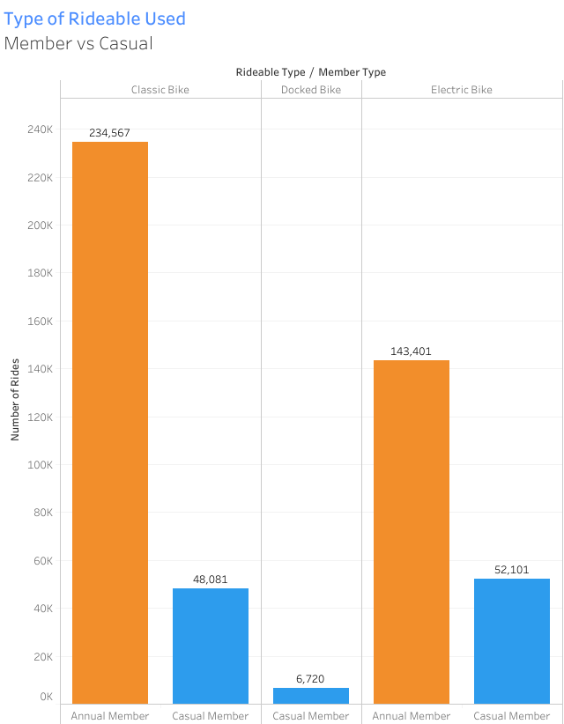
BIKE CATEGORIES
Annual members prefer classic bikes and electric bikes.
Workday ride lengths for annual members suggest nearby commuting patterns.
Annual members show minimal usage of docked bikes, possibly due to various factors such as membership plans or bike features.
Notes:
Ride Counts for Each Member Type categorized by Rideable Type. Member type distinctions are represented by color, and the marks are annotated with ride counts. The visualization suggests that annual members predominantly opt for classic bikes and electric bikes. In contrast, casual members utilize classic bikes, docked bikes, and electric bikes. Notably, annual members show minimal usage of docked bikes, possibly influenced by membership plans, availability constraints during specific hours, or even considerations related to bike features, as docked bikes emerge as the least utilized type.

Slide 9
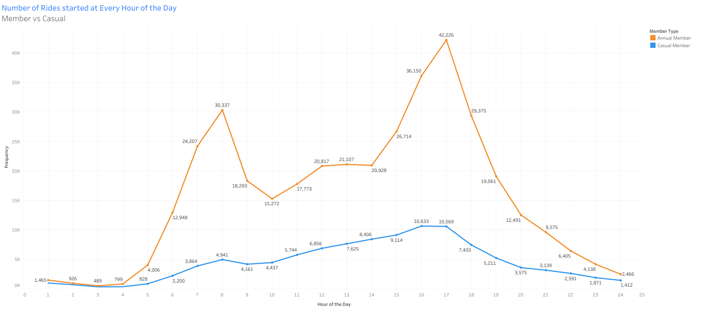
HOUR TO FREQUENCY
Annual members peak in ride frequency during morning and evening rush hours.
Casual members exhibit a rising trend with highest initiation in the afternoon.
Annual members focus on start and end of the day; casual members show increasing usage throughout the day.
Notes:
Sum of Frequency Trend per Hour, with member type distinctions indicated by color. Marks are labeled with the sum of frequency. This visualization illustrates the number of rides initiated at each hour for each member type. For annual members, ride frequency peaks from 7 to 9 in the morning and experiences another surge from 16 to 18 (4 pm to 6 pm), corresponding to heavy traffic during typical shift end times. This suggests a preference for bikes as a faster mode of transportation in congested traffic. The casual members' chart reflects the highest ride initiation at 4 pm and 5 pm, emphasizing a rising trend during daytime hours. The key difference observed is that annual members primarily focus on the start and end of the day, while casual members exhibit an increasing rate of usage throughout the day.

Slide 10
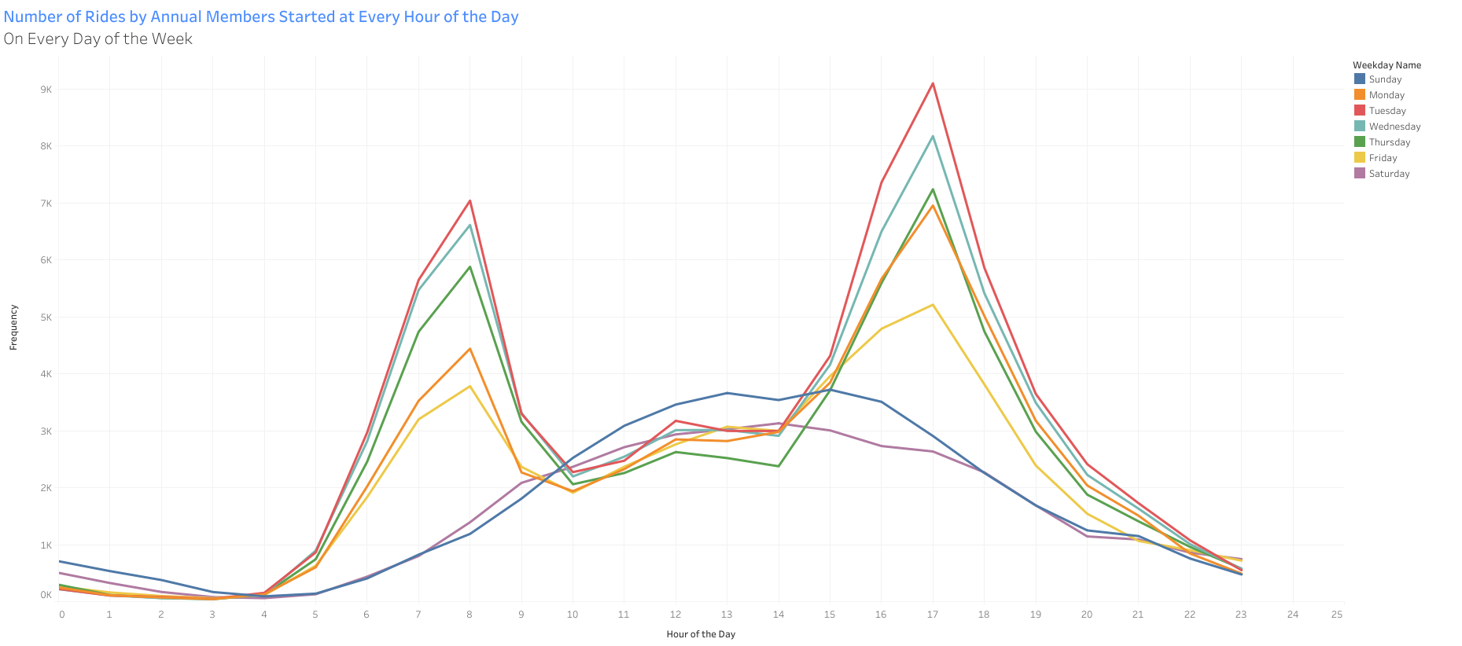
HOUR TO FREQUENCY FOR ANNUALS
Annual members' patterns differ on weekends.
Weekends align with casual members, rising gradually during the day.
Clear peaks during workday rush hours suggest commuting association.
Notes:
Sum of Frequency Trend per Hour, with weekday distinctions represented by color. Marks are labeled with the sum of frequency. The data is filtered for Casual Members, excluding Annual Members. This visualization reveals that annual members exhibit a consistent ride pattern at each hour on workdays, with deviations observed on weekends. The weekend pattern closely aligns with the casual member pattern in terms of the number of rides initiated at every hour of the day, displaying a gradual rise during daytime hours and clear peaks during morning and evening rush hours on workdays. This suggests a pronounced association with commuting activities.

Slide 11
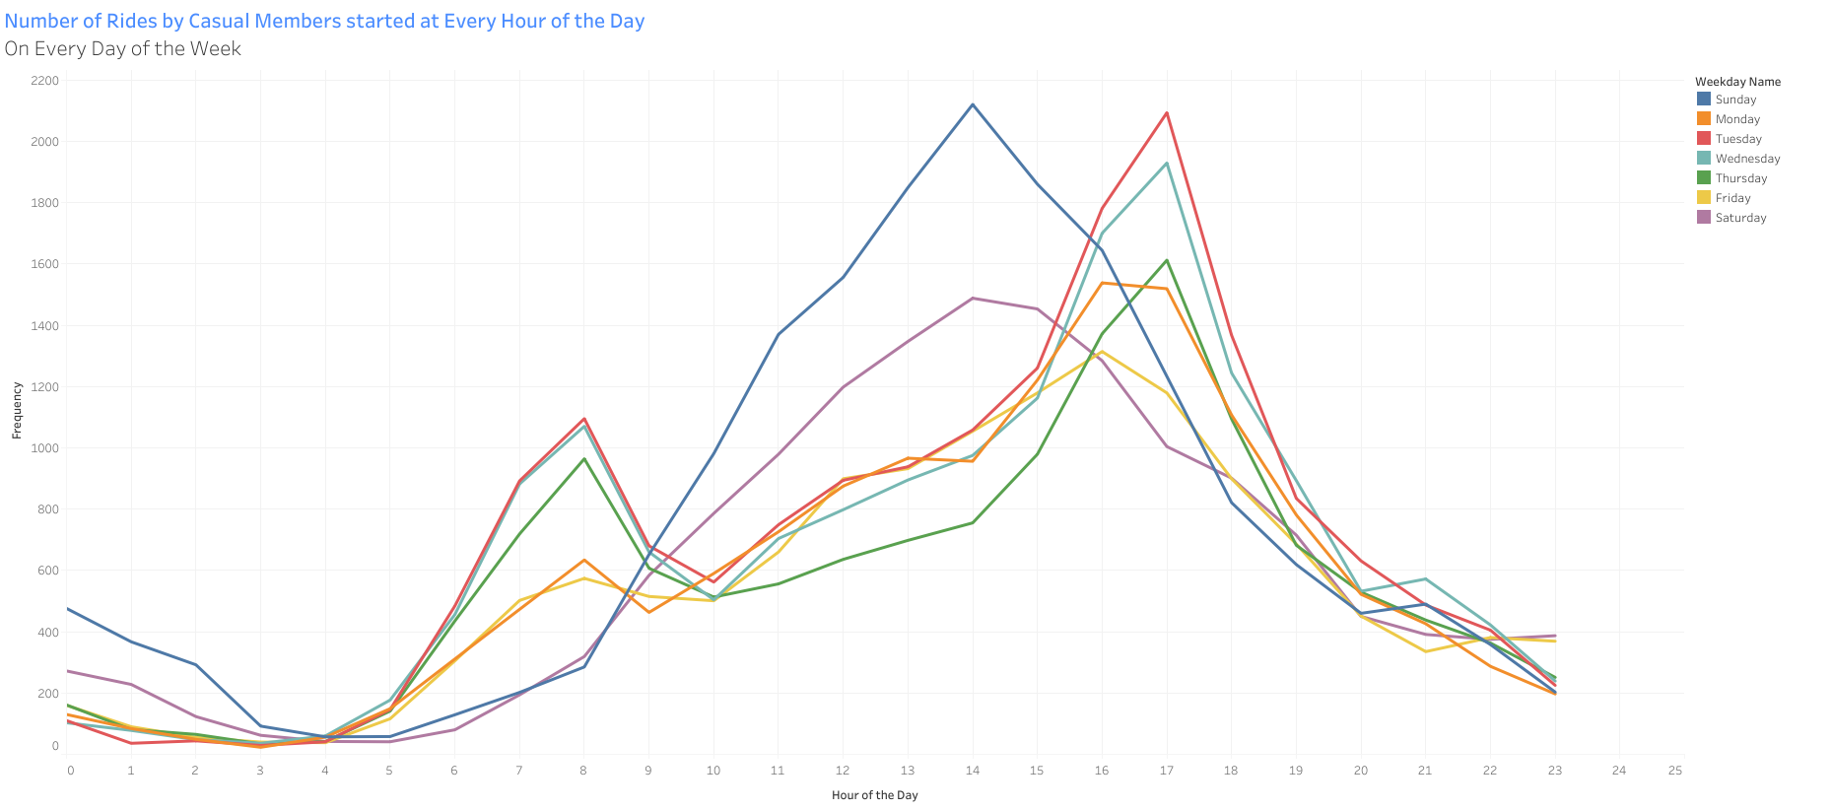
HOUR TO FREQUENCY FOR CASUALS
Casual members exhibit a gradual rise in ride frequency during daytime.
Peaks are less pronounced compared to other members.
Highest usage is expected during the afternoon and evening hours.
Notes:
Sum of Frequency Trend per Hour, with weekday distinctions indicated by color. Marks are labeled with the sum of frequency. The data is filtered for Casual Members, isolating Casual Member patterns. This visualization demonstrates a gradual rise in the rate of rides during daytime hours, with less pronounced peaks. The highest usage is likely to occur during the afternoon and evening hours.

Slide 12
03
Conclusion
Our recommendation to answer the business task.

Slide 13
Understanding the Problem
Ride Length
Ride Frequency
Bike Categories
Casual members’ rides are longer, however annual member’s rides are more frequent.
Annual members’ rides increase during work days, unlike casual members’s rides which is mostly the same amount
Annual members show minimal usage of docked bikes, possibly due to various factors such as membership plans or bike features.
Frequency on Hour
Casual Days
Annual Days
Annual members focus on start and end of the day; casual members show increasing usage throughout the day.
Clear peaks during workday rush hours suggest commuting association.
Casual members exhibit a gradual rise in ride frequency during daytime.

Slide 14
Thanks
Do you have any questions?
Please keep this slide for attribution

