Slide 1

Predicting the Price of Gold
A Machine Learning Approach
Using Global Financial Assets to Forecast the Future of Gold
A Data Science Portfolio Project
Data Science Student
Machine Learning Portfolio

Slide 2
The Question
The Data
The Models
The Core Question
Can we mathematically deduce the price of gold just by looking at the stock market, oil, silver, and currency rates?
• 2,290 days of historical data across 5 major financial assets
SPX · GLD · USO · SLV · EUR/USD
5 Assets · 1 Target
• Goal: Use today's asset prices to predict tomorrow's gold price
• A supervised regression problem — finding patterns in global markets
02

Slide 3
The Question
The Data
The Models
Exploring the Data — Clean & Ready
2,290
0
0
Daily Records
Missing Values
Duplicates
• SPX (S&P 500)
• GLD (Gold)
• USO (Oil)
• SLV (Silver)
• EUR/USD
The dataset was perfectly clean with no null values to impute or drop.
No duplicate rows found. Every record is unique and ready for modeling.
03

Slide 4
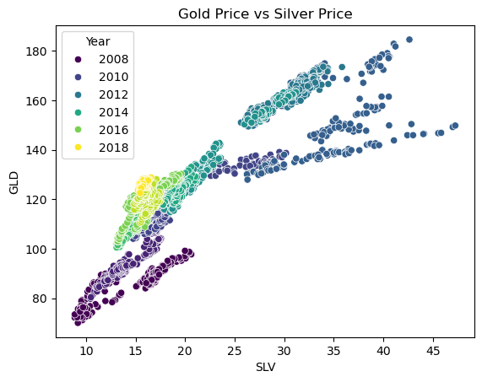
The Question
The Data
The Models
The Silver Bullet — A Powerful Discovery
0.866
SLV ↔ GLD Correlation
• Silver and Gold move almost identically
• This makes SLV our most powerful predictive feature
• The scatter plot shows a near-perfect linear relationship across all years
• This single insight alone explains why our models achieve such high accuracy
04

Slide 5
The Question
The Data
The Models
The Machine Learning Arena
Gradient Boosting
Linear Regression
Random Forest
• A simple baseline model
• Tests if gold prices follow a linear relationship with other assets
• Fast and interpretable, but limited to straight-line patterns
• An ensemble of 100 decision trees
• Captures non-linear patterns and feature interactions
• Robust to outliers and overfitting through bagging
• Sequential trees that learn from errors
• Corrects mistakes of previous trees iteratively
• Often powerful, but sensitive to hyperparameters
05

Slide 6
The Question
The Data
The Models
The Results — Random Forest Crushes It
Random Forest achieved 0.988 R² with only 2.51 RMSE — nearly 99% accuracy. Linear Regression struggled with 7.58 RMSE, proving that non-linear models are essential for financial data.
06

Slide 7
Key Takeaways
▸ Non-linear models are essential for financial data — linear assumptions fail in volatile markets
▸ Silver (SLV) emerged as the single most powerful predictor of gold prices
▸ We built a highly accurate predictive pipeline achieving 98.8% accuracy
Thank You for Watching
Questions Welcome

