Slide 1
9,994
IS DEPARTMENT
Rows
Walmart Sales
21
Business Intelligence Project
Columns
Data Understanding & Project Objective
4
Regions

Slide 2
Agenda
Table of Contents
01
Data Understanding
Slides 3–4
04
Machine Learning
Slides 12–14
▸ Dataset Description
▸ Project Objective & Problem Statement
▸ Feature Engineering & Preparation
▸ Correlation Heatmap & Insights
▸ ML Models Results & Comparison
02
Data Cleaning
Slides 5–6
▸ Before Data Cleaning
▸ After Data Cleaning
05
Business Questions
Slides 15–20
▸ Top Category & Customer Segment
▸ Most Profitable Region & States
▸ Top Cities · Discount vs Profit
03
EDA — Distributions & Charts
Slides 7–11
▸ Summary Statistics · Sales Distribution
▸ Sales by Category · Sales vs Profit
▸ Discount vs Profit · Correlation Heatmap
07
Conclusion & Recommendations
Slides 26–27
06
Time Series Analysis
Slides 21–25
▸ Key Takeaways from the BI Project
▸ Business Recommendations
▸ Executive Summary · Sales Trend Chart
▸ Key Observations · Year-by-Year Summary
▸ Conclusions & Recommendations

Slide 3
Dataset Description
9,995 × 21
Order Info
Customer Info
Row ID
Customer ID
Order ID
Customer Name
Order Date
Segment
Ship Date
Country
Ship Mode
City
Product Info
State
Postal Code
Product ID
Region
Financials
Category
Sub-Category
Sales
Product Name
Quantity
Discount
→The dataset contains 9,995 rows and 21 columns representing Walmart sales transactions. It includes important features such as Sales, Profit, Category, Segment, Region, and Order Date.
Profit

Slide 4
Project Objective & Problem Statement
Introduction
Business Objective
Business Intelligence (BI) is the process of analyzing data to support better business decisions. In this project, we analyze Walmart sales data to understand customer behavior, product performance, and regional trends. The goal is to extract useful insights that help improve sales and profitability.
The main objective of this project is to analyze Walmart sales data to identify:
→The most profitable products and categories
→The best-performing customer segments
→The top regions in terms of sales and profit
→Patterns and trends in sales over time
Problem Statement
Walmart needs to understand which products, customer segments, and regions generate the highest sales and profits. The challenge is to analyze the data and provide insights that support better decision-making.

Slide 5
Before Data Cleaning
9,995 × 21
Dataset Overview
Data Quality Impact
Rows: 9,995
→ May affect analysis accuracy
Columns: 21
⚠ Issues Identified
→ Can lead to misleading insights
Missing Values:
Ship Mode → 23 missing
Discount → 49 missing
Duplicates & Data Types:
Duplicate rows detected
Order Date & Ship Date stored as text
Outliers Detected:
Sales, Profit, Quantity
→ Reduces model performance in ML
These issues must be resolved before analysis to ensure accurate and reliable results.

Slide 6
After Data Cleaning
Clean Dataset
✓ Cleaning Steps Applied
Results After Cleaning
Missing Values
0
0
Mode fill → Ship Mode
Mean fill → Discount
Missing Values
Duplicate Records
Duplicates
All duplicate rows removed
✓
✓
Data Types
Order Date & Ship Date → DateTime
Correct Data Types
Outliers Handled
Outliers (IQR)
🚀 Improved data quality · More accurate analysis · Better ML performance
Sales, Profit, Quantity → capped

Slide 7
EDA - Summary Statistics
After Cleaning
Metric
Sales
Profit
Discount
Quantity
Mean
140.28
16.07
0.157
3.75
Max
498.93
70.82
0.80
9.50
Min
0.44
−39.72
0.00
1.00
Summary of key numerical features after cleaning

Slide 8
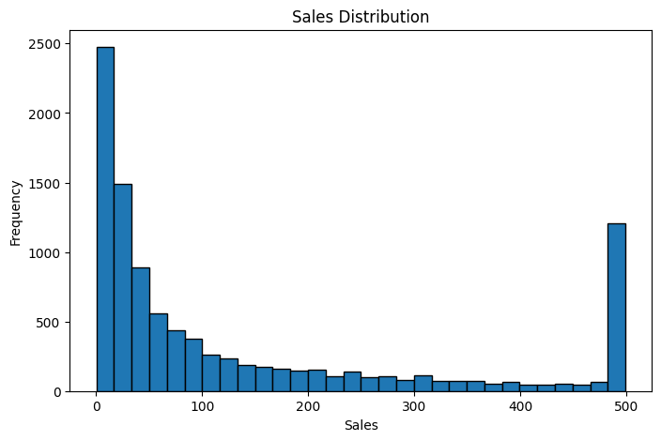
Sales Distribution
EDA
Key Observations
Chart
Most orders are in lower sales ranges — high-value orders are fewer.
Right-skewed shape indicates small orders happen more frequently.
Helps explain daily order behavior and demand patterns.
→ Focus operations on frequent small orders, with separate plans to grow large orders.

Slide 9
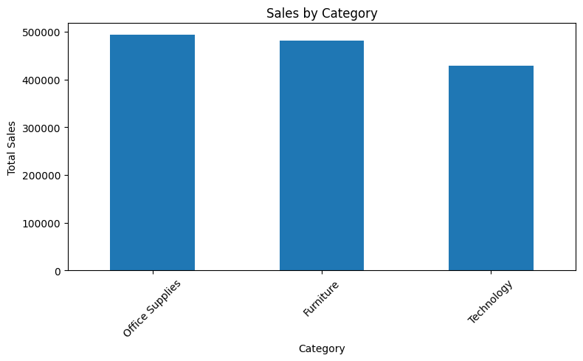
Sales by Category
EDA
Key Observations
Chart
Office Supplies leads total sales among all categories.
Furniture and Technology are strong but slightly lower.
Sales are concentrated in a few key categories.
→ Prioritize budget, stock, and campaigns around top categories first.

Slide 10
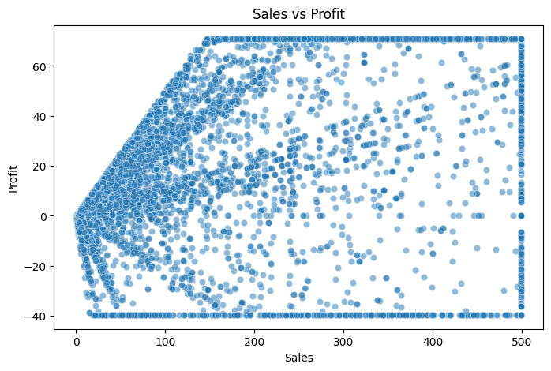
Sales vs Profit
EDA
Key Observations
Chart
Profit usually rises with sales, but not at a constant rate.
The relationship is positive but not perfectly linear.
Some high-sales orders still return low profit.
→ Track margin quality with sales growth to avoid weak-profit growth.

Slide 11
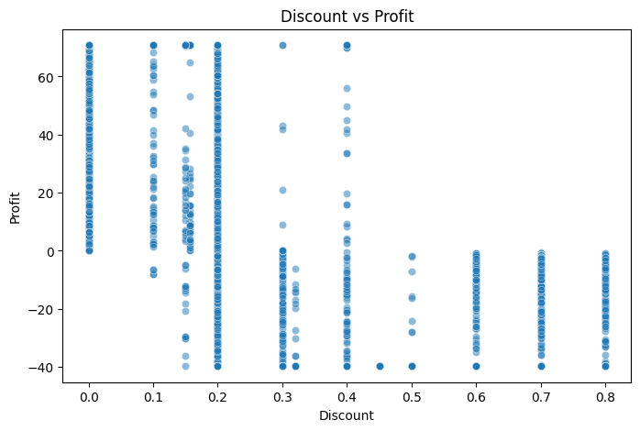
Discount vs Profit
EDA
Key Observations
Chart
Higher discount levels are often linked with lower profit.
At high discounts, low-profit and negative-profit points appear more often.
Discounts can boost sales but may reduce margin fast.
→ Use discount limits by category/segment to protect profitability.

Slide 12
Walmart Sales Prediction Project
Feature Engineering
Removed Unnecessary Columns
Encoding & Data Split
Row ID, Order ID, Customer ID,
Product ID, Customer Name, Product Name
One-Hot Encoding
Applied to all categorical features to convert them into numerical format suitable for ML models.
Train / Test Split
train_test_split() — 80% training / 20% testing
Ensures fair and accurate model performance evaluation.
Selected Features for Prediction
Ship Mode, Segment, Region, Category,
Sub-Category, Quantity, Discount, Profit
These steps ensure clean, well-structured input data to maximize model accuracy and reliability.

Slide 13
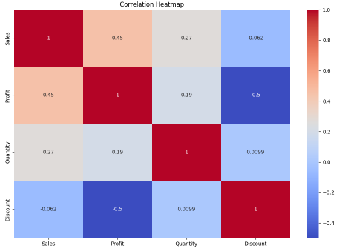
Correlation Heatmap & Insights
Key Findings
Key Insights
Correlation Heatmap
Profit & Discount
Strong negative correlation (−0.5).
High discounts significantly reduce profits.
Sales & Profit
Positive correlation (0.45).
Higher sales generally increase profits.
Quantity & Sales
Quantity has a weak positive effect on sales.

Slide 14
Machine Learning Models Results
Model Comparison
Linear Regression
Performance Comparison
MAE: 70.65
Metric
Linear Reg.
Random Forest
MAE
70.65
33.51
RMSE: 102.10
RMSE
102.10
66.01
R² Score: 0.63
R² Score
0.63
0.85
Random Forest
Conclusion
MAE: 33.51
→ Random Forest significantly outperforms Linear Regression with higher accuracy (R² 0.85 vs 0.63) and lower prediction error, as it captures complex non-linear relationships between features.
RMSE: 66.01
R² Score: 0.85

Slide 15
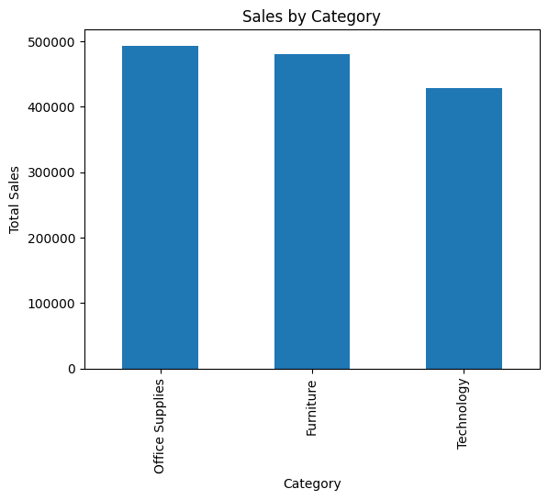
Which category has the highest sales?
Q1 — Category
Finding
Chart
Office Supplies has the highest total sales volume among all categories.
→ Prioritize inventory and marketing investment in Office Supplies to maximize revenue.

Slide 16
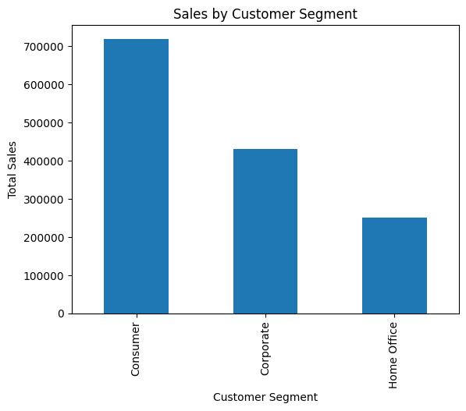
Which customer segment drives the most sales?
Q2 — Segment
Finding
Chart
The "Consumer" segment is our primary revenue driver, contributing the most to total sales.
→ Focus retention and loyalty programs on Consumer segment — it's our top revenue source.

Slide 17
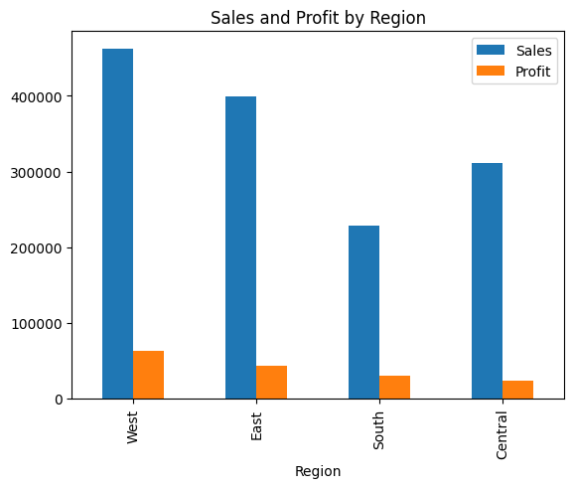
Which region generates the most profit?
Q3 — Region
Finding
Chart
The West Region is our most profitable area, leading both in total sales and profit margin.
→ Allocate additional resources and campaigns to sustain and grow the West Region's advantage.

Slide 18
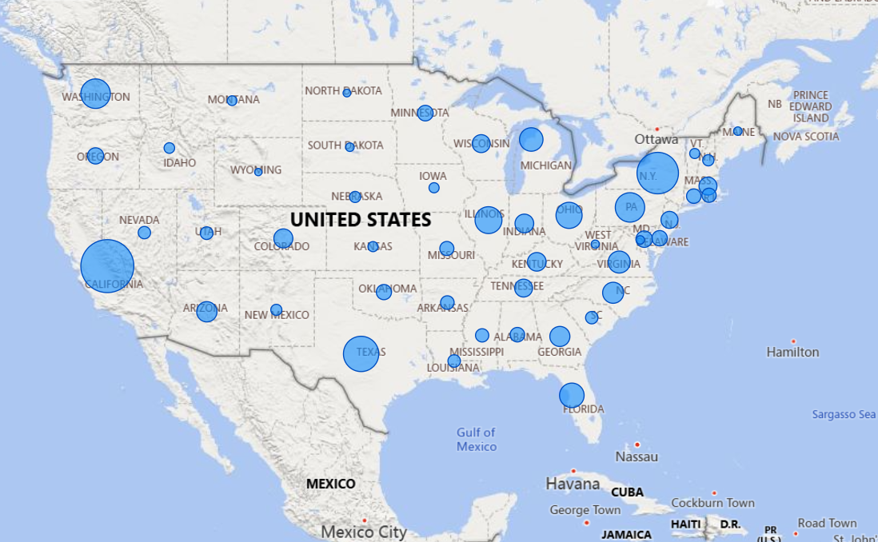
Which states lead in sales and profit?
Q4 — Geography
Finding
Chart
California and New York are the top markets in both sales and profit, dominating the map.
→ Double down on California and New York with targeted campaigns and local stock optimization.

Slide 19
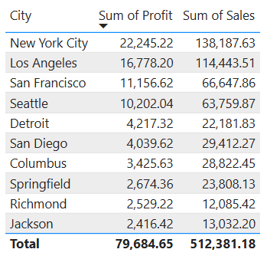
Which cities are the most profitable?
Q5 — Cities
Finding
Chart
Top three cities by profit: New York City → $22,245 Los Angeles → $16,778 San Francisco → $11,156
→ New York City, LA, and SF combined account for the lion's share of profit — prioritize these markets.

Slide 20
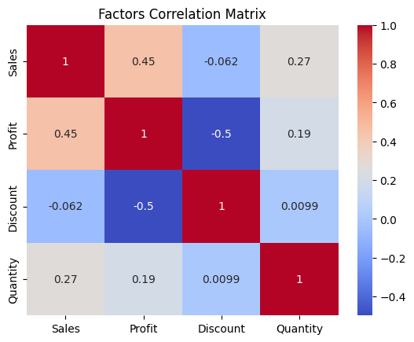
What is the relationship between Discount and Profit?
Q6 —Correlation
Finding
Chart
There is a strong negative correlation (−0.5) between Discount and Profit. Higher discounts consistently reduce profit margins.
→ Cap discounts by category/segment — high discounts directly damage profitability.

Slide 21
Time Series Analysis — Monthly Sales
Time series created by grouping Sales by Order Date (monthly frequency)
2014
2015
2016
2017
Monthly Walmart Sales — Seasonal patterns visible (Q4 spikes)

Slide 22
ARIMA Model — Time Series Forecasting
Step 1
Step 2
Step 3
Step 4
Step 5
Stationarity Test
Differencing
ACF / PACF
ARIMA(1,1,1)
Forecast
ADF Test on original series → Non-stationary detected (p > 0.05)
First difference applied → Series becomes stationary (p ≤ 0.05)
Plotted to determine optimal p, d, q paramters
Model fitted on 80% train data, tested on remaining 20%
Predictions compared to actual test values visually & numerically
Train: 80% of monthly data | Test: 20% | Order: ARIMA(1, 1, 1)
The model captures the trend and produces reasonable short-term sales forecasts.

Slide 23
ARIMA — Forecast vs Actual
Train / Test Split
Train Data
Actual Test
ARIMA Forecast

Slide 24
Time Series — Executive Summary
Jan 2014 – Dec 2017
~$5K
~$120K
~100%+
4 Years
Starting Monthly Sales
Peak Monthly Sales
Estimated CAGR
Observation Window
Summary
This report analyses Walmart's monthly sales performance from January 2014 through December 2017. Using both original monthly sales data and a 3-month moving average, the analysis reveals a clear long-term upward trajectory despite notable short-term volatility.
Key findings indicate that Walmart experienced consistent year-over-year growth, with sales roughly doubling over the four-year observation window.
→ Sales roughly doubled over the 4-year period — from ~$5K to ~$120K per month

Slide 25
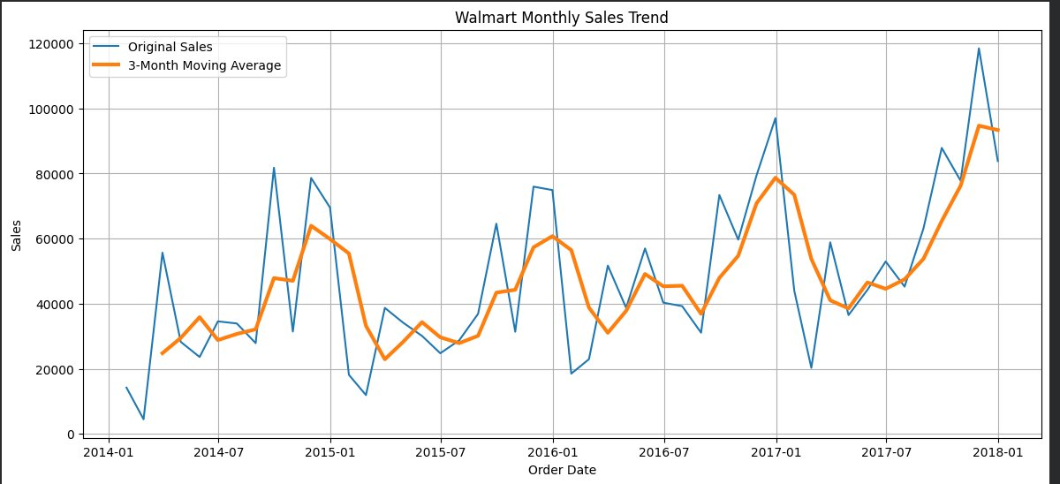
Monthly Sales Trend — Original vs. 3-Month Moving Average
Sales Chart
Figure 1: Walmart Monthly Sales (2014–2017)
→ Blue = Original Monthly Sales · Orange = 3-Month Moving Average

Slide 26
Key Observations
EDA — Time Series
3.1
Overall Growth Trend
3.2
Seasonal Volatility
Sales began at ~$5K–$15K/month in early 2014. By late 2017, monthly sales regularly exceeded $80K–$120K — a CAGR estimated at 100%+, reflecting strong business expansion.
The original sales line exhibits significant month-to-month fluctuations across all four years. Sharp peaks and troughs are evident, with swings sometimes exceeding $40K within a single month — consistent with retail seasonality.
3.3
Moving Average Smoothing
3.4
Notable Peaks
The 3-month moving average effectively smooths short-term noise and reveals the underlying trend. It confirms broadly positive sales momentum with no sustained declines lasting beyond one to two months.
Highest monthly sales (~$120K) occurred in late 2017. A secondary peak of ~$97K was recorded in early 2017. Prior peaks reached ~$80K–$82K in mid-2014 and early 2015.
3.5
Notable Troughs
Lowest sales were observed in early 2014 (~$5K–$6K) and mid-2016 (~$20K–$23K) — likely reflecting post-holiday slowdowns or inventory restocking periods.
→ Consistent upward trend with seasonal volatility — moving average confirms sustained growth

Slide 27
Year-by-Year Sales Summary
2014 – 2017
Year
Min Sales
Max Sales
Trend
Volatility
2014
$5,000
$82,000
↑ Rising
High
2015
$13,000
$79,000
→ Flat / Mixed
High
2016
$20,000
$75,000
↑ Moderate Rise
Medium
2017
$22,000
$120,000
↑↑ Strong Rise
High
→ 2017 saw the strongest growth — sales nearly tripled from the lowest to highest point

Slide 28
Conclusions & Recommendations
Time Series
Conclusions
Recommendations
Robust Growth Trajectory
Demand Forecasting Tools
Invest in forecasting to better anticipate recurring monthly volatility and reduce operational and inventory planning challenges.
The four-year data demonstrates accelerating growth, with sales roughly doubling — confirming strong and sustained business expansion.
Q4 Supply Chain Readiness
Capitalise on strong late-year sales peaks by ensuring supply chain readiness and promotional campaigns are in place ahead of Q4.
Recurring Seasonal Volatility
Investigate Mid-Year Troughs
Identify root causes of mid-year dips (especially mid-2016) and develop targeted promotions to sustain sales momentum.
Monthly swings of up to $40K are consistently observed. Patterns align with holiday periods, promotional events, and inventory cycles.
Monitor Moving Average
Continue using the 3-month moving average as a key management indicator to distinguish genuine trend shifts from seasonal noise.
→ Strong growth confirmed — invest in forecasting, Q4 readiness, and discount monitoring

Slide 29
Conclusion
Key Takeaways from the Walmart BI Project
Sales & Products
Regions & Cities
ML & Discounts
Office Supplies leads all categories in sales volume. Technology and Furniture follow closely.
Most orders are small-value, right-skewed distribution suggests focusing on frequent buyers.
The West Region is the most profitable. California and New York dominate state-level sales.
New York City, LA, and San Francisco are top profit-generating cities.
Random Forest (R² 0.85) significantly outperforms Linear Regression. Discount and Profit have a strong negative correlation (-0.5).
Limiting discounts by segment protects margin without sacrificing sales.
Walmart Sales Business Intelligence Project — IS Department

Slide 30
Business Recommendations
Conclusion
Invest in Office Supplies
Prioritize inventory and marketing for the top-selling category to maximize revenue.
Control Discount Strategy
Cap discounts per segment/category to protect profit margins from erosion.
Target Consumer Segment
Build retention and loyalty programs for the Consumer segment — our primary revenue source.
Expand West & Key Cities
Double investment in West Region and NYC/LA/SF with targeted campaigns and local stock.
Use Random Forest for Forecasting
Deploy the Random Forest model (R² 0.85) for sales forecasting and demand planning.
Monitor Sales Trends Over Time
Set up dashboards to track seasonal patterns and act quickly on emerging trends.

Slide 31
IS Department • Business Intelligence Project
Thank You
We appreciate your time and attention.
Questions & Discussion Welcome
Walmart Sales BI Project

