Slide 1
Association Rule – Apriori Algorithm
Made By:
Mahmoud Samir Mahmoud
Gaafar Soliman
Nour Hammouda
Maya Al-Okda
Supervised By:
Eng. Khaled Kondakji

Slide 2
1.
Association Rule
What is Association Rule?

Slide 3
Association rule learning is a rule-based machine learning method for discovering interesting relations between variables in large databases.

Slide 4
Association Rule
Association rules are made by searching data for frequent if-then patterns and by using a certain criterion under Support and Confidence to define what the most important relationships.

Slide 5
What are Support & Confidence?
Support
The evidence of how frequent an item appears in the data given.
Confidence
How many times the if-then statements are found true.
There is a third criteria that can be used, it is called Lift and it can be used to compare the expected Confidence and the actual Confidence.

Slide 6
2.
Apriori Algorithm
An Association Rule Algorithm

Slide 7
What is Apriori Algorithm?
Apriori algorithm refers to an algorithm that is used in mining frequent products sets and relevant association rules.
Apriori algorithm helps the customers to buy their products with ease and increases the sales performance of the particular store.

Slide 8
How does Apriori Works?
The Apriori Algorithm makes 3 assumptions:
All subsets of a frequent itemset must be frequent.
The subsets of an infrequent item set must be infrequent.
Fix a threshold support level.

Slide 9
Apriori Processes
Dataset
Find
Frequent Itemsets
Generate Association Rules

Slide 10
Step 1- Find the Candidate set
Make a frequency table of all the products that appear in all the transactions.
Then, short the frequency table by removing those products that are under the threshold support level.

Slide 11
Step 2- Generate the 2nd Candidate set
Create pairs of products by cross joining the products that appears in the transactions.
Check all subsets of an itemset are frequent or not and if not frequent remove that itemset.
Again remove the itemsets that are under the threshold support level.

Slide 12
Step 3- Keep Repeating Step 2
Keep Repeating the 2nd step
Until no frequent itemsets are found further.
At the end of this step we found the Frequent itemsets we’re going to use to generate strong association rules.

Slide 13
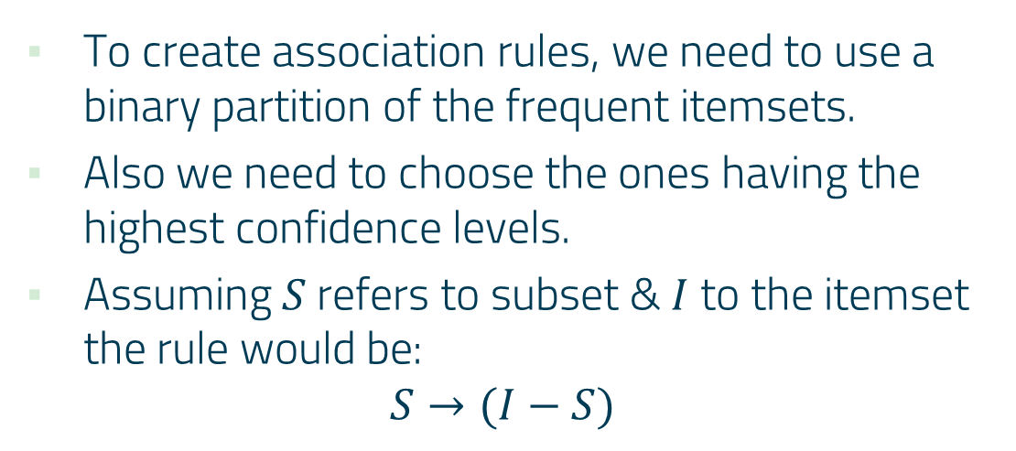
Step 4- Generating association rules
To create association rules, we need to use a binary partition of the frequent itemsets.
Also we need to choose the ones having the highest confidence levels.
Assuming $S$refers to subset & $I$ to the itemset the rule would be:
$$S→(I−S)$$

Slide 14
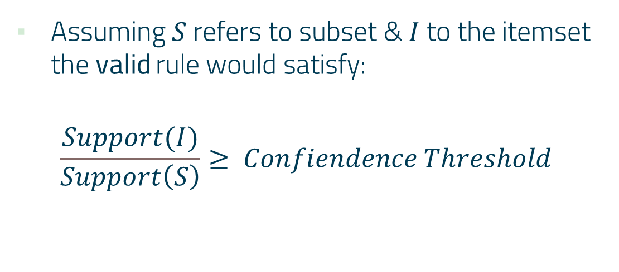
Step 5- Keep valid association rules
Assuming $S$refers to subset & $I$ to the itemset the valid rule would satisfy:
$$\frac{Support(I)}{Support\left(S\right)}≥ Confiendence Threshold$$

Slide 15
3. Overview
Benefits & Downfalls

Slide 16
Benefits
There are many benefits of using Association rules like finding the pattern that helps understand the correlations and co-occurrences between data sets.

Slide 17
Downfalls
Finding the appropriate parameter and threshold settings for the mining algorithm.
Having a large number of discovered rules.
The reason is that this does not guarantee that the rules will be found relevant, but it could also cause the algorithm to have low performance.

Slide 18
THANKS!
Any questions?

