Slide 1


Slide 2
BEST MOVIES AND SERIES IN HISTORY

Slide 3
Table of contents
01
02
03
04
What is IMDB ?
What was our scraping criteria ?
Our main goal
Scraping
05
06
Data Exploration, cleaning and preprocessing
Final Insights

Slide 4

01

Slide 5
01
IMDB
Internet Movie Database
is an online Data of information related to films, television series, podcasts, home videos, video games, and streaming content online
including cast, production crew and personal biographies, plot summaries, trivia, ratings, and fan and critical reviews.

Slide 7
02
Our Main Goal

Slide 8
What are the factors affecting the success of a movie or a series ?
What are the factors that may lead to high revenues ?

Slide 9
What was our scraping criteria ?
03
Using Advanced Search

Slide 10
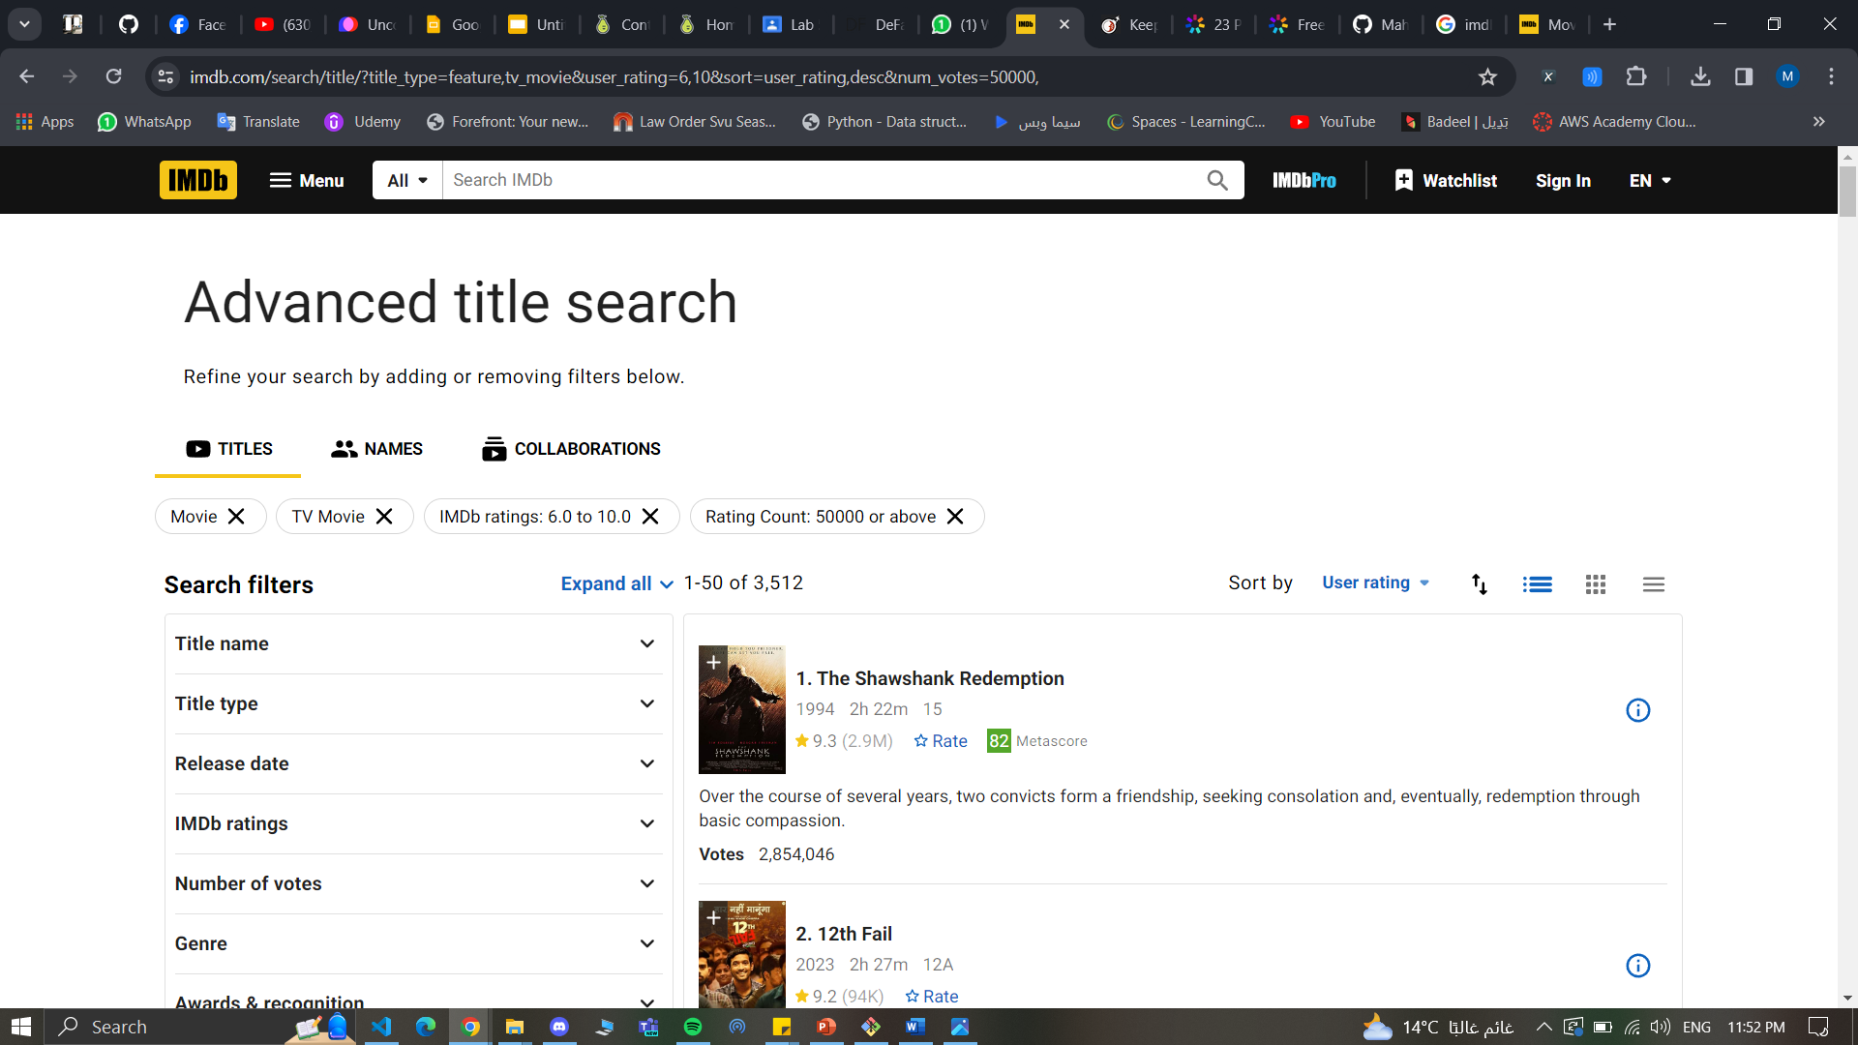
Scraped data that are rated from 6.0 to above

Slide 11
number of votes in each movie must be more than 50K (25 for series) to ensure that the rating is valid

Slide 12
04
Scraping

Slide 13
Scraping
Tools
Features Numbers
Records number
concurrent
concurrent
concurrent
concurrent
19 for movies
16 for series
Selenium
Pandas
Concurrent
3511 for movies
1021 for series

Slide 14
Data Exploration and preprocessing
05
Data Explore
Movie Features
Series Features
Problems with Data
Preprocessing
Cleaning Data

Slide 15
Movie Features
Description
rating
votes
year
duration
title
genre
language
Production _company
country
stars
popularity
writer
Director
Worldwide_gross
certificate
Meta_score

Slide 16
Series Features
Description
rating
votes
year
title
duration
genre
language
Production _company
country
stars
popularity
Creators
certificate

Slide 17
Problems with Data
Features with null values
Features with multi values
Features with special characters
Certification symbols clarification

Slide 18
Data cleaning and preprocessing
Removing nulls
Dropping unwanted columns
Removing Special Characters
Splitting Multi values
Mapping symbols to its meanings

Slide 19
06
Final insights

Slide 20


Join at slido.com #1074990
ⓘ Start presenting to display the joining instructions on this slide.

Slide 21

What do you think the parental guides for the movies with the highest rate ?
ⓘ Start presenting to display the poll results on this slide.

Slide 22
Who is the actor who led the most successful works?
ⓘ Start presenting to display the poll results on this slide.

Slide 23
what do you think the top rated genre ?
ⓘ Start presenting to display the poll results on this slide.

Slide 24

what is the more frequent word in the Title of the movie than the other?
ⓘ Start presenting to display the poll results on this slide.

Slide 25
what is the year with the least worldwide_gross in between 2000 and 2023 ?
ⓘ Start presenting to display the poll results on this slide.

Slide 26
Thank you!
Do you have any questions?

Slide 27
Resources
IMDB
https://www.imdb.com/?ref_=nv_home
GitHub
https://github.com/Mahmoud2227/DEP-Project/blob/main/series_clean.ipynb
Trello
https://trello.com/b/v0HUksqO/kanban-template

