Slide 1



EXAMINATION
SYSTEM
Supervisor-Eng: Nada elaraby
Presented by Mahmoud Salah
and Mahmoud Reda

Slide 2
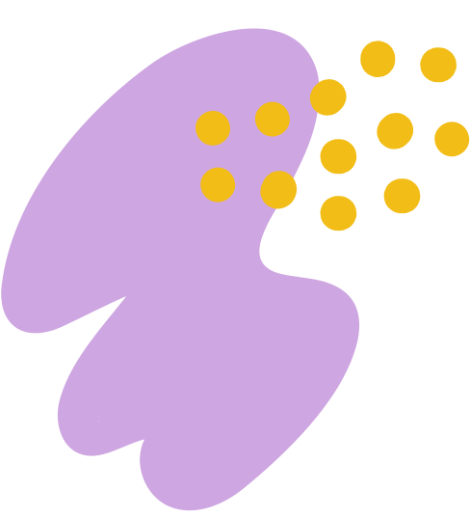


Hello there!
Examination System
A desktop application for examination system where instructor can generate exam and students take exams and get their grades instantly.

Slide 3
Features
Sign in as student/ instructor
- Login as instructor first to add an exam (insert duration and select the courses that this instructor teach And add Questions, database would be updated in grid)
- Logout then login as student (student would only find in the exam list the courses which he is enrolled)
- Press button to get started (a random exam model random questions are generated)
- choose the correct answer and True-False from the combobox beside each question (if student has passed on submit button, the exam is submitted and grade reviewed in table with all exam that student take)
- press submit to get redirected to the grade page
- you can then choose to log out or go to your profile (if went back to profile you wouldn't find the exam that has just finished in the exam list)

Slide 4
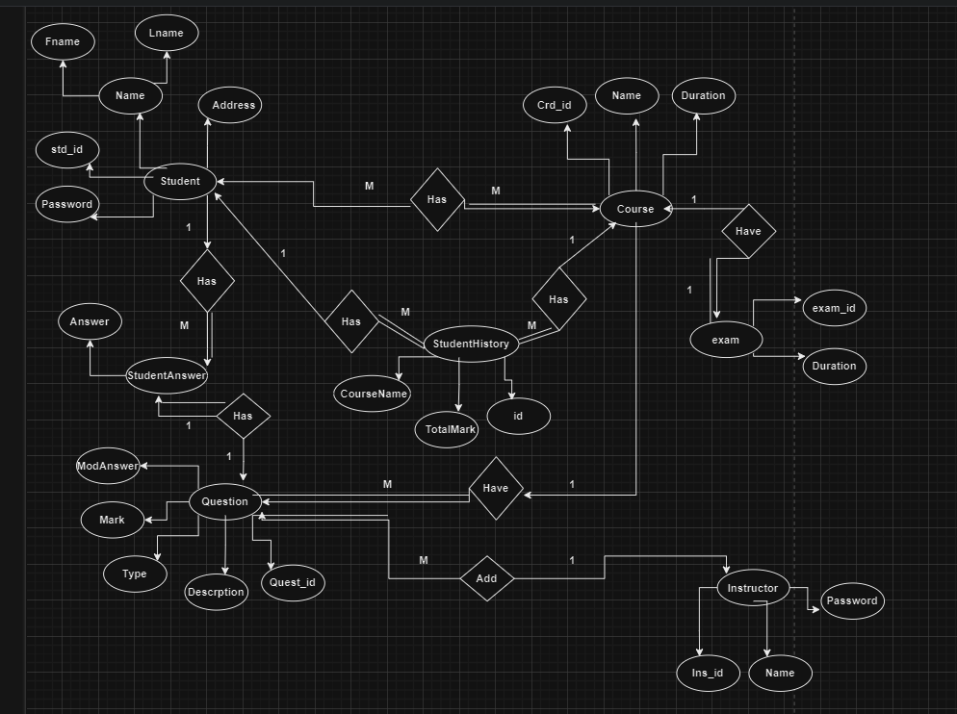
ERD Diagram

Slide 5
SCENARIO
Student (M-to-M) Course: This relationship indicates that a student can enroll in multiple courses, and a course can have multiple students.
Student (1-to-M) StudentAnswer: Each student can have multiple answers to different questions.
Student (M-to-M) Exam: A student can take multiple exams, and an exam can be taken by multiple students.
Course (1-to-1) Exam: Each course has one associated exam.
Question (1-to-1) StudentAnswer: Each question has one corresponding student answer.
Instructor (1-to-M) Question: An instructor can create multiple questions.
Student (1-to-M) StudentHistory: This relationship indicates that each student can have multiple entries in their history.
course(1-to-M) StudentHistory: that each course can have multiple entries in the student history.

Slide 6
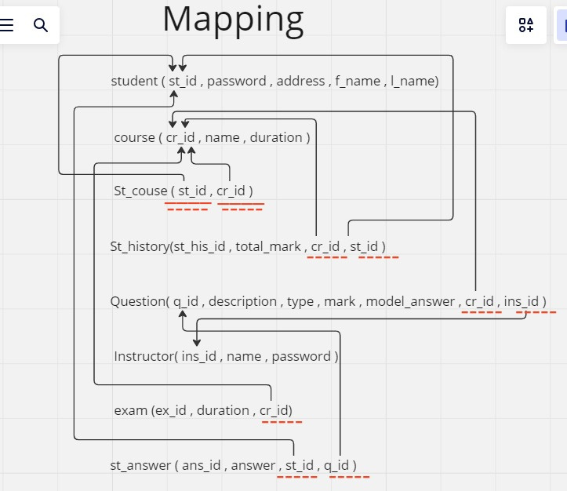

Slide 7
