Slide 1
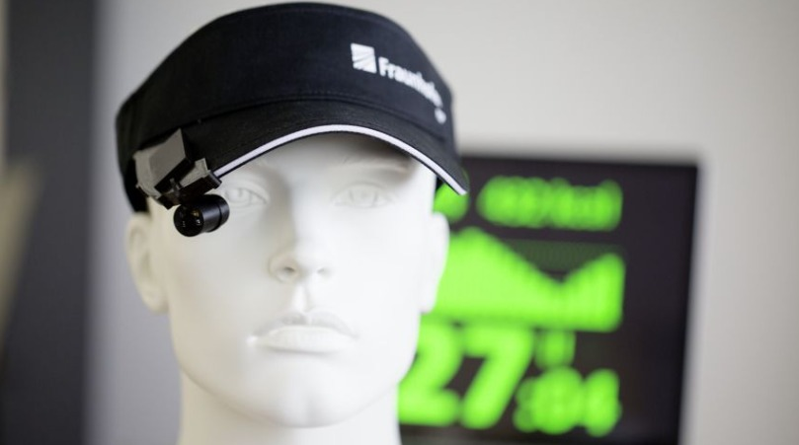
Smart hat for visually impaired
Supervisors:
Dr.Noha AbdElsabour TA. Omar Samy TA.Eslam El_Garhy

Slide 2

Team Members:
Mahmoud Salah Abdel Zaher
Mahmoud Wael Mohamed
Esraa Refaat Salama
Esraa Gamal Abdel Mawla
Marwa Shehta Amen

Slide 3
Agenda
Problem statement
Problem Definition
Background and survey
Proposed Solution
Algorithms
Tools(Software ,Hardware ,Library)
Time Plan
Project Outcome
Problem statement
Problem Definition
Background and survey
Proposed Solution
Algorithms
Tools(Software ,Hardware ,Library)
Time Plan
Project Outcome

Slide 4
Problem Definition:
Over 285 million people are visually impaired worldwide: 39million of them being blind and 246 million have low vision. About 90% of the world’s visually impaired live in developing countries.
Blind people also face great problems in moving from place to another in the town and Guide dogs which can cost much money or Someone guide Them.

Slide 5
Background and survey
Internet of Things (IOT) and Artificial Intelligence (AI) have received much attention in recent years. Embedded with sensors and connected to the Internet, the IOT device can collect massive data and interact with a human.
The data collected by IOT can be further analyzed by applying AI mechanisms for exploring the information behind the data and Cameras then have impacts on the interactions between human and things.
Smart hat which is the Ultrasonic sensing unit(motion sensor) , cameras and headset is able to collect, detect the data and exploring the information with AI then interact with blind people.

Slide 6
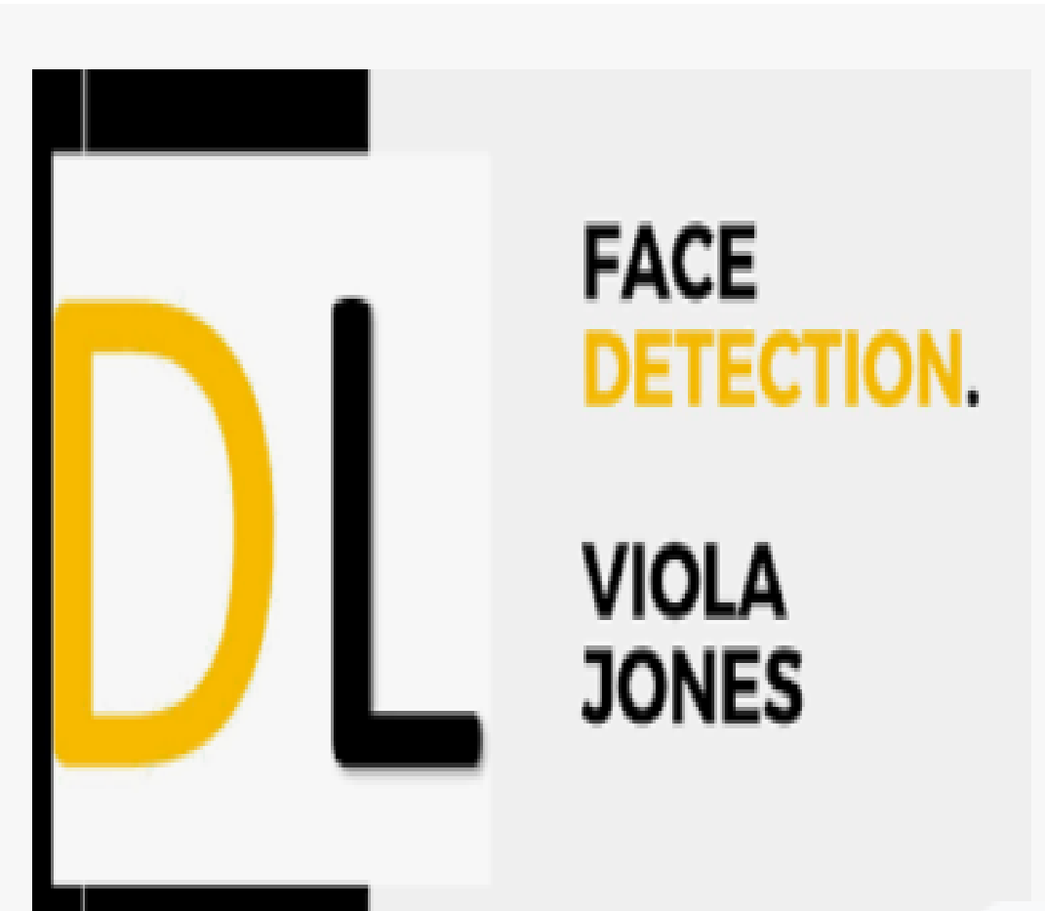
1
TensorFlow
For describing the scene
Possible algorithms :
2
Viola-Jones
For recognize people

Slide 7





Tools
Software
Library
1)Python language
1)OpenCv
2(VNC-Viewer
2)TensorFlow
3)Putty

Slide 8
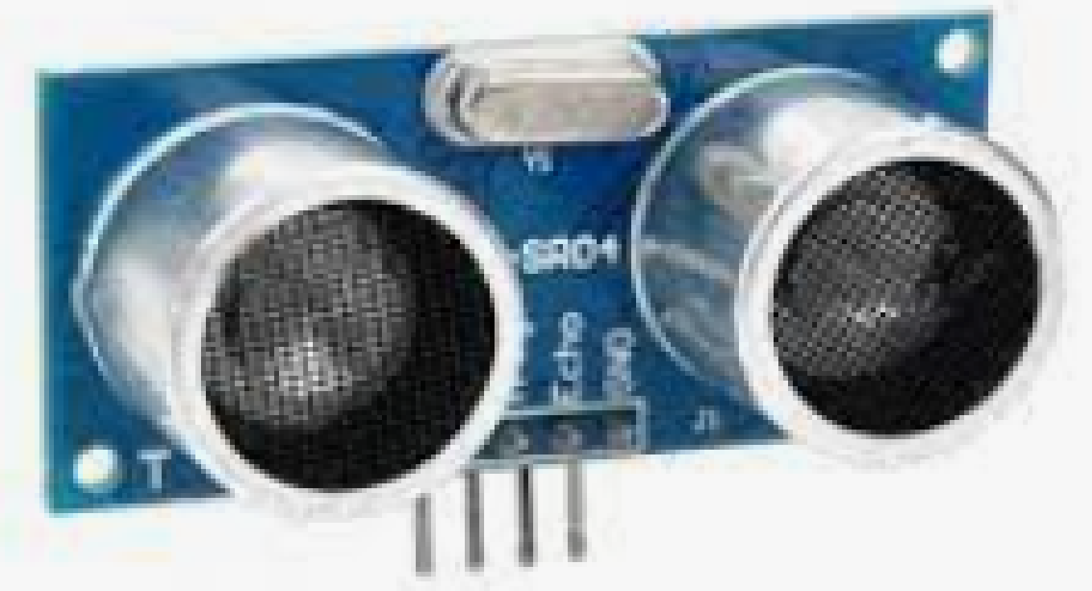
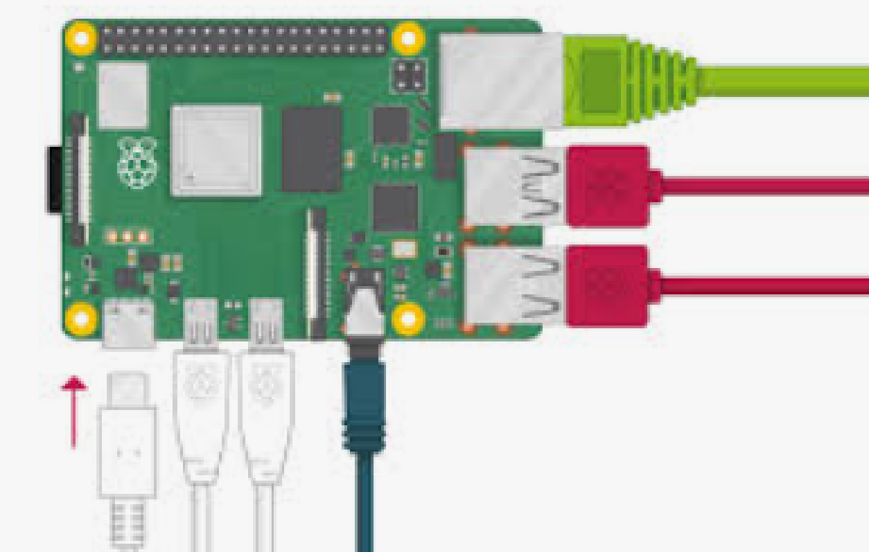
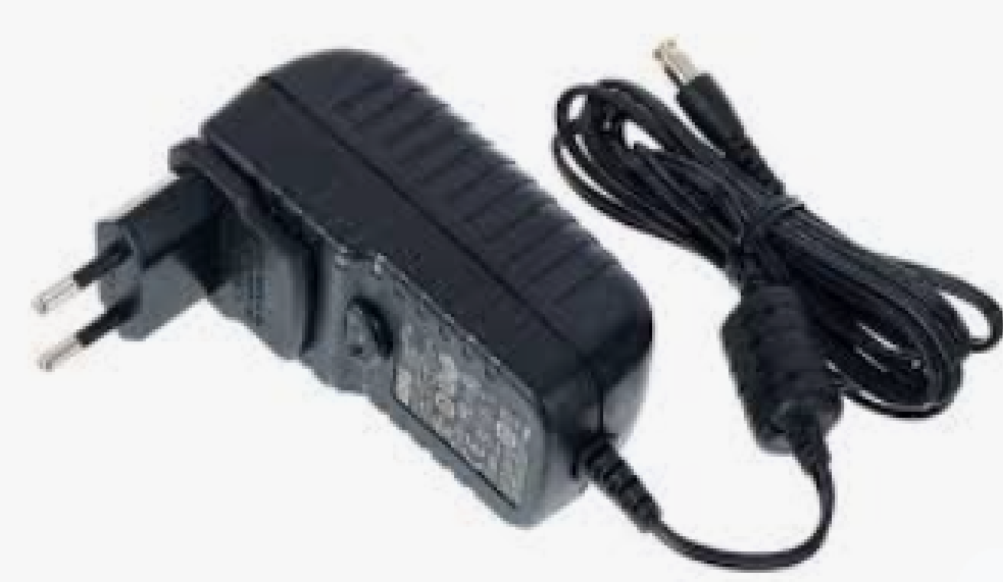
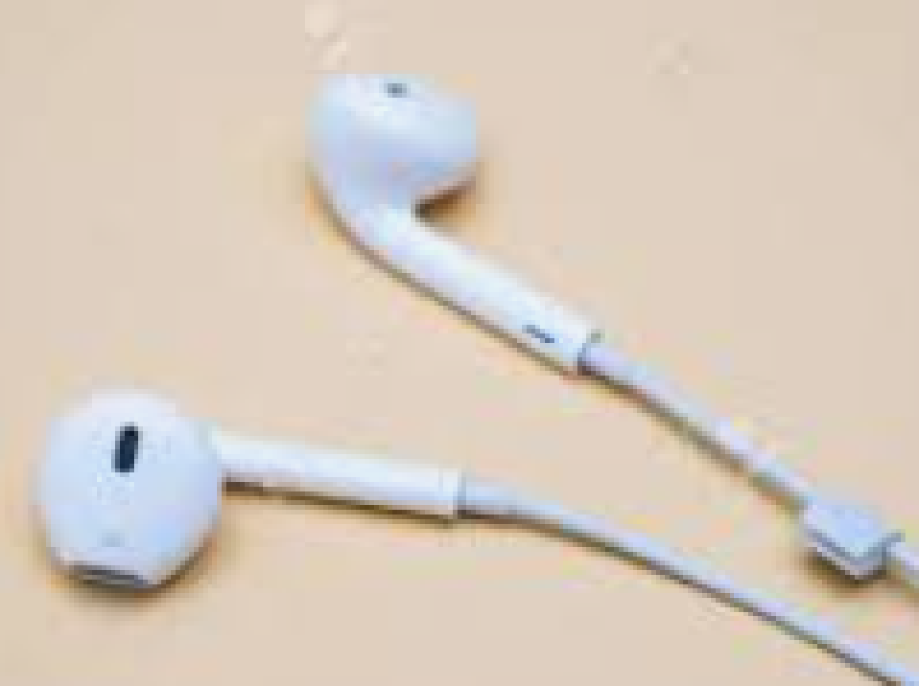
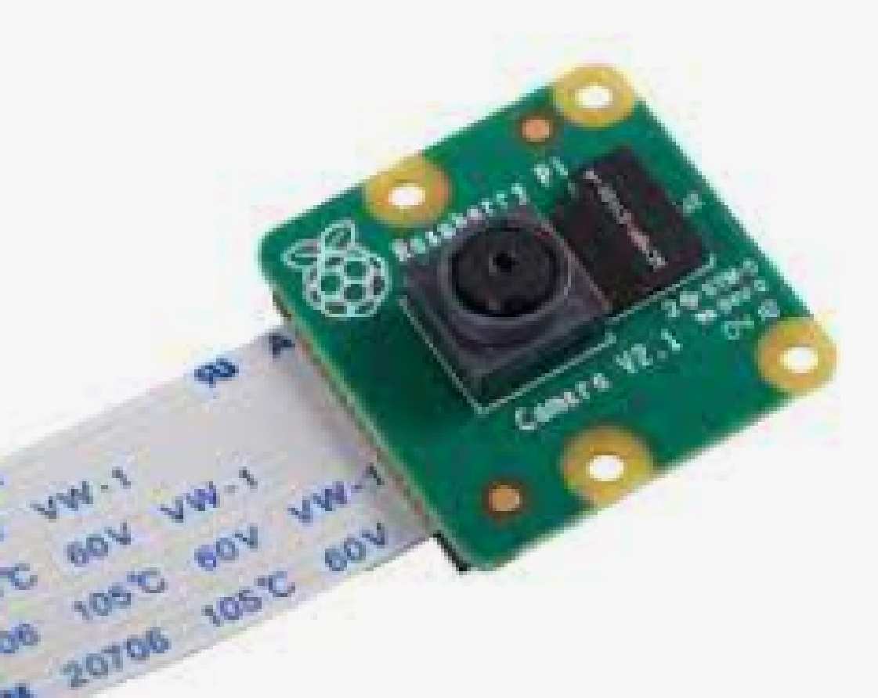
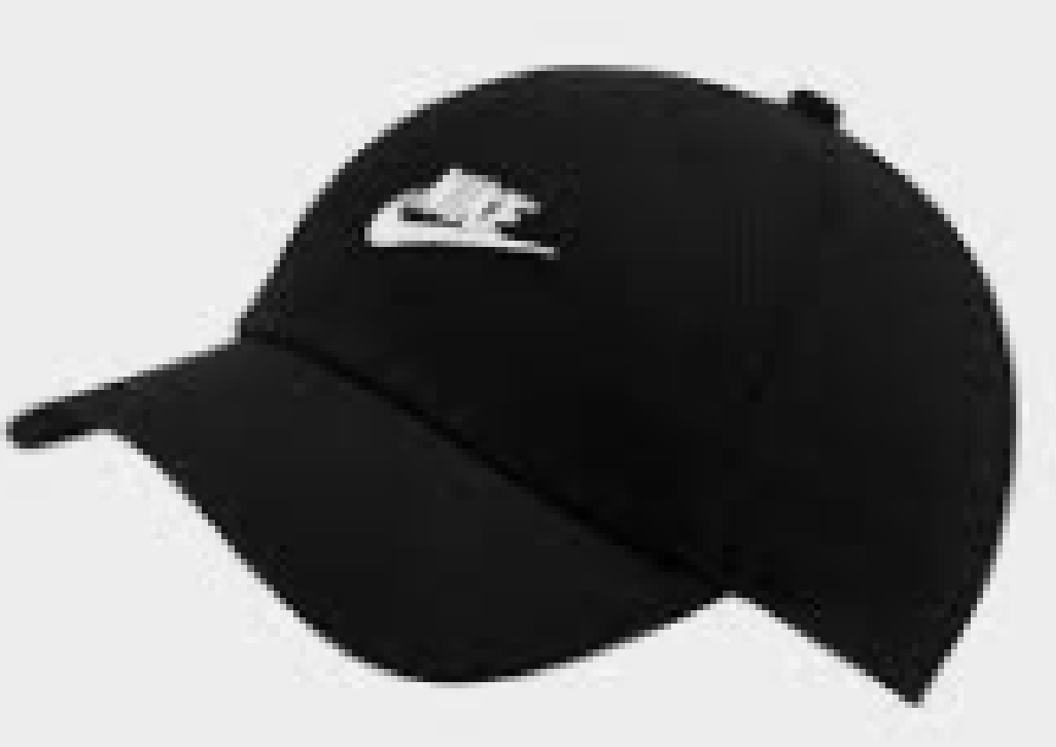
Tools( Hardware)
Ultrasonic Sensor
Raspberry Pi 3 Model B
Power Supply
EarPiece
Camera Raspberry Pi
Hat
Notes:
TFT (thin film transistor)

Slide 9
Available algorithms
Deep Learning algorithms:
Two stage: (higher accuracy , slower)
one stage: )high speed , not good in accuracy,
structurally simpler , Focal Loss enable to achieve accuracy)
R-CNN (training a high-capacity model with only a small quantity of annotated detection data )
Faster R-CNN (more accurate than the original R-CNN)
R-FCN (faster than R-CNN and Faster R-CNN )
YOLOv3 (faster and used for small and complex scenarios for object detection)
SSD (easy to train and integrate and better accuracy )
RetinaNet (high speed and simplicity)
YOLOR (fastest real-time object detector available today)

Slide 10
Available algorithms
Viola Jones to face detection
Haar features
Integral images
Adaboost
Cascading

Slide 11
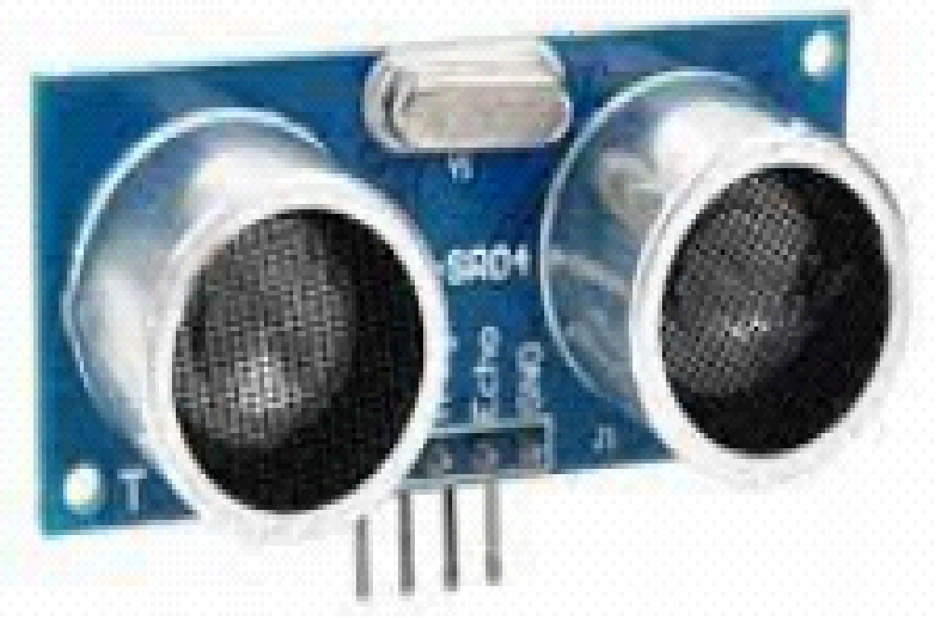
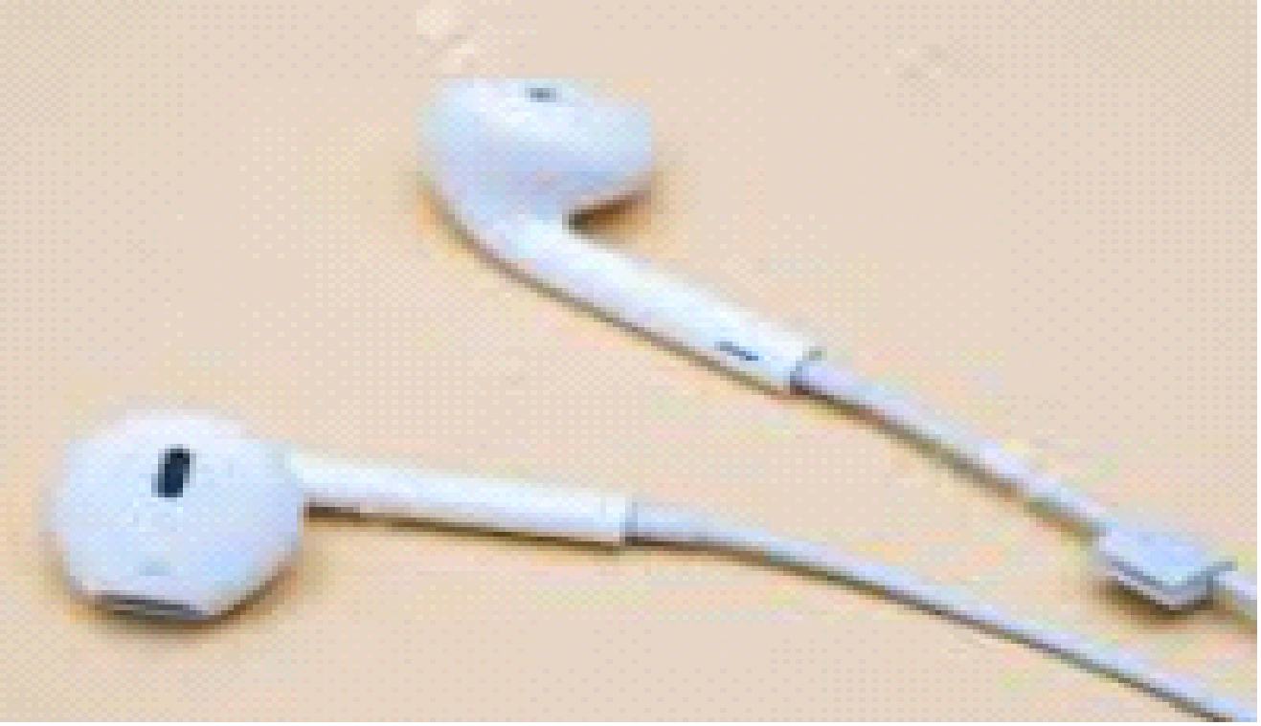
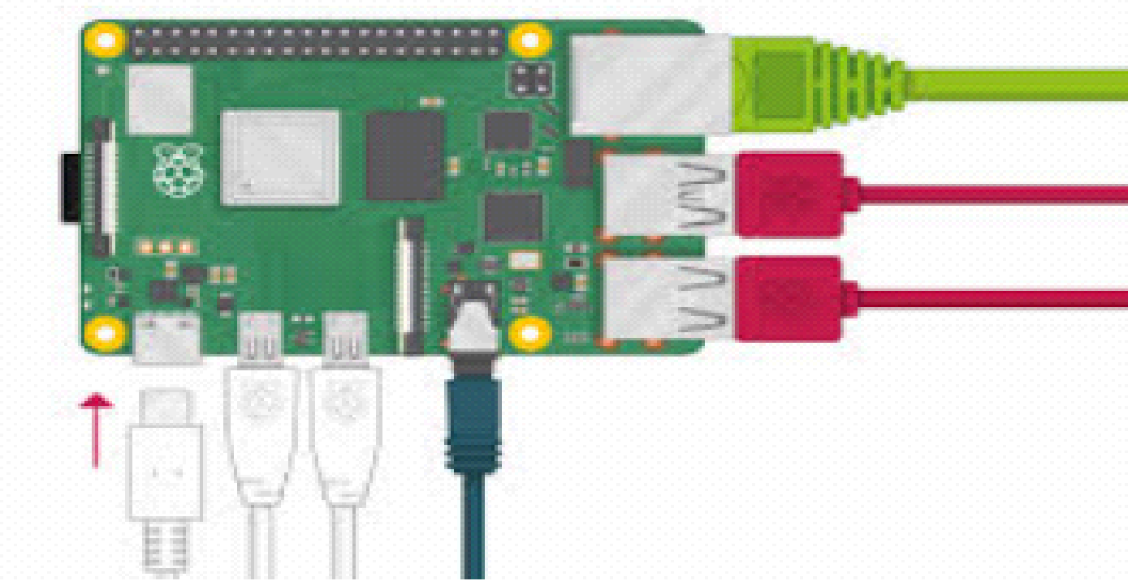

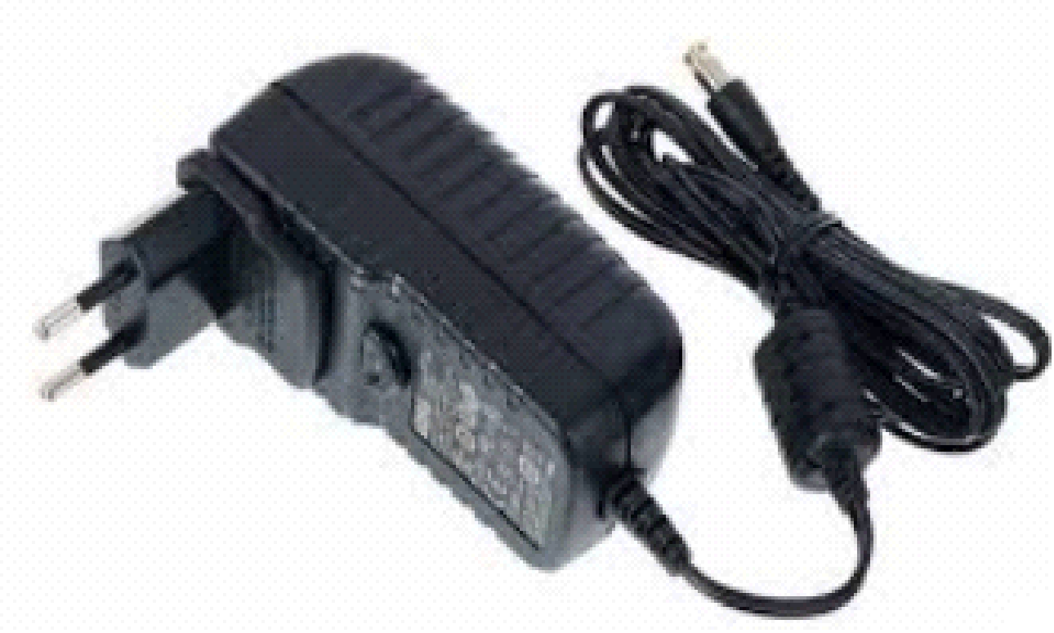
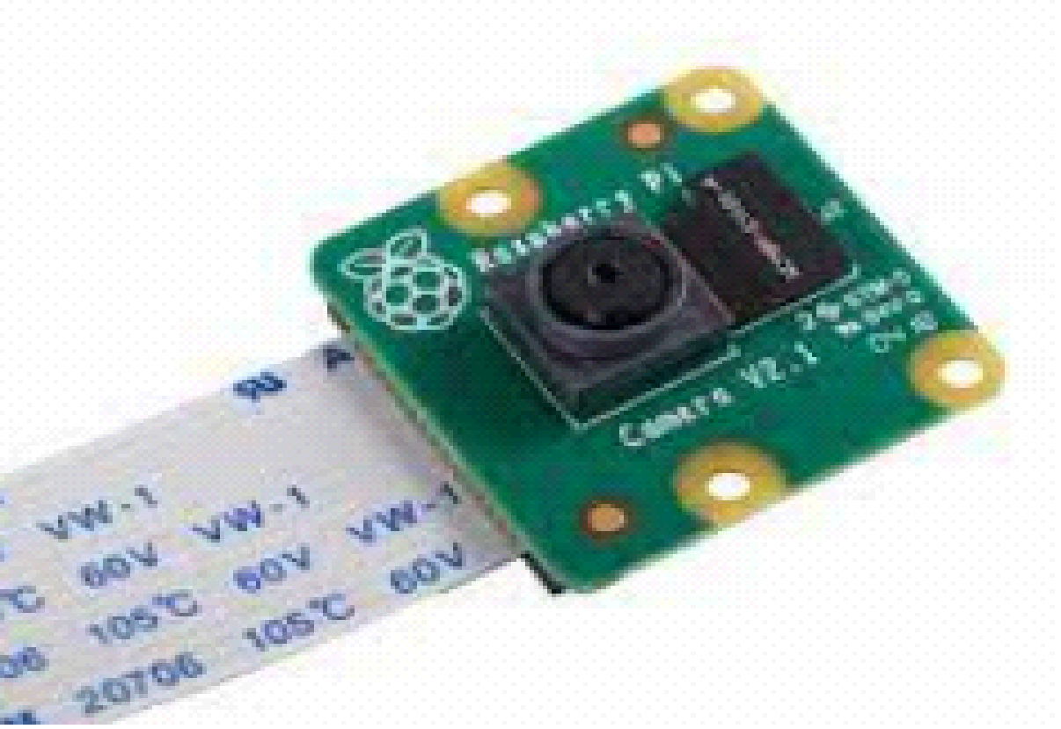
Project Outcomes
1- describing the scene
2- recognize people

Slide 12
Prototype
So our prototype works with the connection of Raspberry and Ai thinker camera raspberry and Ultrasonic sensor.
Camera raspberry work as real time viedeo stream microcontroller so basically it is the third eye.
An ultrasonic sensor is an electronic device that measures the distance of a target object by emitting ultrasonic sound waves.

Slide 13
Stages Of Project [ Time plan]
20th November
December
January
February
March
April
May
July
Requirements Analysis
6 week
Setup Environment
1 week
Searching for sensors
1 week
HardwareDevelopment
6 week
Code implementation
11 week
Testing and Train Model
2 week
4 week
Real System Deployment
8 week
Documentation
30 week

Slide 14


Thank You!

