Slide 1

Notes:
1 · The Mark
Film 0–6 s. A hairline draws, then the emblem resolves out of the dark.

Slide 2
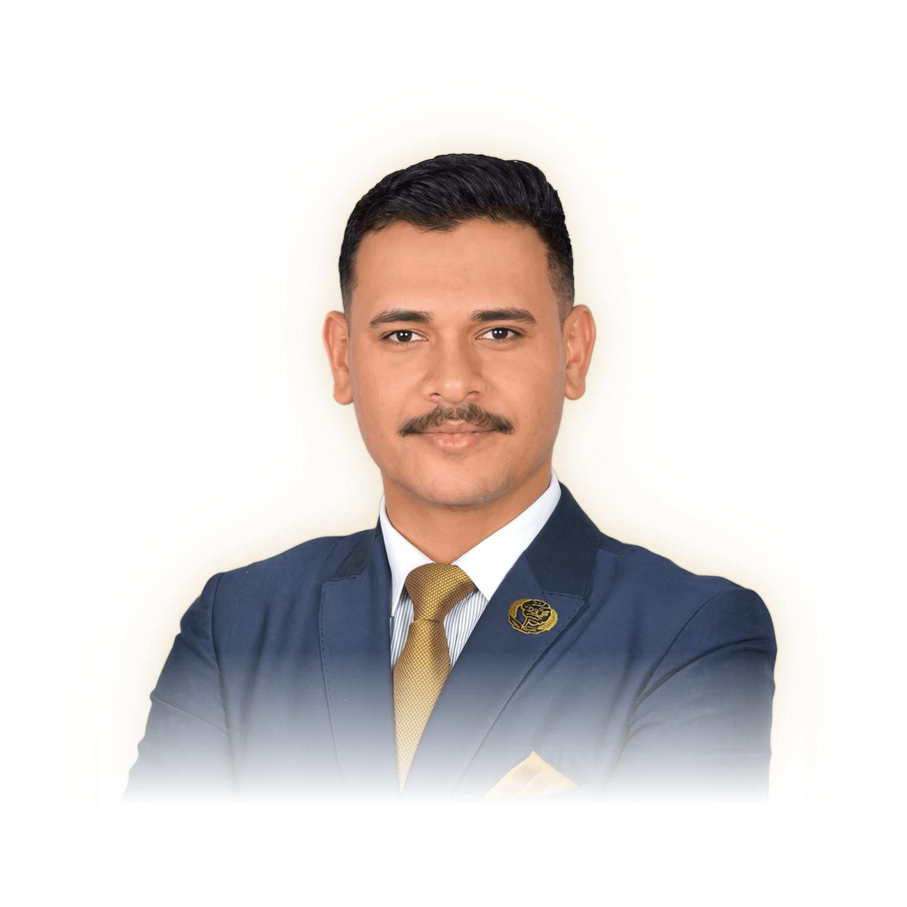


AI ENGINEER · RESEARCHER · EDUCATOR
also known as Mahmoud Sayed Youssef
Notes:
2 · Mahmoud Alyosify
Film 6–12 s. The portrait emerges, the rim light finds him, the name writes itself.

Slide 3
BORN 23 NOVEMBER 2000
It began in Assiut, Upper Egypt.
ASSIUT
2000
2019
2023
2025
2026
Notes:
3 · Origins
Film 12–15 s. Egypt and the Nile draw in gold; a node marks Assiut.

Slide 4
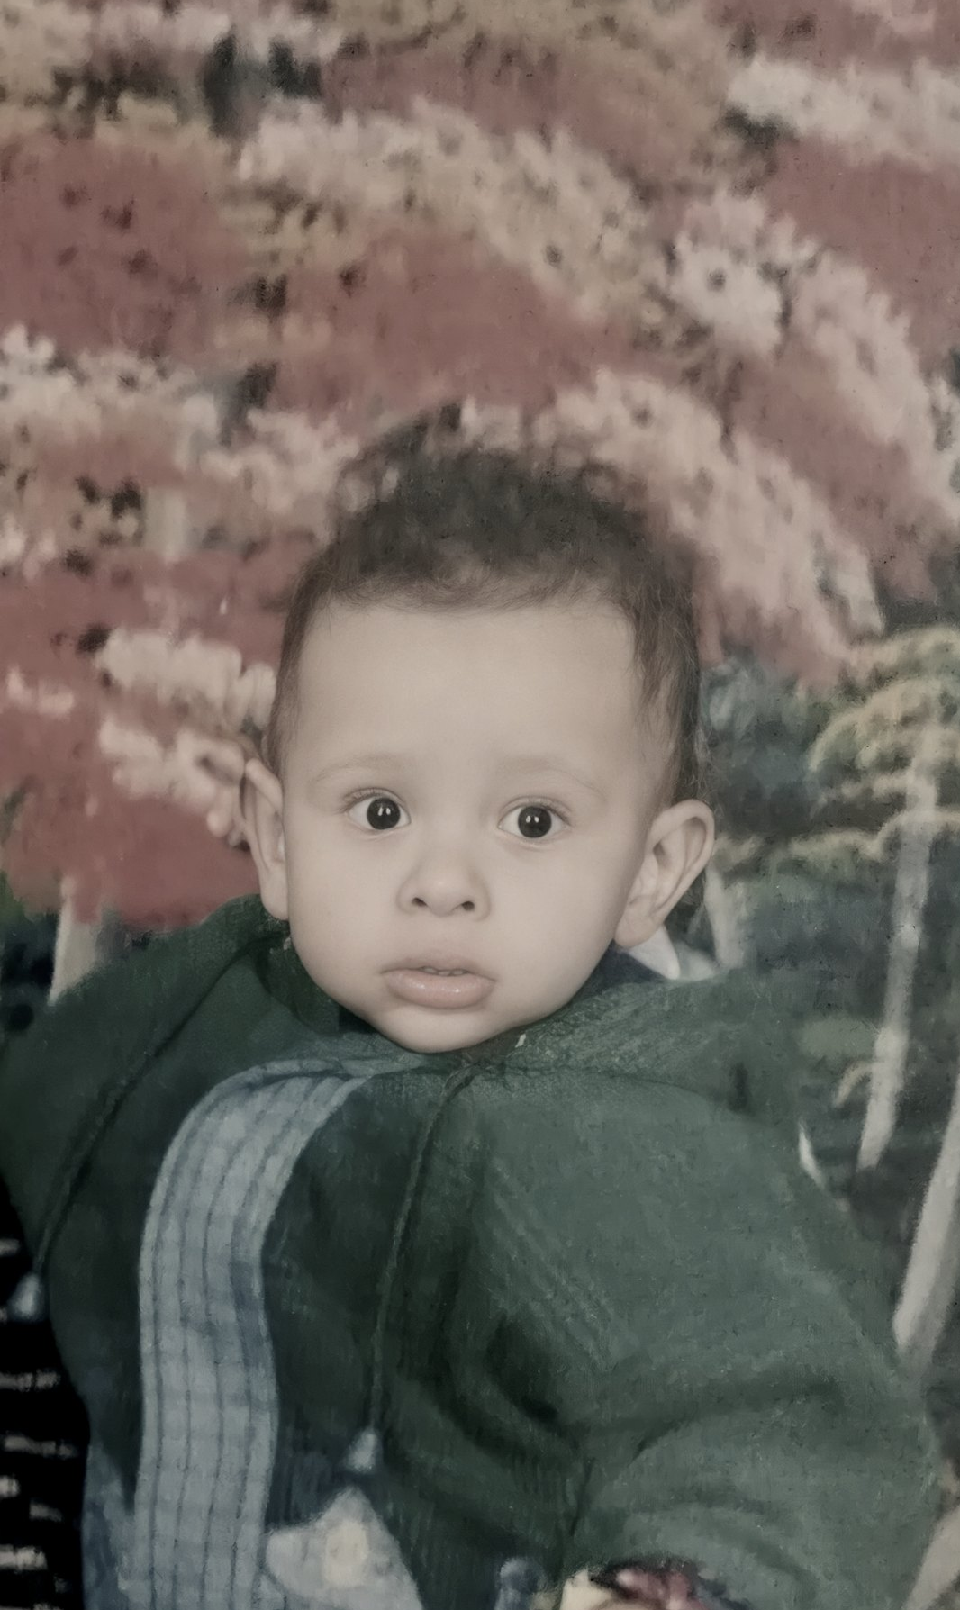
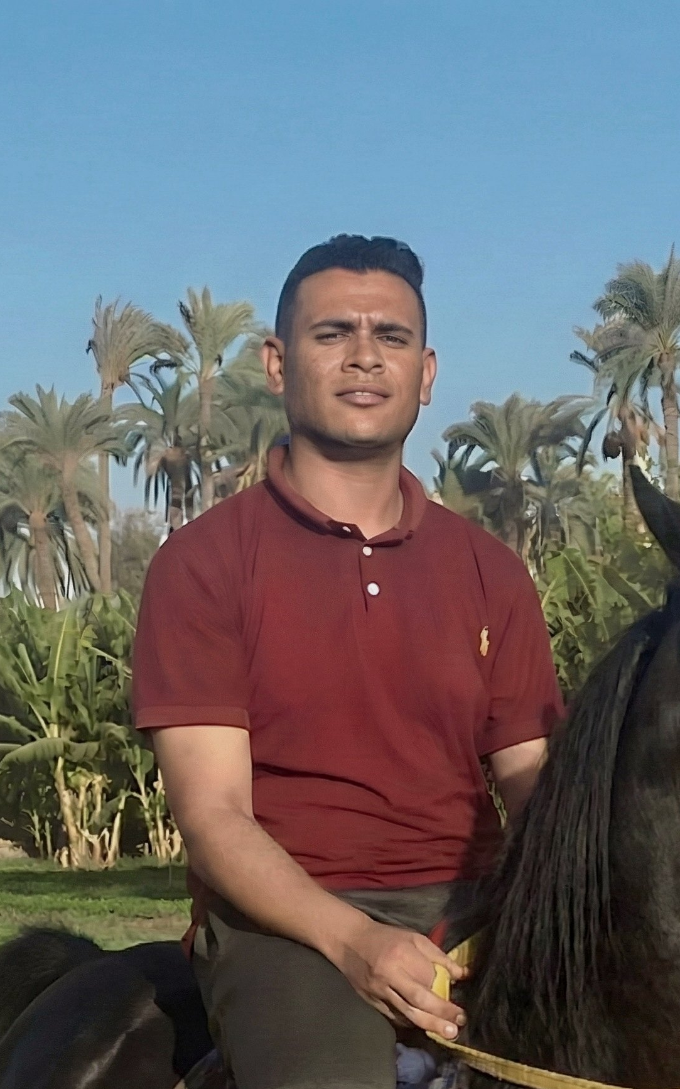
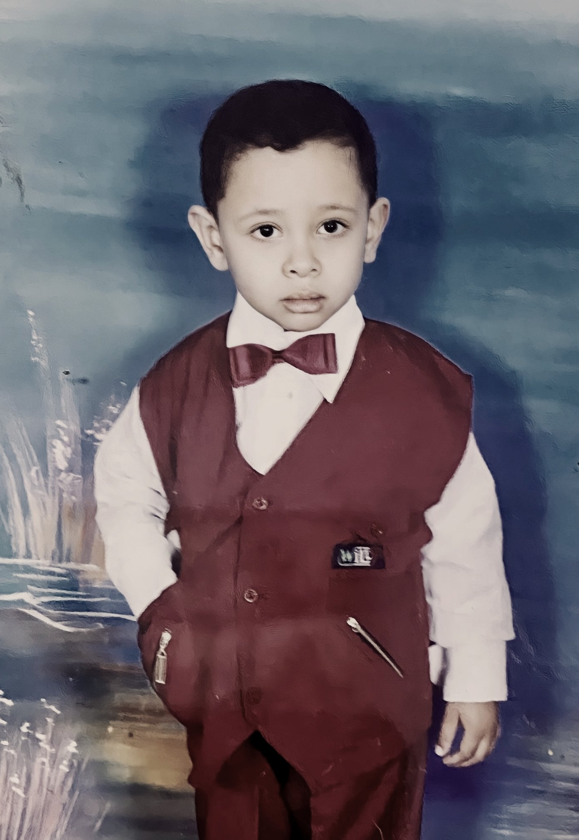

BORN 23 NOVEMBER 2000
His physics teachers called him
“Egypt’s Einstein.”
2000
2019
2023
2025
2026
Notes:
4 · Childhood
Film 14.25–18 s. Three framed photos: as a toddler, at nursery school, on horseback among the palms. No age on screen.

Slide 5
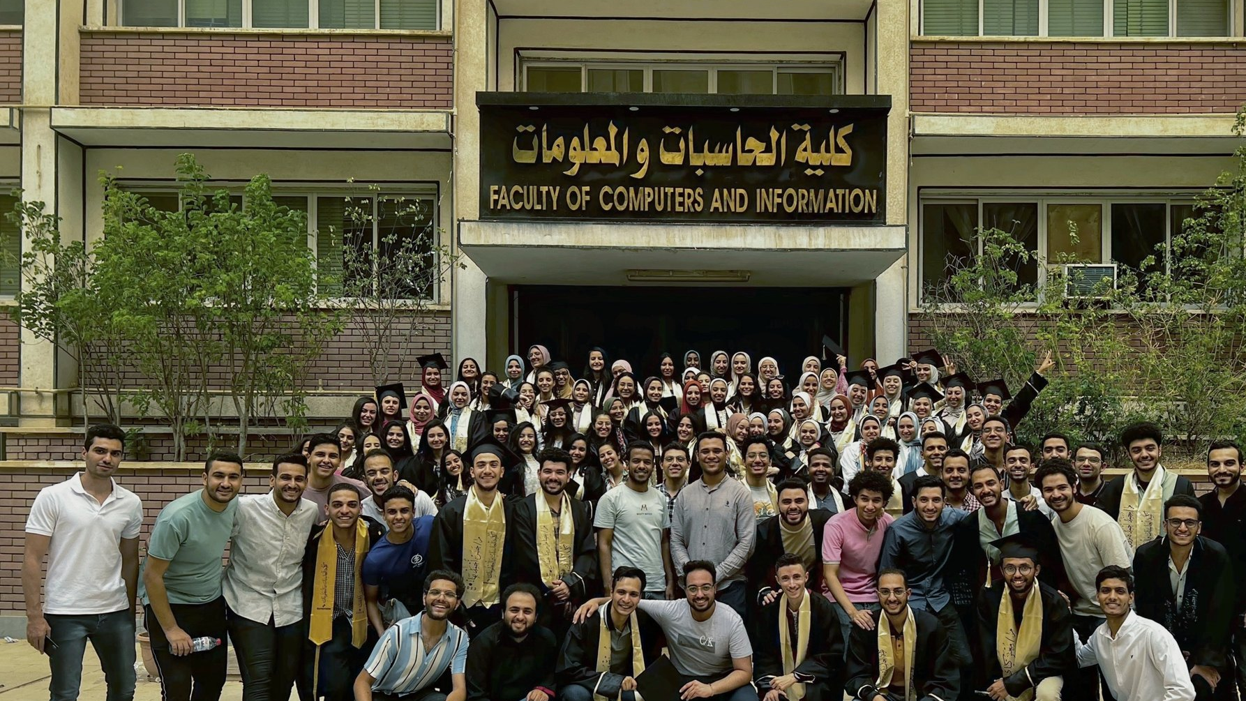

2019 – 2023
Assiut University
Faculty of Computers and Information
2000
2019
2023
2025
2026
Notes:
5 · Assiut University
Film 18–21 s. The class of 2023 in front of the Faculty of Computers and Information.

Slide 6
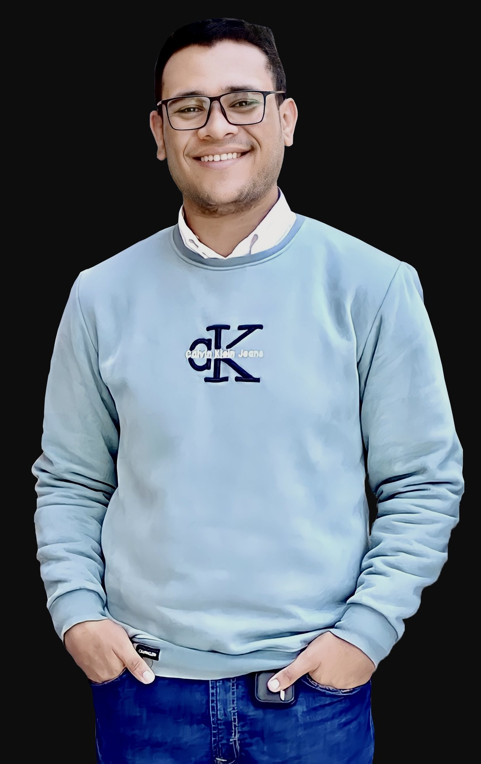
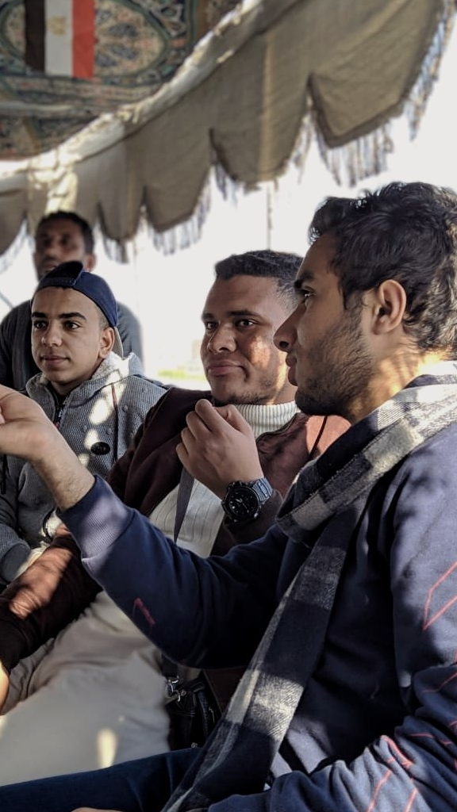
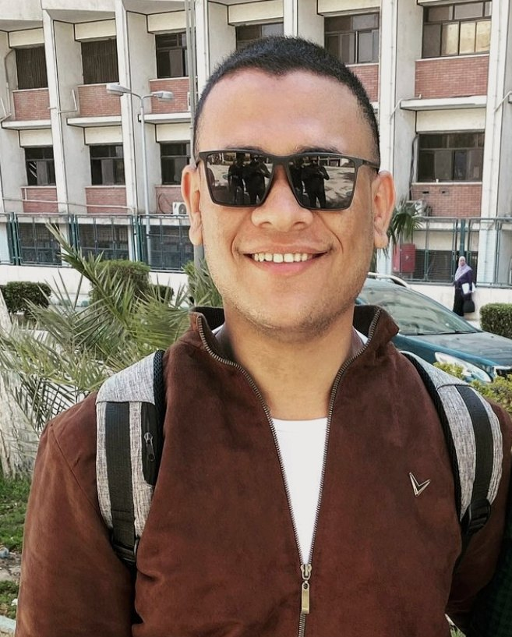
2019 – 2023
Assiut University
B.Sc. Computer & Information Science
Bioinformatics
2000
2019
2023
2025
2026
Notes:
6 · The university years
Film 21–24 s. At FCI, a studio portrait, and the Nile trip in Luxor (2020).

Slide 7
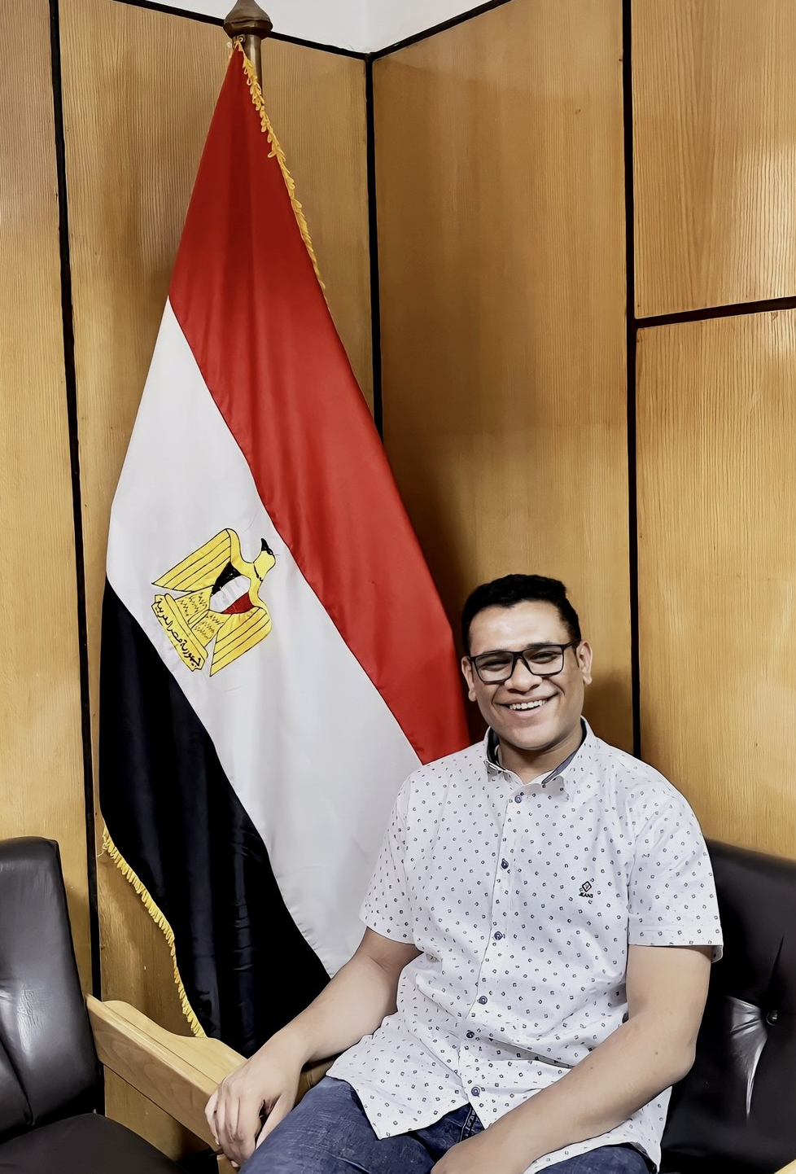
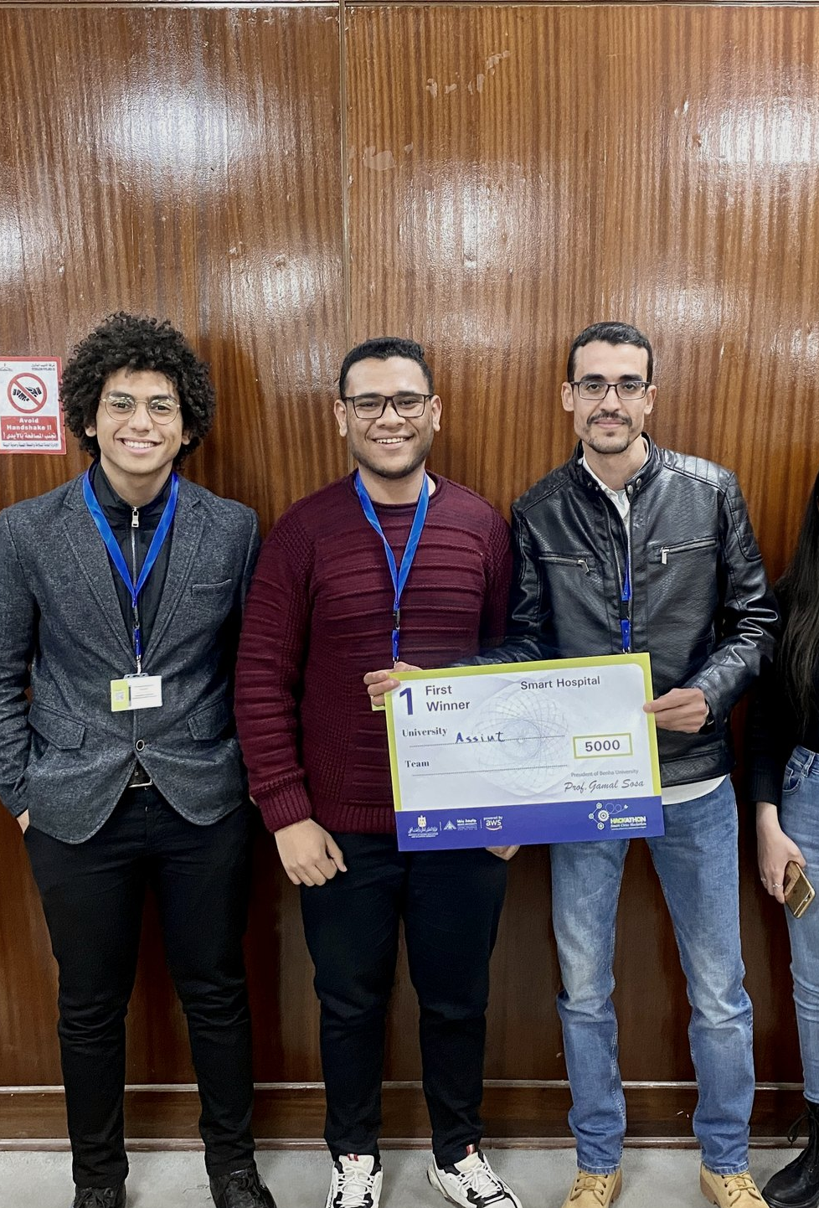
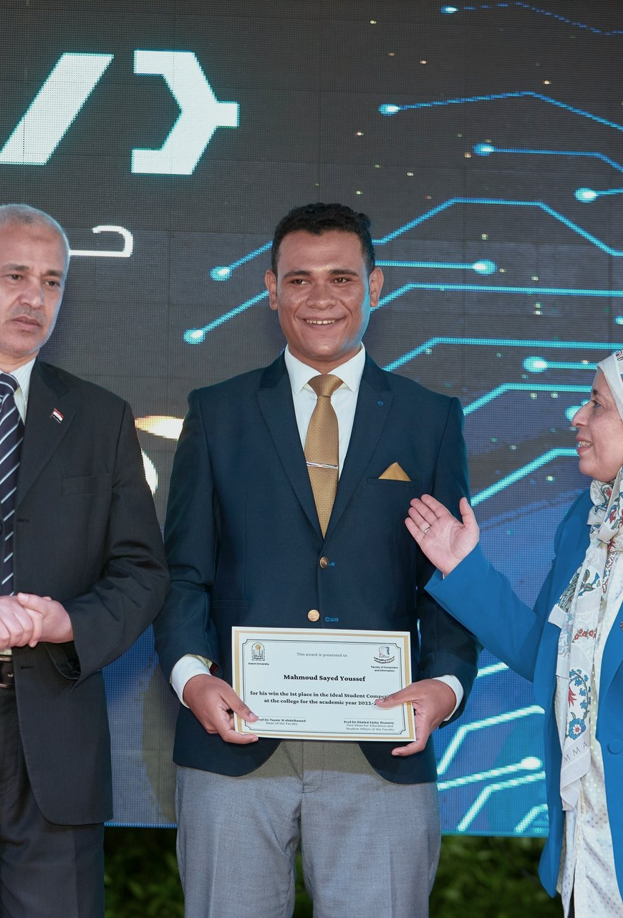
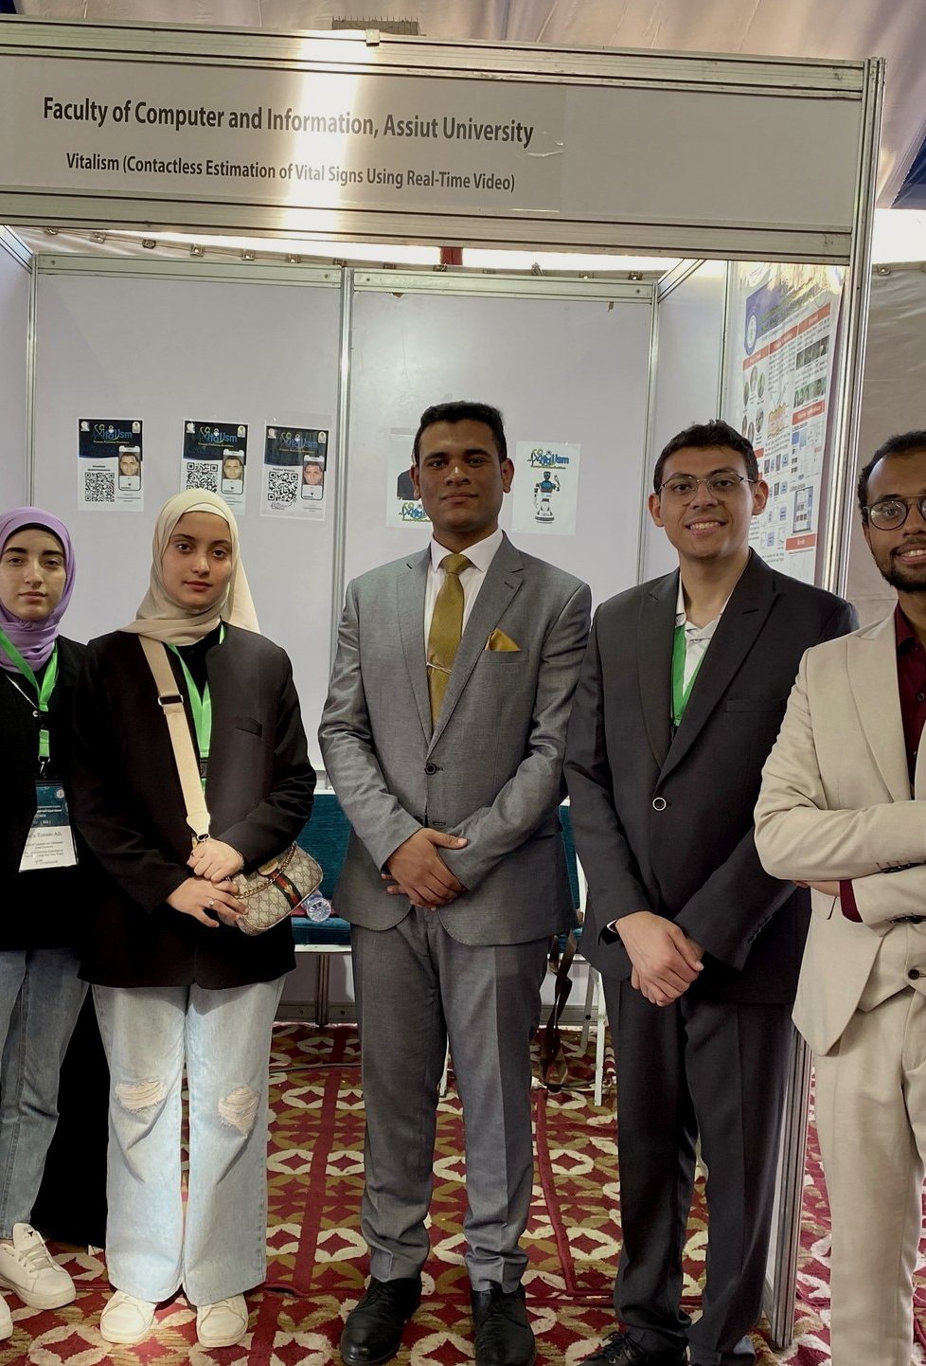
He learned to lead.
STUDENT UNION
Scientific Committee Secretary
1ST PLACE
Smart Cities Hackathon · 2022
IDEAL STUDENT
2022–2023
VITALISM SOLUTION
Imagine Cup semi-finalist
2000
2019
2023
2025
2026
Notes:
7 · He learned to lead
Film 24–30 s. Student Union, Smart Cities Hackathon, Ideal Student, Vitalism Solution.

Slide 8
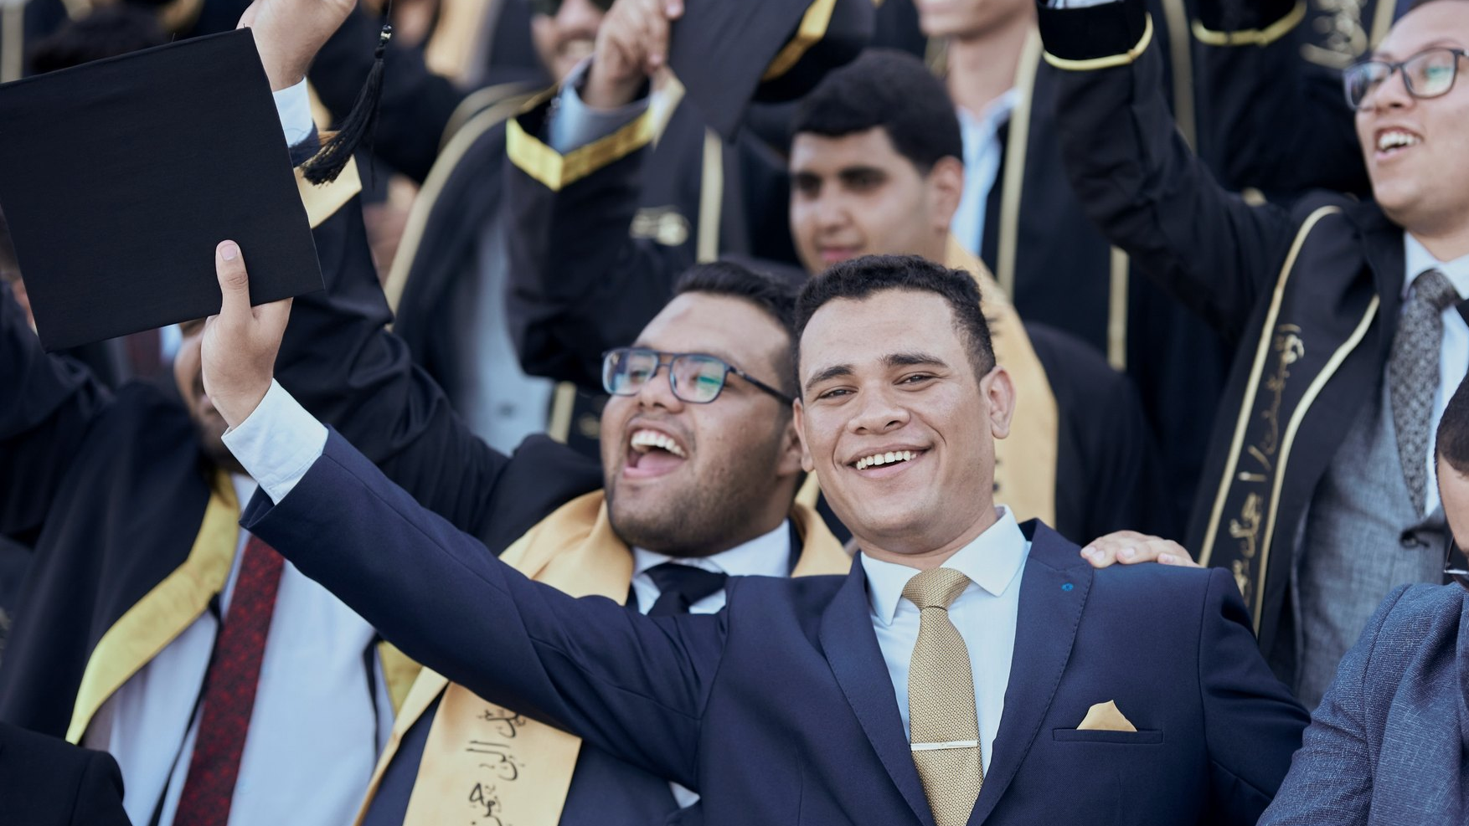
JULY 2023
Graduated.
GPA 3.53 / 4.00
Graduation project graded A+
2000
2019
2023
2025
2026
Notes:
8 · Graduated
Film 30–36 s. July 2023, GPA 3.53 / 4.00, graduation project graded A+.

Slide 9
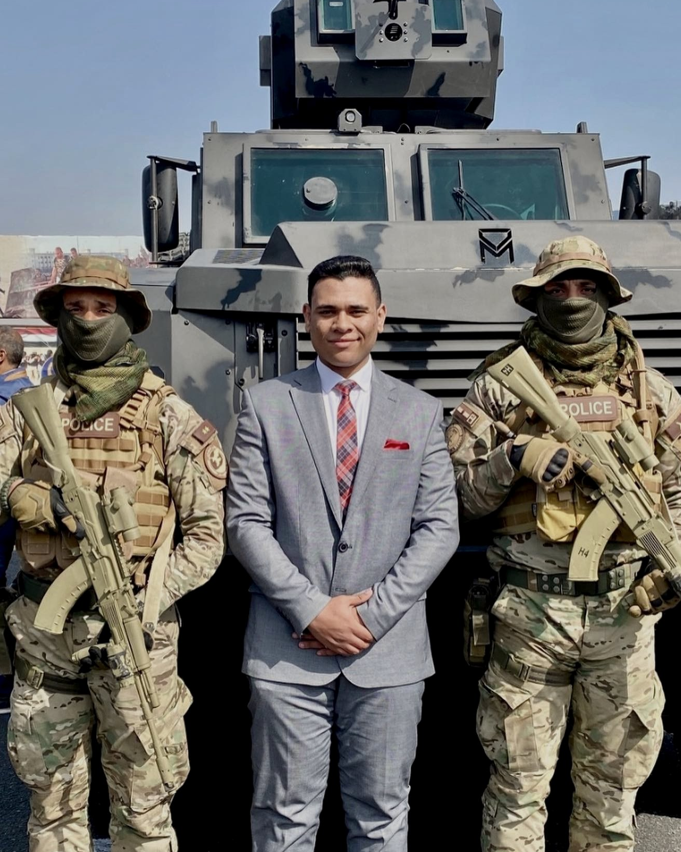
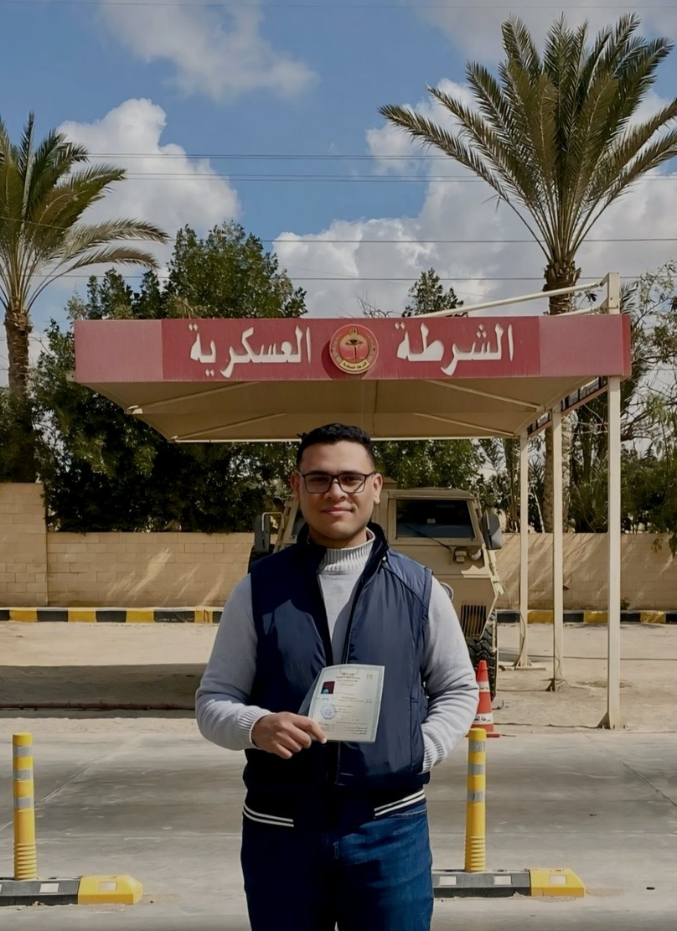
2024 – 2025
Military service,
as a systems engineer.
Back-end systems for toll roads serving
over half of Egypt’s vehicles.
He kept learning when
there was little room to.
2000
2019
2023
2025
2026
Notes:
9 · Service
Film 36–42 s. Military service as a systems engineer, 2024–2025.

Slide 10

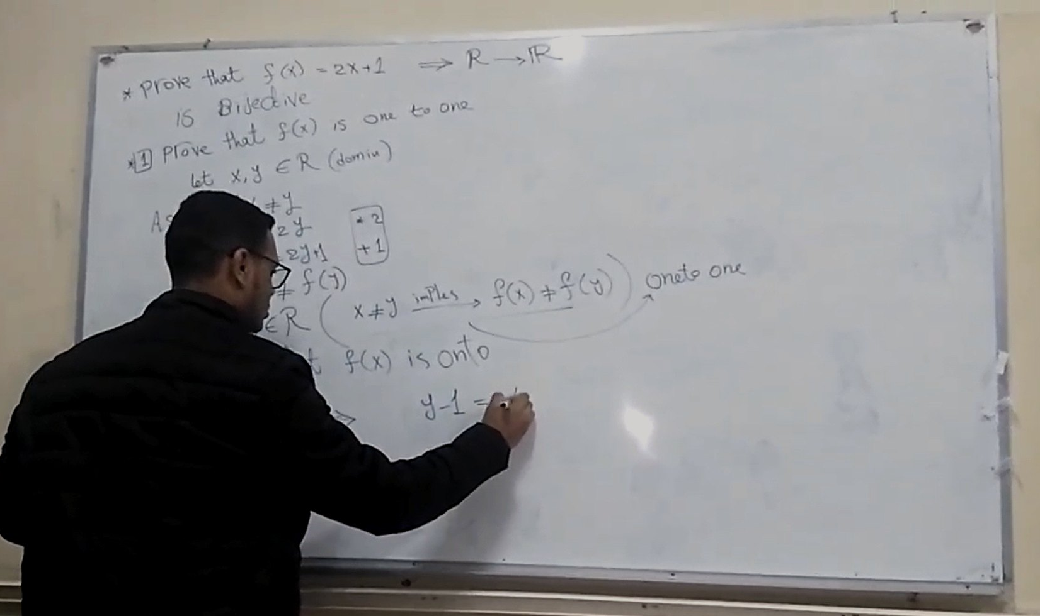
EINSTEIN MISR · SINCE 2020
Arabic lessons
in algorithms,
discrete maths
and probability.
2000
2019
2023
2025
2026
Notes:
10 · Einstein Misr
Film 42–45 s. Teaching since 2020 on his channel, Einstein Misr.

Slide 11
10,000+
700K+
LEARNERS
YOUTUBE VIEWS
2000
2019
2023
2025
2026
Notes:
11 · 10,000+ learners
Film 45–48 s. 10,000+ learners and 700K+ YouTube views.

Slide 12
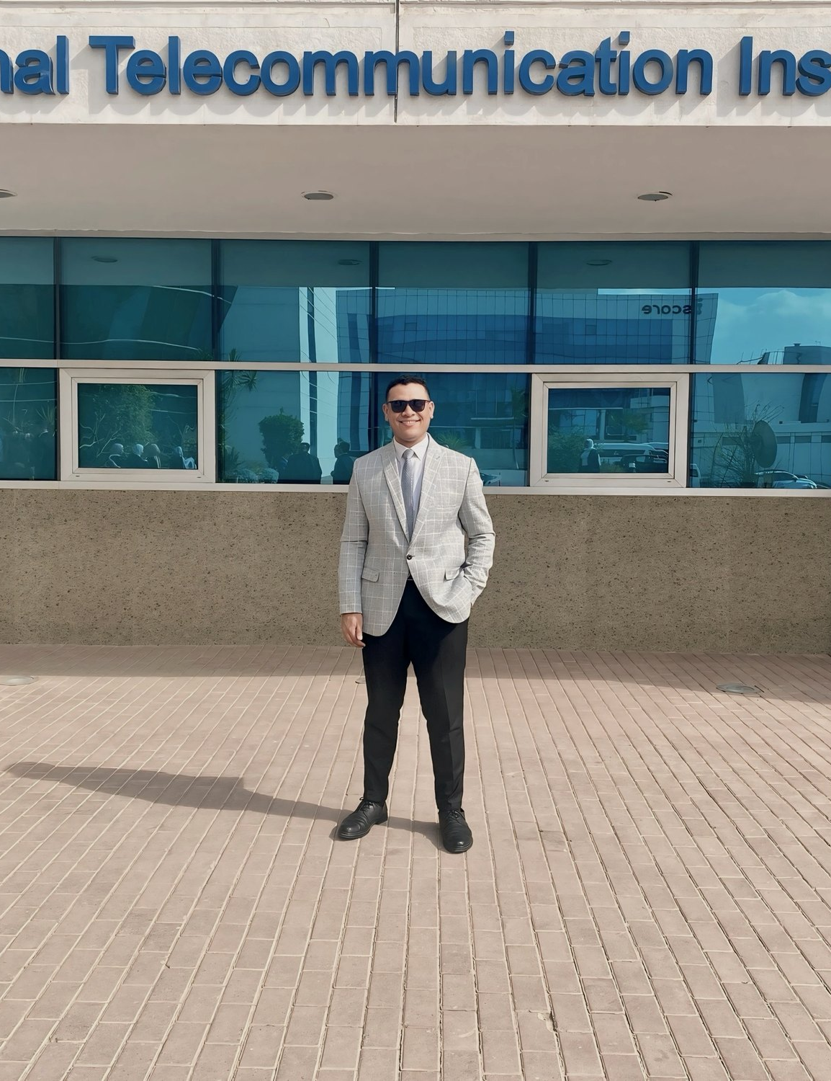
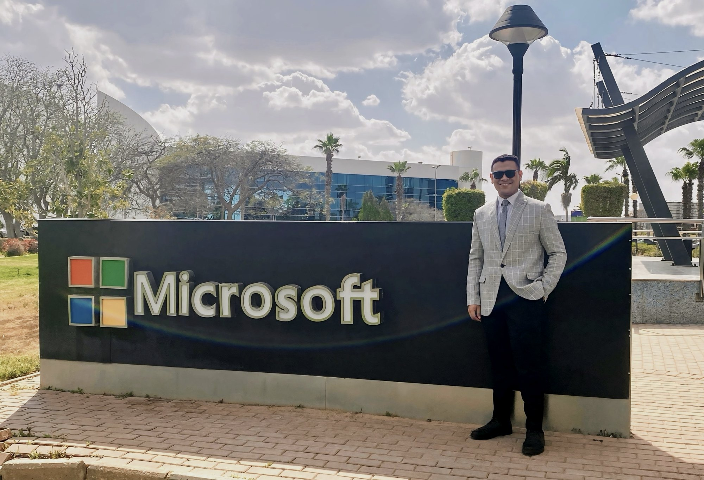
NATIONAL TELECOMMUNICATION
INSTITUTE
From trainee
to machine-learning
instructor.
300+ hours · 100+ students
2000
2019
2023
2025
2026
Notes:
12 · From trainee to instructor
Film 48–51 s. Trained at NTI (photo at Microsoft, Smart Village), later its machine-learning instructor.

Slide 13
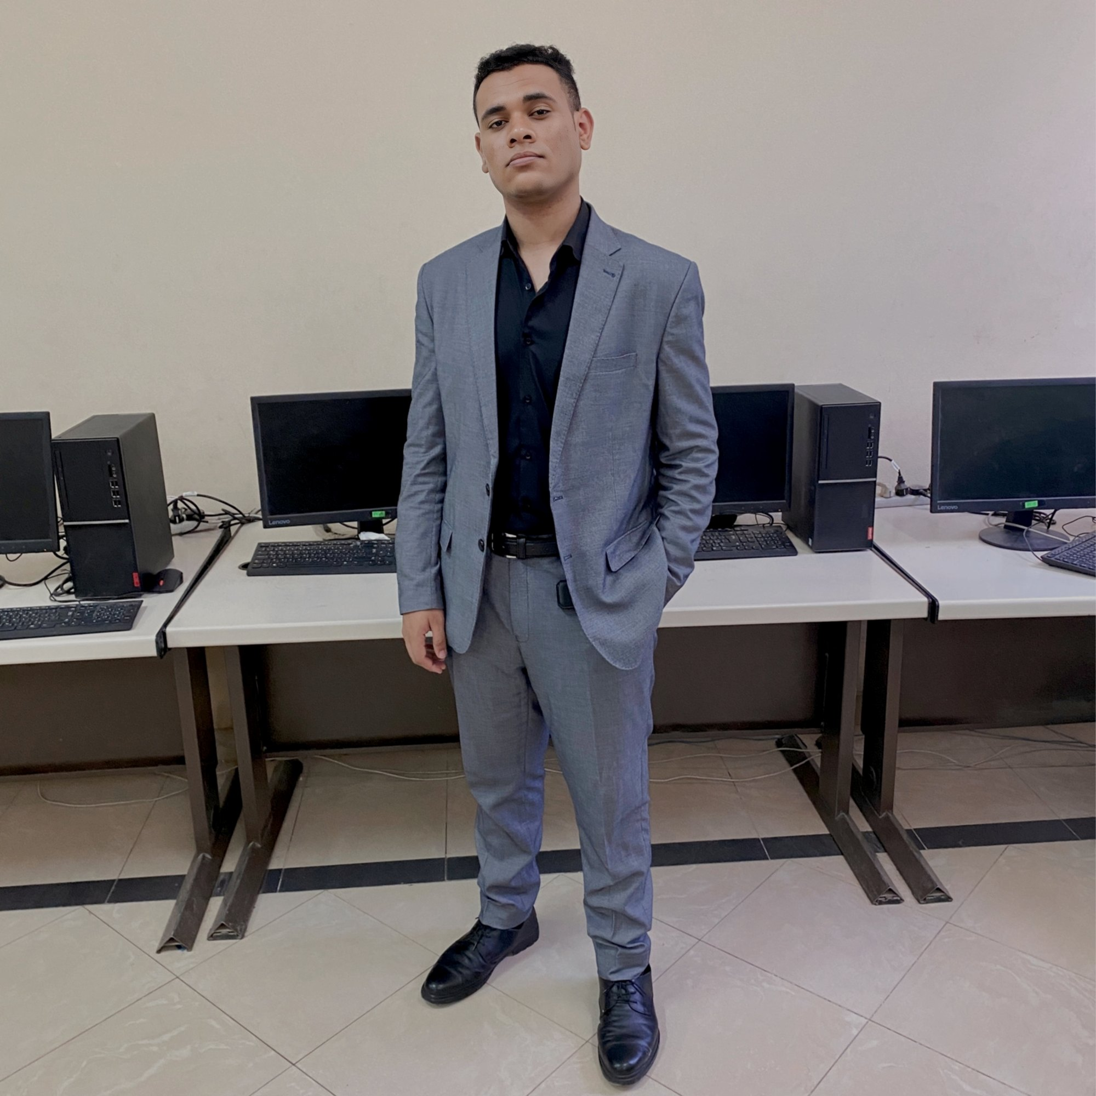
He builds
intelligent systems.
2000
2019
2023
2025
2026
Notes:
13 · He builds
Film 51–54 s.

Slide 14
AUDIOSHIELD
SIMCLR-VISION-SSL
SCRAP
HORUS-OSINT
HORUS SENTINEL
RL-CLOUD-AUTOSCALER
LLMs · Agents · Computer Vision · Reinforcement Learning
2000
2019
2023
2025
2026
Notes:
14 · Intelligent systems
Film 54–60 s. A network whose outputs are his projects. A hard cut follows, on the climax downbeat.

Slide 15


KINGSTON, ONTARIO
SEPTEMBER 2025
From Egypt to Canada.
Notes:
15 · From Egypt to Canada
Film 60–66 s. September 2025: the arc from Assiut to Kingston, Ontario.

Slide 16
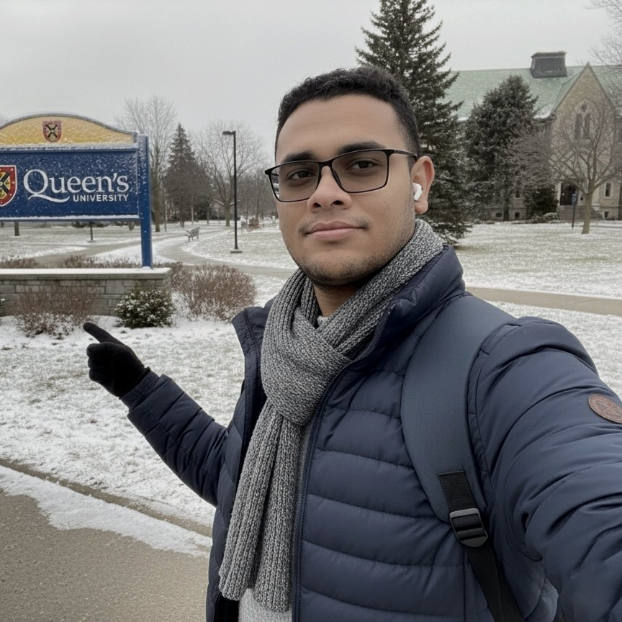

Queen’s University
MSc in Artificial Intelligence
DIGILIANS PRESIDENTIAL SCHOLARSHIP
Notes:
16 · Queen’s University
Film 66–69 s. MSc in Artificial Intelligence, Digilians Presidential Scholarship.

Slide 17
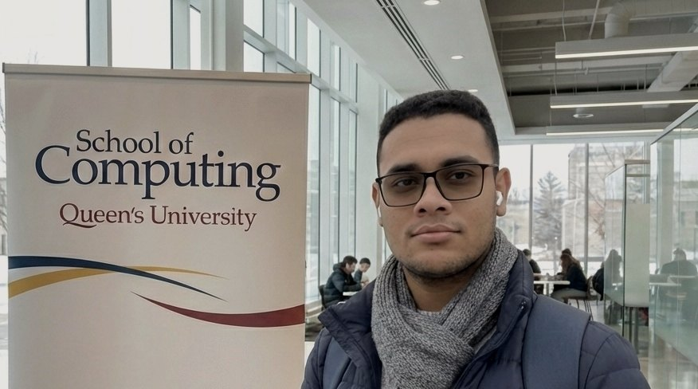
MSC RESEARCH PROJECT · 2026
MinimalLM
Can a language model say less
and lose nothing a reader needs?
Notes:
17 · MinimalLM
Film 69–72 s. His MSc research project, at the School of Computing.

Slide 18
STOP
Kingston
is
in
Ontario
,
Canada
.
In
summary
,
as
mentioned
,
Kingston
is
located
in
Ontario
.
Training-free. Measured for meaning, latency and energy.
He led a four-student team.
Notes:
18 · Say less
Film 72–75.3 s. An illustrative answer stops early at a STOP gate; the redundant tail falls away. Not a reported result.

Slide 19
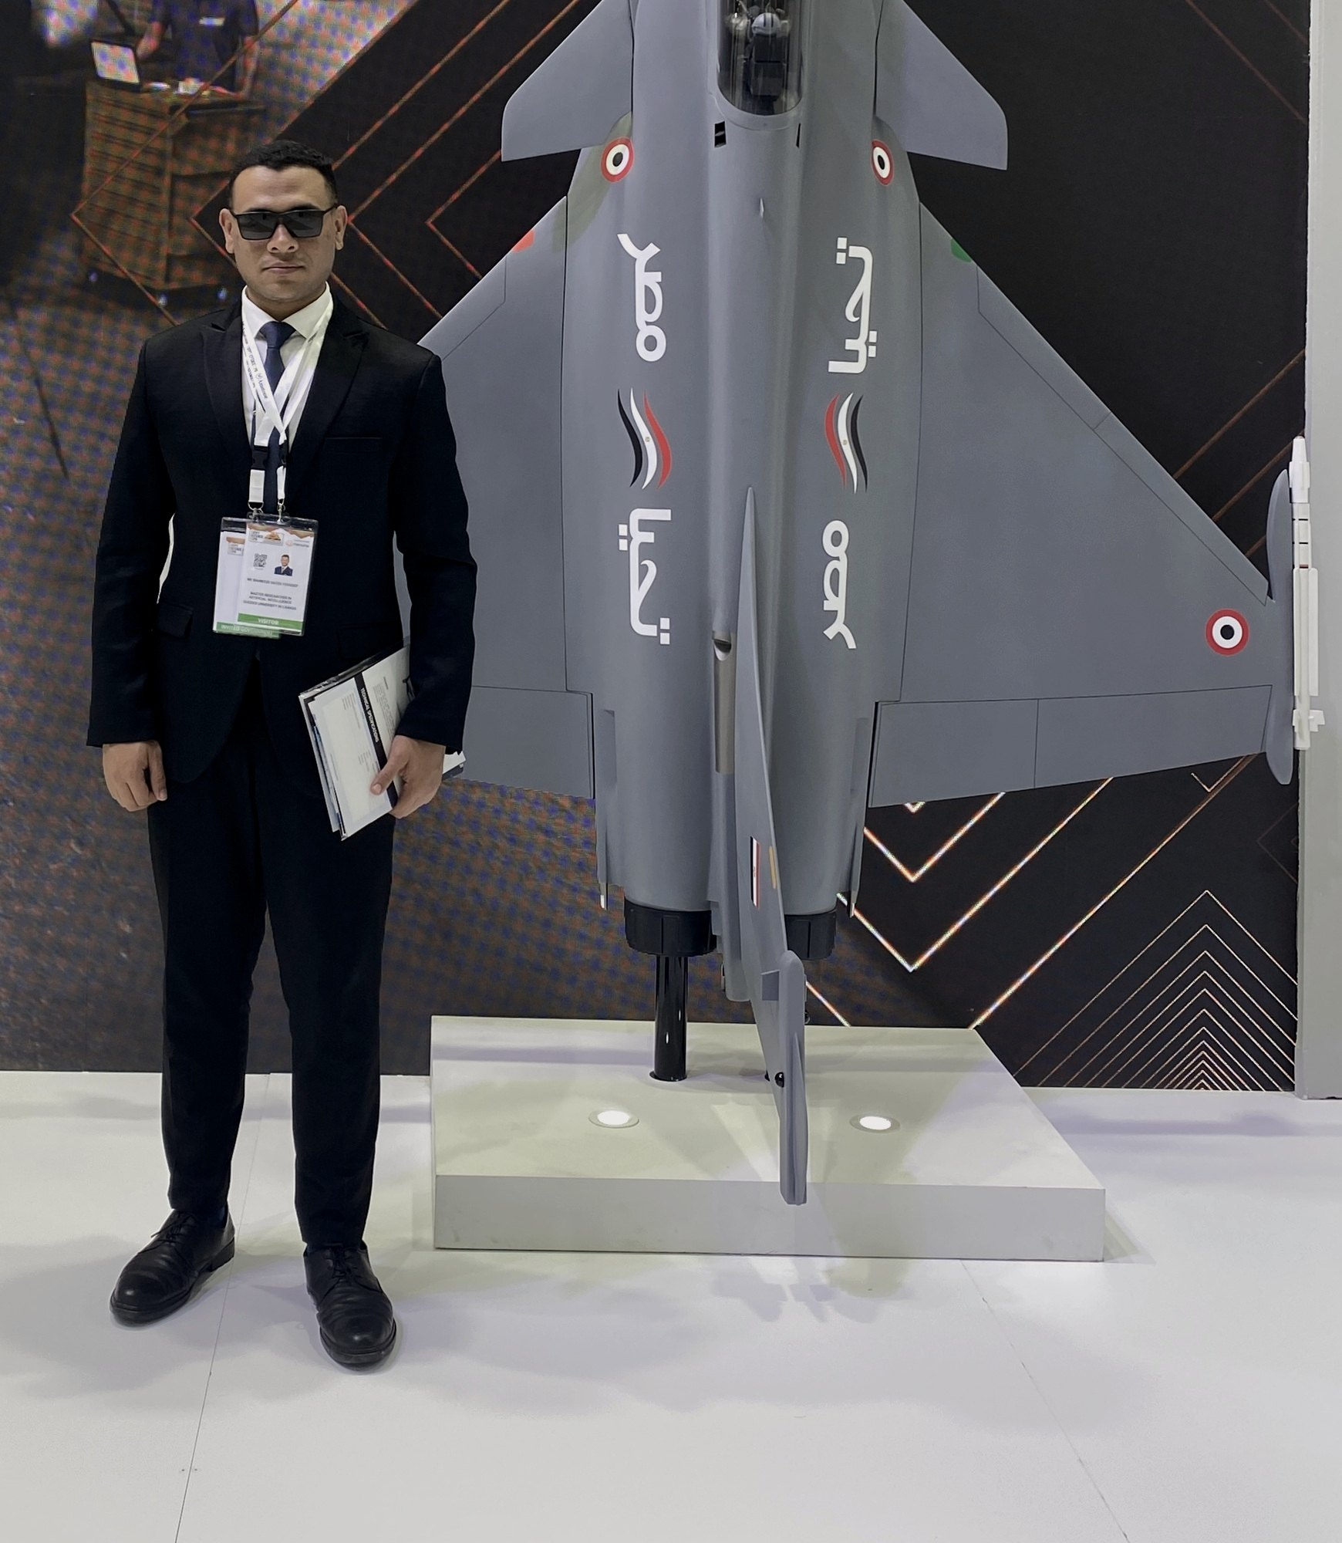
“As for the future,
your task is not to foresee it,
but to enable it.”
— ANTOINE DE SAINT-EXUPÉRY
Notes:
19 · Enable the future
Film 75.3–78 s. Antoine de Saint-Exupéry, Citadelle. The place of the photo is never named.

Slide 20
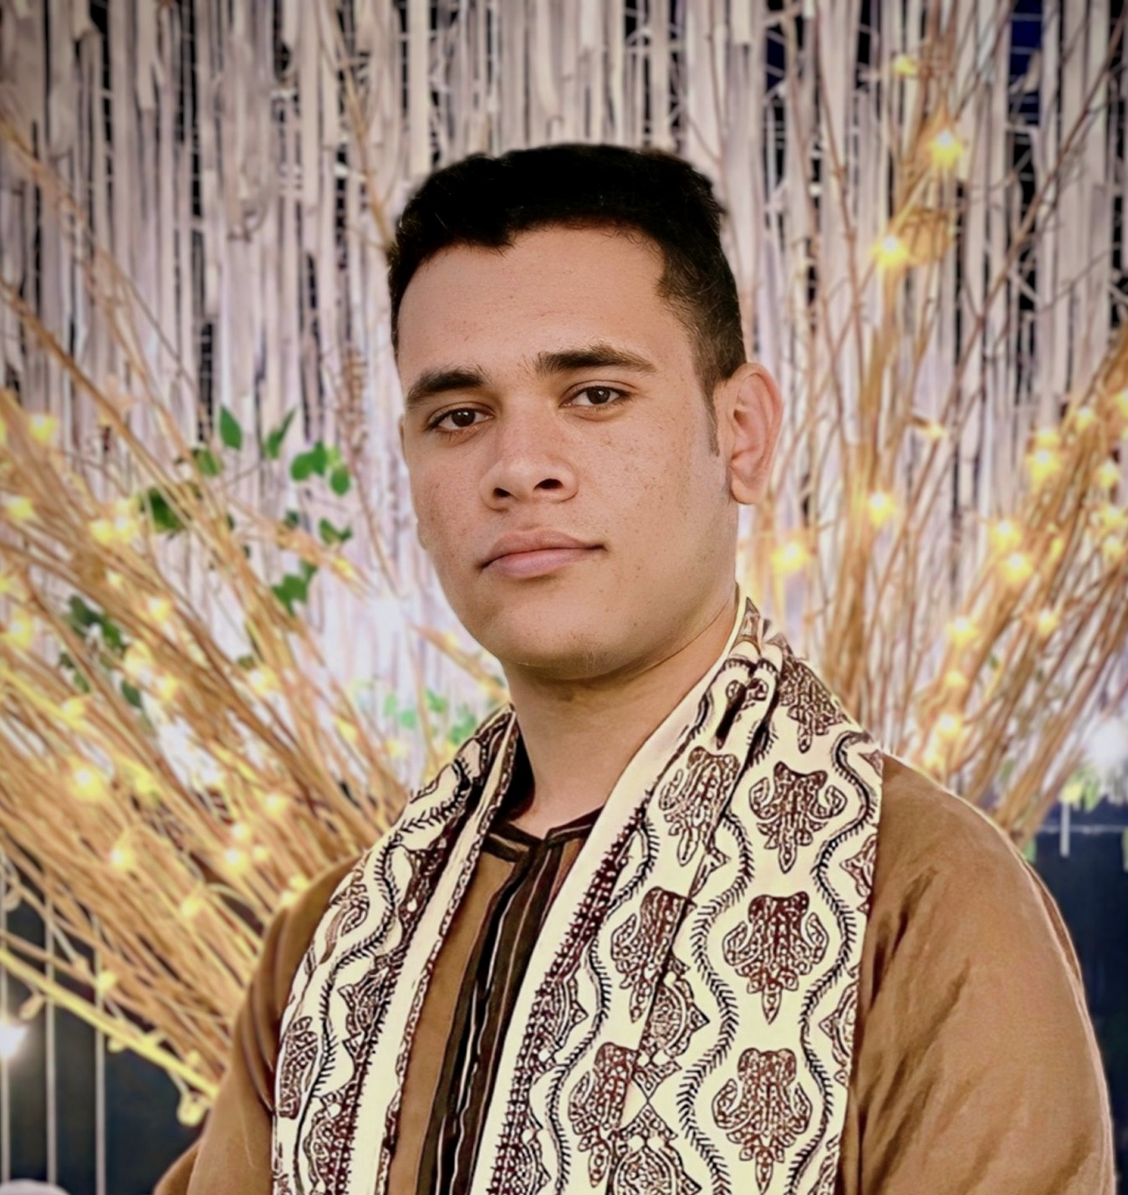
He learns.
He builds.
He teaches.
Notes:
20 · He learns. He builds. He teaches.
Film 78–81 s. In traditional dress under gold lights; the photo gives way to the portrait in the same place.

Slide 21
Let’s give intelligence
a purpose.
Notes:
21 · A purpose
Film 81–84 s. The portrait returns, exactly where it first appeared.

Slide 22

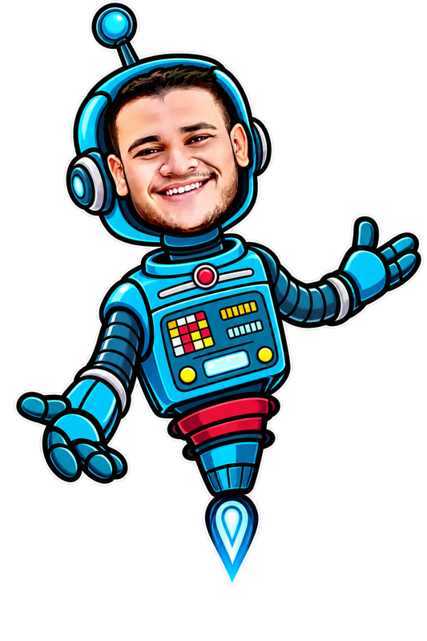
mahmoudalyosifysite.github.io
mahmoud.alyosify@gmail.com
linkedin.com/in/mahmoudalyosify
Ask Mahmoud AI on the site.
Notes:
22 · Mahmoud Alyosify
Film 84–90 s. The end card; the signature writes itself behind him.

Slide 23
Notes:
W1 · The Mark
Website cut 0–6 s (also the scroll prologue on the site).

Slide 24
AI ENGINEER · RESEARCHER · EDUCATOR
also known as Mahmoud Sayed Youssef
Notes:
W2 · Mahmoud Alyosify
Website cut 6–12 s.

Slide 25
He learns.
He builds.
He teaches.
Notes:
W3 · He learns. He builds. He teaches.
Website cut 12–18 s. Centred on black, slower than in the film.

Slide 26
Let’s give intelligence
a purpose.
Notes:
W4 · A purpose
Website cut 18–21 s.

Slide 27
mahmoudalyosifysite.github.io
mahmoud.alyosify@gmail.com
linkedin.com/in/mahmoudalyosify
Notes:
W5 · Mahmoud Alyosify
Website cut 21–30 s. The end card, slower, without the mascot line.

