Slide 1
Cross-Silo Federated Learning
for Privacy-Preserving Medical Image Classification
Training a skin-lesion classifier across 6 hospitals — without ever sharing patient images
Mahmoud Asadi Heris · Bachelor Creative Technologies & AI (Howest) · Innovation & Research Project
Notes:
Opening: hospitals hold the data needed for good diagnostic AI, but can't share patient images. This project builds a federated system so six hospitals train one model together without sharing images, and rigorously measures the trade-offs between accuracy, privacy, security and cost.

Slide 2
The problem & the research question
Valuable medical data is locked inside institutions by law and ethics
Hospitals hold exactly the data needed to train good diagnostic AI.
Privacy law + ethics mean patient images usually cannot leave the building.
So how do several hospitals train one strong model together — sharing no raw data?
Research question
How can cross-silo Federated Learning be engineered to train clinically relevant image-classification models without sharing raw data — while quantifying the trade-offs between performance, data heterogeneity, and privacy?
Federated Learning: each hospital trains locally and sends only model updates (numbers) to a coordinator that averages them. The images never move.
Benchmark: Fed-ISIC2019 (FLamby) — ~23,000 dermoscopy images, 8 diagnoses, 6 hospitals.
Metric: balanced accuracy (all 8 classes count equally; random = 0.125).
Notes:
Frame the real-world stakes: this is the GDPR/clinical-AI tension. FL is the answer, and the contribution is measuring the trade-offs, not just building it. Note balanced accuracy is the strict, honest metric.

Slide 3
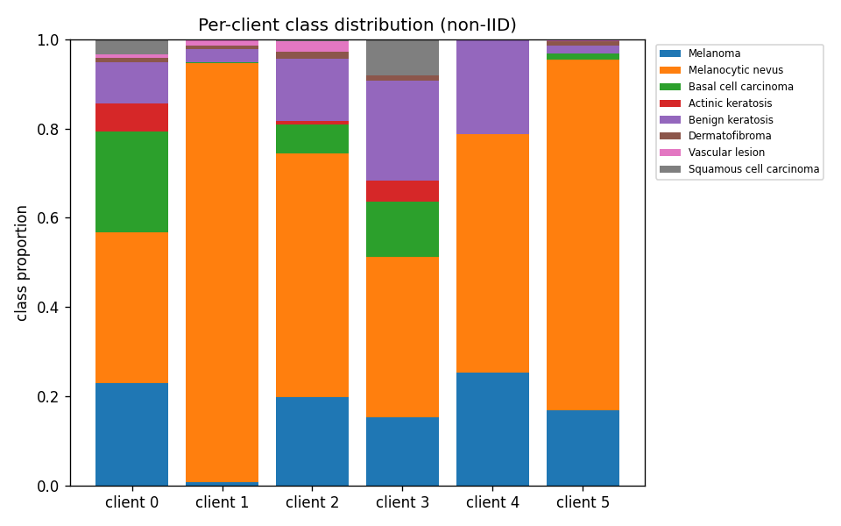
The data is highly uneven across hospitals (non-IID)
This unevenness is exactly what makes federated learning hard
6 hospitals, sizes from 7,947 down to 281 images.
Some hospitals are missing whole disease classes.
Each bar (right) is one hospital; colours are the 8 diagnoses — the mixes clearly differ.
We quantified this: label entropy, missing-class counts, and Jensen–Shannon distance from the global mix.
If every hospital looked the same, averaging their models would be trivial. Because they don't, naive averaging can wobble — motivating every method that follows.
Notes:
Sub-question 1. Explain non-IID plainly: different patient populations and imaging devices per hospital. This is the core difficulty and the reason for FedProx/SCAFFOLD etc.

Slide 4
Approach: one fair pipeline, rigorously validated
Everything held constant except the method — so differences are real
Fair-comparison protocol
One identical training loop for every strategy; only a small 'hook' differs. Same data splits, model, and compute budget.
Reproducibility
Config tiers (smoke/dev/full), global seeding, per-run manifest (git commit + hardware), ≥3 seeds for headline numbers.
Independent verification
A torch-free suite of 20 checks proves the maths (aggregation, privacy accountant, robust aggregators) without a GPU.
From simulation to hardware
Same engine runs in a fast simulation and as a real networked system on a laptop + Raspberry Pi.
Notes:
This slide answers 'how do I trust your numbers'. Emphasise the structural fairness (only the method changes) and the torch-free proof suite — correctness is an acceptance test, not an afterthought.

Slide 5
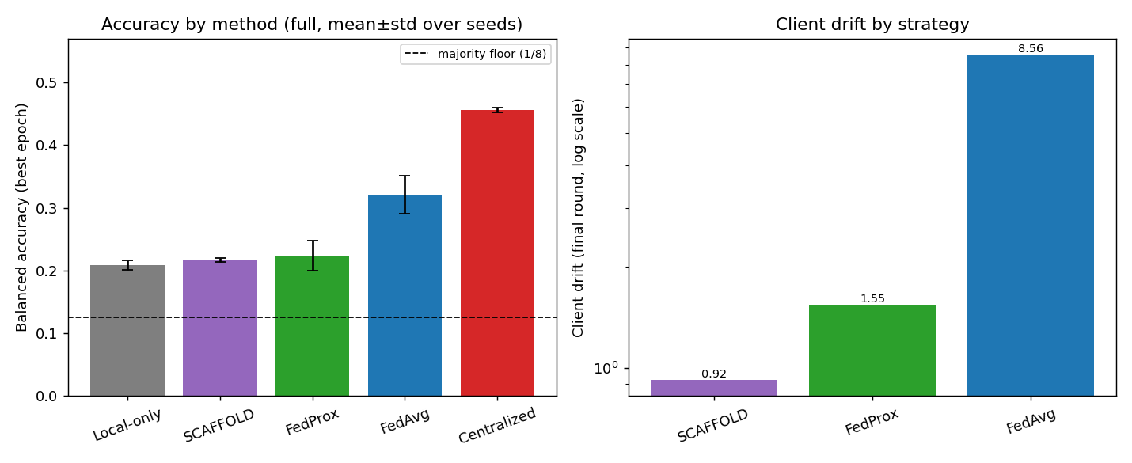
Does federation work? Yes — the core result
FedAvg sits between training alone and pooling all data — with no data shared
0.32
0.46
0.21
FedAvg (federated)
Centralized (pooled)
Local-only (alone)
FedAvg recovers ~45% of the gap between training alone and pooling everything.
Bought without any raw image leaving a hospital (answers Q2).
Client drift is textbook: FedAvg 8.6 ≫ FedProx 1.6 ≫ SCAFFOLD 0.9.
Notes:
Headline. The 'sandwich' (local < FL < centralized) is the value proposition demonstrated. Random is 0.125, so 0.32 is well above chance. Drift ordering matches theory (Q3, Q4).

Slide 6
An honest finding: drift control ≠ accuracy
The fancier methods reduce client drift 5–9× exactly as theory predicts — but on this data that did NOT translate into higher accuracy.
FedProx
SCAFFOLD
FedAdam
FedAvg
0.224
0.217
—
0.320
proximal term
control variates
adaptive server (unstable)
the strong baseline
We report this straight: on Fed-ISIC2019, well-tuned FedAvg wins. FedProx/SCAFFOLD deliver stability, not accuracy; FedAdam was too tuning-sensitive to converge. Honesty over hype.
Notes:
This negative result is a strength — it shows you tested critically rather than assuming the newest method wins. Examiners reward this. FedAdam: server_lr too high exploded; conservative regime over-diverged.

Slide 7
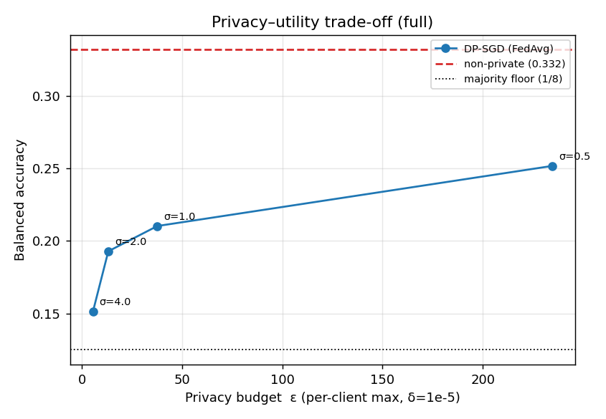
Privacy 1 — a mathematical guarantee (Differential Privacy)
A knob, ε, sets the strength: smaller ε = more privacy = lower accuracy
DP adds calibrated noise so no single patient noticeably changes the model.
We built our OWN privacy accountant (pure Python) to verify ε — not trusting the library blindly.
The curve makes the price explicit: ε≈38 keeps 0.21; very strong privacy (ε≈5) drops to 0.15.
Turns 'we added noise' into a quantified promise a decision-maker can dial.
Notes:
Sub-questions 5–6. Define ε in one line. Stress the independent accountant — that's rigour. δ=1e-5 < 1/N per client.

Slide 8
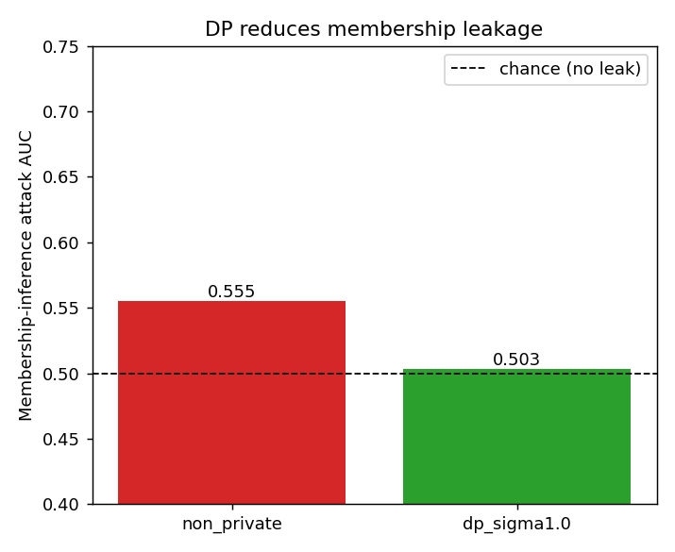
Privacy 2 — proving it works: a membership-inference attack
We didn't just claim privacy — we attacked the model
0.55
0.50
attack AUC — no privacy (leaks)
attack AUC — with DP (= chance)
The attack guesses whether a specific patient was in the training data.
0.5 means the attacker learns nothing; above 0.5 means leakage.
DP measurably shuts the attack down — empirical proof, not a promise.
Notes:
Sub-question 7. Attack-and-defend is how security is demonstrated. The effect is modest because the model is a mild regulariser, but the direction and reduction are clear.

Slide 9
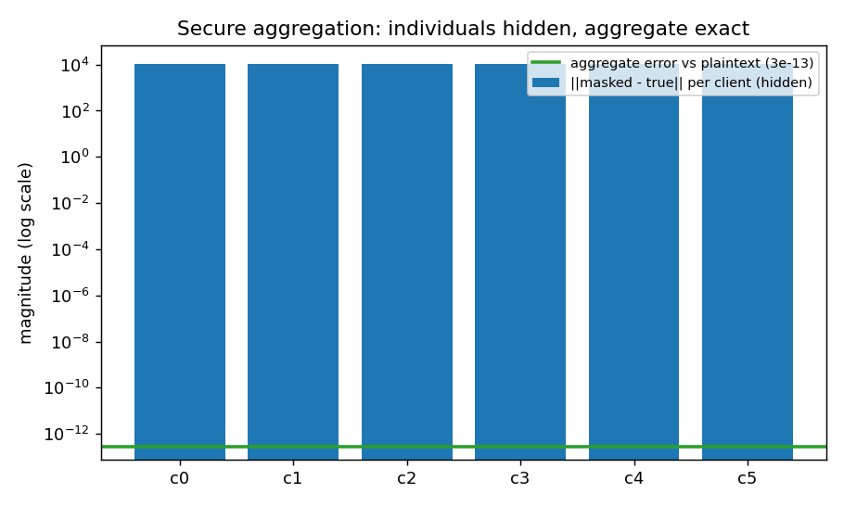
Privacy 3 — hiding each hospital's update (Secure Aggregation)
The coordinator learns the sum, never any single contribution
Different threat from DP: this hides each hospital's individual update from the server.
Hospitals add pairwise secret masks that cancel out when summed.
Verified exact: the recovered average matches plaintext to ~13 decimal places (error ≈ 3×10⁻¹³).
Closes the 'curious server' risk: the coordinator gets the average it needs, but can't inspect any hospital.
Notes:
Bonawitz 2017 pairwise masks. Emphasise it's verified numerically. Together with DP + MIA this is the full confidentiality story.

Slide 10
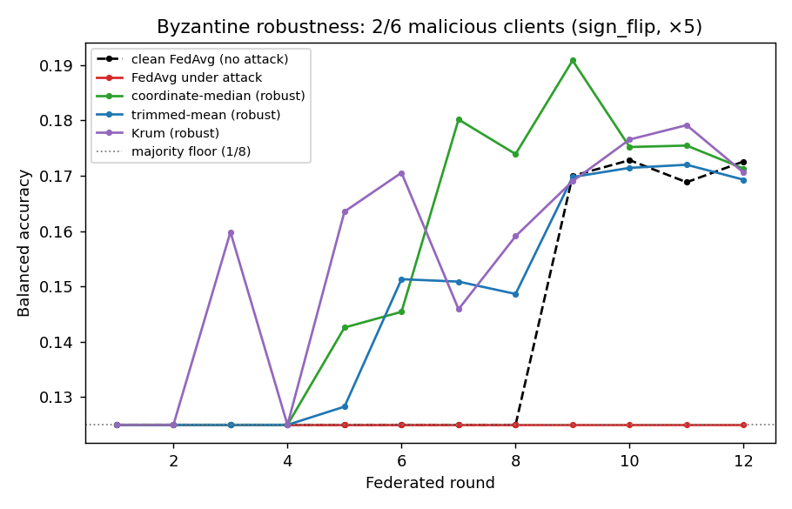
Security — what if a hospital is malicious? (Poisoning & defense)
BONUS: the integrity side of security — attack and defend
2 of 6 hospitals send poisoned updates to sabotage the model.
Plain FedAvg (a mean) has no defence — it collapses to random (0.125).
Robust aggregators — median, trimmed-mean, Krum — bound each client's influence and recover (~0.18–0.19).
0.125
0.19
FedAvg under attack (random)
robust aggregation (defended)
Notes:
New dimension. Confidentiality (DP/MIA/secure-agg) is only half of security; this adds integrity. Krum: pick the update most consistent with the honest majority. Verified in the torch-free suite.

Slide 11
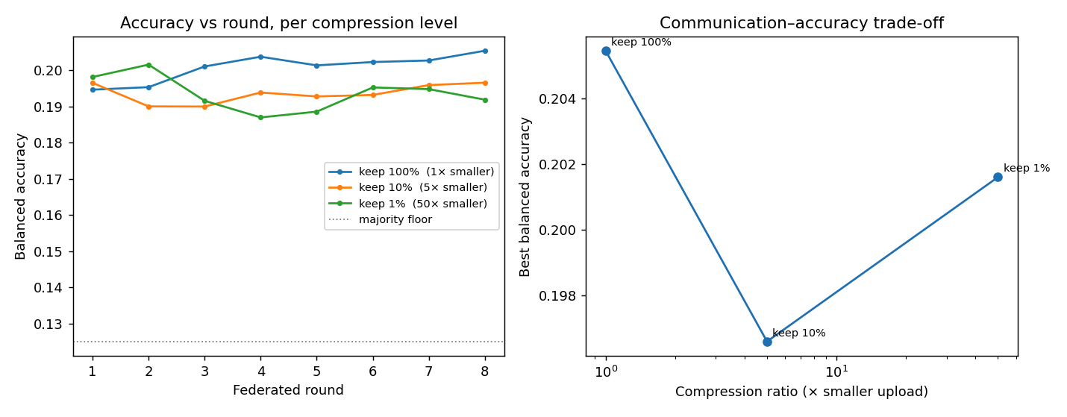
Efficiency — cutting network cost 50× (communication)
BONUS: FL's real bottleneck is bandwidth, acute for edge devices
50×
≈0
smaller uploads
accuracy lost
Send only each hospital's largest 1% of update values (layer-wise top-k), skip the rest.
44.7 MB → 0.89 MB per round, with accuracy essentially unchanged (0.202 vs 0.205).
Pairs with the Raspberry Pi: the slowest, weakest device gains the most from sending less.
Notes:
New. Practicality dimension. Warm-started + layer-wise top-k so the classifier head isn't starved. Directly supports the edge/Pi story on the next slide.

Slide 12
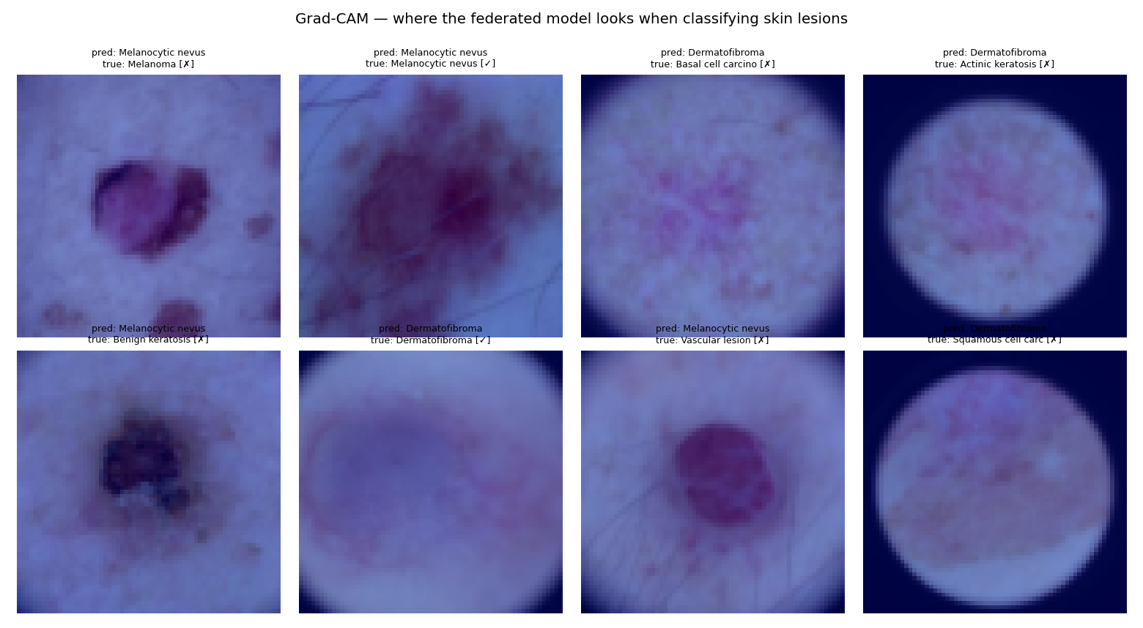
Trust — looking inside the model (Explainability)
BONUS: an honest limitation, surfaced deliberately
Grad-CAM highlights the image regions that drove each decision.
On our compute-limited model, attention is diffuse and sometimes lands on image borders/artifacts, not the lesion.
This is a documented 'shortcut' in dermoscopy AI — and catching it is exactly why explainability belongs in the pipeline.
Reported openly: a production model would need stronger, artifact-free attention before clinical use.
Notes:
Own this as a limitation, not a failure. The responsible-AI point is running the check and being honest about what it revealed.

Slide 13
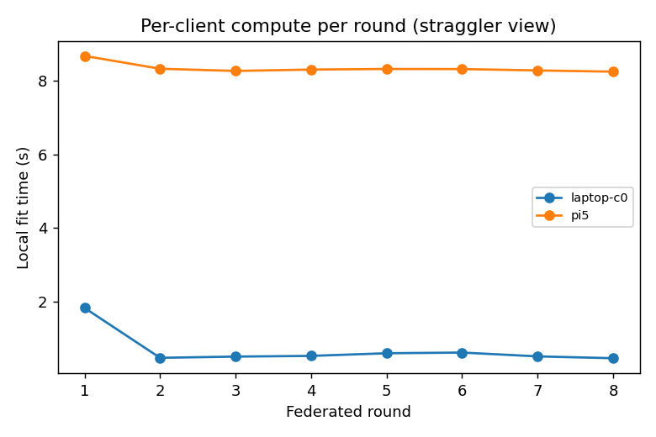
Real hardware: from simulation to a Raspberry Pi
BONUS: genuinely distributed FL — a laptop coordinator + a Raspberry Pi 5 as a real 'edge hospital'
Only model weights crossed the network — the Pi's images never left it.
It exposes the straggler problem: the Pi is ~17× slower per round, and synchronous FedAvg waits for it.
A real systems insight a single-machine simulation cannot show — and why the 50× compression matters.
17×
An ≈€80 device meaningfully joins training — with no data leaving it.
slower on the Pi
Notes:
The credibility upgrade: it's not just a simulation. Describe the setup (Flower/gRPC over the LAN). The straggler is the headline systems finding.

Slide 14
Validation, rigour & honesty
Correctness treated as an acceptance requirement, not an afterthought
20 / 20
torch-free maths checks (aggregation, SCAFFOLD, privacy accountant, secure-agg, robust aggregators)
≥ 3 seeds
for every headline number, reported as mean ± std
Manifests
every run records git commit, tier, and hardware — fully reproducible
Honest negatives
FedAdam and the Grad-CAM limitation reported straight, not hidden
Notes:
Pre-empt the 'how do I trust this' question. The torch-free suite is the standout — it proves the science independent of the GPU stack.

Slide 15
Conclusion — when is FL preferable?
When data cannot leave an institution, FL beats both training alone and slow, risky data-sharing agreements — it recovered ~45% of the centralized-vs-isolated gap with no raw data leaving a hospital.
Privacy is layered and verified: differential privacy (with a self-built accountant), a defeated membership attack, and secure aggregation.
Security covers both sides: confidentiality and integrity (robust aggregation defeats a poisoning attack).
Practical & real: 50× cheaper communication, demonstrated live on a Raspberry Pi.
Future work: EfficientNet backbone for higher accuracy, client-level DP, full-tier robustness runs, artifact-free explainability.
Notes:
Answer Q8 directly, then recap the four pillars (works / private / secure / practical) and end on credible future work.

Slide 16
Thank you
Questions welcome — dashboard, technical report, and code are ready to explore.
github.com/MahmoudAsadi97/cross-silo-fl-medical-image-classification
Notes:
Offer the live dashboard walkthrough and, if possible, the Pi demo. Have docs/design.md and the speaker notes handy.

