Slide 1
Robotics & Edge AI
Introduction to Robotics & ROS 2
Arne Bauwens arne.bauwens@howest.be

Slide 2
Table of content
Introduction robotics
What is ROS?
Setting up: WSL, VS Code and ROS 2 Jazzy
First steps: prebuilt nodes, CLI and rqt
Workspaces and packages
Writing our own nodes

Slide 3
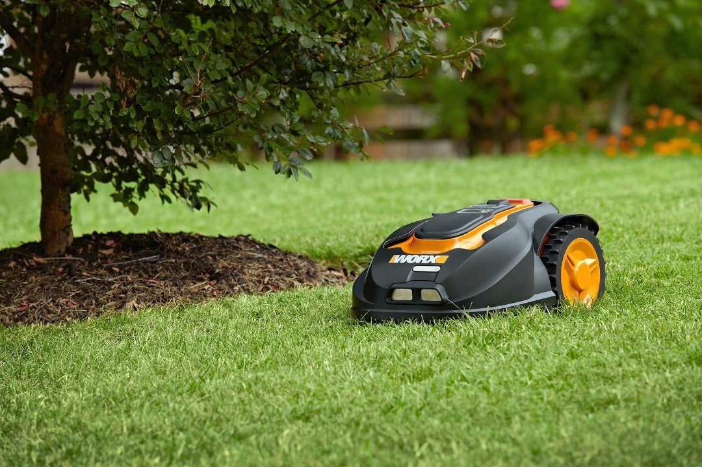
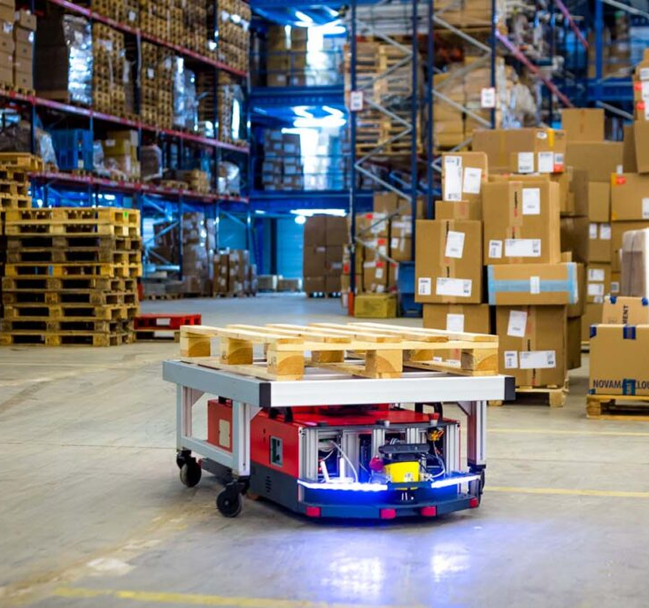
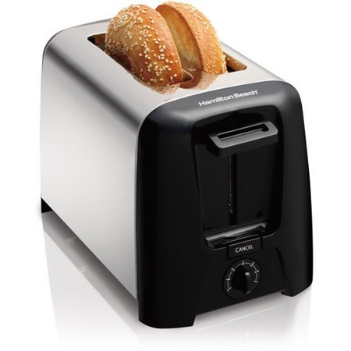
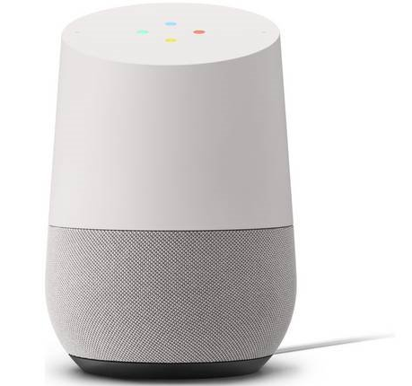
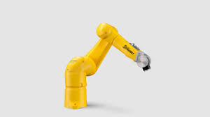
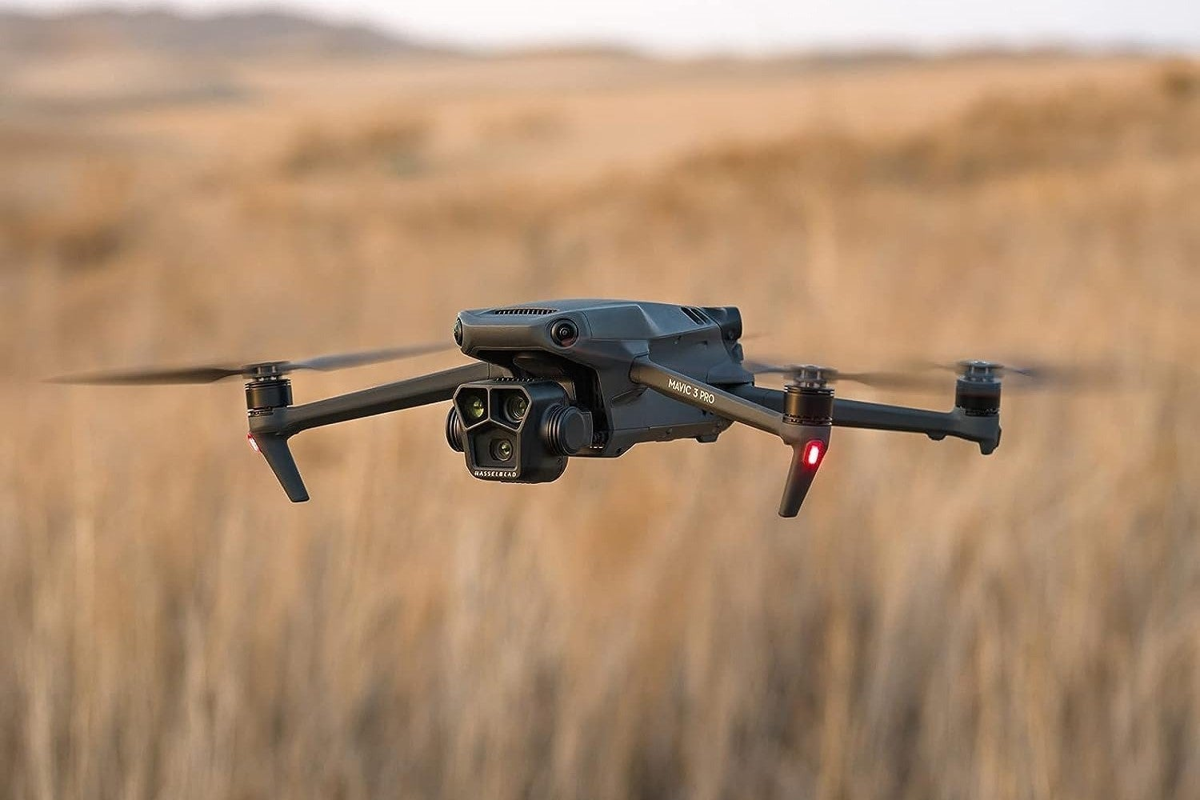
What is a robot?
Oxford: a machine capable of carrying out a complex series of actions automatically, especially one programmable by a computer.
So, what is a robot?

Slide 4
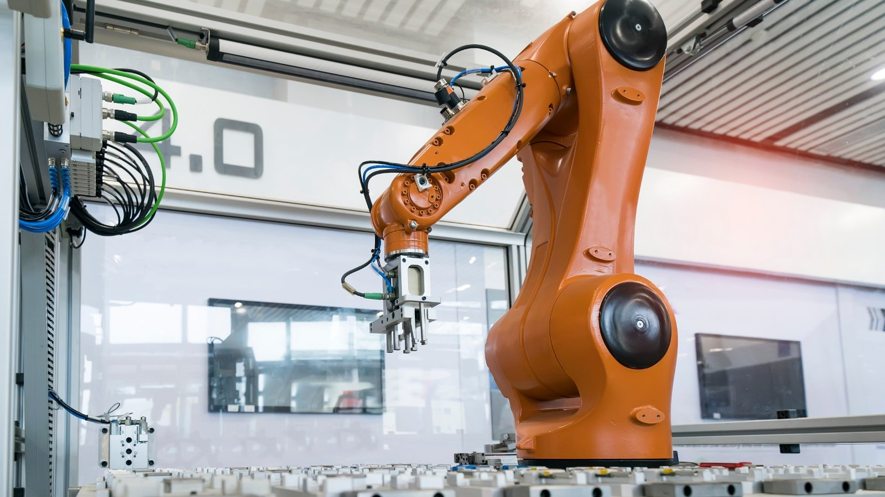
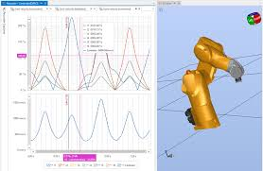
Industrial robots
Automation
  Manufacturing
  Welding
  Painting
  Pick-and-place
  Packaging and palletizing
  Quality inspection

Slide 5
Industrial robots
Advantages
  Higher speed
  Higher precision
  Safer
    Robot can deal with dangerous tasks
  Cheaper over time
    High initial investment but better than humans
    24/7 running, faster assemblies, ...

Slide 6


Industrial robots cost
Total cost is about 1/3 purchase
About 2/3 in maintenance during product lifetime
Mass production = Lower cost
Industrial applications have lower quantities
Industrial customers can pay a premium
Thus industrial robots are expensive

Slide 7
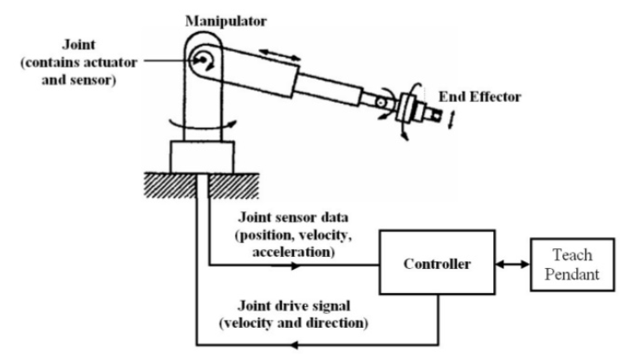
Terminology
Manipulator
  Mechanical elements to position the end effector or manipulate the end effector position
End effector
  Gripper or tooling
Controller
  Controls the motion of the joints in the manipulator and processing of IO
Teach pendant
  User interface for operator

Slide 8
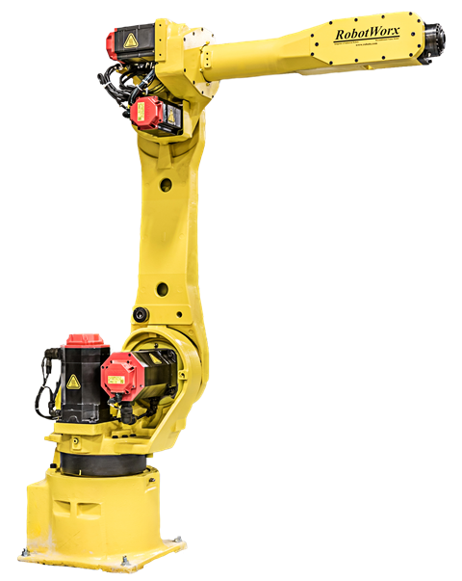
Manipulator
Mechanical arm construction of the robot system
Move end effector + payload
  Position and attitude (orientation)
Consists of LINKS + JOINTS
→ configuration of the manipulator
Actuators = drive chain
Sensors → position feedback to the controller

Slide 9
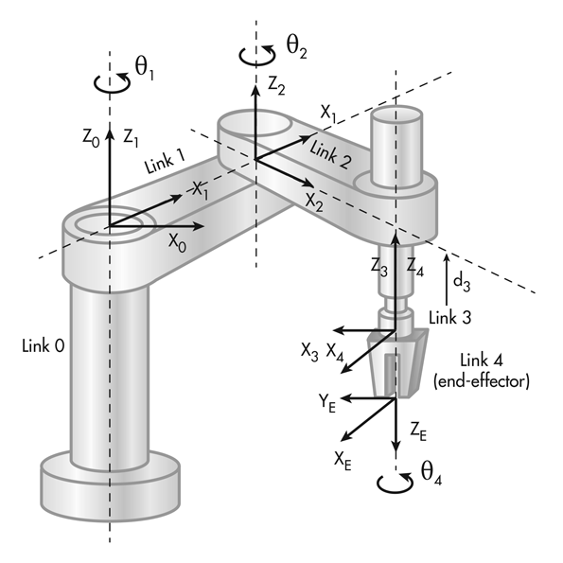
Manipulator
LINK = fixed mechanical components of the manipulator
  Link 0 = manipulator base → can’t move, is the anchor for the kinematic chain
  Final link = connection for end effector
JOINT = mechanical components between 2 links that allow relative movement between those links (relative movement of the output link to the input link)
  Every joint = 1 DOF (degree of freedom)
The joint count, joint types and how the manipulator is constructed (geometry of the links) → robot configuration

Slide 10
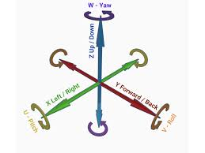
Joint count
DOF: 1 joint = TCP can move in a line or circle, 2 joints = TCP move on a plane (not necessarily flat), 3 joints = TCP move in a volume
Wrist axes (4-6) → determine attitude of the end effector

Slide 11
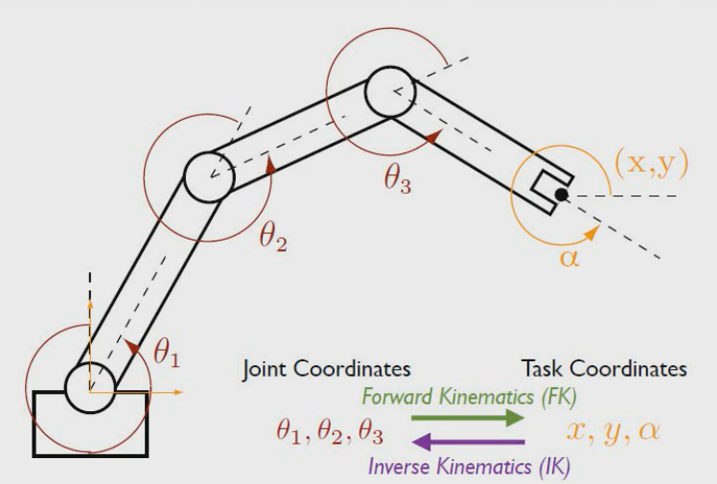
Kinematics
Calculations to convert coordinates between different reference frames (coordinate systems)
2 types: forward and inverse
  Forward: Calculate world position given joint positions
  Inverse: Calculate joint positions give a world position

Slide 12

Joint types
External or redundant axes/joints (7-n)
  Avoid singular or unwanted joint angles
  Expand work volume

Slide 13
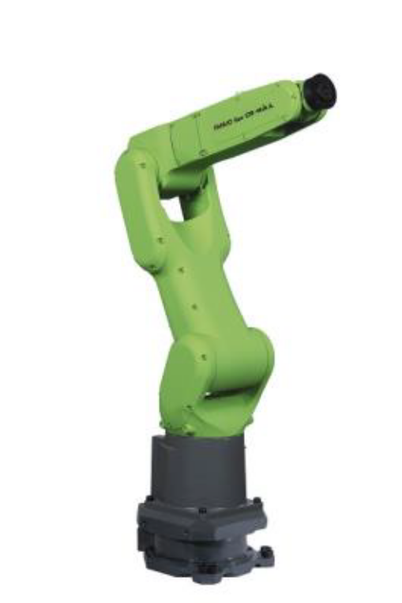
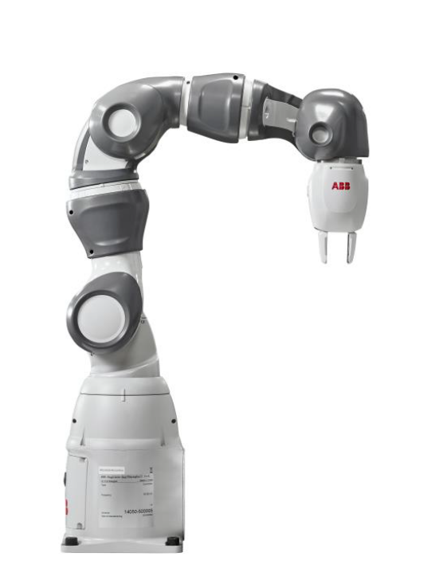
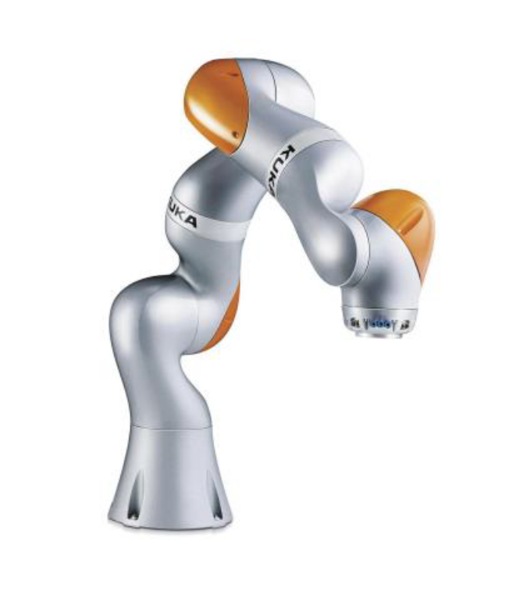
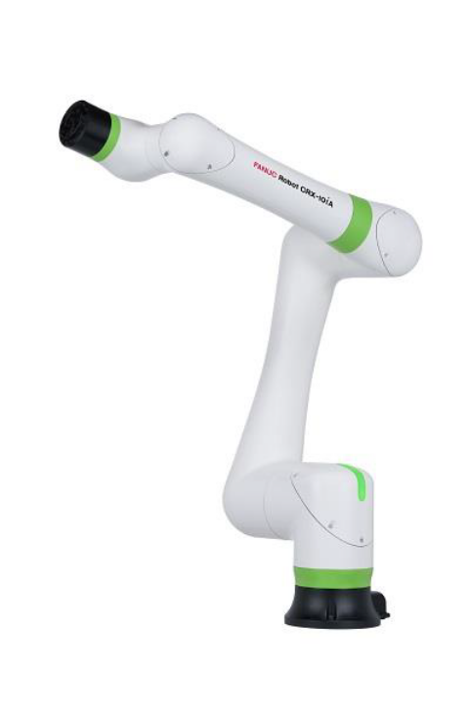
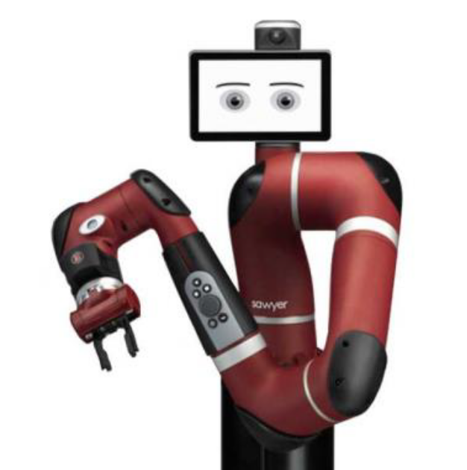
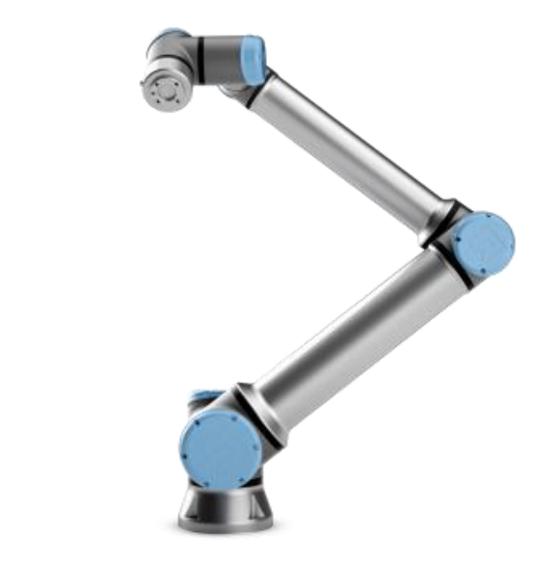
What is a cobot?
Definition:
  “Collaborative industrial robots are complex machines which work hand in hand with human beings. In a shared workspace, they support and relieve the human operator.”
Industrial “cage-free” robot

Slide 14
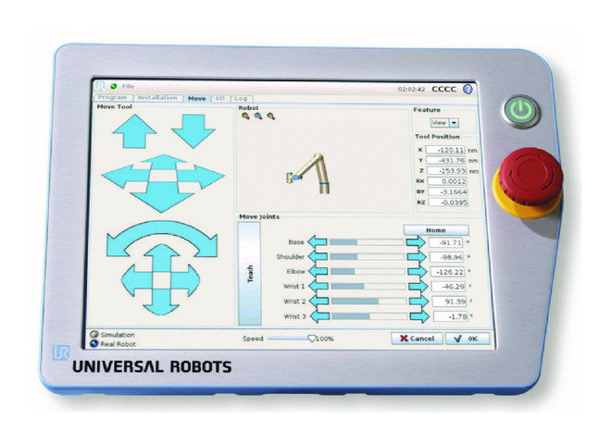
Cobot technical design
Human-friendly control and integration
  Low code/no code programming
  Teaching mode
  User-friendly UI in teach pendant
  Plug-and-play integration with tools, end effectors, safety scanners…
    E.g. onrobot end effectors

Slide 15
Table of content
Introduction robotics
What is ROS?
Setting up: WSL, VS Code and ROS 2 Jazzy
First steps: prebuilt nodes, CLI and rqt
Workspaces and packages
Writing our own nodes

Slide 16

What is ROS?
ROS: Robot Operating System – open-source middleware for robots (not a real operating system)
ROS handles the communication between sensors, actuators, cameras, algorithms, …
A robot running ROS consists of nodes that each do 1 specific thing (control a motor, process laser data, read a camera, …)
Nodes can be publishers or subscribers of a topic (no response)
Nodes can also communicate with services (request + response)

Slide 17
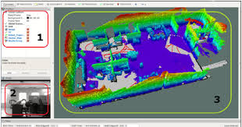
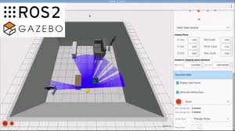
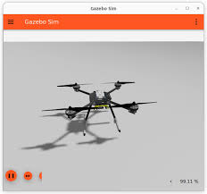
Why use ROS?
Ready-made modules for motor control, mapping, navigation, AI, …
Open source, huge community
Python and C++
Simulators: Gazebo and Webots
Visualization: RViz – shows sensor data (lidar scans, camera images, TF frames) and the robot model

Slide 18
ROS 2 distributions
Every May a new ROS 2 version (a distribution) is released, each built for one Ubuntu version:
Distribution | Released | Ubuntu | Supported until | Type
Humble Hawksbill | May 2022 | 22.04 | May 2027 | LTS
Jazzy Jalisco | May 2024 | 24.04 | May 2029 | LTS ← we use this one
Kilted Kaiju | May 2025 | 24.04 | Nov 2026 | Short-term
Lyrical Luth | May 2026 | 26.04 | May 2031 | LTS
We use Jazzy Jalisco: long-term support (LTS) until 2029, on Ubuntu 24.04
The distro is part of many names: ros-jazzy-desktop, /opt/ros/jazzy, docs.ros.org/en/jazzy/…
Tutorials, forums and robots often use another distro (foxy, humble, …): always check which one!

Slide 19
Table of content
Introduction robotics
What is ROS?
Setting up: WSL, VS Code and ROS 2 Jazzy
First steps: prebuilt nodes, CLI and rqt
Workspaces and packages
Writing our own nodes

Slide 20
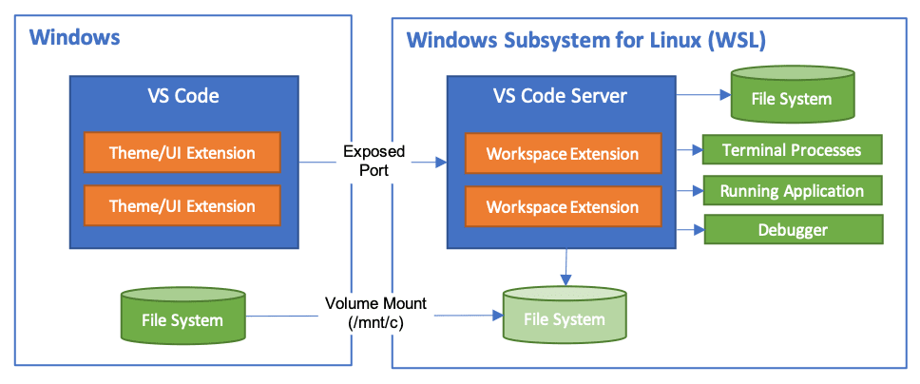
Our setup
WSL 2 (Windows Subsystem for Linux): a real Ubuntu Linux running inside Windows
VS Code runs on Windows, but its terminal, files and extensions run inside Ubuntu
ROS 2 Jazzy is installed in Ubuntu; your code lives in ~/ros2_ws
Later, Webots (on Windows) and the Limo Pro robot (on the network) talk to ROS 2 in WSL
Ubuntu 24.04 on your laptop? Skip the WSL steps.
VS Code (Windows) + VS Code Server and your code (WSL). Source: code.visualstudio.com

Slide 21
Setup in 5 steps
1
2
3
4
5
Install WSL
WSL + Ubuntu 24.04
Networking
Mirrored mode + firewall
VS Code
Connect VS Code to WSL
ROS 2 Jazzy
Install, source and test
Workspace
Create ~/ros2_ws
Steps 1–2: Windows PowerShell (as administrator). Steps 3–5: the VS Code terminal connected to WSL.
Goal: you can set up a ROS 2 computer yourself. Read what each command does instead of only copy-pasting – you will need these skills again on the robot.

Slide 22
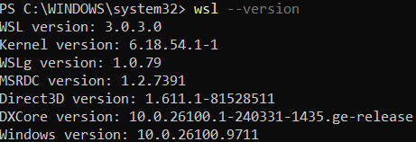
Step 1 – Install WSL
Open PowerShell as administrator (right-click Start → Terminal (Admin)) and run:
# 1. Is WSL installed? Which version?
wsl --version
# 2a. Not installed: install WSL, then restart your PC
wsl --install --no-distribution
# 2b. Already installed: update to the latest version
wsl --update
Example output of wsl --version:
https://learn.microsoft.com/en-us/windows/wsl/install
Error 0x80370102 or “virtualization is not enabled”?
WSL 2 needs hardware virtualization: enable it in the BIOS/UEFI (Intel VT-x / AMD-V / SVM) or ask for help.

Slide 23
Step 1 – Install Ubuntu 24.04
Still in PowerShell: install Ubuntu 24.04 – ROS 2 Jazzy only runs on this Ubuntu version
# Which distributions are available?
wsl --list --online
# Install exactly this version
wsl --install -d Ubuntu-24.04
Why not just “Ubuntu”?
Ubuntu always means the newest release, which is not necessarily 24.04.
Ubuntu asks for a new username and password: remember them! You need the password for every sudo command
  While you type a password, Linux shows nothing on screen – that is normal
Open Ubuntu later via the Start menu or with wsl -d Ubuntu-24.04
Check: wsl -l -v must show Ubuntu-24.04 with VERSION 2
Other distros installed? Make this one the default: wsl --set-default Ubuntu-24.04

Slide 24
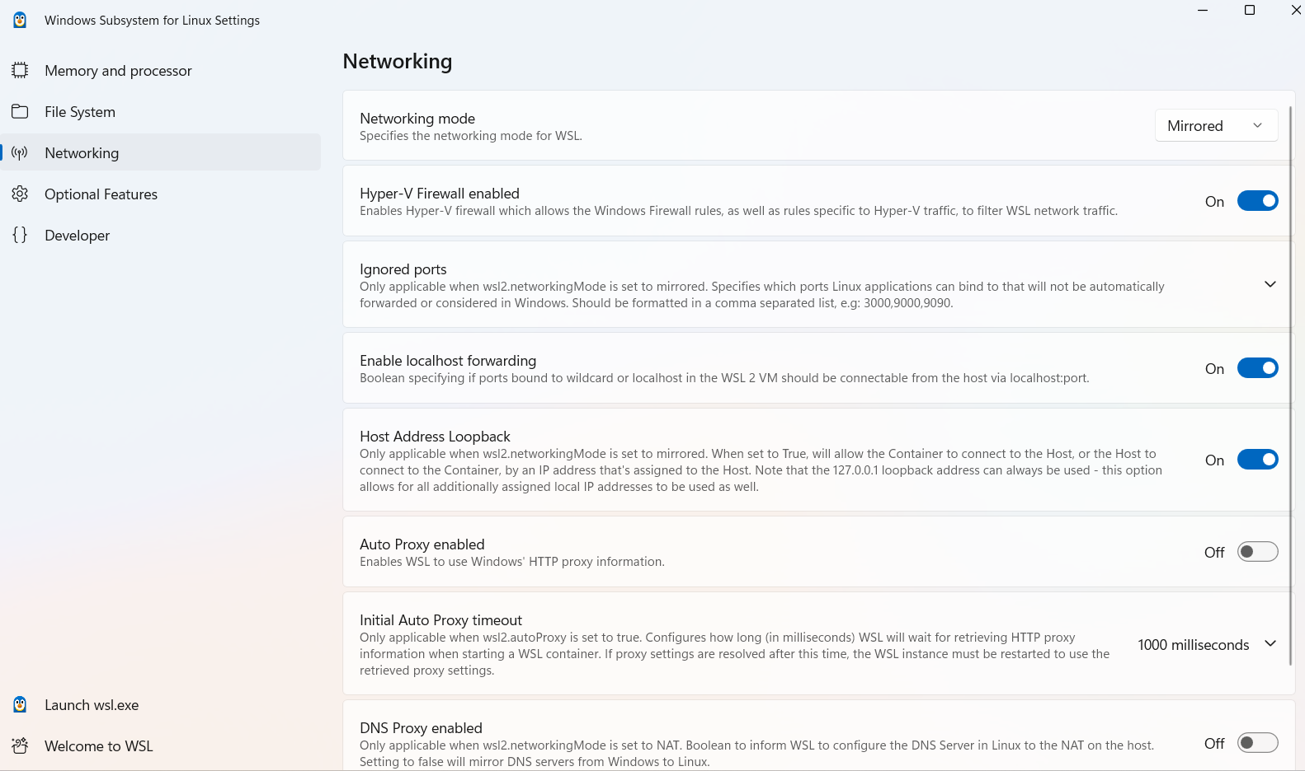
Step 2 – Networking: mirrored mode
Default (NAT): Ubuntu sits behind Windows on its own small network
Mirrored mode: WSL shares the network and IP address of Windows → needed for Webots and the Limo Pro robot
Set it in the WSL Settings app → Networking → Mirrored (see right)
Or edit .wslconfig in Windows: notepad $env:USERPROFILE\.wslconfig
[wsl2]
networkingMode=mirrored
dnsTunneling=true
autoProxy=true
Apply: wsl --shutdown in PowerShell, then open Ubuntu again
Check: hostname -I in Ubuntu shows the same IP as ipconfig in Windows

Slide 25
Step 2 – Firewall rules
The Windows firewall also filters WSL traffic. Allow ROS 2 communication – once per laptop, in PowerShell as administrator:
# Allow traffic in and out of the WSL virtual machine (Hyper-V firewall)
Set-NetFirewallHyperVVMSetting -Name '{40E0AC32-46A5-438A-A0B2-2B479E8F2E90}' -DefaultInboundAction Allow
Set-NetFirewallHyperVVMSetting -Name '{40E0AC32-46A5-438A-A0B2-2B479E8F2E90}' -DefaultOutboundAction Allow
# Allow ROS 2 (DDS) communication: UDP ports 7400-7600
New-NetFirewallRule -DisplayName "ROS2 UDP 7400-7600" -Direction Inbound -Action Allow -Protocol UDP -LocalPort 7400-7600
New-NetFirewallRule -DisplayName "ROS2 UDP 7400-7600 Outbound" -Direction Outbound -Action Allow -Protocol UDP -LocalPort 7400-7600
Set-NetFirewallHyperVVMSetting: lets traffic in and out of the WSL virtual machine (the long ID identifies WSL)
New-NetFirewallRule: opens the UDP ports ROS 2 (DDS) uses to discover nodes and exchange messages
Later, Webots or the robot can’t see your topics? Check step 2 first

Slide 26

Step 2 – Troubleshooting networking
Mirrored mode doesn’t work on every laptop. Typical message when Ubuntu starts:
Result: WSL falls back to another mode → often no internet in Ubuntu (sudo apt update fails)
First try: wsl --update, then wsl --shutdown and open Ubuntu again
Still failing? Use NAT in .wslconfig (see right), then wsl --shutdown again
Everything in this lab works with NAT, but Webots and the robot need extra steps → tell the teacher
[wsl2]
networkingMode=NAT
dnsTunneling=true
autoProxy=true

Slide 27
Step 3 – Connect VS Code to WSL
Install VS Code on Windows: code.visualstudio.com
Install the extension WSL (by Microsoft)
Press Ctrl+Shift+P → WSL: Connect to WSL using Distro... → Ubuntu-24.04
Check the bottom-left corner: WSL: Ubuntu-24.04
Open Terminal → New Terminal: a bash terminal inside Ubuntu
Install extensions in WSL: Python (Microsoft) and Robot Developer Extensions for ROS 2 (Ranch Hand Robotics)
Don’t install the old ROS extension by Microsoft: it is deprecated.
VS Code connected to WSL: the window title shows [WSL: Ubuntu]
Tip: in an Ubuntu terminal, code . opens the current folder in VS Code.

Slide 28
Step 4 – Install ROS 2 Jazzy (1/2)
From now on: type every command in the VS Code terminal (connected to WSL)
Official guide – follow these steps: docs.ros.org/en/jazzy/Installation/Ubuntu-Install-Debs.html
a) Make sure Ubuntu uses UTF-8
b) Add the ROS 2 package repository (tells apt where to download ROS 2)

Slide 29
Step 4 – Install ROS 2 Jazzy (2/2)
c) Install the development tools and ROS 2 Jazzy
What did we just do?
apt = Ubuntu’s package manager (an app store for the terminal)
Step b) added the ROS 2 repository: the server apt downloads ROS 2 from
sudo = run as administrator → asks your Ubuntu password
ros-dev-tools: build tools such as colcon and rosdep
ros-jazzy-desktop: ROS 2 + RViz + rqt + demos + turtlesim
Everything ends up in /opt/ros/jazzy
apt asks Do you want to continue? [Y/n] → press Enter (= yes)
An error? Read the last lines of the output (no internet? a typo?), fix it and run the command again
Done when ls /opt/ros shows jazzy

Slide 30
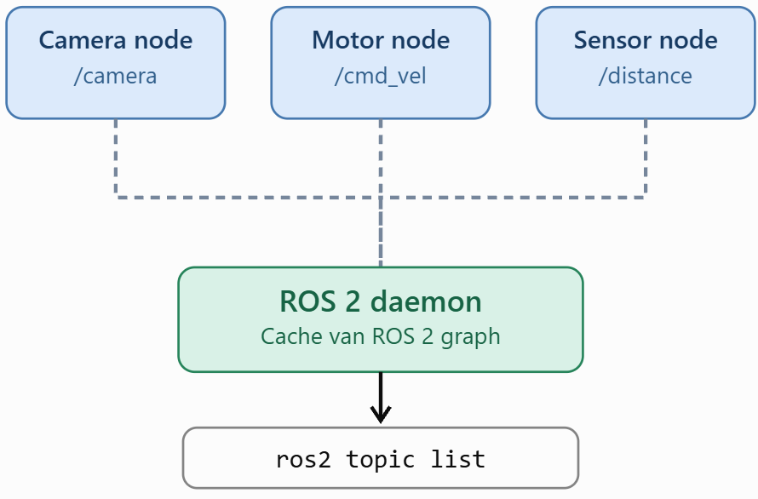
Step 4 – Sourcing ROS 2
ROS 2 is installed in /opt/ros/jazzy: a new terminal doesn’t know the ros2 command yet
source /opt/ros/jazzy/setup.bash prepares the current terminal (PATH, PYTHONPATH, ROS_DISTRO, …)
You need this in every terminal → add it to ~/.bashrc, a script that runs each time a terminal opens:
echo "source /opt/ros/jazzy/setup.bash" >> ~/.bashrc
echo "ros2 daemon start > /dev/null 2>&1" >> ~/.bashrc
source ~/.bashrc # apply it to this terminal
printenv ROS_DISTRO # should print: jazzy
Careful: >> versus >
>> adds a line at the end of the file. A single > replaces the whole file – your .bashrc is gone!
Look inside
code ~/.bashrc opens it in VS Code. Every source line should appear only once.
Line 2 starts the ROS 2 daemon: a background process that commands like ros2 node list ask for information. Why we start it ourselves: see Troubleshooting after the test.

Slide 31
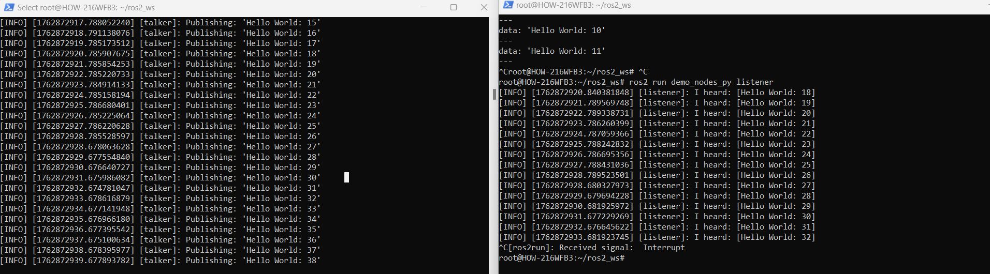
Step 4 – Test your installation
Open a second terminal in VS Code (split terminal button, or Ctrl+Shift+5)
Terminal 1: ros2 run demo_nodes_cpp talker
Terminal 2: ros2 run demo_nodes_py listener
The talker (C++) and listener (Python) talk to each other → your installation works!
Stop a node with Ctrl+C

Slide 32
Step 4 – Troubleshooting: ros2 commands hang
Symptom: ros2 node list or ros2 topic list takes about 2 minutes and ends with TimeoutError: [Errno 110] Connection timed out
Cause: these commands ask the ROS 2 daemon (a background process that keeps track of all nodes) via 127.0.0.1. Normally ros2 starts the daemon itself, but with WSL mirrored networking that check can time out instead
Fix: start the daemon yourself
Still stuck?
ros2 daemon start # no effect if already running
ros2 node list # now answers immediately
# Daemon hangs (or you changed a ROS_ variable)?
pkill -f _ros2_daemon
ros2 daemon start
# Skip the daemon (slower):
ros2 node list --no-daemon --spin-time 5
# Listener hears nothing? In BOTH terminals:
export ROS_AUTOMATIC_DISCOVERY_RANGE=LOCALHOST
We already added ros2 daemon start to ~/.bashrc (step 4), so every new terminal starts it.
Listener works now? Then the network blocks discovery → check the firewall rules of step 2.

Slide 33
Step 5 – Create your workspace
A workspace is the folder with your own ROS 2 packages. Create it in your Linux home folder (~), not on C:
mkdir -p ~/ros2_ws/src
cd ~/ros2_ws
colcon build # creates the folders build, install and log
echo "source ~/ros2_ws/install/setup.bash" >> ~/.bashrc
echo "source /usr/share/colcon_argcomplete/hook/colcon-argcomplete.bash" >> ~/.bashrc
source ~/.bashrc
code ~/ros2_ws # open the workspace in VS Code
Line 4: ROS 2 also finds your packages in every new terminal. Line 5: tab-completion for colcon.
Never sudo colcon build
The files become owned by root and every next build fails with “permission denied”.
Why not on C:?
Files inside Linux (~) are much faster for WSL and get the right Linux permissions.

Slide 34
Setup checklist
Before the next lab, all of this must work:
✓
In PowerShell, wsl -l -v shows Ubuntu-24.04 with VERSION 2
✓
VS Code shows WSL: Ubuntu-24.04 in the bottom-left corner
✓
In a new VS Code terminal, printenv ROS_DISTRO prints jazzy
✓
ros2 run demo_nodes_cpp talker and ros2 run demo_nodes_py listener talk to each other
✓
ls ~/ros2_ws shows build install log src
✓
hostname -I in Ubuntu shows the same IP address as ipconfig in Windows (mirrored networking)

Slide 35
Table of content
Introduction robotics
What is ROS?
Setting up: WSL, VS Code and ROS 2 Jazzy
First steps: prebuilt nodes, CLI and rqt
Workspaces and packages
Writing our own nodes

Slide 36
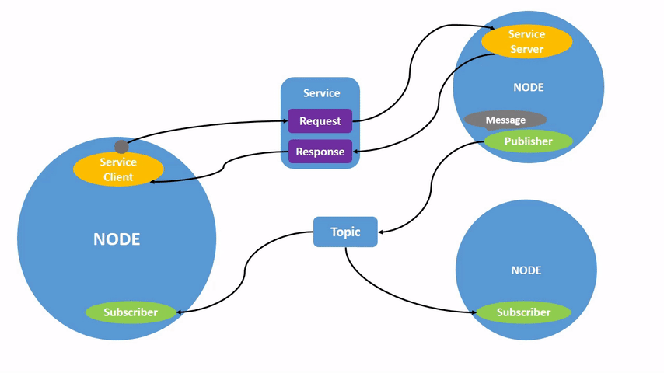
ROS2 nodes
Modular process that performs 1 specific computational task
Nodes run on their own and can be started/stopped independently
Multiple nodes can run on the same machine
If 1 node crashes, the others will continue
Nodes are reusable
https://docs.ros.org/en/jazzy/Tutorials/Beginner-CLI-Tools/Understanding-ROS2-Nodes/Understanding-ROS2-Nodes.html

Slide 37
ROS2 node communication mechanism
Topics: Asynchronous, many-to-many communication (publish/subscribe pattern)
Services: Synchronous, request/response communication
Actions: For long-running tasks with feedback and cancellation
Parameters: Configuration values that can be changed at runtime
https://docs.ros.org/en/jazzy/Tutorials/Beginner-CLI-Tools/Understanding-ROS2-Nodes/Understanding-ROS2-Nodes.html

Slide 38

ROS2 commands
The command ros2 run launches an executable from a package.
ros2 run <package_name> <executable_name>
  ros2 run turtlesim turtlesim_node
    Package name = turtlesim
    Executable name = turtlesim_node
    Node name = ?
  ros2 run demo_nodes_cpp talker
  ros2 run demo_nodes_py listener
➔ ros2 node list

Slide 39
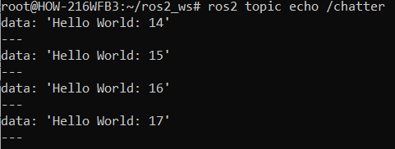
ROS2 commands
Packages?
  ROS software is organized in packages and might contain: nodes, libraries, datasets, config files, ….
  Enough functionality but not too much to keep it lightweight
ros2 run demo_nodes_cpp talker:
  What happens when you run it:
    The system launches a single executable called "talker"
    This node publishes messages to a topic
    The messages contain simple text like "Hello World: [counter]"
    The counter increments with each message
  Talker node is now publishing data to the /chatter, but no other node is subscribing
  We can see logs on the screen (not a subscriber, only logs from the code)
  We can use the command line to output raw messages on a topic (not a node/subscriber)
    ros2 topic echo $topic

Slide 40
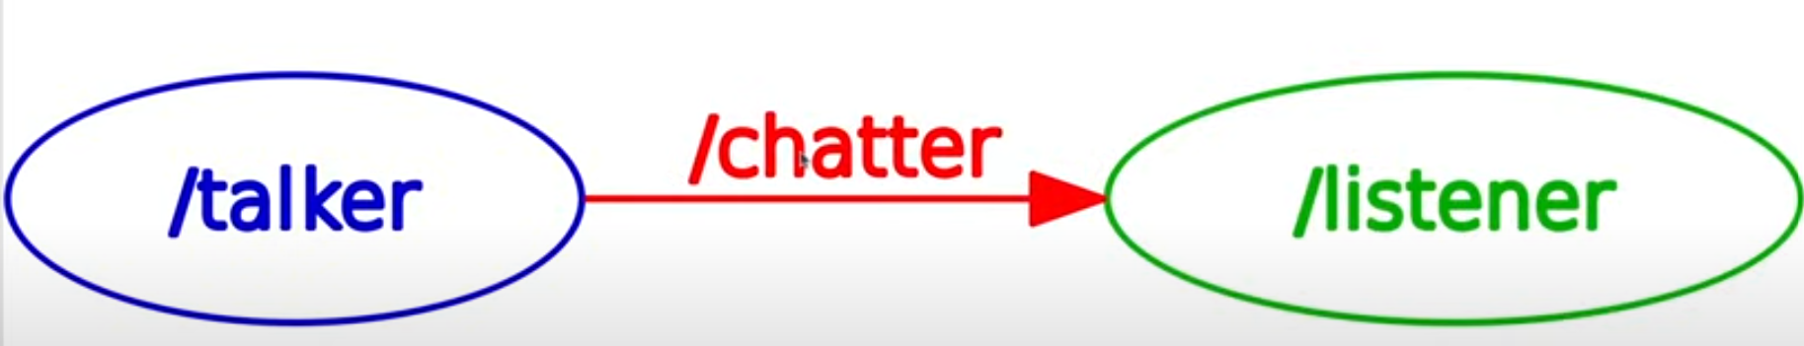
RQT
rqt is ROS2's unified graphical user interface framework (dashboard for visualization and debugging of the robotic system)
Visual Elements:
  Ovals/Rectangles: Individual nodes (like the talker and listener)
  Arrows: Topic connections showing data flow direction
  Topic names: Labels on the arrows (like /chatter)
  Colors: Different colors help distinguish different types of connections
Start it with: rqt_graph (while talker and listener are running)

Slide 41
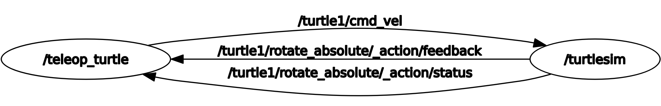
Turtlesim example
Terminal 1: ros2 run turtlesim turtlesim_node
Terminal 2: ros2 run turtlesim turtle_teleop_key → drive with the arrow keys in this terminal
Terminal 3: rqt_graph

Slide 42
Table of content
Introduction robotics
What is ROS?
Setting up: WSL, VS Code and ROS 2 Jazzy
First steps: prebuilt nodes, CLI and rqt
Workspaces and packages
Writing our own nodes

Slide 43
Workspace and colcon
We created our workspace in step 5: ~/ros2_ws
colcon is the ROS 2 build tool: it builds all packages in src/
Always build from the workspace root: cd ~/ros2_ws then colcon build
After a build: source install/setup.bash (or open a new terminal) so ROS 2 finds your packages
  echo "source install/setup.bash " >> ~/.bashrc
Never use sudo with colcon
Tip: colcon build --symlink-install → changes to Python files work without rebuilding
~/ros2_ws/
├── src/ your packages (code)
├── build/ intermediate files
├── install/ built packages
│ + setup.bash
└── log/ build logs

Slide 44
Creating packages
Create a Python package in the src folder:
cd ~/ros2_ws/src
ros2 pkg create my_robot_controller --build-type ament_python --dependencies rclpy
What is inside the package (open it in VS Code):
  package.xml: name, version, description, maintainer and dependencies
  setup.py: how to install the package, and the entry points (our executables)
  setup.cfg: extra configuration (we don’t touch this)
  my_robot_controller/: the folder for your Python code (nodes)
After creating or changing a package, build again:
cd ~/ros2_ws && colcon build

Slide 45
Table of content
Introduction robotics
What is ROS?
Setting up: WSL, VS Code and ROS 2 Jazzy
First steps: prebuilt nodes, CLI and rqt
Workspaces and packages
Writing our own nodes

Slide 46
Creating our first node
Create my_first_node.py in the inner folder my_robot_controller/my_robot_controller/
Line 1 #!/usr/bin/env python3 tells Linux to run the file with Python
rclpy is the ROS 2 Python library; every node is a class that inherits from Node
Make the file executable and test it in the VS Code terminal:
#!/usr/bin/env python3
import rclpy
from rclpy.node import Node
class MyNode(Node):
def __init__(self):
super().__init__('first_node')
self.get_logger().info('Hello from ROS2')
def main(args=None):
rclpy.init(args=args)
node = MyNode()
rclpy.shutdown()
if __name__ == '__main__':
main()
chmod +x my_first_node.py
./my_first_node.py

Slide 47
Run the node as a ROS node
In setup.py, add your node as an entry point (an executable):
Build, source and run:
entry_points={
'console_scripts': [
"test_node = my_robot_controller.my_first_node:main"
],
},
cd ~/ros2_ws
colcon build
source install/setup.bash
ros2 run my_robot_controller test_node
test_node: name of the executable (used by ros2 run)
my_robot_controller: the Python package (folder)
my_first_node: the Python file my_first_node.py
main: the function that starts the node
Opening a new terminal? ~/.bashrc already sources the workspace (step 5)

Slide 48
Add easy functionality
Add a timer: every second ‘hello again’ is logged
class MyNode(Node):
def __init__(self):
super().__init__('first_node')
self.get_logger().info('Hello from ROS2')
self.timer = self.create_timer(1.0, self.timer_callback)
def timer_callback(self):
self.get_logger().info('hello again')
def main(args=None):
rclpy.init(args=args)
node = MyNode()
rclpy.spin(node) # keep the node alive: runs timers + callbacks
rclpy.shutdown()
Without rclpy.spin(node) the program ends immediately and the timer never fires
Stop the node with Ctrl+C
Build again before ros2 run (unless you used --symlink-install)
Exercise: add a counter that counts how many times hello was printed
Check with ros2 node list: do you see /first_node?

Slide 49
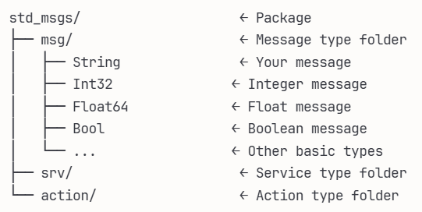
Analyze topics
Run demo talker and listener again
Check the topic with ros2 topic info /chatter
We can see Type: std_msgs/msg/String
  This is the type of the topic (std_msgs)
Investigate the structure of the message a bit deeper:
  ros2 interface show std_msgs/msg/String
  We get some logs and string data
    This means our message has 1 field called data with a string to it
      ros2 topic echo /chatter
      data: 'Hello World: 4'
      ---
      data: 'Hello World: 5'
      ---
      data: 'Hello World: 6'
      ---
Codewise it would look somewhat like this:
# Create an instance of the String message
msg = String() # Creates empty: {"data": ""}
# Fill in the data field
msg.data = "Hello World: 1" # Now: {"data": "Hello World: 1"}

Slide 50
Analyze topics – publish
Add the dependency:
    <depend>std_msgs</depend>
Create the publisher
    self.publisher = self.create_publisher($type, ‘$topic’, queue_size)
Create message and publish
    msg = String()
    msg.data = f'Timer callback triggered: {self.counter}’
    self.publisher.publish(msg)
Publish on your own topic and inspect

Slide 51
Analyze topics
Run turtlesim node and teleop again
Search for the topic that controls the turtle
Investigate this topic and how the message looks

Slide 52
Analyze topics
root@HOW-216WFB3:~/ros2_ws# ros2 interface show geometry_msgs/msg/Twist
# This expresses velocity in free space broken into its linear and angular parts.
Vector3 linear
float64 x
float64 y
float64 z
Vector3 angular
float64 x
float64 y
float64 z
For example (linear in m/s and angular in rad/s):
Move forward:
{
"linear": {"x": 1.0, "y": 0.0, "z": 0.0},
"angular": {"x": 0.0, "y": 0.0, "z": 0.0}
}
Rotate:
{
"linear": {"x": 0.0, "y": 0.0, "z": 0.0},
"angular": {"x": 0.0, "y": 0.0, "z": 0.5}
}
Move and rotate:
{
"linear": {"x": 0.5, "y": 0.0, "z": 0.0},
"angular": {"x": 0.0, "y": 0.0, "z": 0.2}
}

Slide 53
Analyze topics – write a publisher
Create a new node for drawing a circle with the turtlesim
Tips:
  You have to import the Twist message (from geometry_msgs.msg import Twist )
  You’ll have to add dependencies to package.xml:
    <depend>geometry_msgs</depend>
    <depend>turtlesim</depend>
  You’ll have to create a publisher (inherited from Node):
self._cmd_vel_pub = self.create_publisher($msgtype, topic (as string), queue size)
  You’ll have to create timer that calls a function and sets a Twist message with some values
    self._cmd_vel_pub.publish(msg)
  Figure out how the msg, for drawing a circle, should look like (what axes to use)

Slide 54
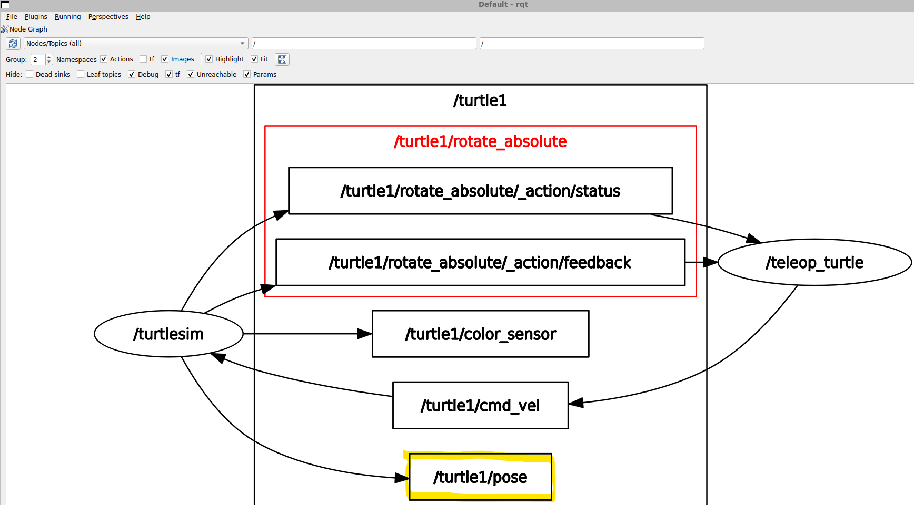
Analyze topics – write a subscriber
Check all topics in RQT:

Slide 55
Analyze topics – write a subscriber
Investigate the topic:
  ros2 topic list
  ros2 topic echo /turtle1/pose
  ros2 topic info /turtle1/pose
  ros2 interface show turtlesim/msg/Pose
Create a new node that subscribes to this topic and logs it to the screen
  from turtlesim.msg import Pose (and <depend>turtlesim</depend> in package.xml)
  self._pose_subscriber = self.create_subscription(Pose, "/turtle1/pose", self.pose_callback, 10)
  def pose_callback(self, msg: Pose):
  self.get_logger().info(str(msg))

Slide 56
Exercise
Create a controller (node) for the turtlesim that starts moving along the x-axis
When it reaches the border of the screen it should rotate in a random direction and start moving forward. You’ll need:
  A publisher to cmd_vel
  A subscriber to pose

