Slide 1


RANPilotAI
In collaboration with
AI-Powered RAN Performance Optimization Platform
Graduation Project • 2026
Tasneem Amein • Ibrahim Samy • Khaled Mogahed Mahmoud Ashraf • Mohab Tarek
Supervisor: Dr. Salma Sobhy
Intake 46 •
Telco-Cloud Track • Information Technology Institute

Slide 2





Agenda
1
Introduction, Architecture & KPI Degradation
KPI Forecasting Engine Optimization Action Analyzer Telecom RAG Assistant
Software Testing & Experimental Results
2
3
4
5
RANPilotAI

Slide 3
Tasneem Amein
Problem Statement • Proposed Solution • Overall Architecture • KPI Degradation Analyzer
RANPilotAI

Slide 4
Problem Statement
[ Fill in your content here ]
RANPilotAI

Slide 5
Project Motivation & Objectives
[ Fill in your content here ]
RANPilotAI

Slide 6
Proposed Solution Overview
[ Fill in your content here ]
RANPilotAI

Slide 7
Overall System Architecture
Screenshot not yet added
screenshots/tasneem/system_architecture.png
RANPilotAI

Slide 8
Telecom Hub — Landing Page
Screenshot not yet added
screenshots/tasneem/hub_landing.png
RANPilotAI

Slide 9
KPI Degradation Analyzer — Module Overview
[ Fill in your content here ]
RANPilotAI

Slide 10
KPI Categories Monitored
[ Fill in your content here ]
RANPilotAI

Slide 11
Detection Pipeline & Root Cause Analysis
[ Fill in your content here ]
RANPilotAI

Slide 12
KPI Degradation Analyzer — Interface
Screenshot not yet added
screenshots/tasneem/kpi_degradation_ui.png
RANPilotAI

Slide 13
KPI Degradation — Sample Results
Screenshot not yet added
screenshots/tasneem/kpi_degradation_results.png
RANPilotAI

Slide 14
Ibrahim Samy
KPI Forecasting Engine • Models • Feature Engineering • Accuracy & Results
RANPilotAI

Slide 15
Forecasting Module Overview & Motivation
Predict Network Problems Before They Become Outages
• Reactive maintenance = incident → ticket → emergency truck roll
• We forecast 12 LTE KPIs per cell, 7 days ahead, from a standard 30-day CSV export
RANPilotAI

Slide 16
Forecasting Approach — XGBoost & Holt-Winters
• Naive baseline — sanity check: is this cell even predictable?
• Holt-Winters — catches weekly traffic rhythms (strong on seasonal KPIs)
• XGBoost — learns cross-KPI relationships (e.g., handover quality → throughput)
RANPilotAI

Slide 17
Feature Engineering & Seasonality Decomposition
• Every cell is scored by weekly seasonality strength — engineers see which forecasts to trust first
• All features are leakage-safe: built strictly from past observations only
• Cross-KPI lags let throughput learn from handover success, PRB utilization, and drop rate — relationships a human might miss
• 40+ features auto-generated per KPI; zero manual feature engineering required
RANPilotAI

Slide 18
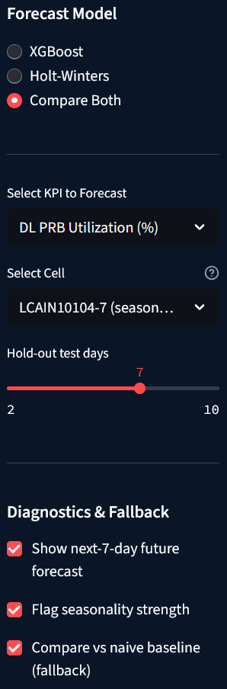
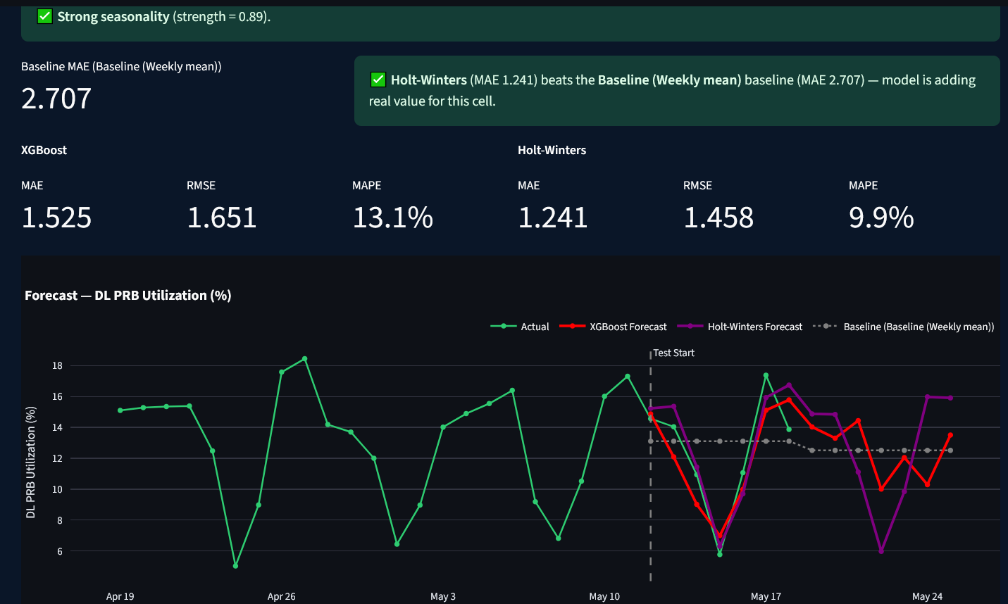
Forecasting Module — Interface
RANPilotAI

Slide 19
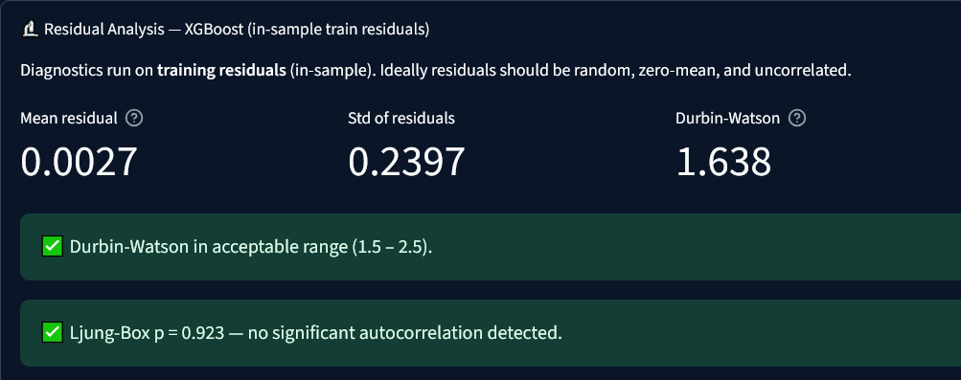
Model Evaluation & Accuracy Metrics
Screenshot not yet added
screenshots/ibrahim/accuracy_metrics.png
RANPilotAI

Slide 20
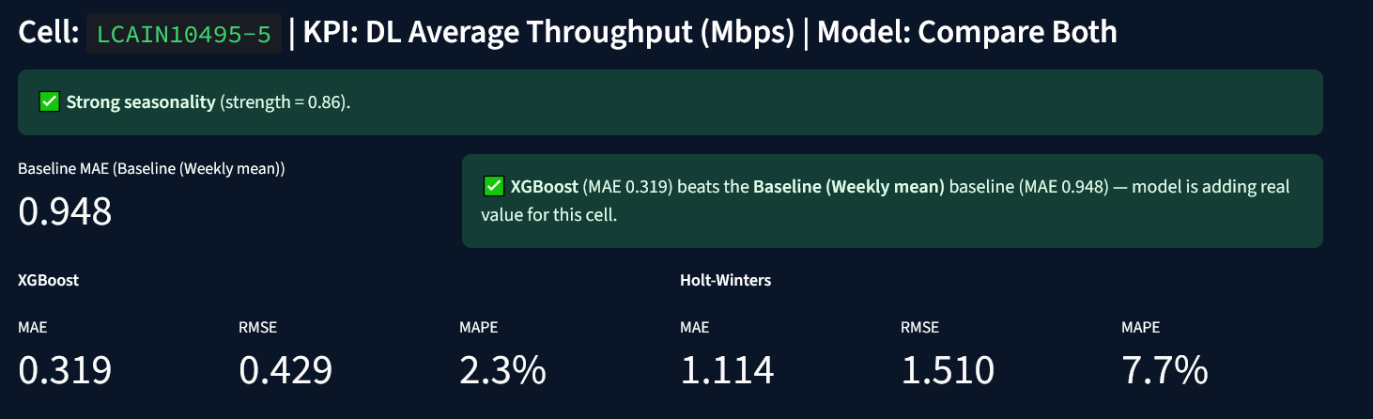
Cell prediction accuracy

Slide 21
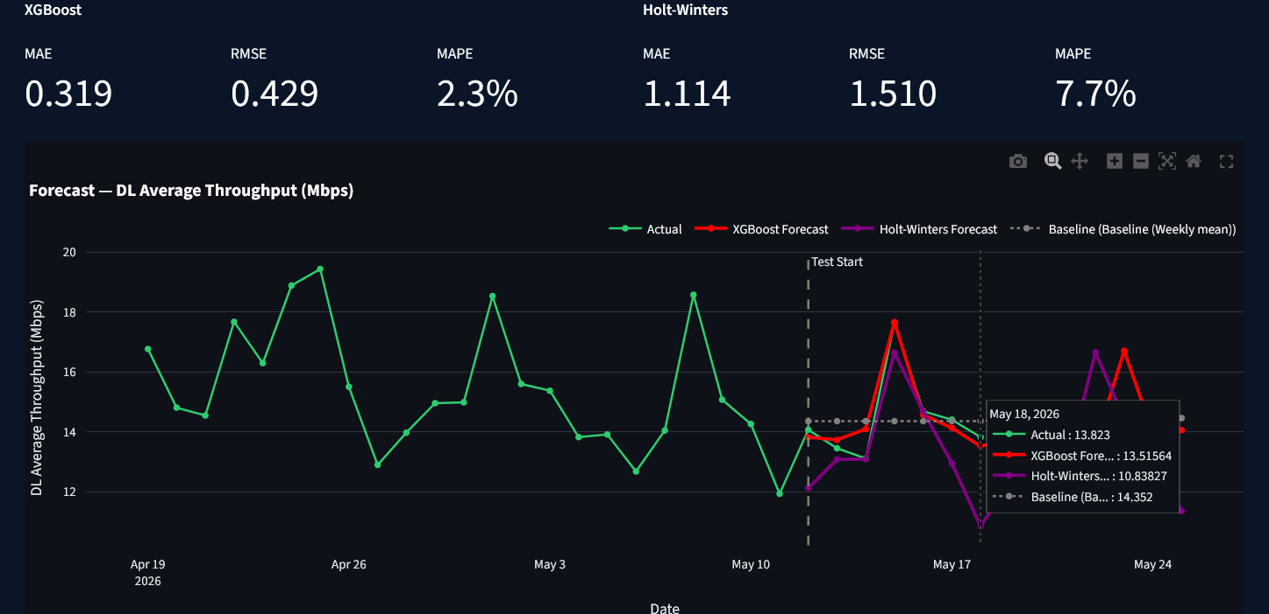
7-Day KPI Forecast — Output
RANPilotAI

Slide 22
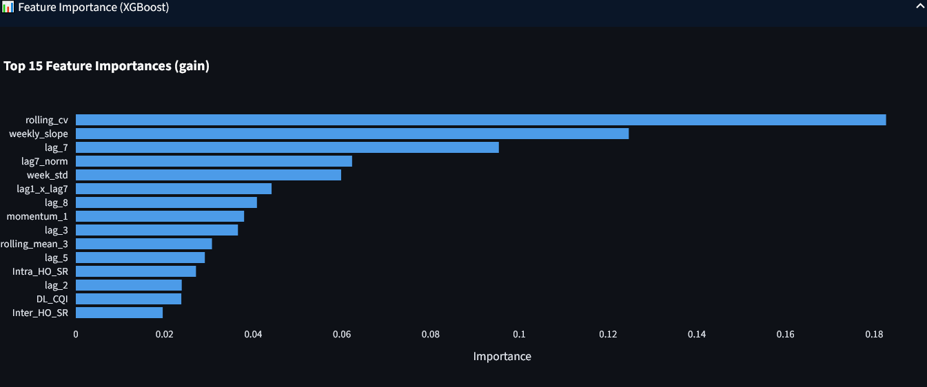
XGBoost Feature Importance
Screenshot not yet added
screenshots/ibrahim/feature_importance.png
RANPilotAI

Slide 24
Khaled Mogahed
Optimization Action Analyzer
Version-Controlled Telecom KPI Impact Analysis
RANPilotAI

Slide 25
The Problem
“Did the change we just made actually improve the network, and by how much?”
RAN optimization teams push configuration changes constantly (antenna tilt, TX power, handover parameters, carrier aggregation, . . . )
Impact assessment requires knowing what changed, when, and comparing against a fair baseline
Traditionally done manually, in spreadsheets — slow and error-prone
Optimization Action Analyzer

Slide 26
Motivation
No single source of truth for “what changed”
Naive before/after comparisons ignore weekly seasonality Overlapping changes confound results
Manual, non-repeatable analysis
Solution
Combine a version-controlled configuration database (Dolt) with a weekday-matched statistical comparison engine and an interactive visualization layer.
Optimization Action Analyzer

Slide 27
High-level Module Architecture
app.py
Streamlit UI Orchestration
config.py
KPI Polarity Persistence (JSON)
db.py
Dolt / PyMySQL Data Access
data.py
Pandas Wrangling Hunk & Matching Logic
viz.py Plotly Chart Builders
Dolt SQL Server network kpis, dolt log
High-level module architecture of the Optimization Action Analyzer. The Streamlit application (app.py) orchestrates calls into four independent layers: database access, data wrangling, visualization, and configuration persistence.
Optimization Action Analyzer

Slide 28
Module Responsibilities
Module
Responsibility
db.py
Dolt connection, KPI schema discovery, commit log & diff queries, KPI time-series fetch
Action Hunk grouping, rolling evaluation window, weekday-matched Before/After profiles
Plotly figures: timeline, trend, delta bars, summary table
Persists KPI optimization polarity to kpi config.json
Streamlit front-end wiring everything together
data.py
viz.py config.py app.py
Optimization Action Analyzer

Slide 29
Data Sources
Served through a Dolt SQL server (version-controlled, Git-like relational database) via PyMySQL:
1
network kpis — time-series KPI table (15-min granularity): throughput, drop rate,
RACH success, CQI, BLER, latency, PRB utilization, handover success, SINR
dolt log — Dolt’s built-in commit history: commit hash, committer, e-mail, timestamp, message
2
Key idea
Dolt’s own version history is the action log — no separate change-management system required.
Optimization Action Analyzer

Slide 30
Action Hunks
Commits sharing the same calendar date are grouped into a single Action Hunk
build action hunks() produces one selectable unit of change per optimization event Label example: "2024-06-10 (Mon) · 3 commits"
Optimization Action Analyzer

Slide 31
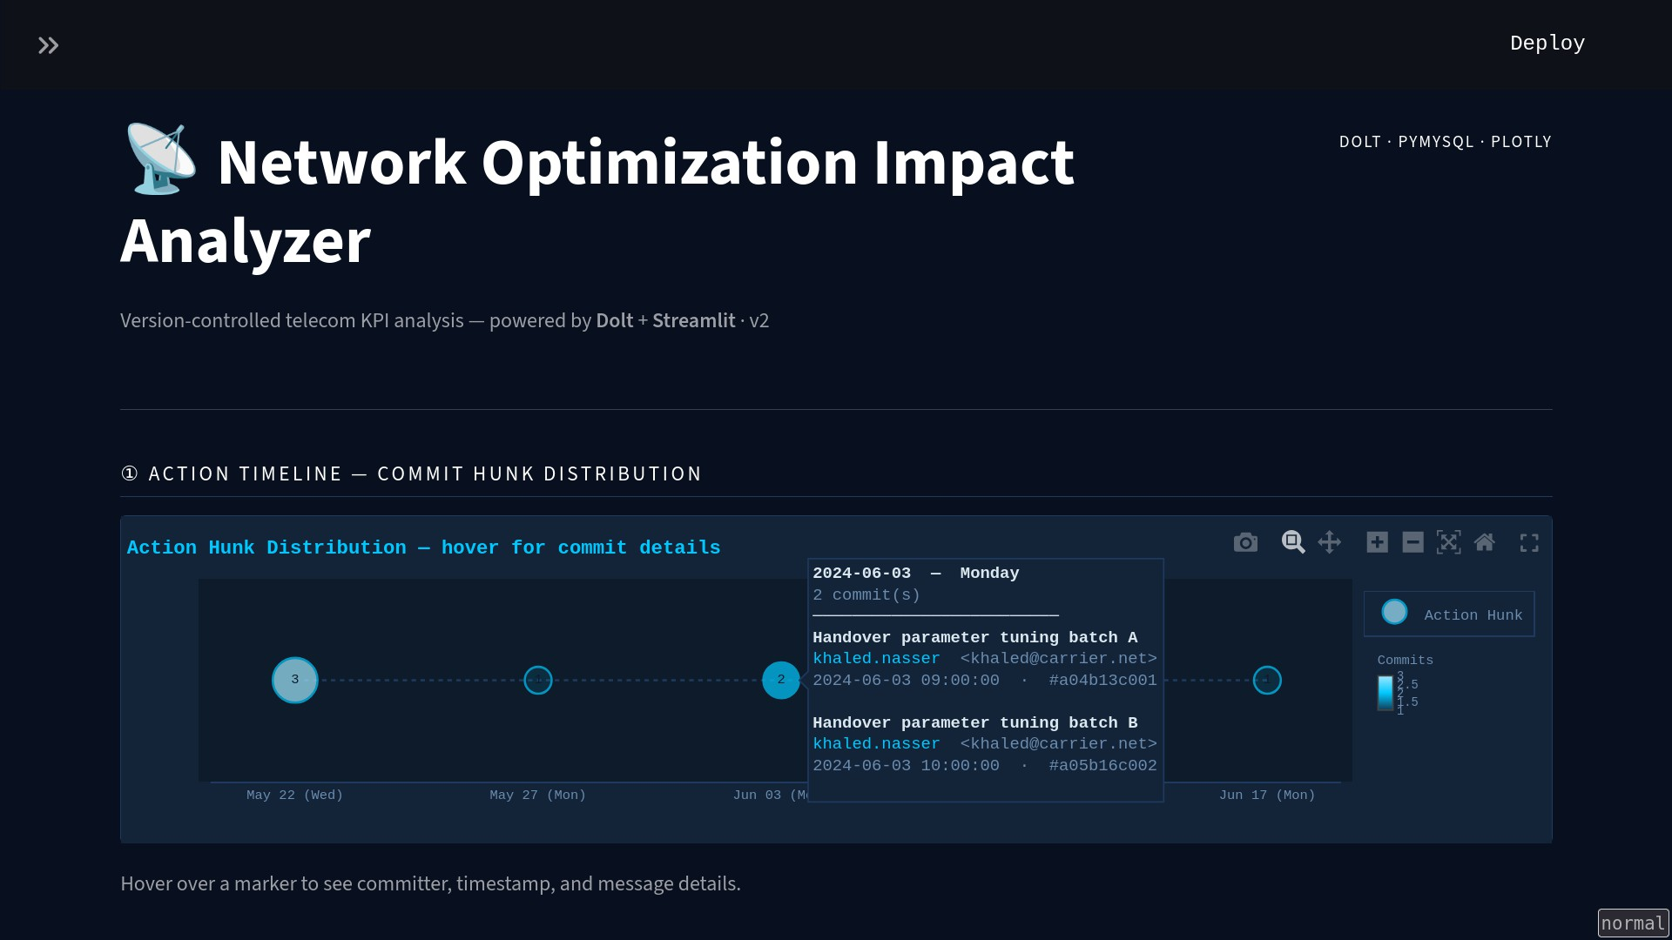
Action Hunk Distribution — hover for commit details
Optimization Action Analyzer

Slide 32
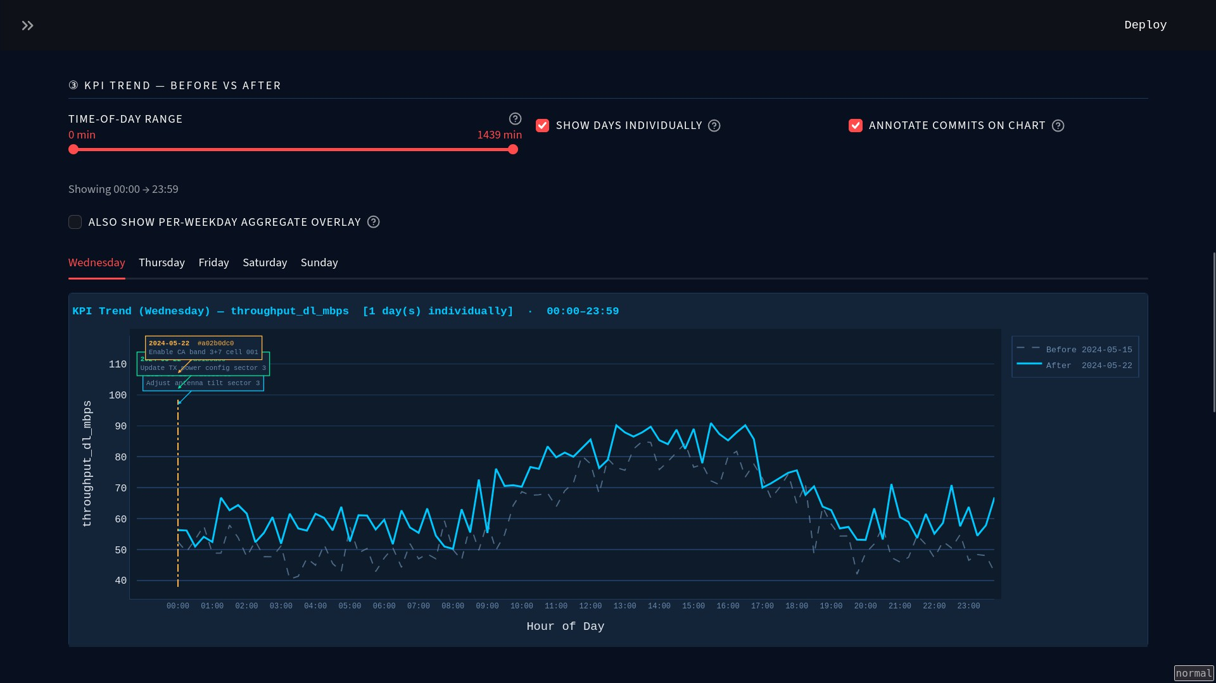
KPI Trend — Before vs. After
Optimization Action Analyzer

Slide 33
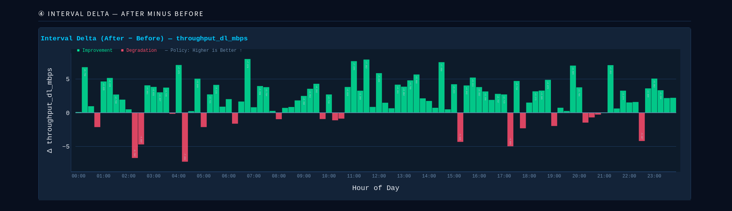
Interval Delta (After − Before)
Optimization Action Analyzer

Slide 34
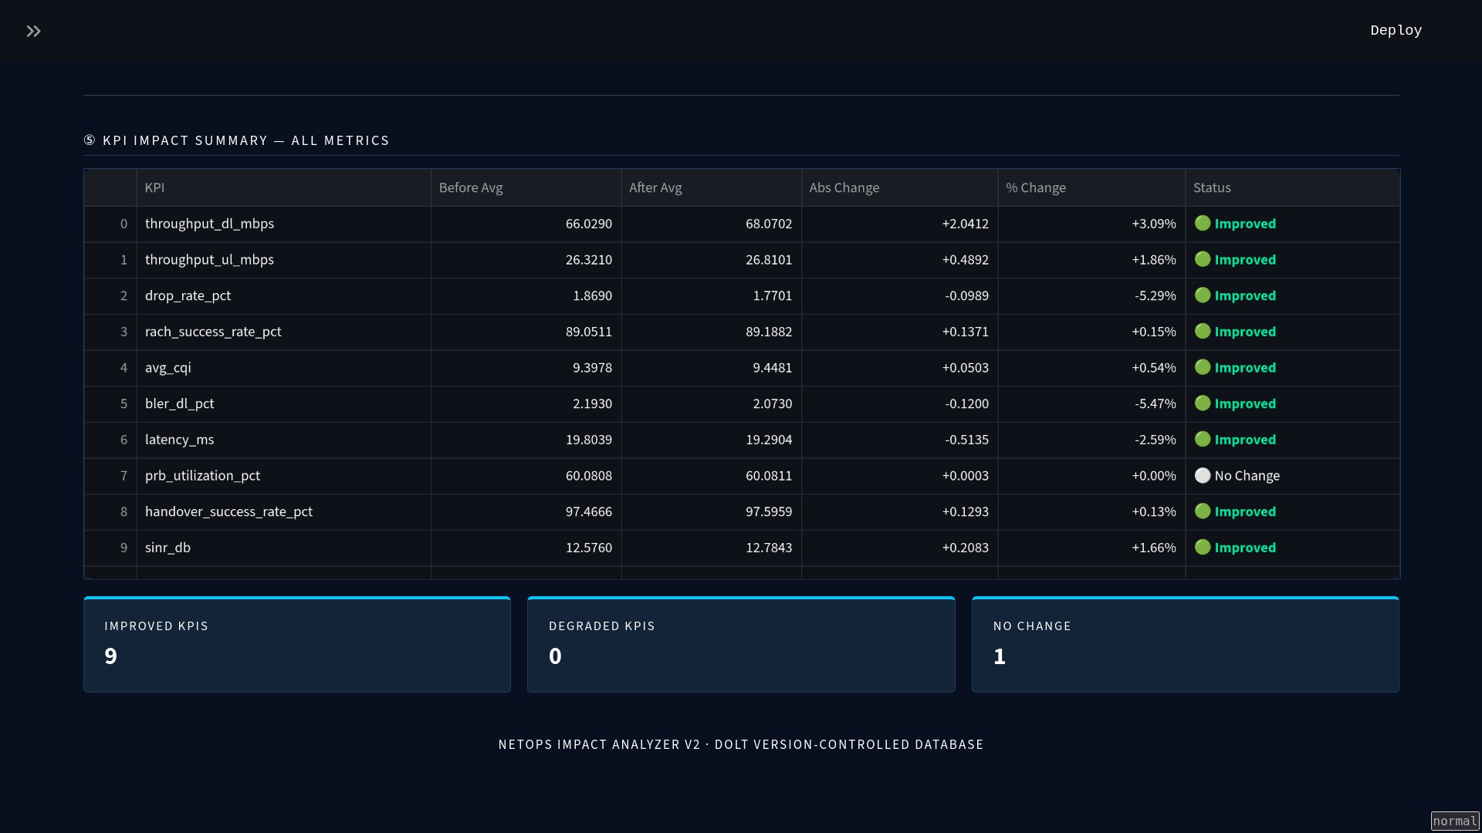
KPI Impact Summary Table
Optimization Action Analyzer

Slide 35
The Five-Step Analyst Workflow
1- Action Timeline — browse all Action Hunks
2- Select Action Hunk + KPI + evaluation window options
3- KPI Trend — Before vs. After (aggregated or per-day)
4- Interval Delta — After minus Before, polarity-coded
5- KPI Impact Summary — all metrics, one table
The five-wstep analyst workflow implemented in app.py.
Optimization Action Analyzer

Slide 36
Workflow Details
Action Timeline — visual context on all past optimization actions
Hunk & Window Selection — metric tiles + expandable Dolt diff panel (table, column, from/to value)
KPI Trend — aggregated or per-weekday individual curves, with a time-of-day zoom slider
Interval Delta — polarity-coded magnitude of change per interval
Impact Summary — Improved/Degraded/No-Change verdict for every KPI at once
1
2
3
4
54
Optimization Action Analyzer

Slide 37
Summary
Pairs a version-controlled database with a seasonality-aware comparison engine and interactive visualization
Turns manual, error-prone impact assessment into a repeatable, auditable, self-service tool Answers the central question: did this change actually help?
Optimization Action Analyzer

Slide 38
Mahmoud Ashraf
Telecom RAG Assistant • Pipeline • Interface • Real case scenario
RANPilotAI

Slide 39
RAG Assistant — Overview & Motivation
The Problem
Our Solution
Manual PDF search is slow and tedious
Telecom LLM RAG
Keyword search misses paraphrased content
Purpose-built specifically for telecom papers
Generic LLMs fabricate protocol details
Fully local: embeddings, vector store, re-ranking
No tool offers cited, spec-grounded answers
Every answer cites: TS number, Release, Section, page
RANPilotAI

Slide 40
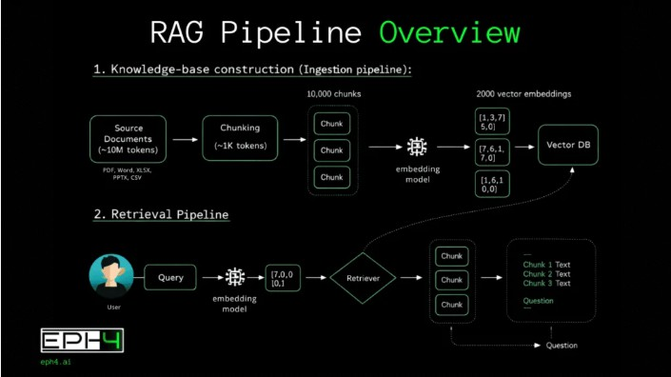
RAG Pipeline Architecture
RANPilotAI

Slide 41
Pipeline — Key Engineering Decisions
Table Extraction
Section-Aware Splitting
Optimal Sizing
Fully Local Execution
Header Stripping
Zero Docker Setup
Precision Metadata Filtering
Over-fetching
Anti-Hallucination Guardrails
Strict Citations
Rich Metadata
Smart Filtering
1. Ingestion & Parsing (PyMuPDF)
2. Chunking
3. Embedding
(BGE-large)
4. Vector Storage
(Local Qdrant)
5. Retrieval
6. Re-ranking
7. Generation (OpenRouter API
RANPilotAI

Slide 42
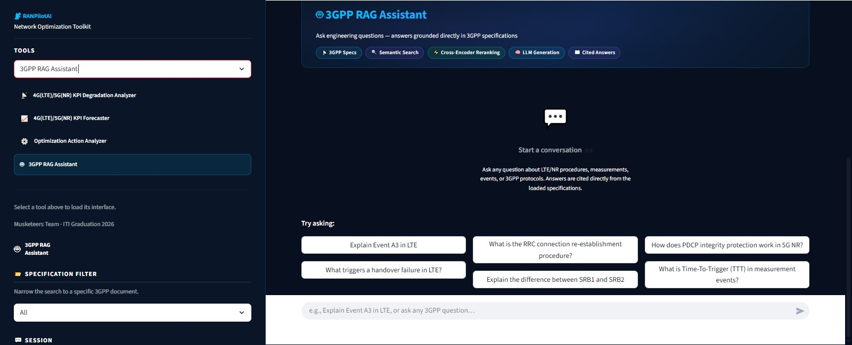
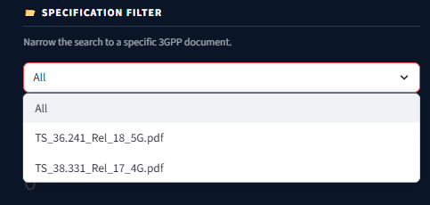
RAG Assistant — Main Interface
RANPilotAI

Slide 43
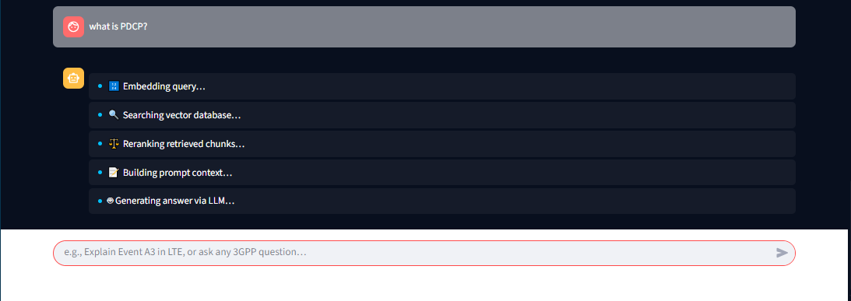
Live Query — Pipeline Execution Steps
RANPilotAI

Slide 44
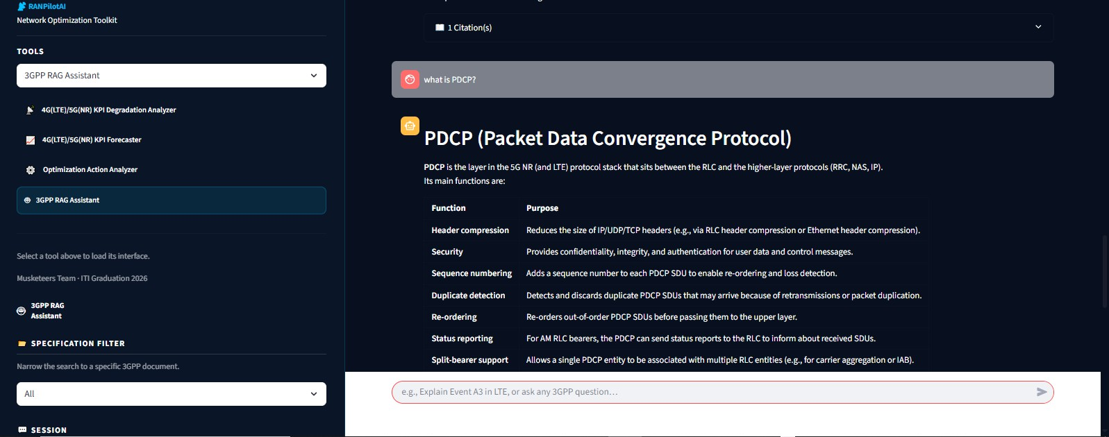
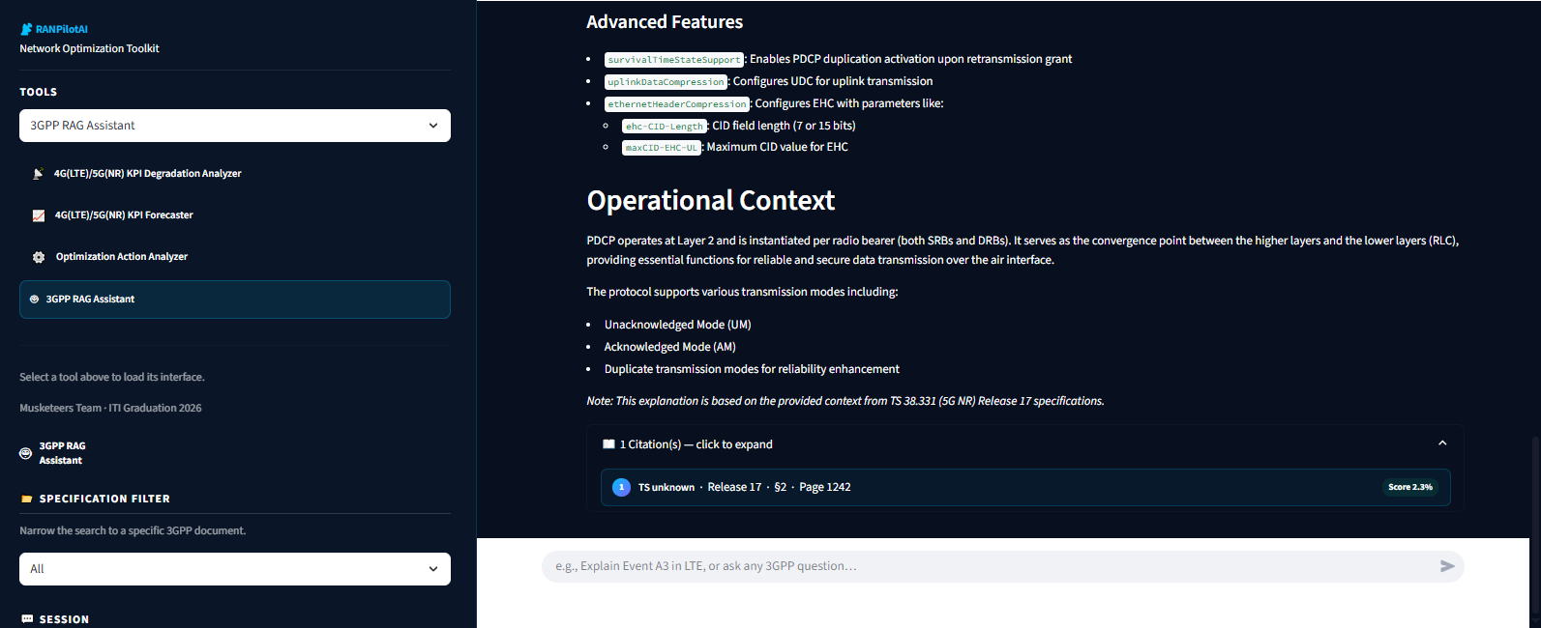
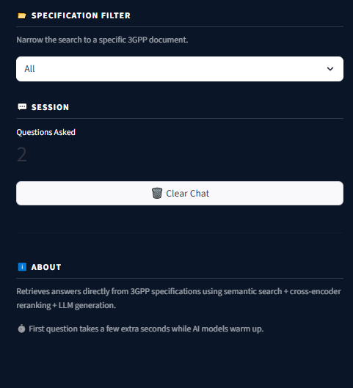
Retrieved Chunks & Source Citations
RANPilotAI

Slide 45
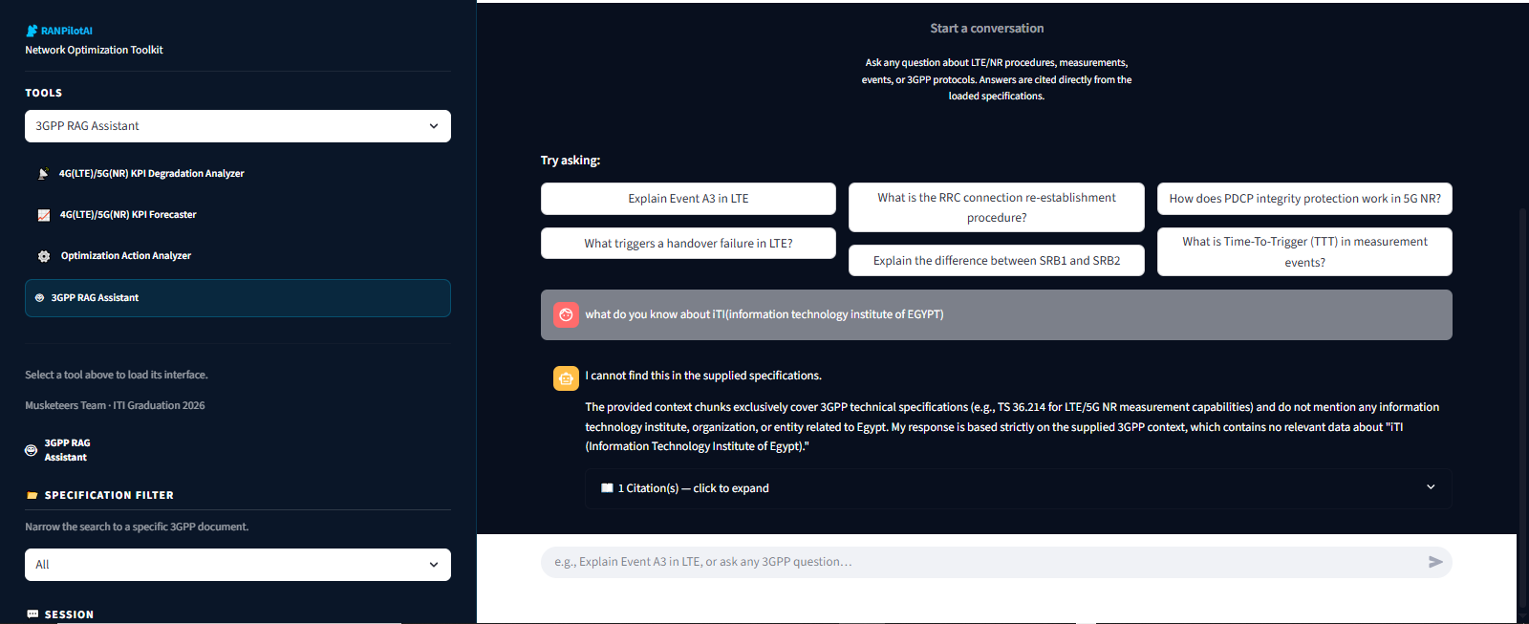
what if I asked Non telecom Question?
RANPilotAI

Slide 46
Summary - Why RAG
Reduce Manual Specification Search
Accelerate Engineering Decision-Making
Reduce Risk of AI Hallucination
Ensure Accurate & Traceable Answers
Fully local LLM Assistant
RANPilotAI

Slide 47
Mohab Tarek
Software Testing • Real-Case Experimental Results • Conclusion
Future Work
RANPilotAI

Slide 48
Testing Strategy & Test Coverage
[ Fill in your content here ]
RANPilotAI

Slide 49
Unit & Integration Testing
[ Fill in your content here ]
RANPilotAI

Slide 50
Real-Case Dataset Description
[ Fill in your content here ]
RANPilotAI

Slide 51
KPI Degradation — Experimental Results
Screenshot not yet added
screenshots/mohab/results_degradation.png
RANPilotAI

Slide 52
Forecasting — Experimental Results
Screenshot not yet added
screenshots/mohab/results_forecasting.png
RANPilotAI

Slide 53
Action Analyzer — Experimental Results
Configuration Change Event
KPI Impact Measured
Screenshot not yet added
screenshots/mohab/results_action_before.png
Screenshot not yet added
screenshots/mohab/results_action_after.png
RANPilotAI

Slide 54
RAG Assistant — Experimental Results
Screenshot not yet added
screenshots/mohab/results_rag.png
RANPilotAI

Slide 55
Conclusion
[ Fill in your content here ]
RANPilotAI

Slide 56
Future Work
[ Fill in your content here ]
RANPilotAI

Slide 57
RANPilotAI · ITI Intake 46 · Ismailia Branch · 2026

