Slide 1
MINDUEL LITE
An Interest-Based Two-Player Live-Audio Intellectual Competition Web Application
IU International University of Applied Sciences
Course: DLBSEPPSD01_E — Software Development
Examination: Oral Project Report · Task 2 — Development of a Web Application
GitHub repository (title-slide link)
https://github.com/MahmoudBKanaan/MiduelLite
Mahmoud B. Kanaan · Matriculation number: see IU myCampus
Minduel Lite · DLBSEPPSD01_E · Oral Project Report
1/18

Slide 2
Outline — process over UI walkthrough
Presentation focus (IU oral project report)
Task definition — problem, objective, users, requirements
Planning & process — Kanban, iterative-incremental model
Architecture & data — C4 containers, ER model, matchmaking
Implementation — state machine, core logic, security choices
Software result — operational demo evidence (not a screen tour)
Testing & Docker — automated tests, reproducible run
Reflection — goal achievement, limits, lessons, outlook
Minduel Lite · DLBSEPPSD01_E · Oral Project Report
2/18

Slide 3
1. Task definition — problem & objective
Problem
Objective (Task 2 + project)
Short intellectual interaction is often blocked by registration, permanent profiles, and heavy multiplayer platforms. Text-only flows also remove natural spoken exchange for a brief two-player duel.
Deliver a demonstrable full-stack SPA for IU Task 2 (React, Express, PostgreSQL, tests, Docker Compose, docs) with two-user interaction. Live spoken answers via managed LiveKit are part of this project’s defined solution — not a separate IU examination mandate for audio/WebRTC.
Minduel Lite · DLBSEPPSD01_E · Oral Project Report
3/18

Slide 4
1. Task definition — users & benefit
Primary user: person seeking a short, anonymous intellectual competition without permanent identity or PII.
Derived requirements for the solution
Zero signup friction → temporary session (playerId + sessionToken)
Meaningful pairing → interest overlap matchmaking (no ML stack)
Spoken two-user interaction → LiveKit room + turn-based peer scoring
Demonstrable full stack → SPA + API + DB + Docker Compose (+ LiveKit Cloud for audio)
Minduel Lite · DLBSEPPSD01_E · Oral Project Report
4/18

Slide 5
1. Task definition — MVP scope
Scope reduction is an engineering decision aligned with the knowledge base and IU Task 2.
In scope (built) | Explicitly excluded
React SPA, Express API, PostgreSQL | Accounts / OAuth / JWT login
Live spoken answers (managed LiveKit) | Self-hosted WebRTC / TURN stack
Matchmaking 3→2→1; answer-complete | Chat, rankings, history UI
Peer scoring, flags, results | Recording / transcription
Tests, Docker Compose (3 services), docs | K8s / microservices / AI scoring
Minduel Lite · DLBSEPPSD01_E · Oral Project Report
5/18

Slide 6
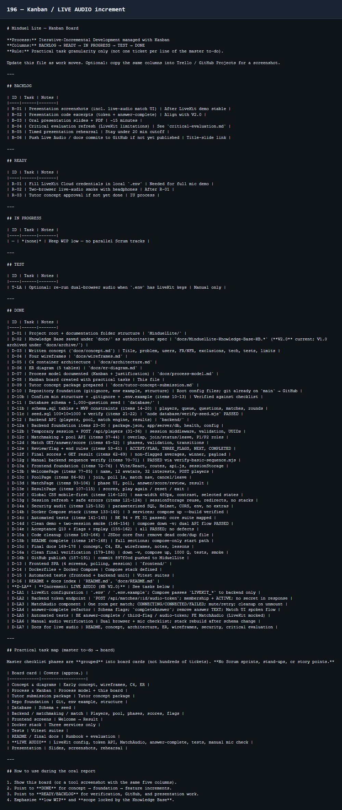
2. Planning & process — Kanban
Model: Iterative-Incremental Development managed with Kanban
Why not pure Scrum? Solo student, fixed MVP, short timeline — ceremonies add overhead without team coordination benefit.
Increments: concept → foundation → matchmaking → match → result → LIVE AUDIO → tests/docs → presentation.
Board columns: BACKLOG → READY → IN PROGRESS → TEST → DONE (evidence below).
Figure 1. Kanban board snapshot (own project process evidence).
Minduel Lite · DLBSEPPSD01_E · Oral Project Report
6/18

Slide 7
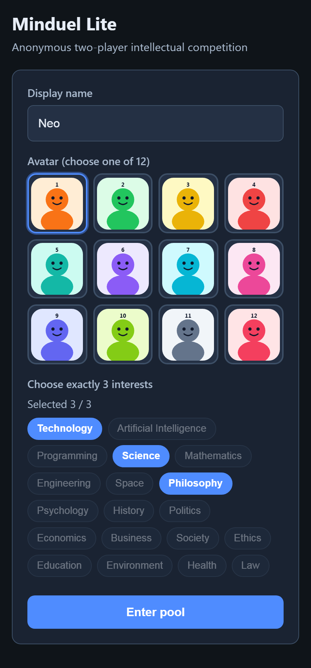
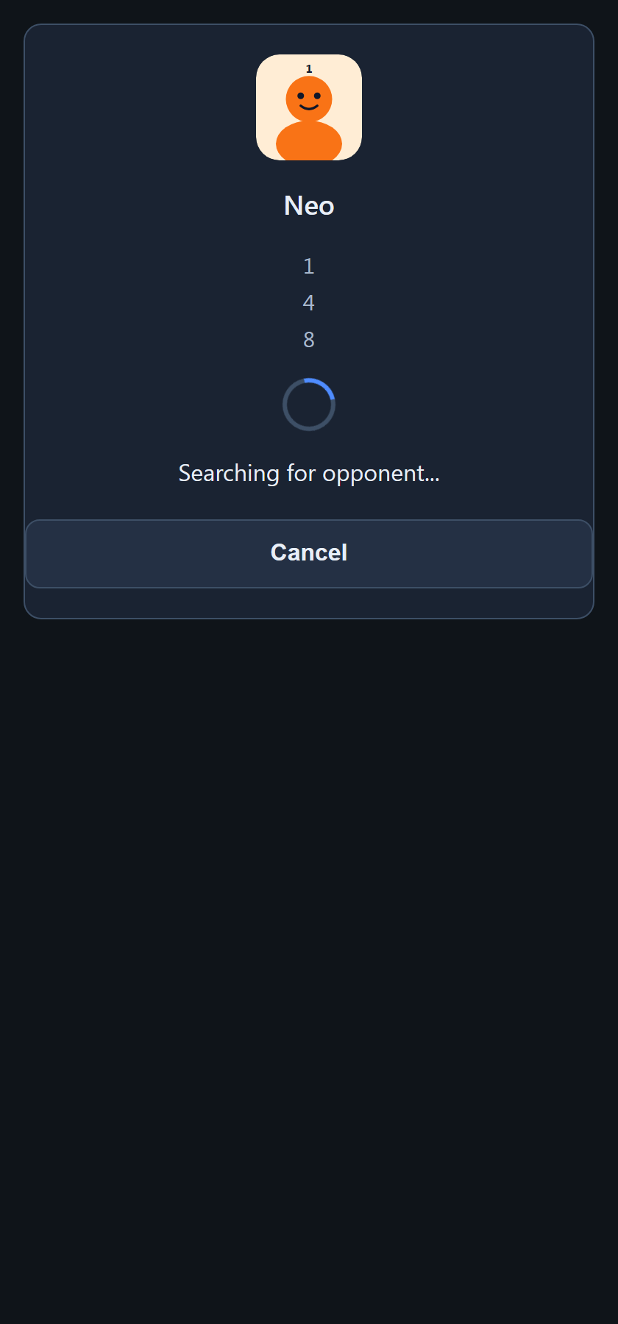
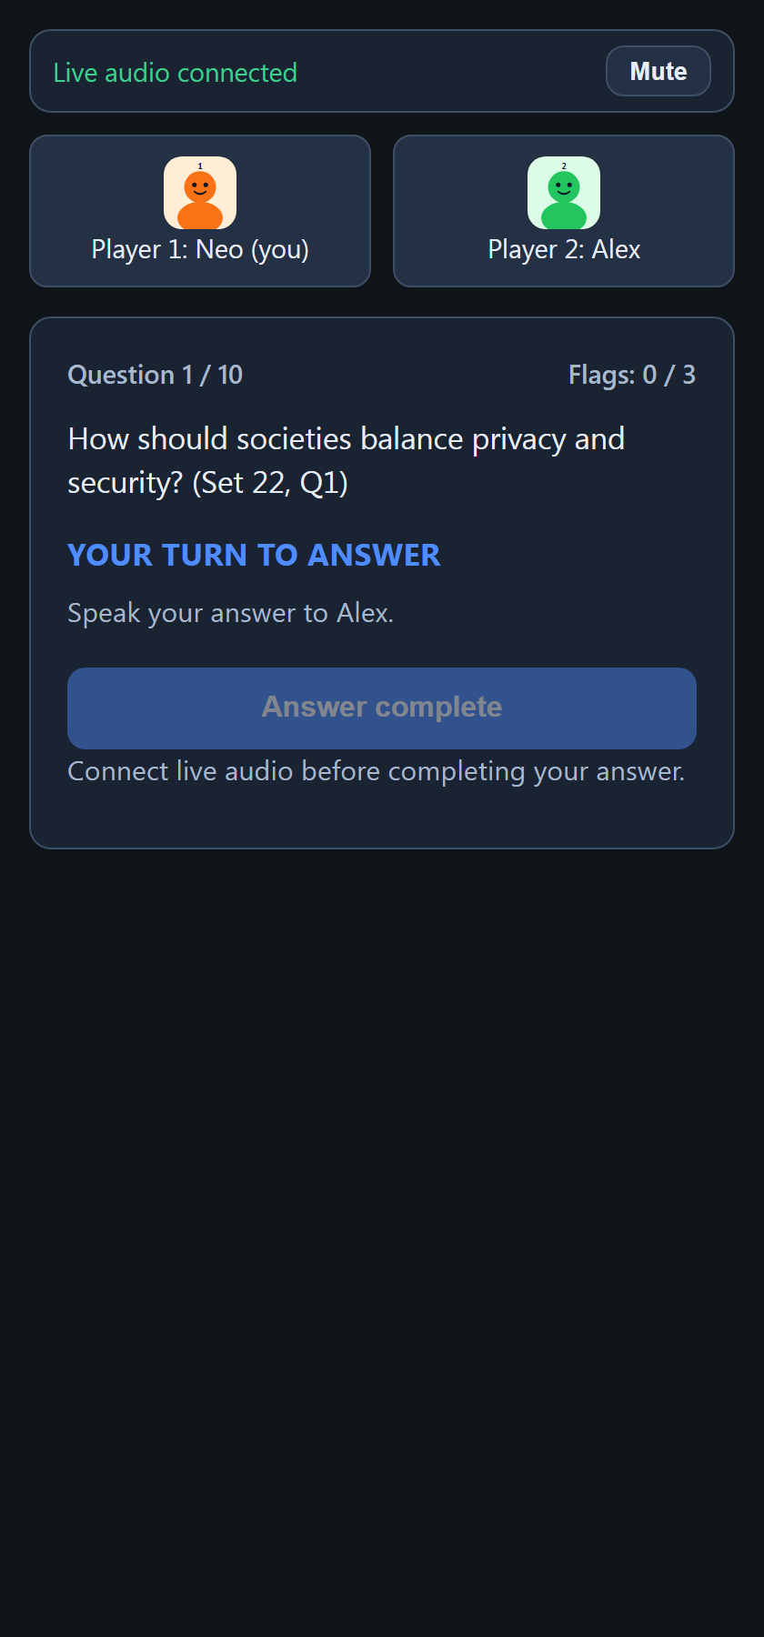
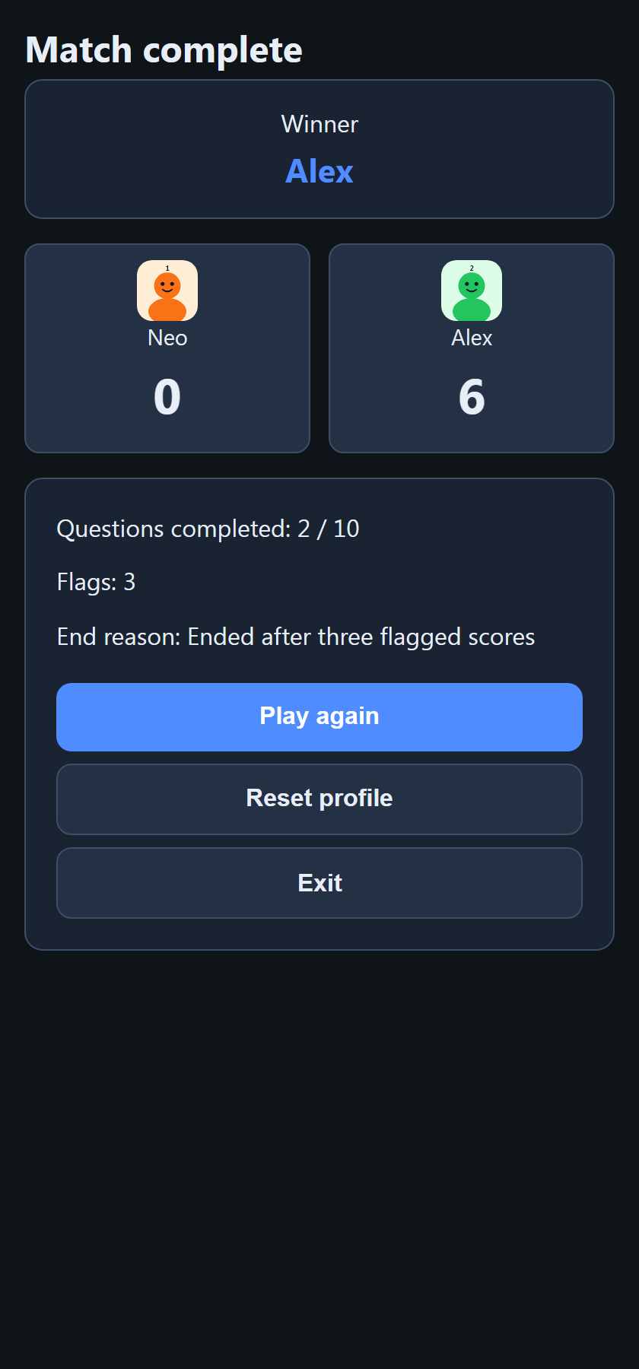
2. Planning — user journey (spoken live audio)
Welcome → Pool → match created → audio connected → spoken answers → Result
Play again → Pool (new match + new LiveKit room) · Reset → Welcome
Welcome
Pool
Match + audio
Result
Figures 2–5. Four-screen journey with live spoken match (own software).
Minduel Lite · DLBSEPPSD01_E · Oral Project Report
7/18

Slide 8
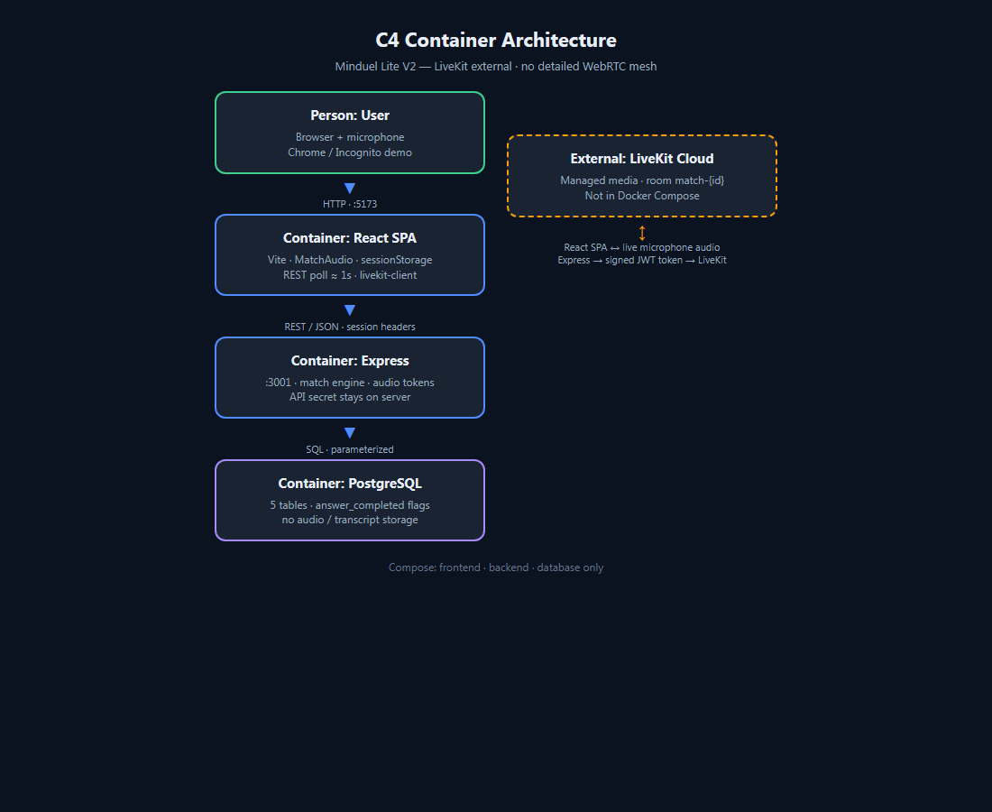
3. Architecture — C4 + LiveKit
Simple distinction: Express + PostgreSQL = game state · LiveKit = live audio · REST polling = game sync
Talking points
• EXPRESS + POSTGRESQL
= authoritative game state
• LIVEKIT (managed Cloud)
= live microphone audio
• REST polling ≈ 1s
= game synchronisation
• LiveKit is part of the
project’s defined solution
(not an IU audio mandate)
Figure 6. C4 + external LiveKit (own diagram). Media API: LiveKit docs (external).
Minduel Lite · DLBSEPPSD01_E · Oral Project Report
8/18

Slide 9
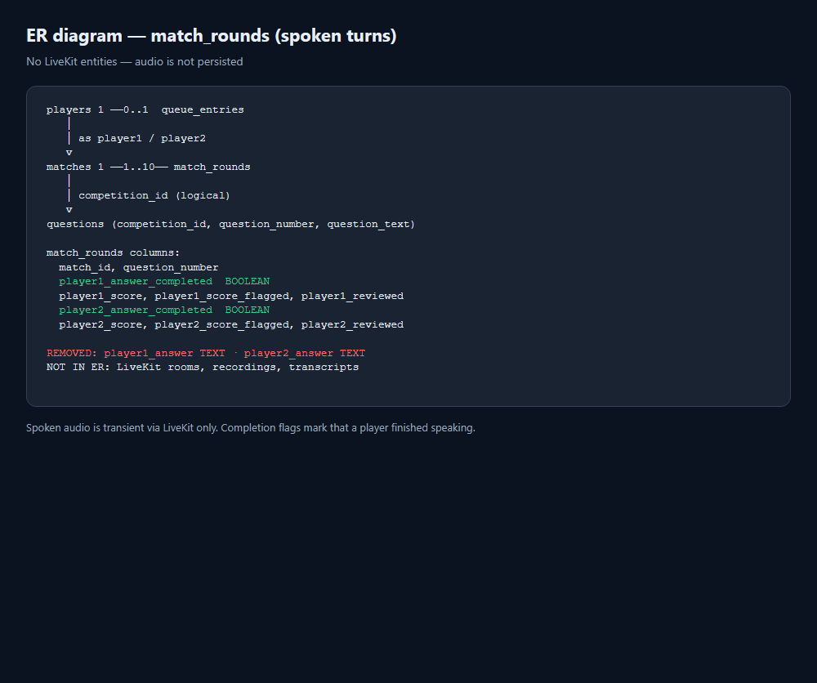
3. Architecture — data model
Figure 7. ER (own). answer_completed booleans; no answer TEXT; LiveKit not in ER (audio not persisted).
Minduel Lite · DLBSEPPSD01_E · Oral Project Report
9/18

Slide 10
4. Implementation — LiveKit token & MatchAudio
audioTokenService.js — signed grant (secret on server only)
MatchAudio.jsx — connect lifecycle
const at = new AccessToken(apiKey, apiSecret, {
identity: playerId,
ttl: '2h',
});
at.addGrant({
roomJoin: true,
room: `match-${matchId}`,
canPublish: true,
canSubscribe: true,
canPublishSources: [MICROPHONE],
canPublishData: false,
});
const token = await at.toJwt();
return { token, serverUrl };
// CONNECTING → getAudioToken → Room
const { token, serverUrl } =
await getAudioToken(matchId);
room = new Room({ ... });
room.on(TrackSubscribed, attachRemote);
await room.connect(serverUrl, token);
await room.localParticipant
.setMicrophoneEnabled(true);
setAudioState('CONNECTED');
// cleanup on unmount only:
// mic off, disconnect, remove listeners
// deps: [matchId] — not phase/question
Actual source excerpts. Membership validated before token; no API secret in the browser.
Minduel Lite · DLBSEPPSD01_E · Oral Project Report
10/18

Slide 11
4. Implementation — matchmaking & third flag
matchmakingService.js
matchService.js — submitReview
export function selectBestCandidate(
currentInterests, waitingPlayers) {
return waitingPlayers
.map(c => ({ ...c,
overlap: calculateInterestOverlap(
currentInterests, c.interests) }))
.filter(c => c.overlap >= 1) // never 0
.sort((a, b) => {
if (b.overlap !== a.overlap)
return b.overlap - a.overlap;
return new Date(a.joined_at)
- new Date(b.joined_at);
})[0] || null;
}
if (flag) {
await client.query(
`UPDATE matches
SET flag_count = flag_count + 1
WHERE id = $1`, [matchId]);
}
const m = (await client.query(
'SELECT * FROM matches WHERE id = $1',
[matchId])).rows[0];
// Immediate end — do not wait for
// the other player's review
if (m.flag_count >= 3) {
await client.query(
`UPDATE matches SET status='ENDED',
end_reason='THREE_FLAGS',
ended_at=NOW() WHERE id=$1`,
[matchId]);
}
Business logic excerpts: interest priority 3→2→1; third flag ends at count 3 (parameterized SQL).
Minduel Lite · DLBSEPPSD01_E · Oral Project Report
11/18

Slide 12
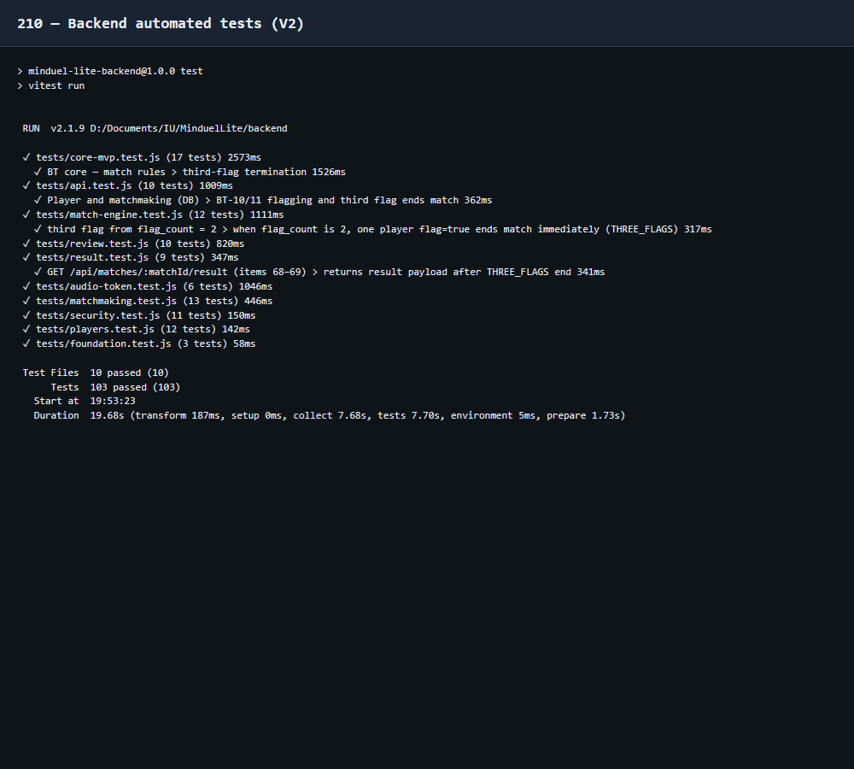
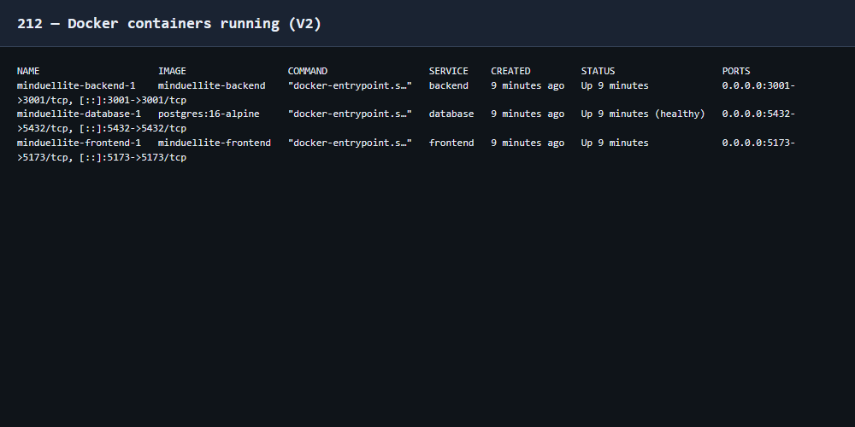
5. Testing & reproducible run
Backend: audio-token (participant / outsider / ended match / no secret leak); answer-complete; third-flag from flag_count=2
Frontend: MatchAudio CONNECTING / CONNECTED / FAILED + RETRY; cleanup disconnect; Answer complete calls completeAnswer
Manual: Chrome + Incognito; mic permission; Live audio connected; speak both ways; full spoken match path
docker compose up --build · LiveKit env on backend only
Figures. Backend test evidence; Docker services (own environment).
Minduel Lite · DLBSEPPSD01_E · Oral Project Report
12/18

Slide 13
5. Software result — what was demonstrated
Evidence of an operational system (process outcome), not a feature-by-feature UI description:
Two browser sessions share Express + PostgreSQL; each joins LiveKit for speech
Match created → audio connected → spoken answers (answer-complete, no text upload)
Authoritative phases: speak → score → review; third flag ends immediately
Speech not recorded/stored/transcribed; only completion flags + scores in DB
Play-again: new match + new LiveKit room; Docker Compose runs three app services
Repository: frontend, backend, DB, Docker, tests, docs (GitHub on title slide)
Minduel Lite · DLBSEPPSD01_E · Oral Project Report
13/18

Slide 14
6. Evaluation — was the goal achieved?
Yes — for the defined academic MVP (not production readiness).
Evidence
Why LiveKit (not raw WebRTC)
Two anonymous browser sessions
Interest matchmaking (3→2→1)
Live spoken turns + peer scoring
Flags → THREE_FLAGS at count 3
SPA + API + Postgres + LiveKit
Docker Compose (3 app services)
Automated tests pass (FE + BE)
LiveKit is part of this project’s defined solution (not an IU-required audio stack). Managed LiveKit reduced:
• signaling complexity
• TURN/STUN responsibility
• connection-management complexity
• development time
(Technical API: LiveKit official docs.)
Limits: Cloud + internet, demo reconnection, no recording/transcription/moderation, temporary sessions, polling for game state.
Minduel Lite · DLBSEPPSD01_E · Oral Project Report
14/18

Slide 15
6. Reflection & future improvements
Lessons from this implementation
Discussed only (not implemented)
Managed LiveKit avoided raw WebRTC infrastructure
Server-owned game state + short-lived media tokens
Polling adequate for game sync; LiveKit for audio only
Focused tests (token, audio states, third flag) beat volume
Authenticated accounts & history
WebSockets for game state; advanced reconnect
Recording / transcription / voice moderation
Cloud deploy of the app stack; rankings
Minduel Lite · DLBSEPPSD01_E · Oral Project Report
15/18

Slide 16
Conclusion
Task definition drove a deliberately small MVP
Kanban + iterative increments structured solo development
Architecture and state machine kept multiplayer consistent
Tests, Docker, and GitHub complete the Task 2 evidence chain
https://github.com/MahmoudBKanaan/MiduelLite
Minduel Lite · DLBSEPPSD01_E · Oral Project Report
16/18

Slide 17
List of figures
All figures below are the author’s own work produced for this project (UI screenshots, process evidence, and original diagrams). External materials are listed only in the bibliography.
Figure 1. Kanban board snapshot (project process evidence).
Figures 2–5. Application screenshots: Welcome, Pool, Match, Result (own software).
Figure 6. C4 container architecture diagram (own diagram).
Figure 7. Entity-relationship diagram (own diagram).
Figure 8. User flow and match state machine (own diagram).
Figure 9. Automated test run output (own development environment).
Figure 10. Docker Compose services status (own development environment).
Minduel Lite · DLBSEPPSD01_E · Oral Project Report
17/18

Slide 18
Bibliography
APA 7th-style references for external sources used in the project and presentation. Original project diagrams and screenshots are not external sources.
IU International University of Applied Sciences. (n.d.). Task for course DLBSEPPSD01_E – Software Development [Examination task]. Examination Office.
IU International University of Applied Sciences. (n.d.). Guidelines for the creation of an oral project report. Examination Office.
Meta Platforms. (n.d.). React documentation. https://react.dev/
OpenJS Foundation. (n.d.). Express — Node.js web application framework. https://expressjs.com/
PostgreSQL Global Development Group. (n.d.). PostgreSQL documentation. https://www.postgresql.org/docs/
Docker Inc. (n.d.). Docker Compose documentation. https://docs.docker.com/compose/
LiveKit. (n.d.). LiveKit documentation. https://docs.livekit.io/
LiveKit. (n.d.). Access tokens. https://docs.livekit.io/home/server/generating-tokens/
LiveKit. (n.d.). JavaScript client SDK. https://docs.livekit.io/home/client/connect/
Kanaan, M. B. (2026). Minduel Lite [Computer software]. GitHub. https://github.com/MahmoudBKanaan/MiduelLite
Minduel Lite · DLBSEPPSD01_E · Oral Project Report
18/18

