Slide 1



Ministry of Communications and Information Technology
Digital Egypt Pioneers Initiative
STUDENT MANAGEMENT SYSTEM
Java Object-Oriented Programming • Graduation Project
Mahmoud Bakri AbdelSamea Ahmed
ONL5_SWD6_G1
Notes:
رحّب باللجنة. قدّم نفسك والجامعة والمبادرة. المشروع تطبيق عملي لمبادئ OOP في سيناريو أكاديمي.

Slide 2
AGENDA
01 Vision & Scope
06 Validation & Exceptions
02 System Architecture
07 Testing Evidence
03 UML Class Diagram
08 HTML Reporting
04 OOP Principles
09 Gaps & Next Phase
05 Domain & Business Rules
10 Conclusion
Student Management System • DEPI 2026/2027
2 / 14
Notes:
استعرض الأجندة بسرعة. ركّز أن العرض يغطي التصميم الكائني والتحقق والاختبارات وخطة المرحلة القادمة.

Slide 3



01 • PROJECT VISION
A structured academic management system applying Java OOP to a real university scenario.
MANAGE
VALIDATE
REPORT
• Students & Instructors
• Input validation
• HTML academic reports
• Courses & Enrollment
• Business rules
• Statistics dashboard
• Grades & Attendance
• Domain exceptions
• Student full report
Student Management System • DEPI 2026/2027
3 / 14
Notes:
الهدف: تطبيق OOP عمليًا. ثلاثة محاور: إدارة – تحقق – تقارير.

Slide 4
02 • SYSTEM ARCHITECTURE
Presentation • Main (Console Menu)
User interaction loop • Menu-driven workflow
Service Layer
StudentManagementSystem • HTMLReportService
Domain Model
Person • Student • Instructor • Course • Grade • Attendance • Department
Support
Enums (StudentType, InstructorType, AttendanceStatus) • CourseEnrollmentException
Student Management System • DEPI 2026/2027
4 / 14
Notes:
اعرض الطبقات من أعلى لأسفل. Main بدون منطق أعمال، Service ينسق، Model يحمل القواعد.

Slide 5
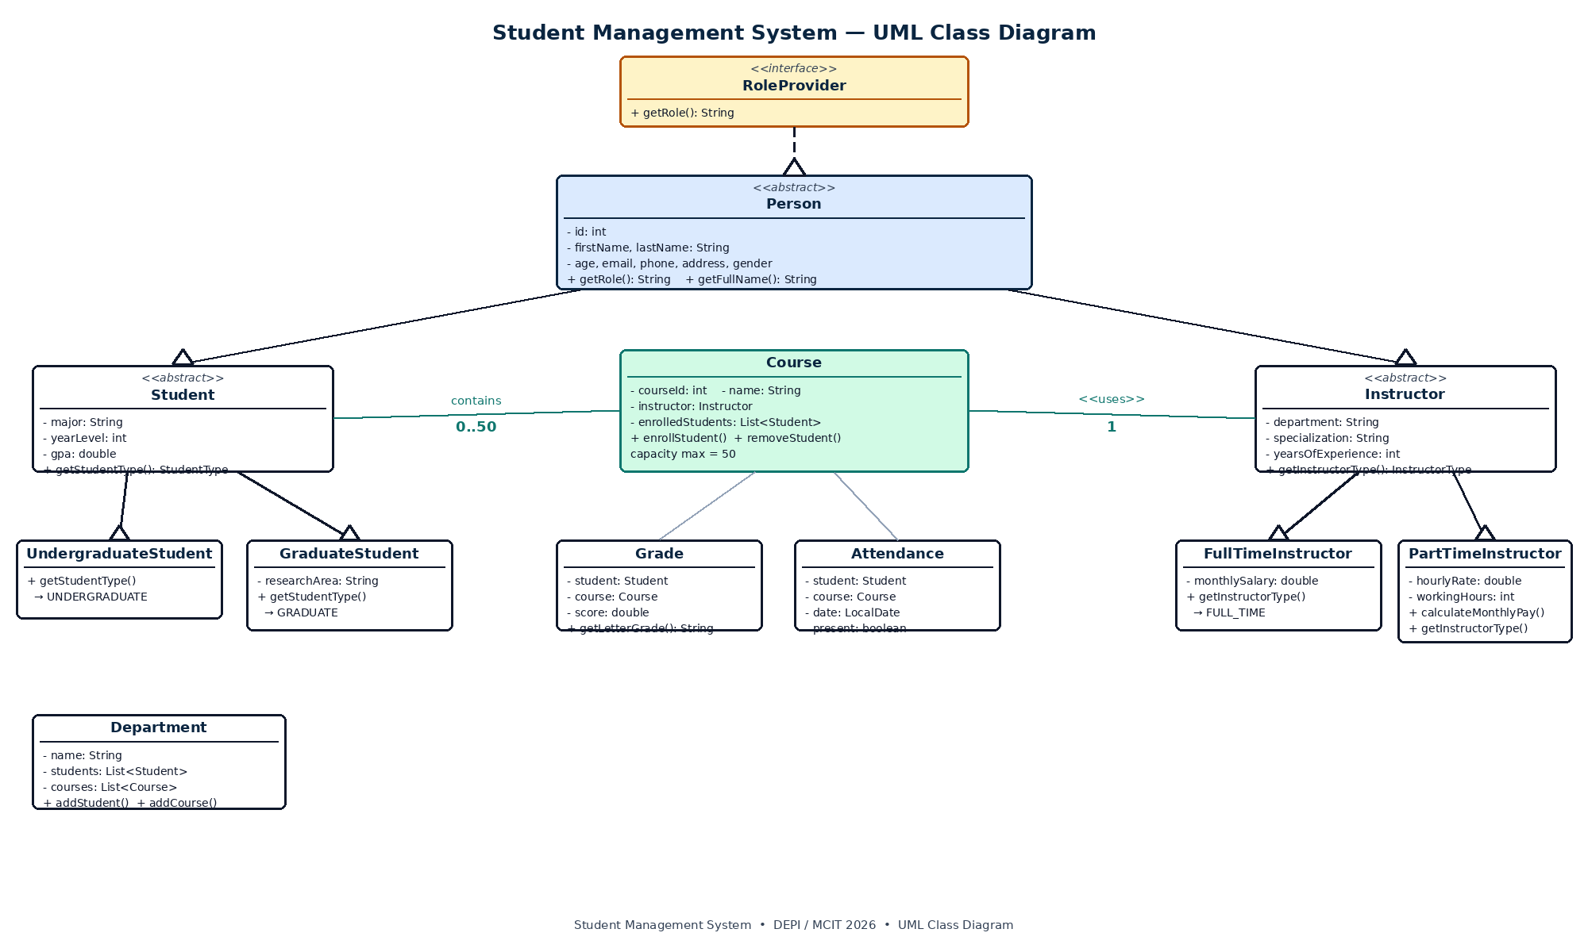
03 • UML CLASS DIAGRAM
Student Management System • DEPI 2026/2027
5 / 14
Notes:
اشرح الـ hierarchy: RoleProvider → Person → Student/Instructor → الأنواع الملموسة. Course يرتبط بـ Instructor وطلاب.

Slide 6
04 • OOP PRINCIPLES DEMONSTRATED
Encapsulation
Inheritance
Abstraction
Private fields + validated setters protect object state.
Person → Student / Instructor → concrete types.
Abstract Person, Student, Instructor define contracts.
Polymorphism
Interface
Composition
Subclasses provide type-specific runtime behavior.
RoleProvider formalizes getRole() cleanly.
Department & Course manage related objects.
Student Management System • DEPI 2026/2027
6 / 14
Notes:
الشريحة الأهم. اذكر مثالاً سريعًا لكل مبدأ من الكود الفعلي.

Slide 7
05 • DOMAIN MODEL & BUSINESS RULES
Entity
Key Responsibility
Person
Identity + contact + role
Student
Major, year, GPA (UG / Grad)
Instructor
Dept, specialization, experience
Course
Instructor + enrollment (max 50)
Grade
Score 0–100 → letter grade
Attendance
Student + Course + Date + status
Department
Aggregates students & courses
Student Management System • DEPI 2026/2027
7 / 14
Notes:
مر سريعًا على الكيانات. ركّز على Course capacity و Grade derivation.

Slide 8
06 • VALIDATION & EXCEPTION HANDLING
INPUT VALIDATION
DOMAIN EXCEPTION
▸ Names → non-blank, trimmed
CourseEnrollmentException
▸ Age → > 0
Checked exception for enrollment business rules.
▸ Email → pattern match
▸ Phone → +201XXXXXXXXX
Triggered by:
▸ GPA → 0.0 – 4.0
• Null student
▸ Score → 0 – 100
• Duplicate enrollment
▸ Year → 1 – 6
• Capacity exceeded
▸ Capacity → max 50
Student Management System • DEPI 2026/2027
8 / 14
Notes:
الـ validation يمنع حالة غير صالحة، والـ Exception المخصصة تجعل قاعدة التسجيل واضحة.

Slide 9

07 • TESTING EVIDENCE
TC-01
TC-02
Valid student → ID assigned
Graduate + research area stored
TC-03
TC-04
Invalid age/email/phone rejected
Duplicate enrollment → Exception
TC-05
TC-06
Grade 90 → A + GPA 4.00
Attendance rate correct
TC-07
TC-08
HTML reports generated
Statistics match live counts
Student Management System • DEPI 2026/2027
9 / 14
Notes:
النتائج موثقة في Test Report. الاختبارات يدوية عبر Console.

Slide 10
08 • HTML REPORTING
HTMLReportService separates presentation from domain logic.
Students
Instructors
Courses
ID, Name, Type, Major, GPA
Type, Dept, Spec, Pay
Enrollment, Capacity, Rate
Grades
Student Report
Dashboard
Student, Course, Letter
Profile + Grades + Attendance
System-wide statistics
Student Management System • DEPI 2026/2027
10 / 14
Notes:
التقارير تفصل العرض عن المنطق.

Slide 11
09 • CURRENT GAPS & NEXT PHASE
CURRENT GAPS
NEXT PHASE ADDITIONS
▸ No data persistence (in-memory)
▸ JSON / SQLite persistence
▸ No automated Unit Tests (JUnit)
▸ JUnit 5 unit + integration suite
▸ No instructor delete operation
▸ Delete Instructor operation
▸ Phone validation limited to +201
▸ Flexible phone validation
▸ No authentication / roles
▸ Simple login + roles
▸ Console-only interface
▸ Optional JavaFX / Web UI
Student Management System • DEPI 2026/2027
11 / 14
Notes:
كن صريحًا: الفجوات معروفة ومخططة. الشفافية تزيد الثقة.

Slide 12
10 • NEXT PHASE ROADMAP
Phase 1
Persistence
JSON or SQLite • Load/Save on start/exit
Phase 2
Testing
JUnit 5 for models, services & rules
Phase 3
Security
Login + role-based access
Phase 4
UI Layer
JavaFX or web interface
Phase 5
Analytics
GPA trends • PDF/Excel export
Phase 6
Production
Logging • Packaging • Deploy
Student Management System • DEPI 2026/2027
12 / 14
Notes:
المرحلة 1 و 2 هما الأولوية القصوى للاكتمال.

Slide 13
CONCLUSION
A complete academic domain model
implemented with practical Java OOP principles.
Encapsulation • Inheritance • Abstraction • Polymorphism
Interface • Validation • Exceptions • Collections • Reporting
Notes:
اختم بتأكيد أن المشروع يحقق أهداف OOP ويضع أساسًا واضحًا للتطوير.

Slide 14
THANK YOU
Mahmoud Bakri AbdelSamea Ahmed
ONL5_SWD6_G1
Digital Egypt Pioneers Initiative
Questions & Discussion Welcome
Notes:
اشكر اللجنة وافتح باب الأسئلة.

