Slide 1
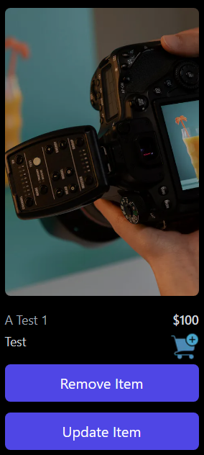
E-commerce Business
E-commerce is the buying and selling of goods and services online.

Slide 2
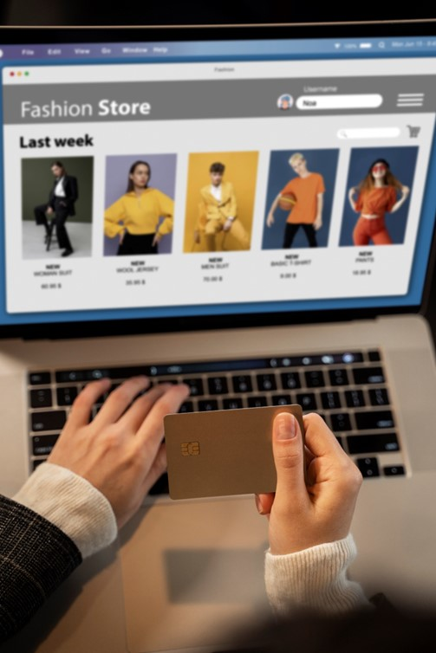

Introduction
Team member:
Mahmoud Easa
Person’s role:
All roles

Slide 3
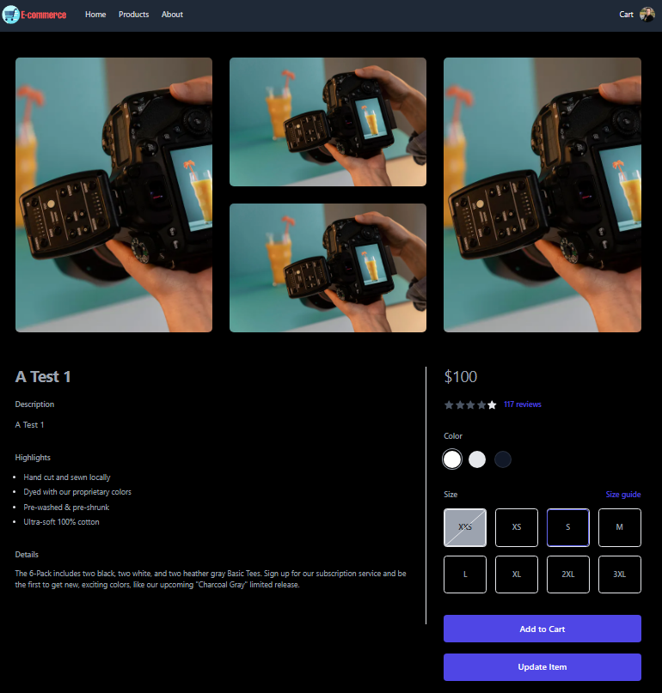
Story of how the project was inspired
I have been learning about web development for a while now, and I have always wanted to start my own e-commerce business. When I was asked to come up with an idea for a project to work on in the program, I decided to use the opportunity to implement the idea that I had been thinking about for a while.

Slide 4
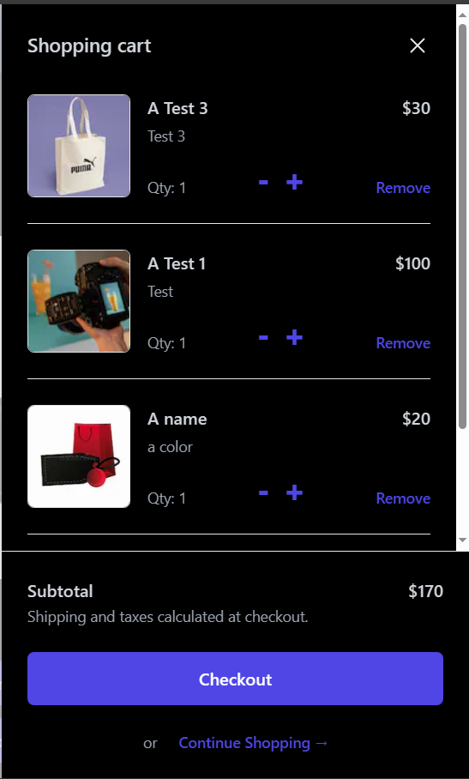
Technology
Back-End:
Front-End:
1- Python
2- Flask
3- Flask_cors
4- MySQL
5- Sqlalchemy
1- Nextjs
2- Firebase (To store images)
3- Tailwind CSS
4- Axios
Server: (ubuntu)
1- Nginx
2- Gunicorn
3- Firewall
4- Load balancer (HAproxy)

Slide 5
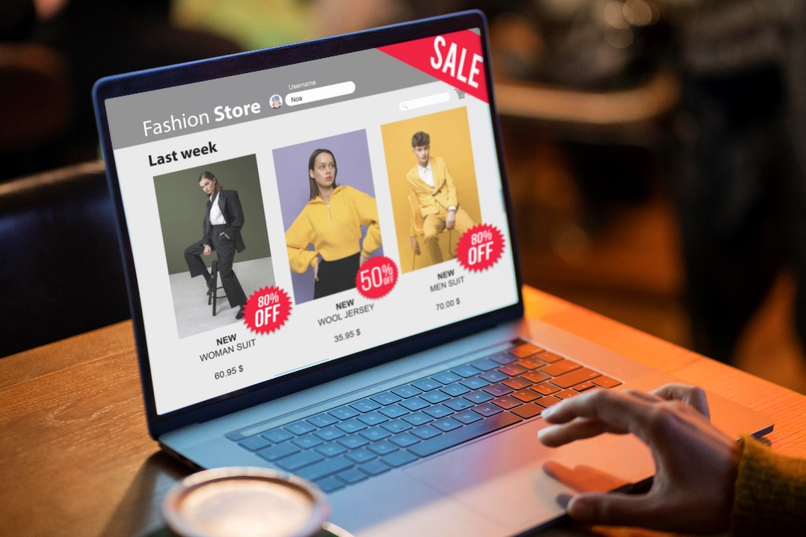
Architecture
1- Home
2- Products
3- About
4- Cart
5- Your Profile
6- Your Orders
7- Sign In
8- Sign Out
9- Sign Up
10- Add Item (For Admin)
11- Remove Item (For Admin)
12- Update Item (For Admin)

Slide 6

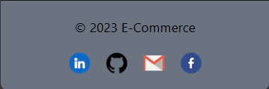
Live Demo
https://www.mahmoudeasa.tech/

Slide 7
Core algorithms and code snippet
1-

Slide 8
Discussion of process, collaboration and timeline
1-

Slide 9
Challenge(s) overcome
1-

Slide 10
Learnings about technical interests as a result of this project
1-

Slide 11
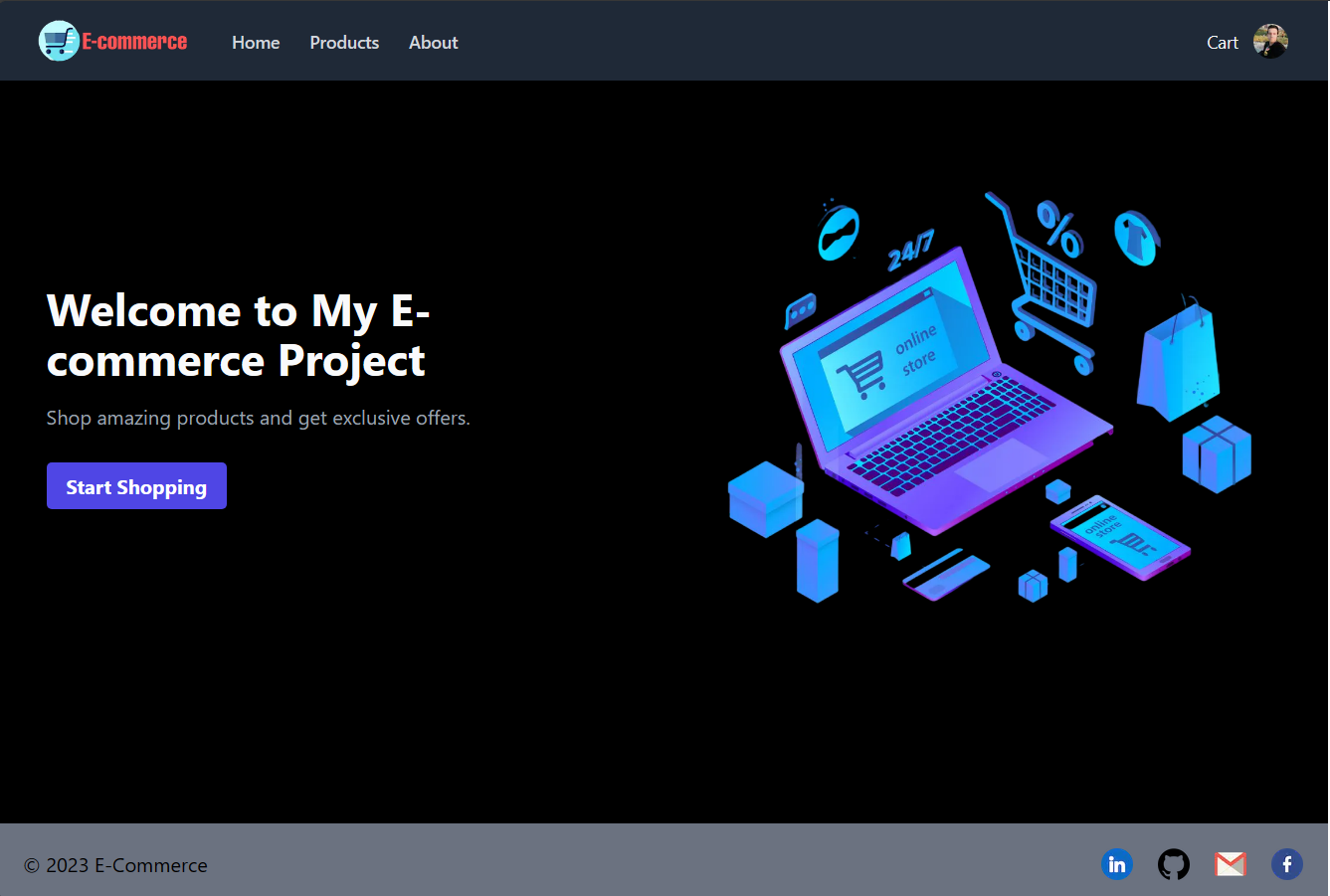

Slide 12
Thank You!

