Slide 1
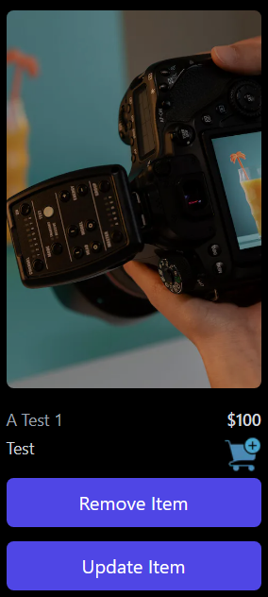
E-commerce Business
E-commerce is the buying and selling of goods and services online.

Slide 2
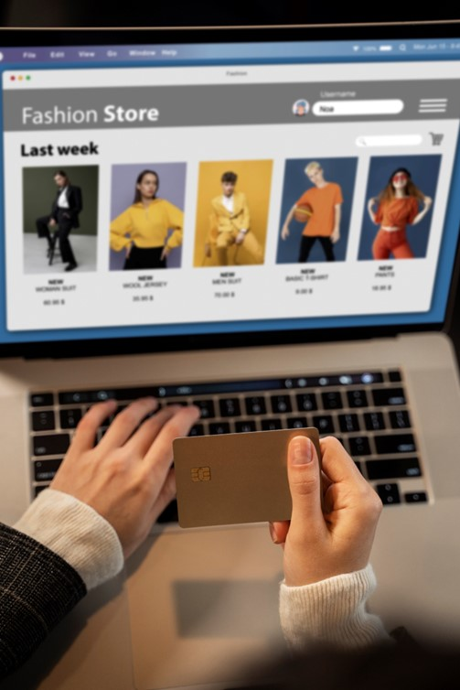

Introduction
Team member:
Mahmoud Easa
Person’s role:
All roles

Slide 3
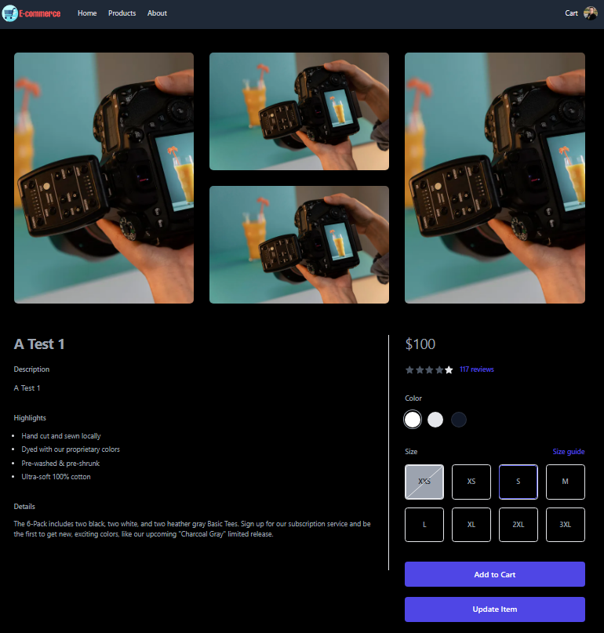
Story of how the project was inspired
I have been learning about web development for a while now, and I have always wanted to start my own e-commerce business. When I was asked to come up with an idea for a project to work on in the program, I decided to use the opportunity to implement the idea that I had been thinking about for a while.

Slide 4
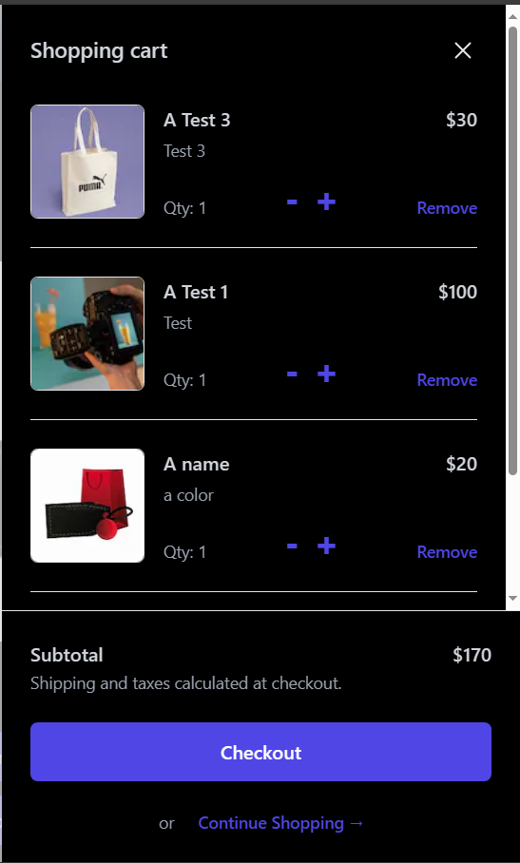
Technology
1-
2-
3-
4-
5-
6-

Slide 5
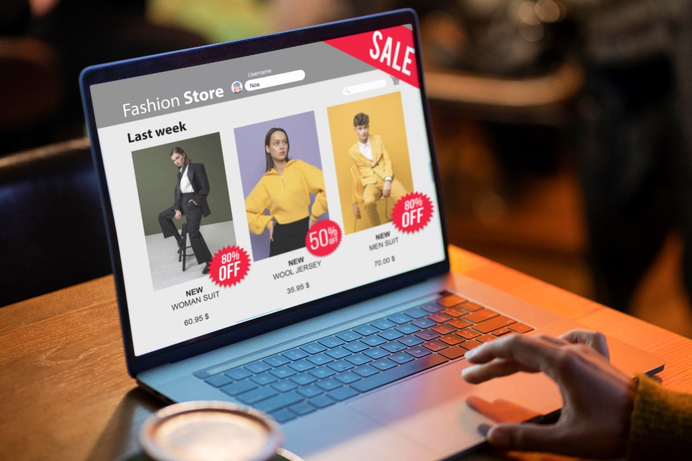
Architecture
1-
2-
3-
4-
5-

Slide 6
Core algorithms and code snippet
1-

Slide 7
Discussion of process, collaboration and timeline
1-

Slide 8
Challenge(s) overcome
1-

Slide 9
Learnings about technical interests as a result of this project
1-

Slide 10


Live Demo
https://www.mahmoudeasa.tech/

Slide 11
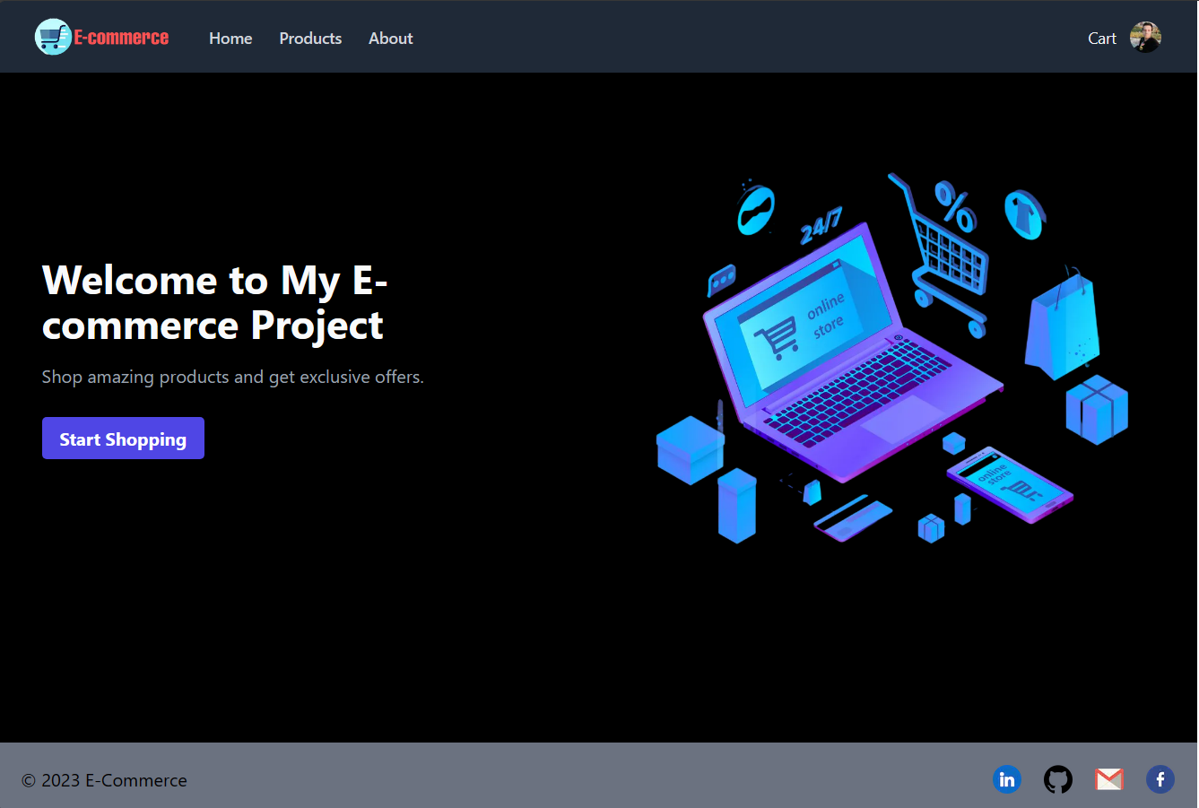

Slide 12
Thank You!

