Slide 1
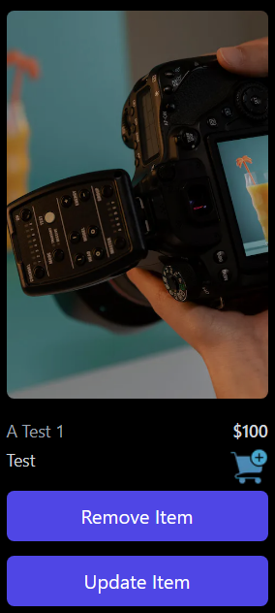
E-commerce Business
E-commerce is the buying and selling of goods and services online.

Slide 2
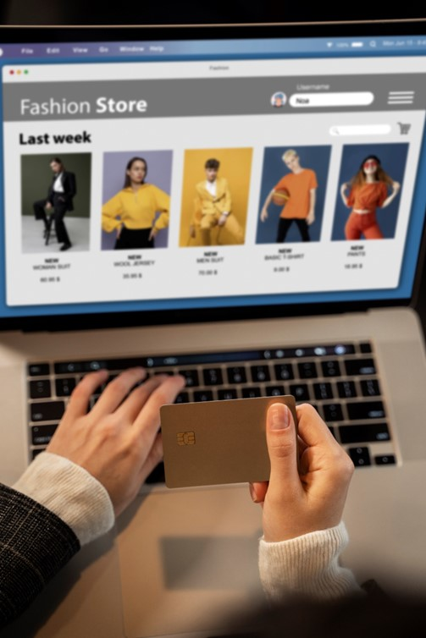

Introduction
Team member:
Mahmoud Easa
33 years old software engineer
A student at ALX
Person’s role:
I developed the entire project by myself, including the Front-End and Back-End. So, there is no other team member.

Slide 3
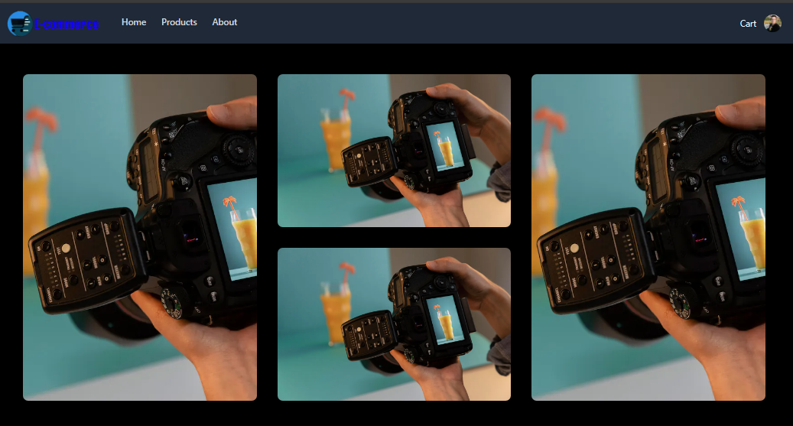
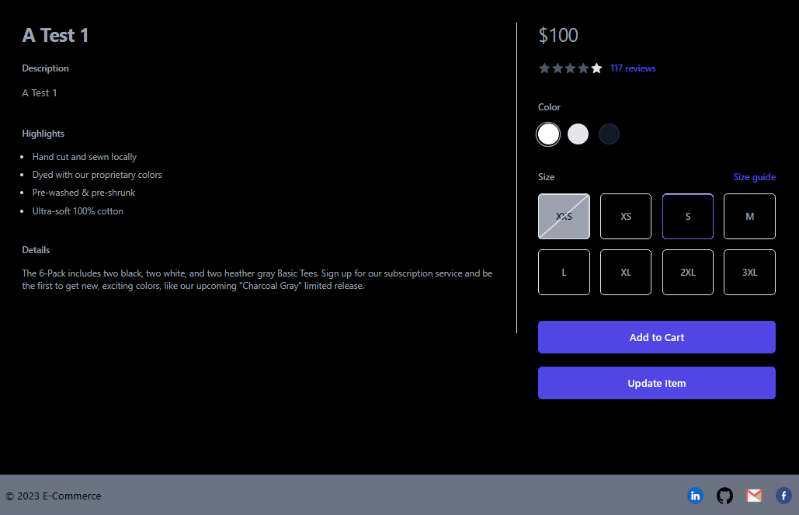
Story of how the project was inspired
I have been learning about web development for a while now, and I have always wanted to start my own e-commerce business. When I was asked to come up with an idea for a project to work on in the program, I decided to use the opportunity to implement the idea that I had been thinking about for a while.

Slide 4
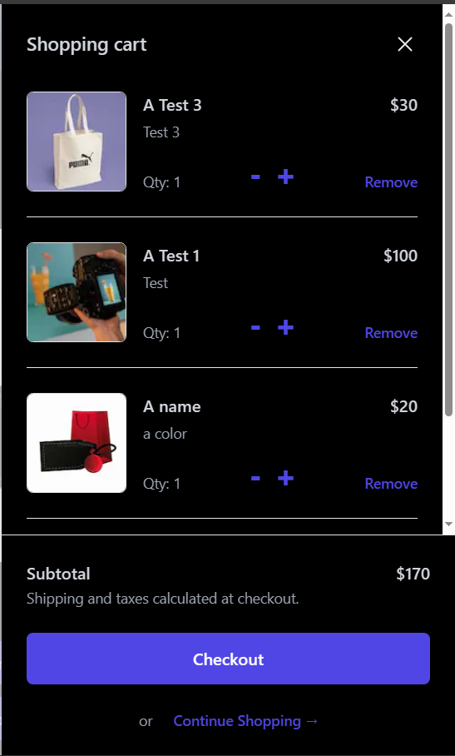
Technology
Back-End:
Front-End:
1- Python
2- Flask
3- Flask_cors
4- MySQL
5- Sqlalchemy
1- Nextjs
2- Firebase (To store images)
3- Tailwind CSS
4- Axios
Server: (ubuntu)
1- Nginx
2- Gunicorn
3- Firewall
4- Load balancer (HAproxy)

Slide 5
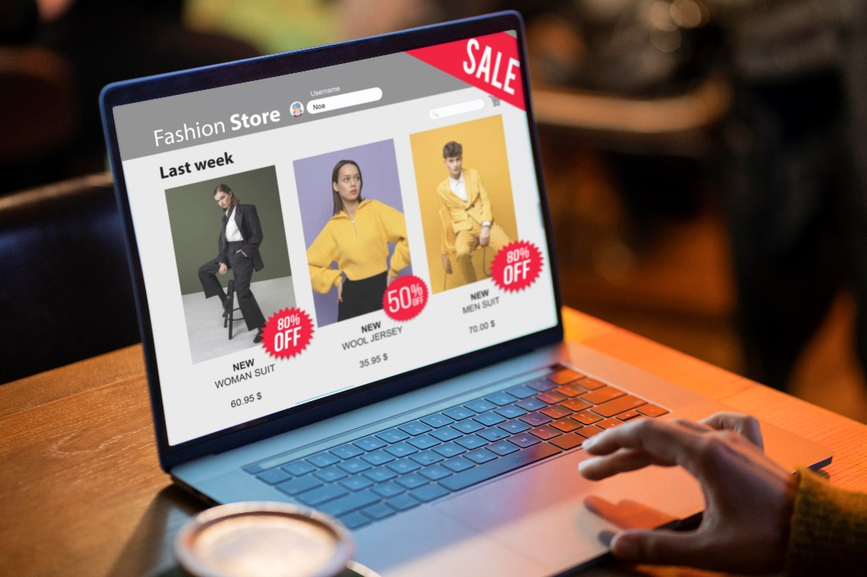
Architecture
1- Home
2- Products
3- About
4- Cart
5- Your Profile
6- Your Orders
7- Sign In
8- Sign Out
9- Sign Up
10- Add Item (For Admin)
11- Remove Item (For Admin)
12- Update Item (For Admin)

Slide 6
Discussion of process, collaboration and timeline
Started by the Back-End models, engine, app flask
Create API endpoints to handle requests.
Create A simple Front-End.
Add more features.
Deploy the Back-End on the server.
Deploy the Front-End on the Vercel Platform.

Slide 7
Challenge(s) overcome
When I first deployed my application to the server, I was using Next.js for the first time. I was familiar with React.js, but I chose Next.js for its easy routes.
Integrating Flask with Next.js: I initially tried to integrate Flask with Next.js, In the end, I decided to keep them separate and call the APIs from the front-end. This was a more straightforward solution and it worked perfectly.
Deploying the application: When I first deployed the entire application to the server, it was too heavy and would crash. This was because the back-end and front-end were both running on the same server. In the end, I moved the Front-End to Vercel, which is a cloud-based hosting platform that is optimized for static websites. This solved the problem and the website now works perfectly.
When I moved the Front-End to Vercel and left the Back-End on the server, the problem was solved and the website worked efficiently and quickly.
I am happy that I was able to overcome these challenges and successfully deploy my application. This experience has taught me a lot about integrating different technologies and deploying applications to the server.

Slide 8
Learnings about technical interests as a result of this project
Learn Nextjs.
Learn Flask.
Learn Python.
Learn APIs.
Learn MySQL.
Learn Sqlalchemy to handle databases.
Learn more about requests model and http headers usage.
Learn more about handling servers (Ubuntu) using:
Nginx, Gunicorn, Firewall, and Load balancer.
Learn Nextjs.
Learn Firebase Storage to store images.
Learn Tailwind CSS.
Learn Axios to handle requests from Front-End to Back-End.
Learn a little about E-Commerce business.

Slide 9
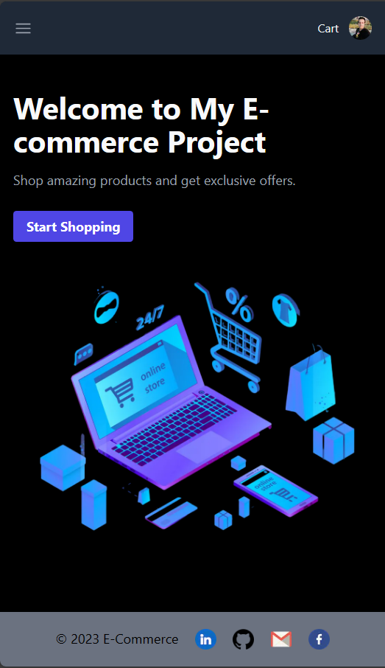
Live Demo
https://www.mahmoudeasa.tech/

Slide 10
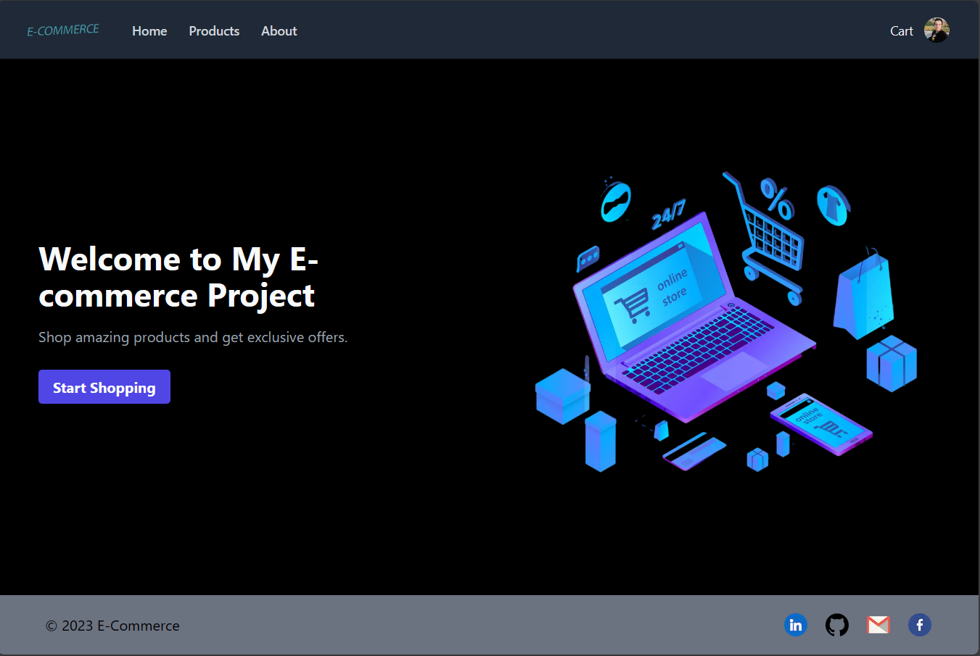

Slide 11
Thank You!

