Slide 1
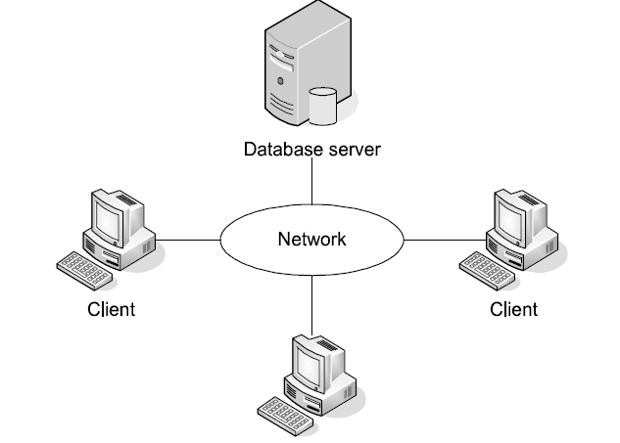
Client/Server Architecture
Notes:
Client/Server Hardware implementation:
1-client need pc can communicate through LAN.
2-Server must be a computer with special and efficient hardware ex: mainframe.
3-Network can be LAN or WAN or Internet (depends on your business).
Client/Server system implementation:
1-Server need DBMS to manage Data as SQL Server or oracle.
2-Client have application software this application software must contain Database API(Application Programming Interface) As ADO.Net, It provide service like taking the SQL queries and transmitting to SQL Server and Return result.

Slide 2
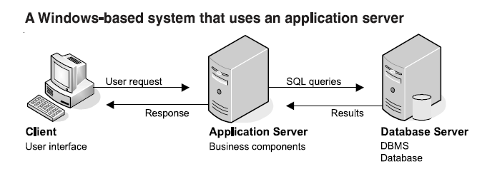
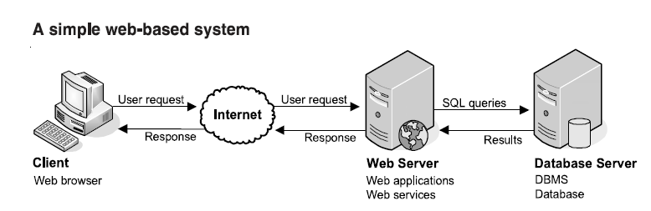
Other Client/Server Architectures
Notes:
In windows based system the only user interface running on the client pc and the user do some sort of action required processing from application server, it sends the request for the server for processing the application server receive the request and make processing and find that processing requires accessing data in database, the application server formulate the appropriate query and sent it to the database server, the result of the query sent back to the application server which making processing and sent the appropriate response to the client.

Slide 3
SQL
S-Q-L or sequel
SQL is both an ANSI and ISO standard language based on the relational model, designed for querying and managing data in an RDBMS
SQL used a declarative programming paradigm not imperative
Notes:
In the early 1970s, IBM developed a language called SEQUEL (short for Structured English QUEry
Language) for their RDBMS product called System R. The name of the language was later changed
from SEQUEL to SQL because of a trademark dispute. SQL first became an ANSI standard in 1986,
and then an ISO standard in 1987. Since 1986, the American National Standards Institute (ANSI) and
the International Organization for Standardization (ISO) have been releasing revisions for the SQL
standard every few years. So far, the following standards have been released: SQL-86 (1986), SQL-89
(1989), SQL-92 (1992), SQL:1999 (1999), SQL:2003 (2003), SQL:2006 (2006), SQL:2008 (2008), and
SQL:2011 (2011).
Imperative: what to do and how to do.
Declarative: What to do only.
Or
imperative - The focus is on what steps the computer should take rather than what the computer will do(ex. C, C++, Java).
Declarative - The focus is on what the computer should do rather than how it should do it (ex. SQL).

Slide 4
SQL Categories
DDL: stands for Data Definition Language, deals with object definition and include statements such as CREATE, ALTER, DROP.
DML: stands for Data Manipulation Language DML allows you to query and modify data and includes statements such as SELECT, INSERT, UPDATE, DELETE, TRUNCATE, and MERGE.

Slide 5
SQL Categories(Cont.)
DCL: stands for data control language, deals with permissions and includes statements such as GRANT and REVOKE
Notes:
It’s acommon misunderstanding that DML includes only data modification statements, but as I mentioned,
it also includes SELECT. Another common misunderstanding is that TRUNCATE is a DDL statement,
but in fact it is a DML statement. DCL deals with permissions and includes statements such as GRANT
and REVOKE.
The GRANT command is used by administrators to add new permissions to a database user.
The REVOKE command is used to remove database access from a user previously granted such access.

Slide 6
T-SQL
Microsoft’s and Sybase’s proprietary extension to SQL.
T-SQL expands on the SQL standard to include:
1-Procedural Programming
2-Local Variables
3-various support functions for string processing
4-changes to the UPDATE and DELETE statements.

Slide 7
SQL Server History
year | Release name | Code name
1989 | SQL Server 1.0 (16 bit) | -
1991 | SQL Server 1.1 (16 bit) | -
1993 | SQL Server 4.21 | SQLNT
1995 | SQL Server 6.0 | SQL95
1996 | SQL Server 6.5 | Hydra
1998 | SQL Server 7.0 | Sphinx
1999 | SQL Server 7.0 OLAP Tools | Palato mania
2000 | SQL Server 2000 | Shiloh
2003 | SQL Server 2000 64-bit Edition | Liberty
2005 | SQL Server 2005 | Yukon
2008 | SQL Server 2008 | Katmai
2010 | SQL Azure DB | CloudDatabase
2010 | SQL Server 2008 R2 | Kilimanjaro (aka KJ)
2012 | SQL Server 2012 | Denali
2014 | SQL Server 2014
Notes:
SQL Server 1.0 was jointly released in 1989 by Microsoft, Sybase, and Ashton-Tate. The product was based
on Sybase SQL Server 3.0 for Unix and VMS.
SQL Server 4.2.1 for Windows NT was released in 1993. Microsoft began making changes to the code.
SQL Server 6.0 (code-named SQL 95) was released in 1995. In 1996, the 6.5 upgrade (Hydra) was released.
It included the first version of Enterprise Manager (StarFighter I) and SQL Server Agent (StarFighter II).
SQL Server 7.0 (Sphinx) was released in 1999, and was a full rewrite of the Database Engine by Microsoft.
From a code perspective, this was the first Microsoft SQL Server. SQL Server 7 also included English Query
(Argo), OLAP Services (Plato), replication, Database Design and Query tools (DaVinci) and Full-Text Search
(aptly code-named Babylon.) Data Transformation Services (DTS) is also introduced.
SQL Server 2000 (Shiloh) 32-bit, version 8, introduced SQL Server to the enterprise with clustering, much
better performance, and real OLAP. It supported XML though three different XML add-on packs. It added userdefined
functions, indexed views, clustering support, Distributed Partition Views, and improved replication.
SQL Server 2000 64-bit version for Intel Itanium (Liberty) was released in 2003, along with the first version
of Reporting Services (Rosetta) and Data Mining tools (Aurum). DTS became more powerful and gained in
popularity. Northwind joined Pubs as the sample database.
SQL Server 2005 (Yukon), version 9, was another rewrite of the Database Engine and pushed SQL Server
further into the enterprise space. 2005 added a ton of new features and technologies, including Service
Broker, Notification Services, CLR, XQuery and XML data types, and SQLOS. T-SQL gained try-catch and
the system tables were replaced with Dynamic Management Views (DMVs). Management Studio replaced
EnterpriseManager and Query Analyzer. DTS is replaced by Integration Services. English Query was removed,
and stored procedure debugging was moved from the DBA interface to Visual Studio. AdventureWorks and
AdventureWorksDW replaced Northwind and Pubs as the sample databases. SQL Server 2005 supported
32-bit, 64x, and Itanium CPUs. Steve Ballmer publically vowed to never again make customers wait five
years between releases, and to return to a 2–3 year release cycle.
My favorite new features? T-SQL Try-Catch, Index Include columns, VarChar(max), windowing/ranking
functions, and DMVs.
SQL Server 2008 (Katmai), version 10, is a natural evolution of SQL Server, adding Policy-BasedManagement,
data compression, Resource Governor, and new beyond relational data types. Notification Services go the
way of English Query. T-SQL finally gets date and time data types and table-valued parameters, the debugger
returns, and Management Studio gets IntelliSense.
My favorite new features? Table-valued parameters and policy-based management .

Slide 8
SQL Server Editions
Description | Edition
This is considered the premium edition of SQL Server. This edition is all-inclusive, meaning that it contains all the features available in every edition. that supports a high level of mission-critical workloads, blazing-fast performance. | Enterprise
This is a new edition to the SQL Server family. It is focused on delivering all-encompassing BI-focused solutions. | Business Intelligence
it encompasses basic data management and BI capabilities that are more in line with the needs of smaller-scale deployments of SQL Server. | Standard

Slide 9
SQL Server Editions
Description | Edition
This is identical to the Enterprise edition, except that it is only licensed for development and test systems. You cannot use it for production purposes. | Developer
The Express version of SQL Server is a great entry-level product. It is perfect for learning and building small data-driven applications. | Express

Slide 10
SQL Server Components
Description | Component
Responsible for storage and processing. | Database Engine
SSIS, SSAS, SSRS | Business Intelligence
Notes:
SQL Server 2012 includes several components. The product itself, however, is often divided into two distinct categories: business intelligence (BI) and the Database Engine.
Business intelligence (BI) refers to data transformed into knowledge that can then be used to make more informed business decisions.For example, a company whose primary purpose is to sell bikes could use its data to identify sales trends and the purchasing patterns of its customers.From that analysis, the company could decide to focus sales efforts on a particular area or region, which in turn could lead to better opportunities and offer the company competitive advantages in its industry.
Business intelligence (BI) is the name given to the discipline and tools that enables the management of data for the purpose of analysis, exploration, reporting, mining, and visualization. While aspects of BI appear in many applications, the BI approach and toolset provides a rich and robust environment to
understand data and trends.
SQL Server provides a great toolset to build BI applications, which explains Microsoft’s continued gains in the growing BI market. SQL Server includes three services designed for business intelligence: Integration Services (IS, or sometimes called SSIS for SQL Server Integration Services), Reporting Services (RS),
and Analysis Services (AS). Development for all three services can be done using the BI Development Studio.
SSIS: Integration Services is extremely useful during data conversions, collecting data from many dissimilar data sources, or gathering for data warehousing data that can be analyzed using Analysis Services.
SSAS: The Analysis Services service hosts two key components of the BI toolset: Online Analytical Processing(OLAP) hosts multidimensional databases, whereby data is stored in cubes, while Data Mining provides methods to analyze data sets for non-obvious patterns in the data.
SSRS: Reporting Services (RS) for SQL Server is a full-featured, web-based, managed reporting solution.RS reports can be exported to PDF, Excel, or other formats with a single click, and are easy to build and customize.
Within the Database Engine itself, the storage engine is the primary component. Surrounding it are several additional components that depend on the engine. These components include the following:
1-T-SQL programming interface (Microsoft's implementations of the SQL ANSI standard language)
2-Security subsystem
3-Replication
4-SQL Server Agent
5-High availability and disaster recovery tools
6-SQL Server Integration Services
7-SQL Server Management tools

Slide 11
:Database Engine
The SQL Server Database Engine, sometimes called the Relational Engine, is the core of SQL Server. It is the component that handles all the relational database work. SQL is a descriptive language, meaning it describes only the question to the engine; the engine takes over from there.
Notes:
Database Engine
The SQL Server Database Engine, sometimes called the Relational Engine, is the core of SQL Server. It is
the component that handles all the relational database work. SQL is a descriptive language, meaning it
describes only the question to the engine; the engine takes over from there.
Within the Relational Engine are several key processes and components, including the following:
■ Algebrizer: Checks the syntax and transforms a query to an internal representation that is
used by the following components.
■ Query Optimizer: SQL Server’s Query Optimizer determines how to best process the query
based on the costs of different types of query-execution operations. The estimated and actual
query-execution plans may be viewed graphically, or in XML, using Management Studio or
SQL Profiler.
■ Query Engine, or Query Processor: Executes the queries according to the plan generated by
the Query Optimizer.
Storage Engine: Works for the Query Engine and handles the actual reading from and writing
to the disk.
■ The Buffer Manager: Analyzes the data pages being used and pre-fetches data from the data
file(s) into memory, thus reducing the dependency on disk I/O performance.
■ Checkpoint: Process that writes dirty data pages (modified pages) from memory to the data
file.
■ Resource Monitor: Optimizes the query plan cache by responding to memory pressure and
intelligently removing older query plans from the cache.
■ Lock Manager: Dynamically manages the scope of locks to balance the number of required
locks with the size of the lock.
■ SQLOS: SQL Server eats resources for lunch, and for this reason it needs direct control of the
available resources (memory, threads, I/O request, etc.). Simply leaving the resource management
to Windows isn’t sophisticated enough for SQL Server. SQL Server includes its own OS
layer, SQLOS, which manages all of its internal resources.

Slide 12
SQL Server Management tools
Desc. | Management tool
SQL Server Management Studio is an integrated environment to access, configure, manage, administer, and develop components of SQL Server. | SQL Server Management Studio
SQL Server Configuration Manager provides basic configuration management for SQL Server services, server protocols, client protocols, and client aliases. | SQL Server Configuration Manager
SQL Server Profiler provides a graphical user interface to monitor an instance of the Database Engine or Analysis Services. | SQL Server Profiler
Database Engine Tuning Advisor helps create optimal sets of indexes, indexed views, and partitions. | Database Engine Tuning Advisor
Notes:
Management Studio lets developers and administrators of all skill levels use SQL Server.

Slide 13
SQL Server Management tools
Desc. | Management tool
SQL Server Data Tools (SSDT) provides an IDE for building solutions for the Business Intelligence components: Analysis Services, Reporting Services, and Integration Services. | SQL Server Data Tools
Installs components for communication between clients and servers, and network libraries for DB-Library, ODBC, and OLE DB. | Connectivity Components

Slide 14
SQL Server authentication
When SQL Server was installed, one of the decisions made was which of the following authentication
methods to use:
■ Windows Authentication mode: Windows authentication only
■ Mixed mode: Both Windows authentication and SQL Server user authentication

Slide 15
SQL server databases:
Master DB
Temp DB
Model
msdb
Notes:
The master database, as its name suggests, is the primary system database. Without it, SQL Server cannot start. The master database contains the most important information about objects within the SQL Server instance, such as the following:
Databases
Configurations
Logins
The tempdb database is a global playground for temporary objects created by the internal processes that run SQL Server and temporary objects that are created by users or applications.
These temporary objects included temporary tables and stored procedures, table variables, global temporary tables, and cursors.
One important thing to note about tempdb is that it is re-created every time SQL Server is restarted. Although you can create objects in tempdb, you should never use it as a database where persisted information is stored
The model database is exactly what its name implies: a model for all databases that are created on an instance of SQL Server.In other words, it’s used as a template each time you create a database.For example, if you want a particular table to exist in every database created on an instance of SQL Server, you will create that table in the model database. As a result, each time a database is created, it will include that table.
Note If the model database does not exist or is offline, tempdb cannot be created.This is because, as mentioned previously, it is re-created each time SQL Server is restarted.Since each database uses model as a template, and tempdb is no exception, it must exist to re-create tempdb at startup.
The serves primarily as the back-end database for Microsoft SQL Server Agent. Whenever you create and/or schedule a SQL Server Agent job, the metadata for that job is stored in this database.
The msdb database is used by SQL Server Agent for scheduling alerts and jobs and by other features such as SQL Server Management Studio, Service Broker and Database Mail.

Slide 16
Select statement
The purpose of a SELECT statement is to query tables, and return a result.
SELECT [DISTINCT][TOP (n)] *, columns, or expressions [FROM data source(s)] [into newtable] [JOIN data source ON condition](may include multiple joins) [WHERE conditions] [GROUP BY columns] [HAVING conditions] [ORDER BY Columns];
Notes:
Before getting into the details of each phase of the SELECT statement, notice the order in which
the query clauses are logically processed. In most programming languages, the lines of code are
processed
in the order that they are written. In SQL, things are different. Even though the SELECT
clause appears first in the query, it is logically processed almost last. The clauses are logically processed
in the following order:
1. FROM
2. WHERE
3. GROUP BY
4. HAVING
5. SELECT
6. ORDER BY
FROM Sales.Orders
WHERE custid = 71
GROUP BY empid, YEAR(orderdate)
HAVING COUNT(*) > 1
SELECT empid, YEAR(orderdate) AS orderyear, COUNT(*) AS numorders
ORDER BY empid, orderyear
Or, to present it in a more readable manner, here’s what the statement does:
1. Queries the rows from the Sales.Orders table
2. Filters only orders where the customer ID is equal to 71
3. Groups the orders by employee ID and order year
4. Filters only groups (employee ID and order year) having more than one order
5. Selects (returns) for each group the employee ID, order year, and number of orders
6. Orders (sorts) the rows in the output by employee ID and order year
The SELECT statement begins with a list of columns or expressions. At least one expression is
required — everything else is optional. The simplest possible valid SELECT statement is as follows:
SELECT 1;
The FROM portion of the SELECT statement assembles all the data sources into a result set, which is
then acted upon by the rest of the SELECT statement. Within the FROM clause, multiple tables may be
referenced by using one of several types of joins.
The WHERE clause acts upon the record set assembled by the FROM clause to filter certain rows based
upon conditions.
Aggregate functions perform summation-type operations across the data set. The GROUP BY clause can
group the larger data set into smaller data sets based on the columns specified in the GROUP BY clause.
The aggregate functions are then performed on the new smaller groups of data. The results of the aggregation
can be restricted using the HAVING clause.
Finally, the ORDER BY clause determines the sort order of the result set.
SQL Server Management Studio includes two basic methods for constructing and submitting queries:
Query Designer and Query Editor.

Slide 17
[Table Name]
If the name of a database object, such as a table or column name, conflicts with a SQL reserved keyword, you can let SQL know that it’s the name of an object by placing it inside square brackets.
Note that the square brackets are specific to SQL Server and not part of the ANSI SQL standard.
Notes:
Although it’s an incredibly poor practice to include spaces within the names of database objects, it
is possible nevertheless. If this is the case, square brackets are required when specifying the database
object.
Fully qualified names
The full and proper name for a table is not just the table name but what is called a fully qualified name,
sometimes informally referred to as the four-part name:
Server.Database.Schema.Table

Slide 18
Selecting All Columns
Example For Retrieving All Columns
Of Table
Select * From Employees

Slide 19
Selecting Specific Columns
Example For Retrieving Specific Columns Of Table
Select Employeeid,Salary,Address From Employees

Slide 20
Column aliases
Renames Column Heading
Useful With Calculation
Follows Column Name (Optional As Keyword Between CN and Alias)
Require Double quotation If it contains spaces Or Special Characters Or Case Sensitive
SELECT Employeeid,Salary as “Employee Salary” FROM Employees
SELECT Employeeid,salary FROM Employees

Slide 21
Concatenation Operator
Links Columns or Character Strings To Other Columns
Represented By (+)
Creates Resultant column That is Character Expression
Select EmployeeName + address From Employees

Slide 22
Literal Column Strings
Specify Own quotation Mark delimiter
Choose delimiter
Increase Readability
Select EmployeeName + ‘ The Address is ’ + address From Employees
Select EmployeeName + ‘ it’’s address: ’ From Employees

Slide 23
Select Distinct
eliminates duplicate rows from the result set of the query.
SELECT DISTINCT Salary
From Employee

Slide 24
Using Arithmetic Operators
SELECT Employeeid, Salary + 3000
From Employee

Slide 25
Operators Precedence
SELECT Employeeid,300+Salary*10 From Employee
SELECT Employeeid,10*(Salary+3000) From Employee

Slide 26
Defining Null Value
A null is value that is unavailable,unknown,unassigned
A null is not zero or blank space
Select Employeeid , MobileNo
From Employee

Slide 27
Null Values In Arithmatic Expressions
Select Employeeid ,Salary * 10
From Employee

Slide 28
Where Conditions
The WHERE conditions filter the output of the FROM clause and restrict the rows that will be returned in the result set. The conditions can refer to the data within the tables, expressions, built-in SQL Server scalar functions, or user-defined functions.
Notes:
One sure way to improve the performance of a client/server database is to let the Database Engine
do the work of restricting the rows returned, rather than make the client application wade through
unnecessary data.

Slide 29
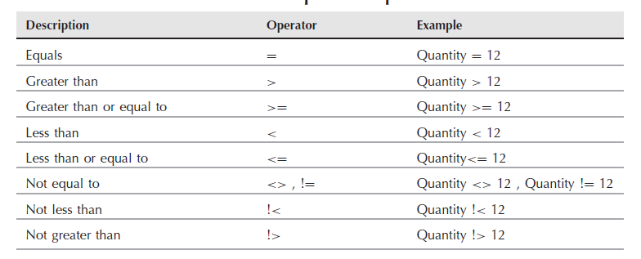
Comparison operator

Slide 30
Using the between search condition
greater than or equal to the first value, and less than or equal to the second value.
SELECT EmployeeName , salary FROM Employees WHERE salary > 2000 SELECT EmployeeName , salary FROM Employees WHERE salary between 2000 and 4000

Slide 31
Comparing with a list
The WHERE condition can compare the test value against the values in a list using IN. IN operator can also be mixed with a NOT to reverse the condition.

Slide 32
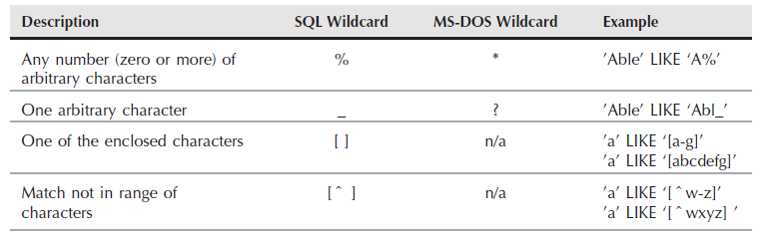
Like operator
The LIKE search condition uses wildcards to search for patterns within a string.
Notes:
SELECT ProductName
FROM dbo.Product
WHERE ProductName LIKE ‘Air%’;
% replaces any string of zero or more characters
select * from Student as s where (s.St_Fname like '%a%')
Contains a

Slide 33
Using NULL Condition
Select Employeename,MobileNo
From Employee
Where Mobileno is NULL

Slide 34
AND Condition
Returns True If Both Conditions are True
Select Employeename,MobileNo,salary
From Employee
Where salary >3000
And employeename like ‘ad%’

Slide 35
OR Condition
Returns True If One Condition is True
Select Employeename,MobileNo,salary
From Employee
Where salary >3000
OR employeename like ‘ad%’

Slide 36
NOT Condition
Returns True If Both Conditions are False
Select Employeename,MobileNo,salary
From Employee
Where salary not in (2000,3000,4000)

Slide 37
Ordering the Result Set
SQL Server usually returns the data in the order of the primary key (because that’s probably the clustered index), but there’s no logical guarantee of that order.
The only correct way to sort the results is with an ORDER BY clause.
Sort order can be specified as ASC (ascending) or DESC (descending) for each column.
Notes:
SELECT FirstName, LastName
FROM dbo.Customer
ORDER BY LastName, FirstName;
In the case of sorting by an expression, the entire expression can be repeated in the ORDER BY clause.
This does not cause a performance hit because the SQL Server Query Optimizer is smart enough to
avoid recomputing the expression:
select Ins_Degree+','+Ins_Name from Instructor
order by Ins_Degree+','+Ins_Name
--order by expression
select Ins_Degree+','+Ins_Name as 'ss' from Instructor
order by ss;
Order by alias
select Ins_Degree,Ins_Name from Instructor
order by 2
Order by second column

Slide 38
Top
TOP() predicate tells SQL Server to return only a few rows (either a fixed number or a percentage) based upon the options specified.
TOP() works hand-in-hand with ORDER BY. It’s the ORDER BY clause that determines which rows are first. If the SELECT statement does not have an ORDER BY clause, then the TOP() predicate still works by returning an unordered sampling of the result set.
Notes:
select top(3)* from Instructor
select * from Instructor
where Salary is not null and Salary in(select distinct top(3) salary from Instructor
where Salary is not null)
order by Salary asc
--select all employees whom salary is from the minimum 3 salaries
The WITH TIES option is important to the TOP() predicate. It allows the last place to include multiple
rows if those rows have equal values in the columns used in the ORDER BY clause.
Example:
select top(3) * from Instructor
where Salary is not null
order by Salary desc
Out:
9 Hussien NULL 5000.00 NULL NULL 50
4 Yasmin PHD 4000.00 NULL NULL 10
5 Amany PHD 4000.00 NULL NULL 10
select top(3) with ties * from Instructor
where Salary is not null
order by Salary desc
Out
9 Hussien NULL 5000.00 NULL NULL 50
8 Amr NULL 4000.00 NULL NULL 30
4 Yasmin PHD 4000.00 NULL NULL 10
5 Amany PHD 4000.00 NULL NULL 10

Slide 39
Selecting a random row
Using the TOP(1) predicate will return a single row, and sorting the result set by newid() randomizes the sort. Together they will return a random row each time the query is executed.
Example:
select top(1)* from Instructor order by newid();

