Slide 1





Popular Used tools in data science field
In this presentaion will discuss about popuar tools
Vott – PoweBI

Slide 2
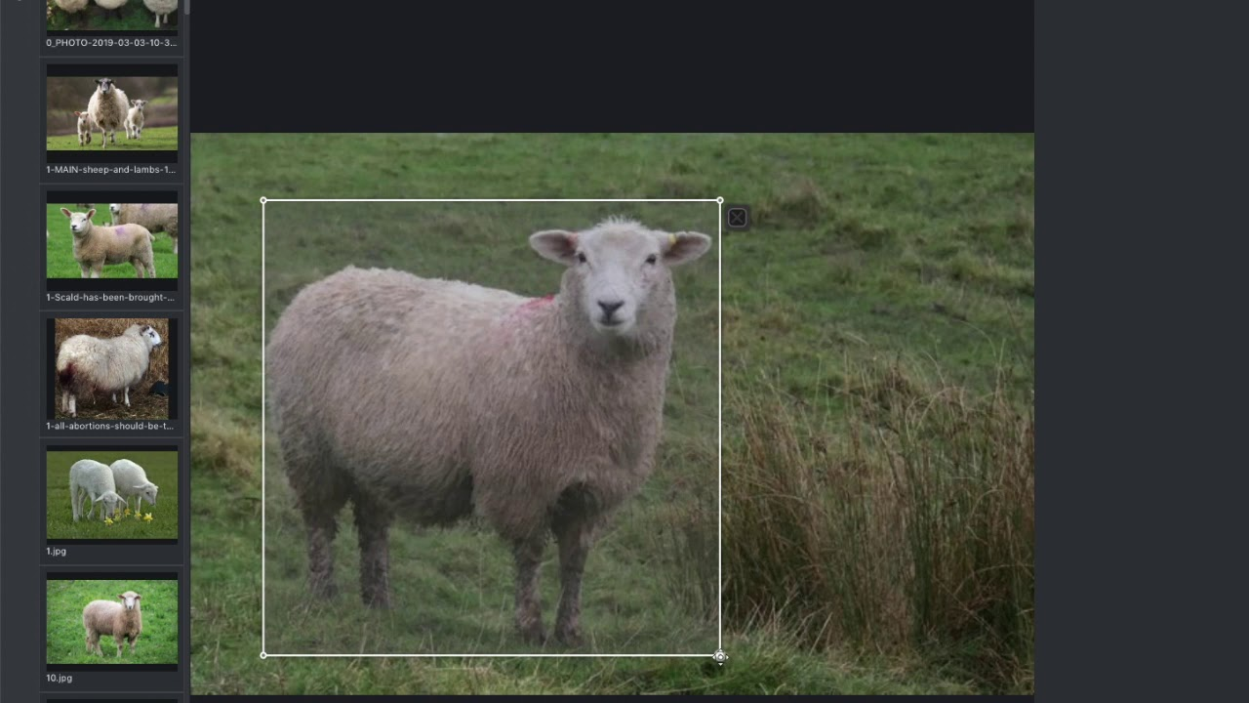
VoTT: Visual Object Tagging Tool
VoTT is a powerful tool for annotating and training models for computer vision tasks. Discover its features, setup process, annotation workflow, and more!

Slide 3
Features of VoTT
Intuitive Interface
Labeling Flexibility
VoTT provides a user-friendly interface, allowing users to efficiently annotate objects in images and videos.
With VoTT, you can create custom labels and define multiple object classes to suit your specific project needs.
Collaboration Tools
VoTT offers collaborative annotation features, enabling multiple team members to work on the same project simultaneously.

Slide 4
Annotation Workflow in VoTT
1
Create Project
2
Annotate Objects
Start by creating a new project in VoTT and specify the annotation parameters.
Use the annotation tools provided by VoTT to mark and label objects of interest accurately.
3
Review and Validate
4
Save and Export
Thoroughly review and validate the annotations to ensure accuracy and consistency.
Save and export the annotations in various formats compatible with popular machine learning frameworks.

Slide 5

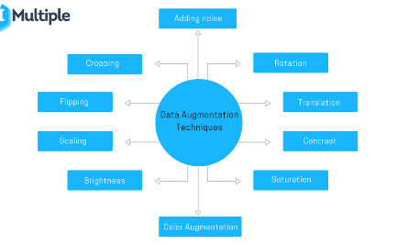
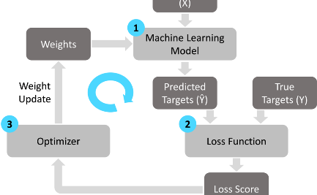
Training Models with VoTT
Model Configuration
Data Augmentation
Training Process
Configure and fine-tune your machine learning models using VoTT's flexible training options.
Apply data augmentation techniques to increase the diversity and size of your training dataset.
Monitor the training progress and adjust the model parameters to achieve optimal performance.

Slide 6
Exporting Annotations and Models from VoTT
1
Package Annotations
Combine and export annotations along with the original images to simplify data sharing and model deployment.
Export Trained Models
2
Export the trained models generated using VoTT to utilize them for inference and integration in various applications.
3
Supported Formats
VoTT supports popular formats like COCO, Pascal VOC, and TensorFlow Object Detection API for seamless integration.

Slide 9
Thanks
Do you have any questions?
youremail@freepik.com
+34 654 321 432
yourwebsite.com

Slide 10
Fonts & colors used
This presentation has been made using the following fonts:
Coustard
(https://fonts.google.com/specimen/Coustard)
Didact Gothic
(https://fonts.google.com/specimen/Didact+Gothic)
#3a4443
#e0eeec
#b6cac7
#5f5f5f
#3d3d3d
#ffffff
#7aa274
#89d3fe
#102570
#dff3ff

