Slide 1





Popular Used tools in data science field
In this presentaion will discuss about popuar tools
Vott – PoweBI

Slide 2
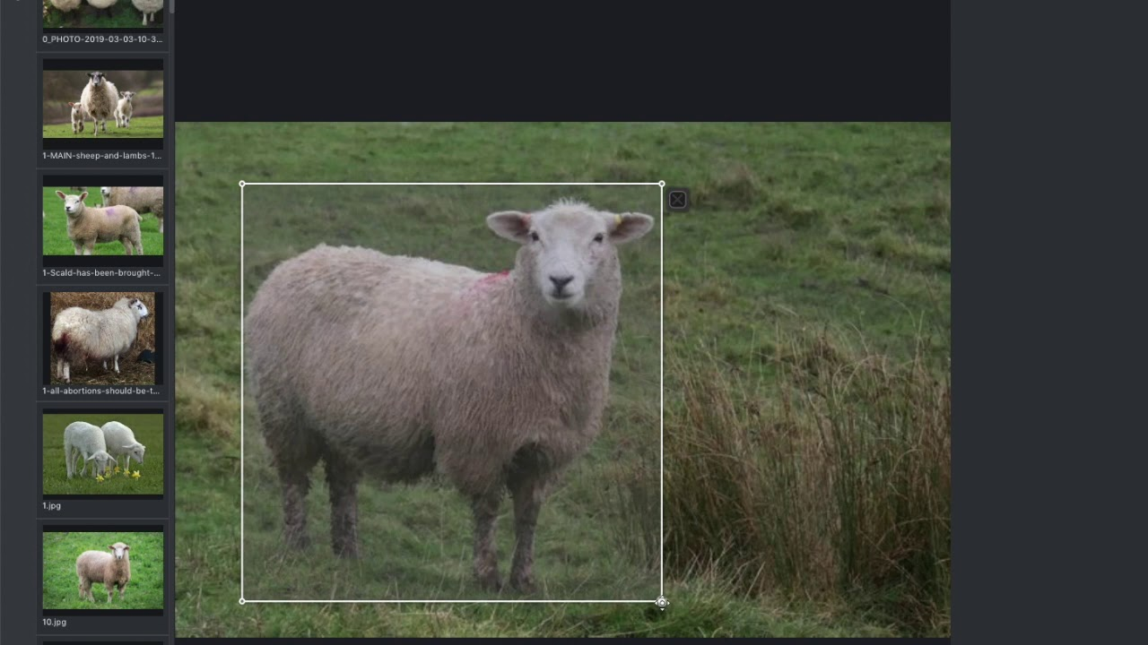
VoTT: Visual Object Tagging Tool
VoTT is a powerful tool for annotating and training models for computer vision tasks. Discover its features, setup process, annotation workflow, and more!

Slide 3
Features of VoTT
Intuitive Interface
Labeling Flexibility
VoTT provides a user-friendly interface, allowing users to efficiently annotate objects in images and videos.
With VoTT, you can create custom labels and define multiple object classes to suit your specific project needs.
Collaboration Tools
VoTT offers collaborative annotation features, enabling multiple team members to work on the same project simultaneously.

Slide 4
Annotation Workflow in VoTT
1
Create Project
2
Annotate Objects
Start by creating a new project in VoTT and specify the annotation parameters.
Use the annotation tools provided by VoTT to mark and label objects of interest accurately.
3
Review and Validate
4
Save and Export
Thoroughly review and validate the annotations to ensure accuracy and consistency.
Save and export the annotations in various formats compatible with popular machine learning frameworks.

Slide 5

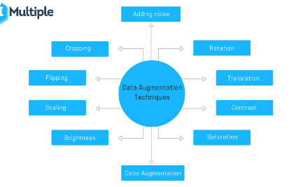
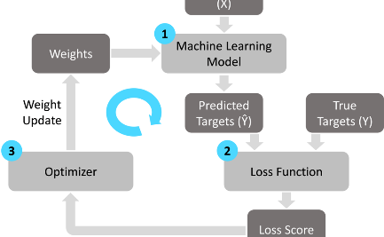
Training Models with VoTT
Model Configuration
Data Augmentation
Training Process
Configure and fine-tune your machine learning models using VoTT's flexible training options.
Apply data augmentation techniques to increase the diversity and size of your training dataset.
Monitor the training progress and adjust the model parameters to achieve optimal performance.

Slide 6
Exporting Annotations and Models from VoTT
1
Package Annotations
Combine and export annotations along with the original images to simplify data sharing and model deployment.
Export Trained Models
2
Export the trained models generated using VoTT to utilize them for inference and integration in various applications.
3
Supported Formats
VoTT supports popular formats like COCO, Pascal VOC, and TensorFlow Object Detection API for seamless integration.

Slide 7
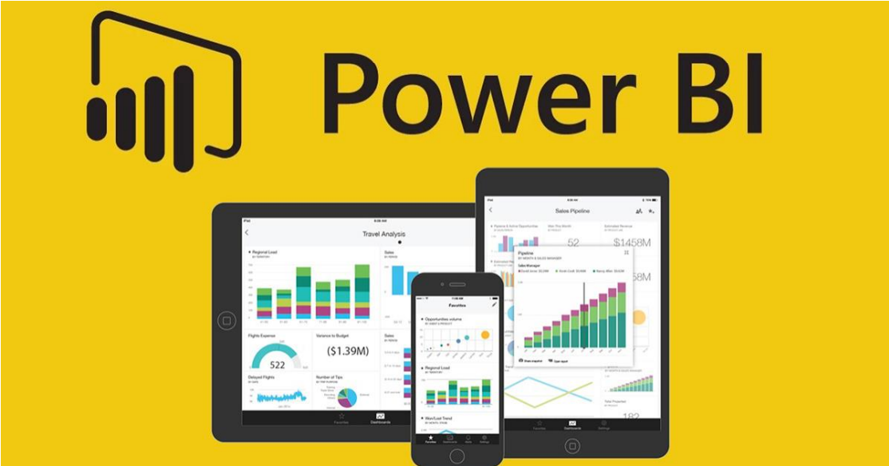

Slide 8
What is Power BI?
• Power BI is a business analytics solution that lets you visualize your data and share insights
across your organization or embed them in your app or website. Connect to hundreds of
data sources and bring your data to life with live dashboards and reports.
• Make informed decisions quickly. Connect, model, and then explore your data with
visual reports that you can collaborate, publish, and share. Power BI integrates with other
tools, including Microsoft Excel, so you can get up to speed quickly and work seamlessly
with your existing solutions.
• Connect to hundreds of data sources on premises and in the cloud.
• Use Power Query to simplify data ingestion, transformation, integration, and enrichment.
• Create reports using built-in visuals or create your own custom visuals.

Slide 9
Why Power BI?
• Rely on one of the largest and fastest growing business intelligence clouds.
• Create and share interactive data visualizations across global data centers, including
national clouds to meet your compliance and regulation needs.
• Better protect Power BI data with Microsoft Information Protection and Microsoft Cloud App Security.
•Apply sensitivity labels familiar in Office365 apps like Word, Excel, PowerPoint, and
Outlook to Power BI data.
•Extend protection and governance policies to Power BI data—including exported
data—with Microsoft Information Protection.
•Better meet privacy and regulatory requirements with oversight of sensitive data
through Microsoft Cloud App Security.
•Help prevent exposure of sensitive data by blocking risky user activities, in real

Slide 10
• Find answers fast with industry-leading AI.
Take advantage of the latest advances in Microsoft AI to help non-data scientists prepare
data, build machine learning models, and find insights quickly from both structured and
unstructured data, including text and images.
• Get unparalleled Excel integration.
Anyone who’s familiar with Office 365 can easily connect Excel queries, data models, and
reports to Power BI Dashboards—helping to quickly gather, analyze, publish, and share
Excel business data in new ways.
• Turn insights into action.
Go from data to insights and insights to action with the Microsoft Power Platform—
combining Power BI with PowerApps and Power Automate to easily build business
applications and automate workflows.
• Stream analytics in real time
Know what’s happening now, not just in the past. From factory sensors to social media
sources, get access to real-time analytics so you’re always ready to make timely decisions.

Slide 11
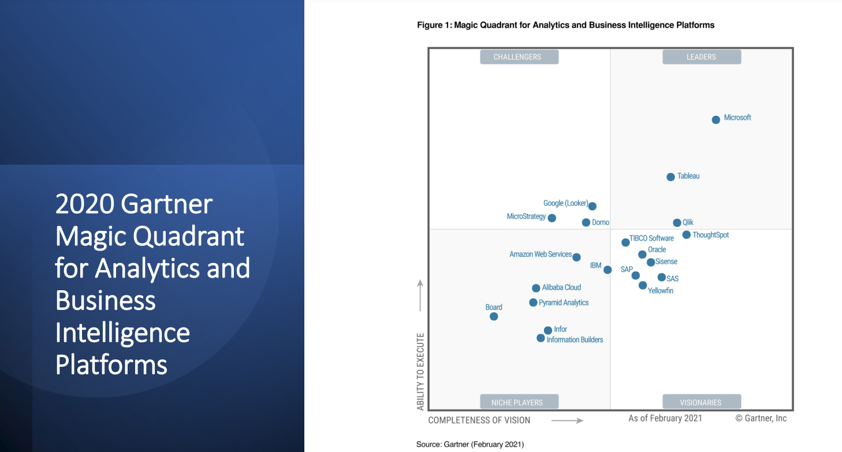

Slide 12
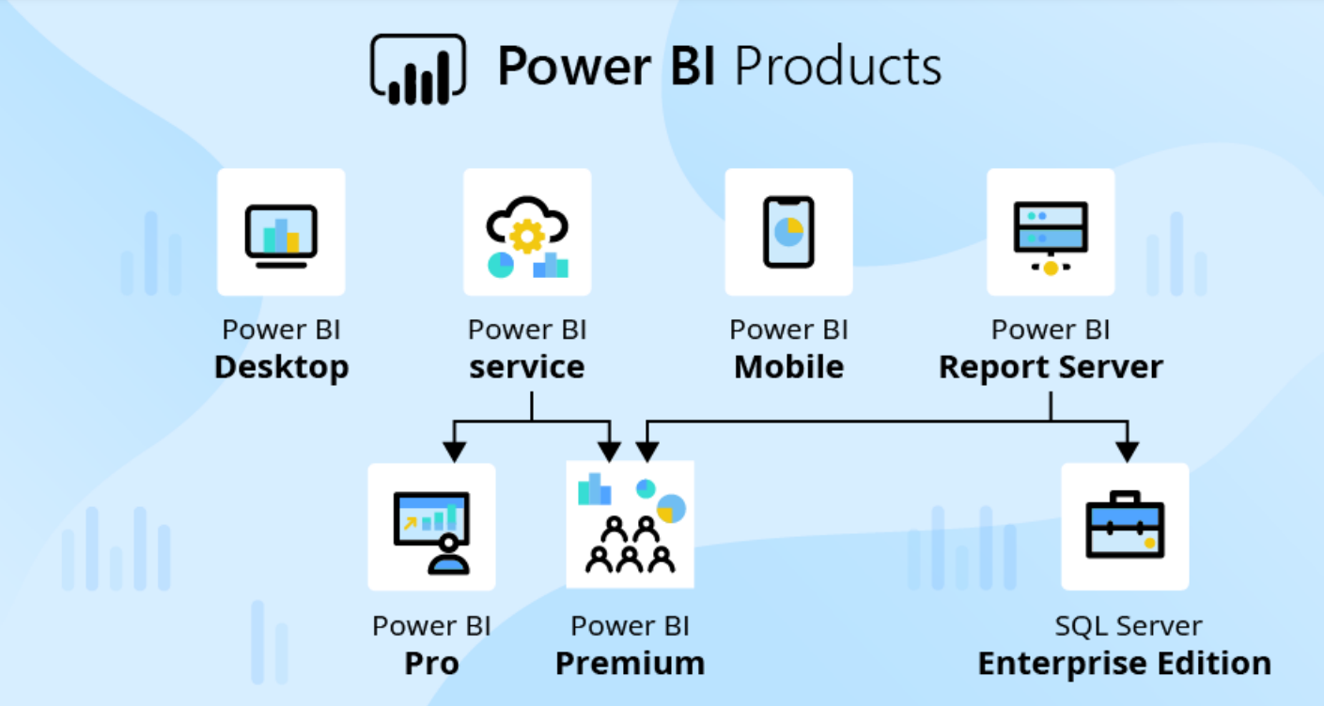

Slide 13
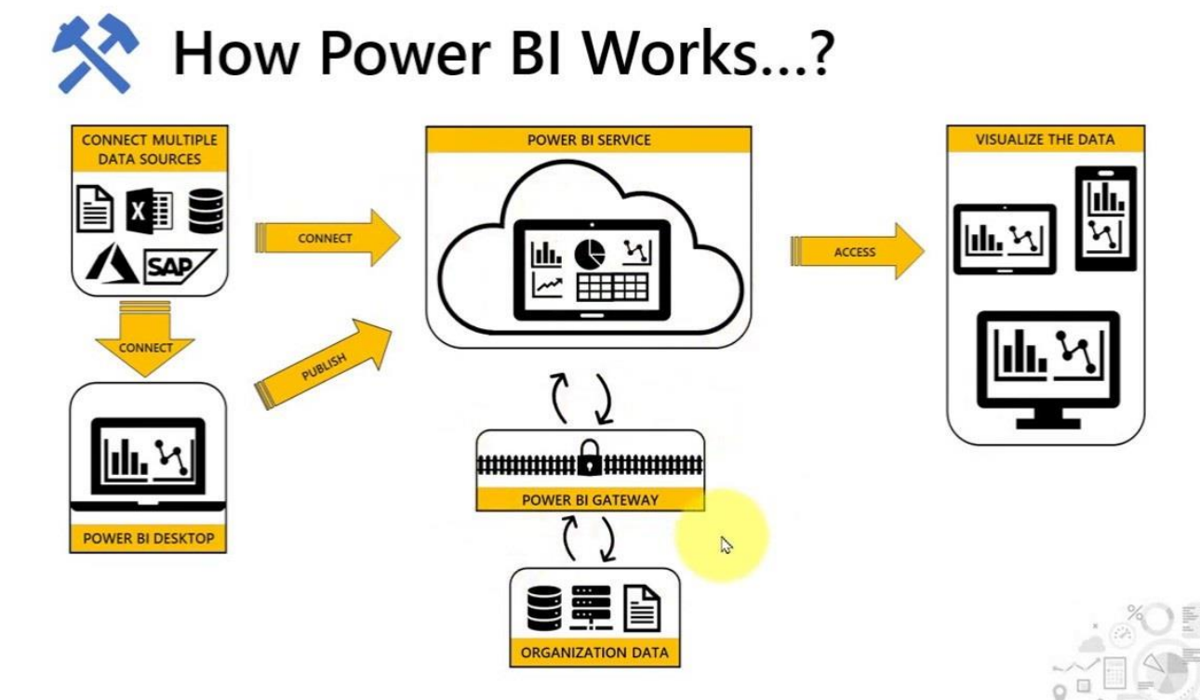

Slide 14
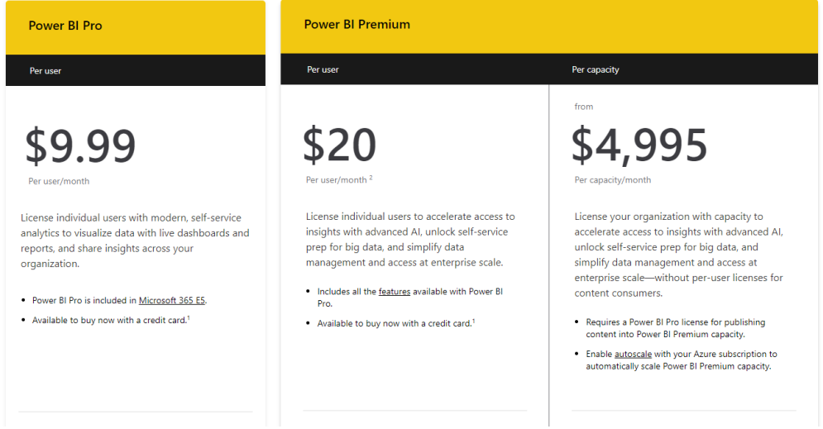
Power BI Prices

Slide 15
Thanks
Do you have any questions?
Name | ID
Mahmoud Essam Fathy | 20221460231
Abdelrahman Ashraf | 20221374041
Abdallah Hussein | 20221427861
Zyad Ashraf Hafez | 20221374025
Fares Mohamed | 20221461330

Slide 16
Fonts & colors used
This presentation has been made using the following fonts:
Coustard
(https://fonts.google.com/specimen/Coustard)
Didact Gothic
(https://fonts.google.com/specimen/Didact+Gothic)
#3a4443
#e0eeec
#b6cac7
#5f5f5f
#3d3d3d
#ffffff
#7aa274
#89d3fe
#102570
#dff3ff

