Slide 1
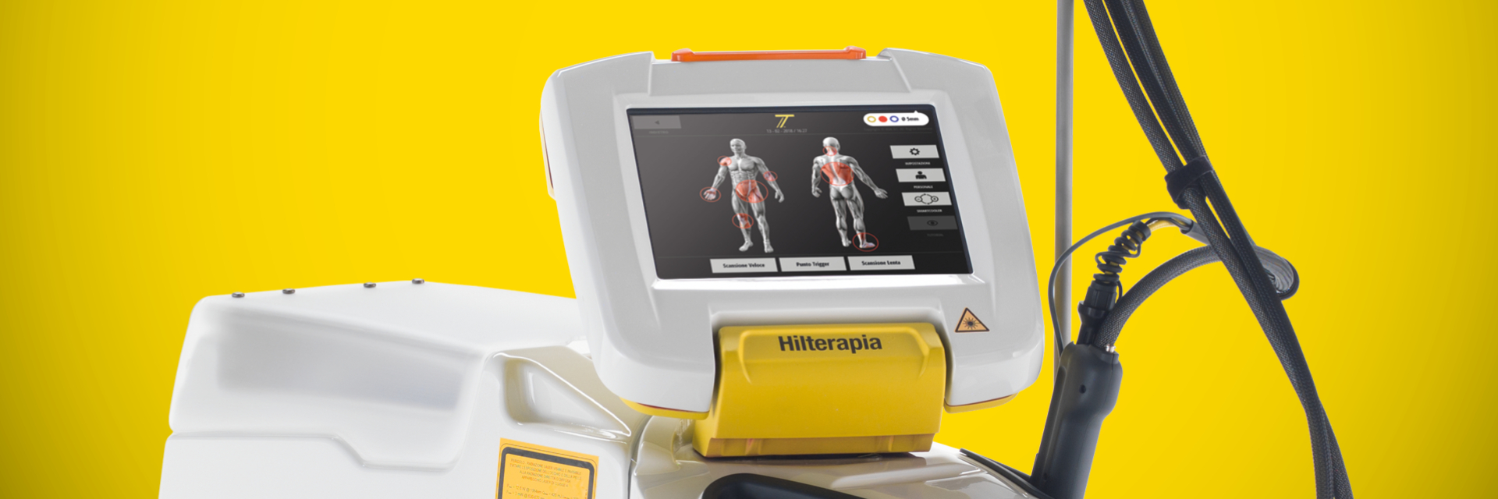
MEDICAL DEVICE SALES INTERVIEW
Two technologies.
One stronger clinical story.
INDIBA CT9 and ASA Laser HIRO TT Hilterapia
A customer-led portfolio conversation for modern rehabilitation, sports medicine and musculoskeletal clinics.
Presented as a Product Specialist
Clinical logic • Commercial relevance • Confident next step
Official product imagery: INDIBA and ASA Laser materials
Notes:
Good morning, and thank you for the opportunity. I would like to present two complementary technologies that can create a very strong clinical and commercial proposition for a modern rehabilitation clinic: the INDIBA CT9 and the ASA Laser HIRO TT with Hilterapia. My approach today is not to treat them as isolated machines. I want to show how each one solves a different part of the patient journey, how they fit into the therapist’s workflow, and why that matters to the clinic owner. The key message is simple: broader versatility with INDIBA, deeper and more targeted action with HIRO TT, and a clearer value story when the technologies are positioned together.

Slide 2
THE COMMERCIAL THESIS
A portfolio conversation, not a product dump
The best recommendation starts with the clinic’s clinical ambition and workflow.
1
Broaden the clinic
2
Deepen the offer
3
Create the bridge
INDIBA CT9
ASA HIRO TT
Product Specialist role
Versatile RF platform for rehabilitation, sports, podiatry and selected aesthetic-rehab applications.
High-intensity pulsed Nd:YAG with SmartCooler for pain, acute presentations and deeper musculoskeletal targets.
Translate features into treatment pathways, staff adoption, patient experience and return on investment.
Customer promise
Customer promise
My value
“Help me treat more patients, more comfortably, in a way my team can use every day.”
“Give me a distinctive, premium intervention I can explain and charge for.”
“I make the technology easy to understand, easy to use and easy to justify.”
Notes:
Before discussing specifications, I would frame the opportunity around three customer questions. First, how can the clinic broaden what it can treat and how many clinicians can use the platform? That is where CT9 is compelling. Second, where does the clinic need a more distinctive, deeper and premium intervention? That is where HIRO TT earns attention. And third, how do we make the investment easy to adopt and easy to justify? That is the role I would play as Product Specialist. I would connect clinical outcomes with workflow, patient experience and commercial value, so the buyer sees a business solution rather than two pieces of equipment.

Slide 3
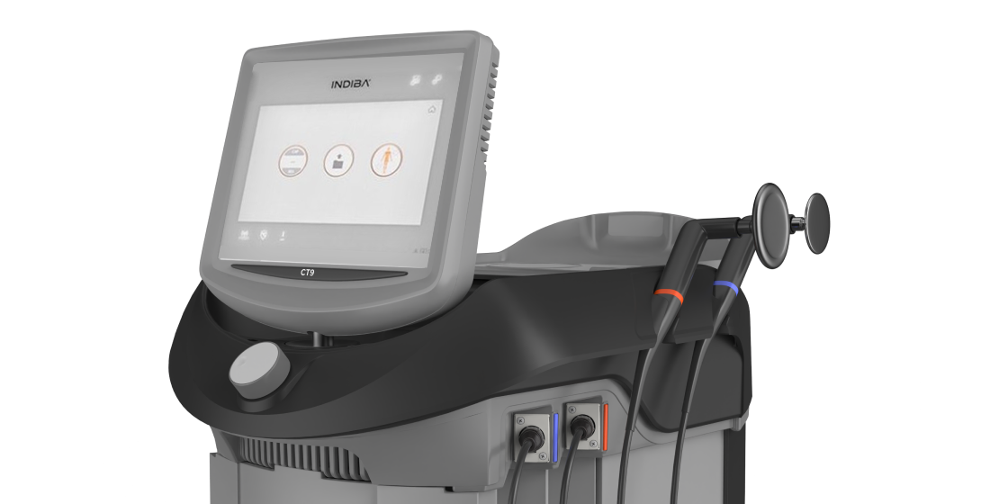
PLATFORM 01
INDIBA CT9: versatile radiofrequency, built for daily clinical use
A broad platform that integrates with manual therapy and active rehabilitation.
What I would say to a clinician
“CT9 is a platform you can use across the patient journey.”
~
Technology
Stable 448 kHz monopolar radiofrequency with thermal and non-thermal modes.
+
Clinical fit
Acute recovery, pain modulation, edema support, tissue preparation and chronic rehab.
↔
Workflow fit
Designed to combine with hands-on treatment, exercise and individualized protocols.
€
Commercial fit
One platform can serve multiple specialties and create repeatable treatment pathways.
MONOPOLAR RF
448 kHz
Notes:
The INDIBA CT9 is the versatile platform in this portfolio. It uses stable 448 kilohertz monopolar radiofrequency, with both thermal and non-thermal effects, so the clinician can adapt the treatment to the phase of the condition. In practical terms, that means the CT9 can support pain modulation, tissue preparation, edema management and recovery, while fitting naturally alongside manual therapy and exercise. From a sales perspective, I would position it as a daily-use platform. It is relevant to more than one specialist and more than one body area, which helps the clinic build utilization rather than relying on a single niche indication.

Slide 4
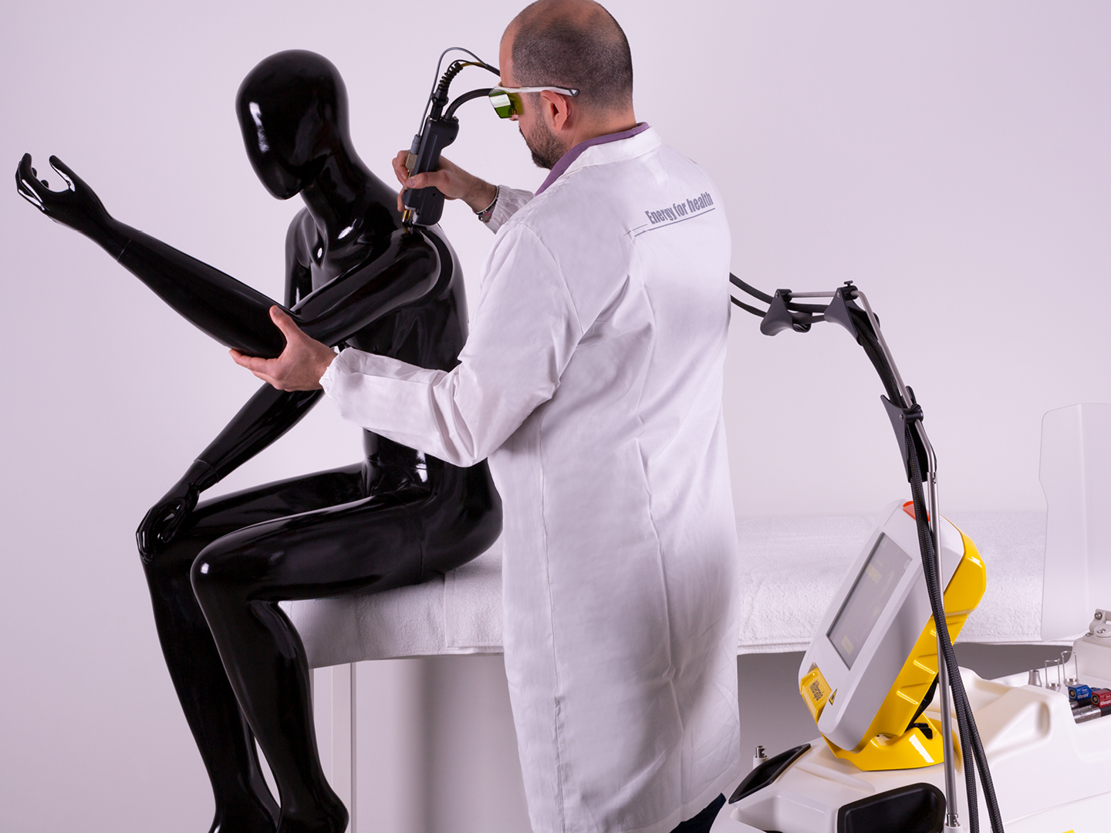
PLATFORM 02
ASA HIRO TT: high-intensity pulsed laser with a comfort advantage
Hilterapia combines depth, intensity and SmartCooler thermal exchange.
The proof points I would highlight
Deep action, controlled experience
15,000
W/cm² max intensity
≤100
microsecond pulse
A premium intervention that is easy for the patient to feel, understand and value.
18–28°C
SmartCooler range
10″
touchscreen interface
Sales translation
HILT® PULSE
SMARTCOOLER
When a clinic sees acute pain, deeper targets or a need for differentiated care, HIRO TT gives the therapist a clear, premium story: high-intensity pulsed Nd:YAG plus localized cooling for comfort and control.
1 optic fiber • 3 handpieces
Notes:
HIRO TT is the more specialized and differentiated platform. Hilterapia uses a high-intensity pulsed Nd:YAG laser, and the SmartCooler creates a thermal exchange that helps the clinician work with intensity while maintaining patient comfort. The numbers that matter in a conversation are the maximum intensity of fifteen thousand watts per square centimeter, pulses of up to three hundred and fifty millijoules, and the controlled cooling range from eighteen to twenty-eight degrees Celsius. But I would not lead with numbers alone. I would translate them into a clinical experience: deeper targeting, immediate intervention in acute presentations, and a premium treatment that feels controlled rather than aggressive.

Slide 5
CLINICAL VALUE
Different mechanisms, complementary patient benefits
The strongest proposition is a continuum from comfort and preparation to deeper, targeted intervention.
PATIENT NEED
CT9 ROLE
HIRO TT ROLE
CUSTOMER-LEVEL OUTCOME
Pain and sensitivity
Gentle, adjustable thermal or subthermal support
High-intensity pulse with localized cooling
A more comfortable start to treatment
Acute injury / edema
Support circulation and tissue recovery
Immediate intervention with thermal exchange
Earlier, more confident treatment
Deep musculoskeletal target
Prepare tissue and integrate with manual care
Pulse delivery designed for depth
More differentiated clinical offer
Rehab progression
Pair treatment with movement and exercise
Target stubborn or chronic areas
A coherent pathway, not a single session
The sales point: clinical benefits become more persuasive when they are connected to a patient pathway and a repeatable service line.
Notes:
I would explain the clinical benefit in terms of the patient journey, because that is how a clinic actually works. CT9 gives the therapist flexibility: it can be gentle and supportive in the early phase, help prepare tissue, and then integrate with hands-on care and exercise. HIRO TT brings a different advantage when the clinician wants a high-intensity, deeper and more distinctive intervention, especially in acute or stubborn musculoskeletal presentations. The value is not that one device replaces the other. The value is that together they allow the clinic to match the modality to the patient in front of them, while keeping the treatment pathway coherent and easy to explain.

Slide 6
TREATMENT FIT
Where each platform wins in the conversation
A confident Product Specialist knows when to recommend, when to combine and when to ask one more question.
Recommend CT9 when…
Recommend HIRO TT when…
✓
The clinic wants one versatile platform used by several therapists.
✓
The clinic sees acute pain, deep targets or demanding sports cases.
✓
The owner prioritizes daily utilization and multiple specialties.
✓
The team wants a premium, clearly differentiated intervention.
✓
The team already combines modalities with manual therapy or exercise.
✓
The clinician values intensity with an added comfort strategy.
✓
Patient comfort, workflow simplicity and broad adoption are central.
✓
The business model supports a focused, higher-value service line.
Best discovery question: “Which patient group do you most want to treat better or more profitably over the next 12 months?”
Notes:
This is where discovery matters. I would recommend CT9 when the clinic wants broad utilization, several therapists need access to the technology, and the device must fit naturally into everyday treatment. I would recommend HIRO TT when the opportunity is more focused: acute pain, deeper targets, sports performance, or a premium service line that needs a clear point of difference. And I would be comfortable recommending both when the clinic has the patient volume and the ambition to build a broader pathway. My first discovery question would be: which patient group do you most want to treat better or more profitably over the next twelve months? The answer tells me where to lead.

Slide 7
COMPARISON
Side-by-side: two technologies, two buying cases
The comparison is designed to support a recommendation, not create a winner.
Decision lens
INDIBA CT9
ASA HIRO TT
Why it matters to the clinic
Core modality
448 kHz monopolar RF
Pulsed Nd:YAG HILT®
Different mechanisms for different clinical asks
Primary strength
Versatility and integration
Intensity, depth and differentiation
Match investment to the clinic’s ambition
Best-fit workflow
Daily use with manual therapy and exercise
Focused protocols and premium interventions
Adoption depends on workflow fit
Patient experience
Comfortable, adjustable warmth
High intensity with SmartCooler support
A treatment patients can feel and value
Commercial role
Broad utilization across specialties
Focused, higher-value service line
One expands the base; one elevates the offer
Proof points
Power, stability, 448 kHz, accessories
15,000 W/cm², ≤100 μs, 10″ UI
Specific, memorable reasons to believe
Clinical claims should always be presented within the manufacturer’s approved indications, training and local regulatory framework.
Notes:
This comparison helps me keep the recommendation honest. CT9 is the broader, more flexible platform: 448 kilohertz monopolar radiofrequency, designed for daily integration with manual therapy and exercise. HIRO TT is the more focused premium proposition: pulsed Nd:YAG Hilterapia with very high peak intensity, depth and SmartCooler support. I would not say that one is simply better. I would say they solve different buying problems. CT9 helps a clinic expand utilization across its team and specialties. HIRO TT helps a clinic build a differentiated service line around deeper, more targeted interventions. The right recommendation depends on the clinical mix, workflow and business ambition.

Slide 8

USE CASE 01
Sports clinic: from acute complaint to return-to-play
A service-line story that combines speed, comfort and clinical progression.
SPORTS REHAB
01
Settle
CT9 supports comfort and tissue preparation.
The patient wants confidence, not just relief.
02
Target
HIRO TT adds a focused, deeper intervention when appropriate.
The clinic needs a pathway that is visible, repeatable and easy to communicate to athletes, coaches and parents.
03
Progress
Hands-on care and exercise carry the patient forward.
Business implication
A clearer pathway supports repeat visits, stronger referrals and a premium sports-rehab identity.
Notes:
Let me make this practical with a sports clinic example. The athlete does not just want pain relief; they want confidence and a clear route back to performance. CT9 can be used early in the pathway for comfort, tissue preparation and integration with manual therapy. When the presentation calls for a more focused or deeper intervention, HIRO TT can add a differentiated step. Then the therapist progresses the patient through movement and exercise. From a business standpoint, that creates a service line that is easier to explain, easier to repeat and easier to refer into. The technology becomes part of a return-to-play pathway, not a standalone treatment room event.

Slide 9
USE CASE 02
MSK and pain clinic: make the treatment feel purposeful
The patient experience matters because it influences trust, adherence and perceived value.
PATIENT LANGUAGE
“I want something that feels active, targeted and worth coming back for.”
1
›
2
›
3
›
4
Listen
Match
Explain
Progress
Understand pain behavior, irritability, goals and previous treatment.
Choose CT9 for versatility or HIRO TT for focused intensity and depth.
Tell the patient what they may feel and what the treatment is designed to support.
Link the session to movement, self-management and a measurable next step.
The differentiator is not only the device. It is the clinician’s ability to turn the device into a confident conversation.
Notes:
In a musculoskeletal or pain clinic, the patient experience is part of the value proposition. Patients want to understand what is being done, why it is being done and what happens next. I would encourage the clinician to follow a simple sequence: listen to the patient’s goals and irritability, match the modality to the clinical need, explain the expected sensation and purpose, and then connect the session to movement or self-management. CT9 can make the treatment feel comfortable and integrated. HIRO TT can make it feel targeted and distinctive. In both cases, the technology becomes more valuable when the clinician can explain it with confidence and tie it to a measurable next step.

Slide 10
BUSINESS VALUE
Why a clinic owner should care
A strong sales conversation connects clinical capability to utilization, differentiation and repeatable revenue.
↗
Utilization
★
Differentiation
One device can support multiple clinicians, specialties and body areas.
A visible, premium intervention can strengthen referrals and patient choice.
✓
Workflow
↻
Retention
Preset protocols, accessories and a clear interface support staff adoption.
A coherent treatment pathway gives patients a reason to return and progress.
A simple ROI conversation
Start with patient volume → define the service line → estimate realistic treatment frequency → measure utilization and contribution margin.
I would use the clinic’s actual numbers, never a generic payback promise.
Notes:
For the clinic owner, the business value comes from four areas. Utilization: can more than one clinician use the platform, and can it support more than one specialty? Differentiation: does the clinic have a clear reason for patients and referrers to choose it? Workflow: can the team adopt the device without slowing the day down? And retention: does the treatment fit into a pathway that encourages patients to return and progress? For ROI, I would always use the clinic’s real numbers: patient volume, realistic treatment frequency, price per session, staffing and utilization. I would avoid generic payback promises. Credibility is more valuable than an aggressive spreadsheet.

Slide 11
SALES APPROACH
How I would run the first customer meeting
A consultative sequence that earns the right to recommend.
1
›
2
›
3
›
4
›
5
Discover
Qualify
Demonstrate
Prove value
Close next step
“Which patient group do you most want to grow?”
“What does your current workflow handle well, and where is it limited?”
Show the modality in the language of the clinic’s patient and staff.
Use protocols, training, utilization and real clinic economics.
Agree on a demo, clinical evaluation or business case.
If the interviewer asks for my objection handling:
“I would acknowledge the concern, clarify whether it is clinical, workflow or financial, then answer with evidence and a next step. For example: rather than defend the price, I would ask what utilization level would make the investment compelling and build the case from there.”
Notes:
My sales approach would be consultative and structured. I would begin by discovering the clinic’s priority patient group and its current limitation. Then I would qualify the workflow, because a clinically strong device still fails if the team cannot integrate it. In the demonstration, I would show only the features that answer the customer’s needs, rather than giving a technical tour. I would prove value with approved clinical information, training and a realistic business case. And I would always close on a clear next step: a demo, a clinical evaluation or a quantified proposal. If an objection comes up, I would first identify whether it is clinical, operational or financial before answering it.

Slide 12

THE TAKEAWAY
Recommend with clarity.
Sell the clinical pathway, not just the machine.
CT9 expands the clinic’s everyday capability. HIRO TT adds depth, intensity and a distinctive premium intervention. My job is to connect those capabilities to the right patient, the right workflow and the right business case.
My next step with a customer would be simple:
identify the priority patient group, demonstrate the fit, and build the business case together.
Thank you.
Notes:
To close, I would bring the conversation back to the customer. CT9 expands the clinic’s everyday capability through versatility, workflow fit and broad utilization. HIRO TT adds a more differentiated proposition through intensity, depth and SmartCooler-supported comfort. My role as Product Specialist is to connect those capabilities to the right patient group, the right clinical workflow and the right business case. So my next step with a customer would be simple: identify the priority patient group, demonstrate the fit in the real workflow, and build the business case together. That is how I would sell these technologies with confidence, clinical respect and commercial discipline. Thank you.

