Slide 1
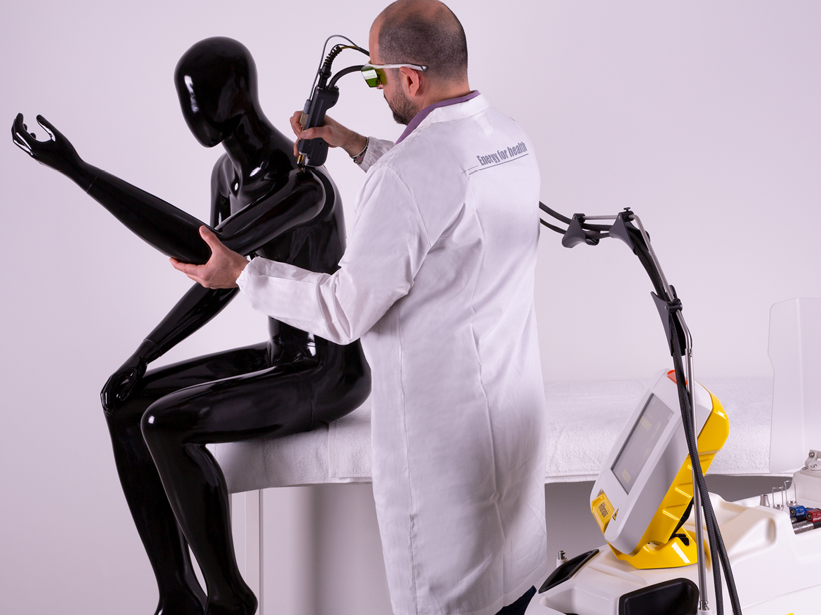
MEDICAL DEVICE SALES INTERVIEW
Two technologies.
One stronger clinical story.
INDIBA CT9 and ASA Laser HIRO TT
A concise portfolio conversation for rehabilitation, sports medicine and musculoskeletal clinics.
Clinical logic • Commercial relevance • Confident next step
Product Specialist interview
Notes:
Good morning. Today I will present two complementary technologies for rehabilitation, sports medicine and musculoskeletal clinics: INDIBA CT9 and ASA Laser HIRO TT. My focus is not only the devices themselves, but how a Product Specialist connects each technology to the right patient, the right workflow and a realistic business case.

Slide 2
THE PORTFOLIO THESIS
Two technologies, two buying cases
Start with the clinic need, then match the modality.
INDIBA CT9
ASA HIRO TT
My role
Versatile 448 kHz radiofrequency platform
• Broad daily utilization
• Integrates with manual therapy
• Supports multiple specialties
High-intensity pulsed Nd:YAG Hilterapia
• Depth and focused intensity
• SmartCooler for comfort and control
• Differentiated premium intervention
Translate technology into a clear treatment pathway
• Discover the patient group
• Demonstrate the clinical fit
• Build the business case
Memory hook
CT9 broadens the offer. HIRO TT deepens and differentiates it.
INDIBA CT9 | ASA HIRO TT
INTERVIEW PRESENTATION | 2
Notes:
My commercial thesis is simple. CT9 broadens a clinic's everyday capability because it is versatile and easy to integrate. HIRO TT deepens and differentiates the offer through high-intensity pulsed laser therapy and SmartCooler. My role is to understand the clinic's priority patient group, then recommend the technology that fits the clinical workflow and the business goal.

Slide 3
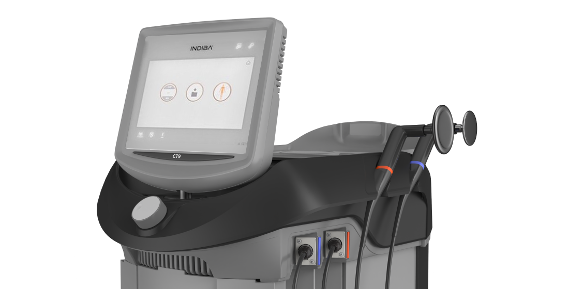
PLATFORM 01
INDIBA CT9: versatile RF for daily clinical use
A broad platform that can sit inside the whole rehabilitation pathway.
How I would explain it
“A platform you can use across the patient journey.”
-
Thermal and non-thermal treatment modes
-
Can support pain modulation, circulation and tissue preparation
-
Fits alongside manual therapy, exercise and active rehabilitation
-
A versatile platform for repeatable, multi-specialty use
MONOPOLAR RF
448 kHz
Commercial translation: broad utilization and strong staff adoption.
INDIBA CT9 | ASA HIRO TT
INTERVIEW PRESENTATION | 3
Notes:
INDIBA CT9 is a monopolar radiofrequency platform operating at a stable 448 kilohertz frequency. I would describe it as versatile rather than narrow. It offers thermal and non-thermal modes and can be combined with manual therapy, exercise and active rehabilitation. For a clinic, the value is broad utilization: several therapists can use it across different body areas and treatment pathways. I would stay within approved indications and explain that the device supports the clinician's overall rehabilitation plan.

Slide 4
PLATFORM 02
ASA HIRO TT: high-intensity laser with SmartCooler
Hilterapia combines depth, intensity and a controlled patient experience.
Proof points
15,000 W/cm²
≤100 μs
Maximum intensity
Pulse duration
18–28°C
10″ screen
SmartCooler range
Graphic touch interface
Sales translation
HILT® PULSE
SMARTCOOLER
A focused, premium intervention for acute pain, deeper targets and demanding sports cases.
INDIBA CT9 | ASA HIRO TT
INTERVIEW PRESENTATION | 4
Notes:
ASA HIRO TT is built around Hilterapia: a high-intensity pulsed Nd:YAG laser approach. The key sales story is depth and intensity, balanced by SmartCooler thermal exchange to support comfort and control. The memorable proof points are up to 15,000 watts per square centimeter, pulse durations up to 100 microseconds, and a SmartCooler range of 18 to 28 degrees Celsius. I would position HIRO TT when the clinic wants a focused, premium intervention for acute pain, deeper musculoskeletal targets or demanding sports cases.

Slide 5
CLINICAL LOGIC
Different mechanisms, complementary roles
The strongest story is a patient pathway, not a single session.
INDIBA CT9 — settle and integrate
HIRO TT — target and differentiate
• Adjustable thermal or subthermal support
• Comfort, preparation and circulation support
• Works naturally with hands-on care and exercise
• Broad platform for everyday rehabilitation
• High-intensity pulsed Nd:YAG
• Focused depth for selected cases
• SmartCooler supports comfort and control
• Clear premium story for patient and clinic
SETTLE -> TARGET -> PROGRESS
INDIBA CT9 | ASA HIRO TT
INTERVIEW PRESENTATION | 5
Notes:
I would present the two technologies as complementary. CT9 can help settle symptoms, prepare tissue and integrate with manual therapy or exercise. HIRO TT can add a more focused, deeper intervention when appropriate. The patient then progresses through movement, exercise and measurable goals. This is more persuasive than presenting either device as a universal answer.

Slide 6
CLINICAL FIT
Where each platform adds value
Use cases should always be discussed within approved indications and clinician judgment.
Sports rehabilitation
MSK and pain care
Multi-specialty clinic
CT9: recovery support and treatment integration
HIRO TT: focused intervention for demanding cases
Outcome: a pathway from acute complaint to return to play
CT9: broad, adjustable support
HIRO TT: deeper, targeted option
Outcome: a treatment story patients can understand
CT9: utilization anchor across the team
HIRO TT: distinctive premium service line
Outcome: more ways to serve and differentiate
Discovery question: Which patient group do you most want to treat better over the next 12 months?
INDIBA CT9 | ASA HIRO TT
INTERVIEW PRESENTATION | 6
Notes:
The clinical fit depends on the clinic. In sports rehabilitation, CT9 can support recovery and integration, while HIRO TT can add a focused option for demanding cases. In musculoskeletal and pain care, CT9 offers broad adjustability and HIRO TT offers intensity and depth. In a multi-specialty clinic, I would see CT9 as the utilization anchor and HIRO TT as the differentiated premium service line. My first discovery question would be: Which patient group do you most want to treat better over the next 12 months?

Slide 7
COMPARISON
Match the technology to the buying case
The goal is not to choose a winner; it is to choose the right fit.
Decision lens
INDIBA CT9
ASA HIRO TT
Clinic implication
Core modality
448 kHz monopolar RF
Pulsed Nd:YAG HILT
Different mechanisms for different clinical asks
Primary strength
Versatility and integration
Intensity, depth and differentiation
Match investment to ambition
Best workflow
Daily use with manual therapy
Focused protocols and premium care
Adoption depends on workflow fit
Commercial role
Broad utilization
Focused higher-value service line
One expands; one elevates
Memory hook: CT9 = breadth. HIRO TT = depth and differentiation.
INDIBA CT9 | ASA HIRO TT
INTERVIEW PRESENTATION | 7
Notes:
The comparison is designed to support a recommendation. CT9 is the broader 448 kilohertz RF platform, with daily integration and multi-specialty utilization. HIRO TT is the more focused pulsed Nd:YAG HILT platform, with intensity, depth and differentiation. For the owner, the question is not which machine is universally better. The question is which clinical ambition, workflow and service-line economics the clinic wants to support.

Slide 8
BUSINESS VALUE
Why a clinic owner should care
Connect clinical capability to utilization, differentiation and adoption.
Utilization
Differentiation
Workflow
Use the platform across clinicians, specialties and body areas.
Create a clear reason for patients and referrers to choose the clinic.
Make protocols, training and patient explanation repeatable.
My ROI conversation
Patient volume -> service line -> treatment frequency -> utilization -> contribution margin
I would use the clinic's actual numbers, never a generic payback promise.
INDIBA CT9 | ASA HIRO TT
INTERVIEW PRESENTATION | 8
Notes:
For the clinic owner, the value discussion should be practical. CT9 can support utilization across several clinicians and specialties. HIRO TT can strengthen differentiation through a focused, premium intervention. Both require workflow fit, training and a patient explanation the team can repeat. For ROI, I would start with the clinic's actual patient volume, define the service line, estimate realistic treatment frequency, and then look at utilization and contribution margin. I would never lead with a generic payback promise.

Slide 9
THE TAKEAWAY
Recommend with clarity.
Sell the clinical pathway, not just the machine.
CT9
HIRO TT
My role
Broad capability and daily integration.
Depth, intensity and differentiation.
Bridge technology, treatment and business value.
Next step: identify the priority patient group, demonstrate the fit, and build the business case together.
Thank you
Notes:
To close, CT9 expands the clinic's everyday capability. HIRO TT adds depth, intensity and a distinctive premium intervention. My role as a Product Specialist is to connect those capabilities to the right patient, the right workflow and the right business case. My next step with a customer would be simple: identify the priority patient group, demonstrate the best fit, and build the business case together. Thank you.

