Slide 1
Canny Edge Detection
Presented By:
Ramy Jaber
Mahmoud fenej

Slide 2
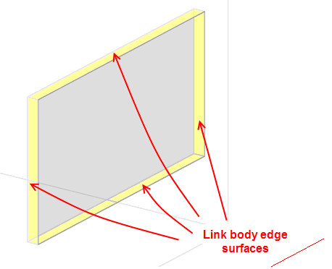
What is Edge ?
The edge is The outside limit of an object, area, or surface.(oxford dictionary)

Slide 3
Edge detection in image processing
Edge detection is an image processing technique for
finding the boundaries of objects within images. It works
by detecting discontinuities in brightness. Edge detection
is used for image segmentation and data extraction in
areas such as image processing, computer vision, and
machine vision.

Slide 4
Algorithms of edge detection
Common edge detection algorithms include Sobel,
Canny, Prewitt, Roberts, and fuzzy logic methods.

Slide 5

Canny Edge
The canny edge detection algorithm It was developed by John F. Canny in 1986.
John F. Canny is an Australian computer scientist. He has made significant contributions in various areas of computer science and mathematics including artificial intelligence, robotics...

Slide 6
Canny edge detection
Canny edge detection is a image processing method
used to detect edges in an image while suppressing
noise.

Slide 7
Steps of canny edge detection
Step 1 - Grayscale Conversion
Step 2 - Gaussian Blur
Step 3 - Determine the Intensity Gradients
Step 4 - Non Maximum Suppression
Step 5 - Double Thresholding
Step 6 - Edge Tracking by Hysteresis
Step 7 - Cleaning Up

Slide 8


Step 1: Grayscale Conversion
Convert the image to grayscale.

Slide 9

Step 2 - Gaussian Blur
Perform a Gaussian blur on the image. The blur removes some of the noise before further processing the image. A sigma of 1.4 is used in this example and was determined through trial and error.

Slide 10
Step 3 - Determine the Intensity Gradients
The gradients can be determined by using a Sobel filter where A is the image. An edge occurs when the color of an image changes, hence the intensity of the pixel changes as well.

