Slide 1

Inter-Symbol Interference due to band-limited channels

Slide 2
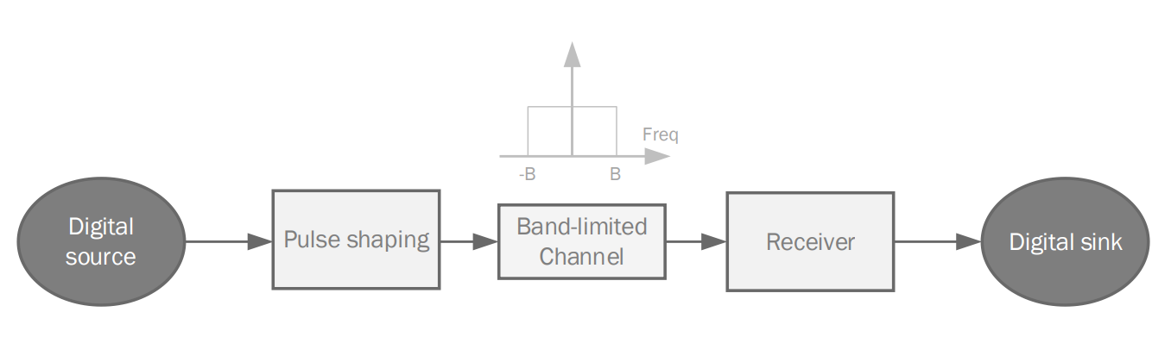
Generating First and second Pulse with period = 2/B IN TIME Domain

Slide 3
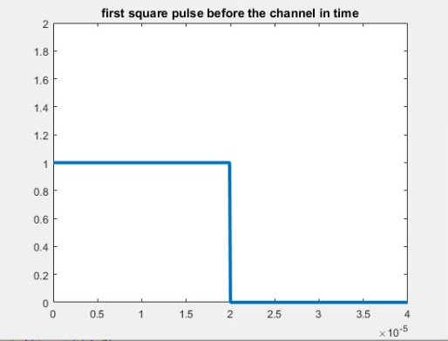
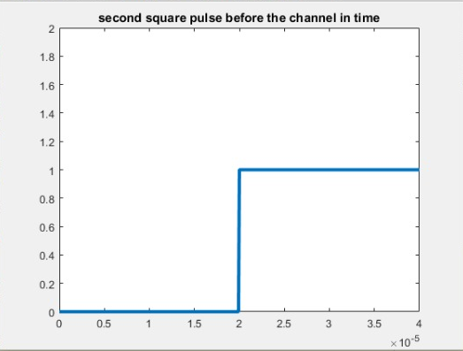

Slide 4
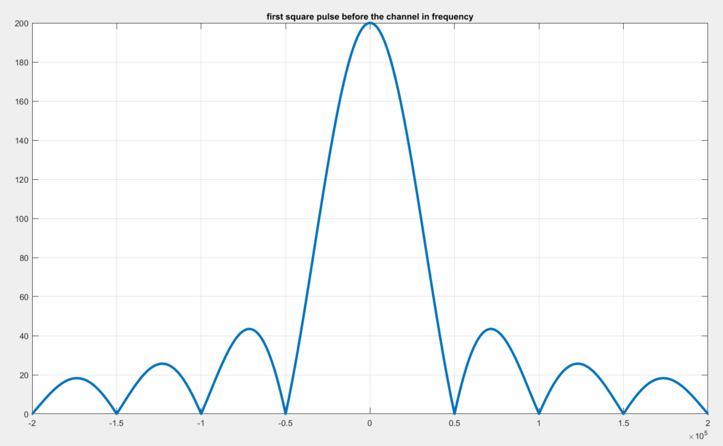
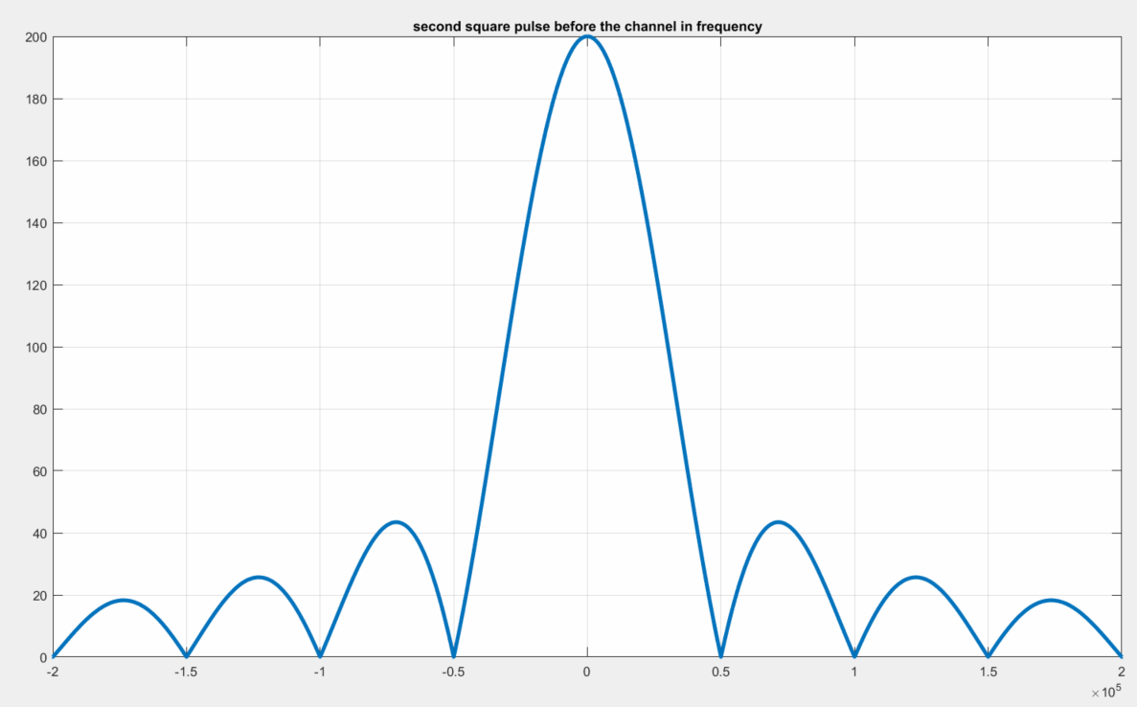
Generating First and second Pulse with period = 2/B IN Frequency Domain
Nrz input null to null bandwidth is 1/$T_{b}$ = 50khz

Slide 5
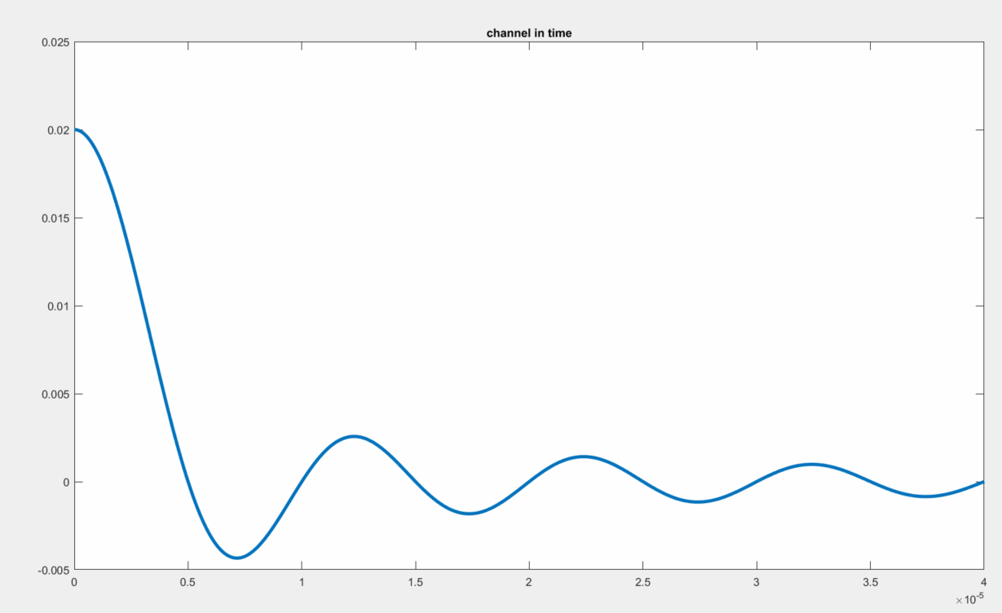
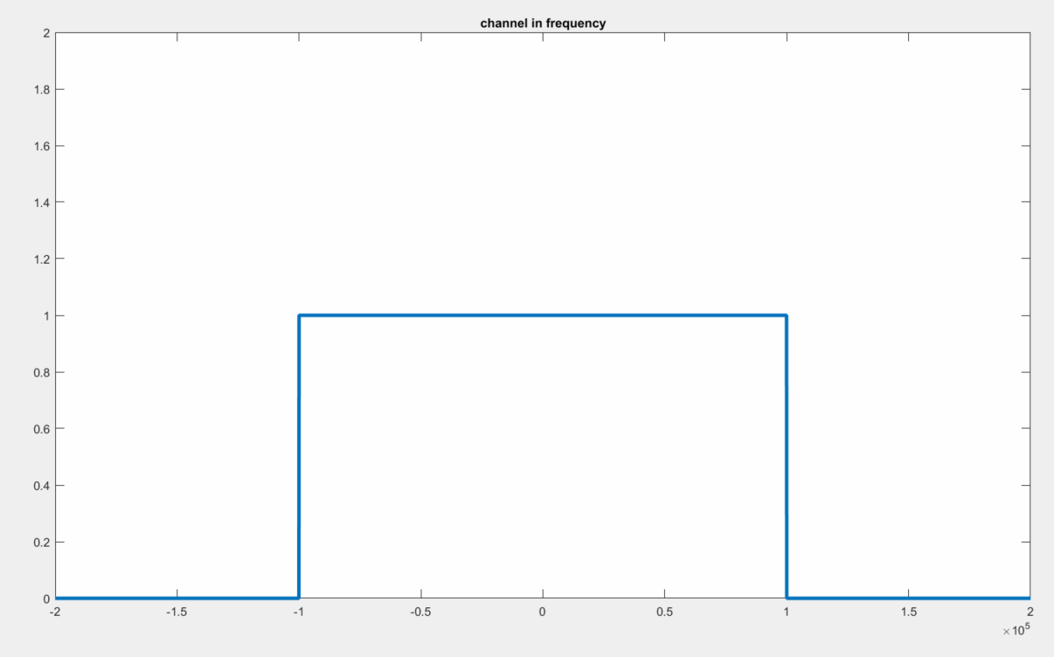
band-limited channel with bandwidth B = 100 kHz.
In time domain In frequency domain

Slide 6
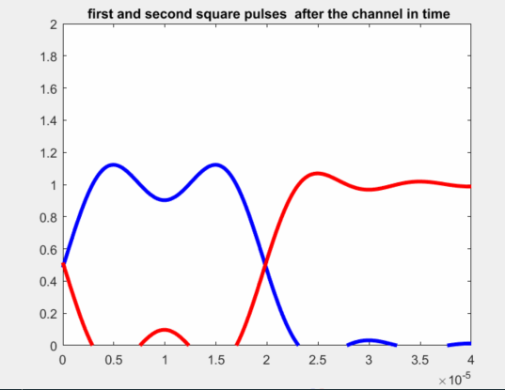
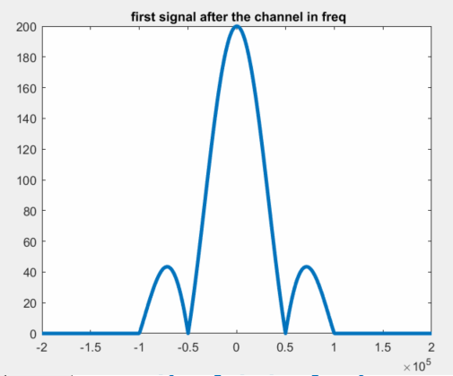
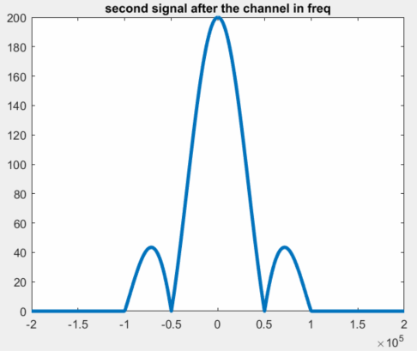
First and second square after the channel in time and frequency domain
In time domain In frequency domain

Slide 7
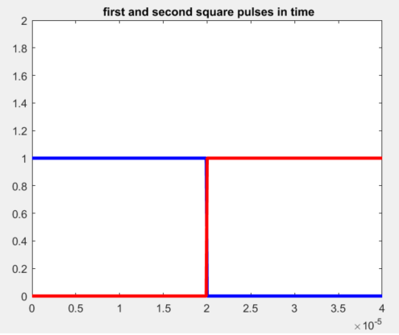
Showing the two plots the first square pulse before it passes through the channel, and one after in time domain.
Before the channel After the channel

Slide 8
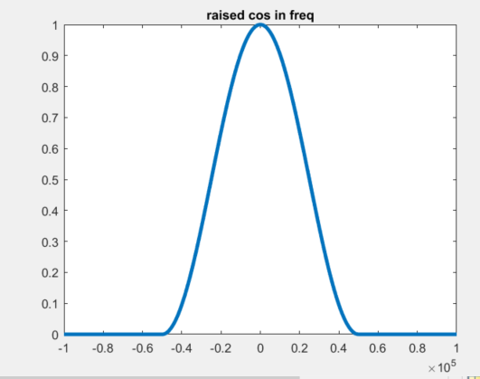
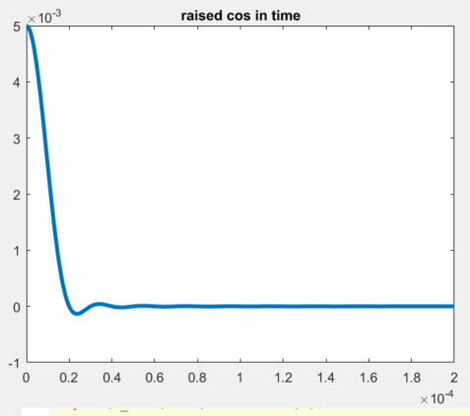
Raised cosine: Limited in frequency and unlimited in time (ß = 1).

Slide 9
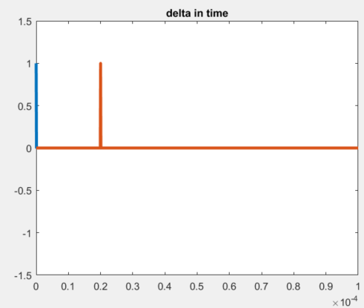
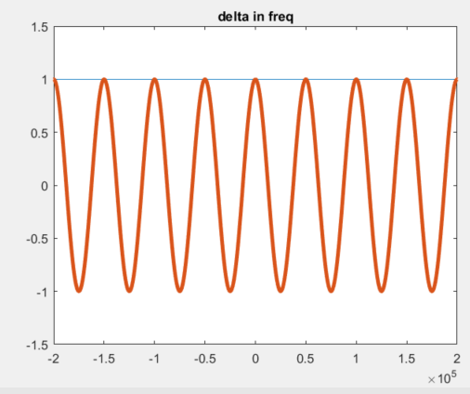
generating delta for shifting the signal

Slide 10
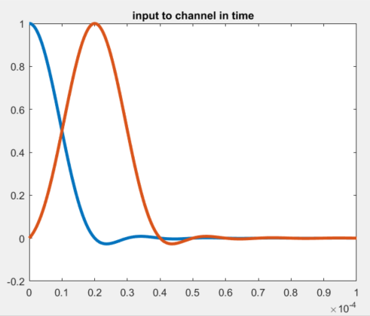
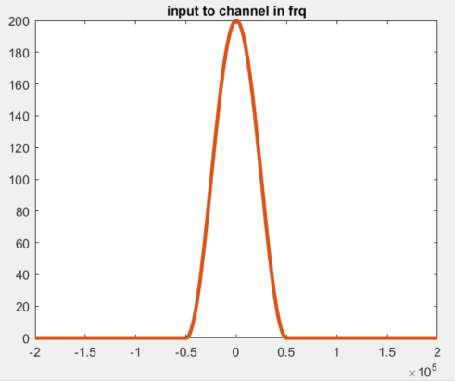
Shifting

Slide 11
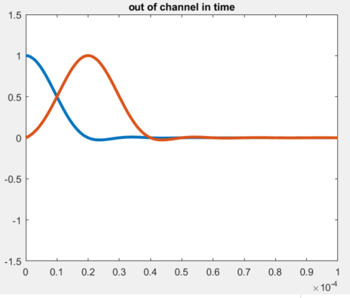
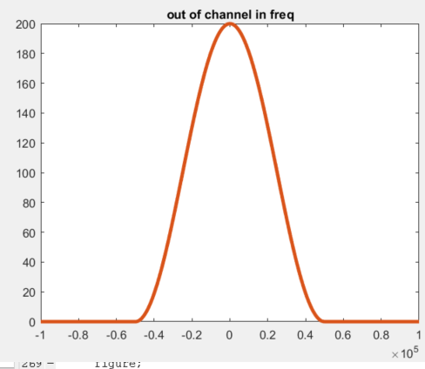
Output from the channel
Channel has no effect

Slide 12
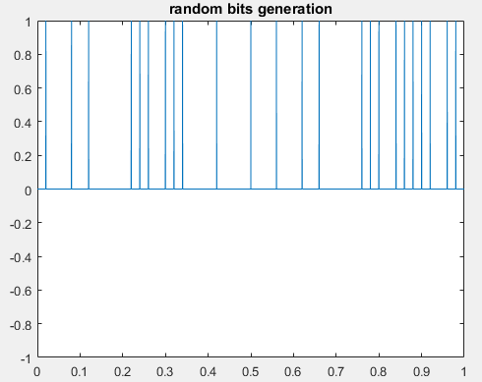
generating RANDOM BITS

Slide 13
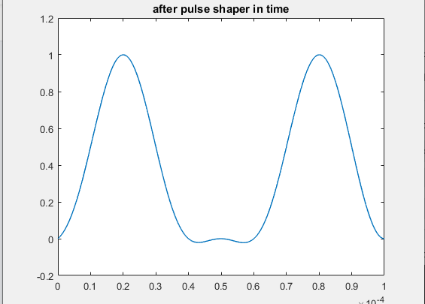
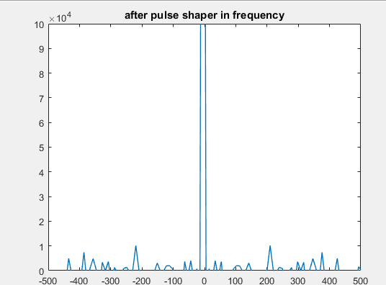
after pulse shaper in time and frequency domain

Slide 14
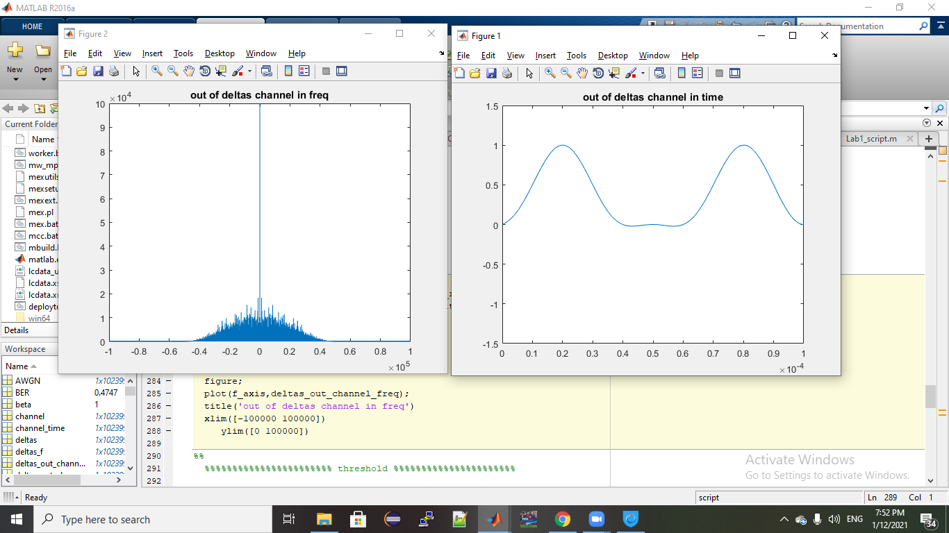
Output from channel

Slide 15
compute BER

Slide 16
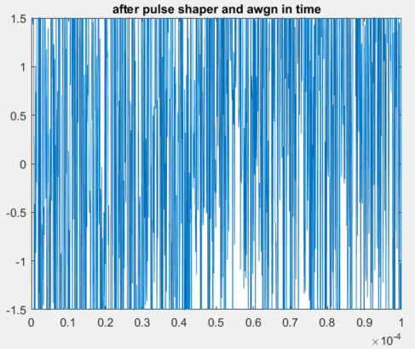
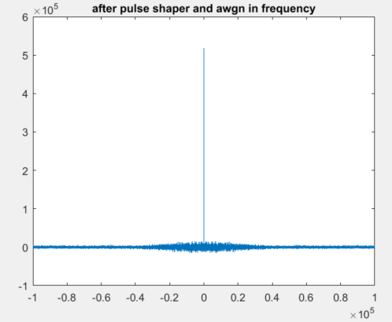
adding AWGN ($N_{o}$ = 10)

Slide 17
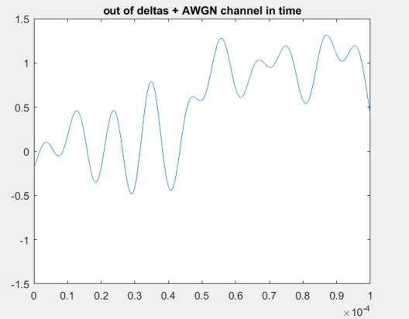
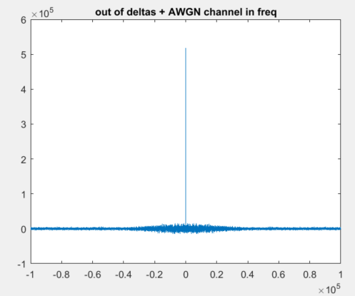
out of deltas + AWGN channel

Slide 18



Compute BER with AWGN
At $N_{0}=10$
At $N_{0}=1000$

Slide 19
Inter-Symbol Interference due to multi-path channels

Slide 20
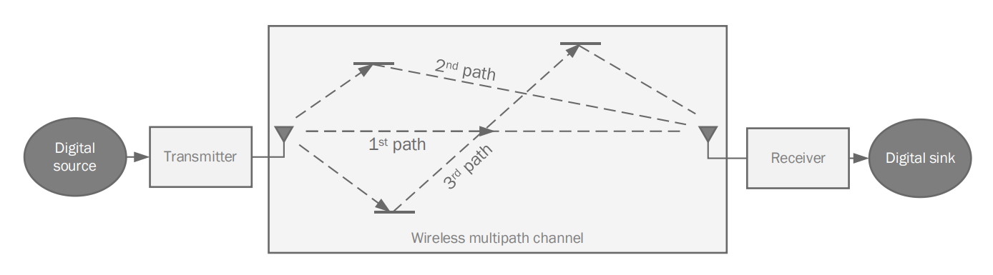
Steps of process
Generate transmitted symbols(X).
Generate channel coefficients (H).
Add effect of AWGN channel (N).
Get Received signal Y=HX+N.
Estimate transmitted signal.
Calculate BER vs Eb/No

Slide 21
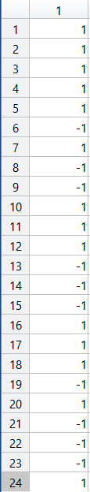
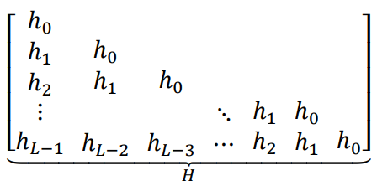
Generate transmitted symbols
Result in MATLAB:
For L=4000 :
Generate random signal of 1’s and -1’s with length L.
Generate channel coefficients
Arrange H matrix as shown:
The next slide shows a part of result in MATLAB
.
.
.

Slide 22
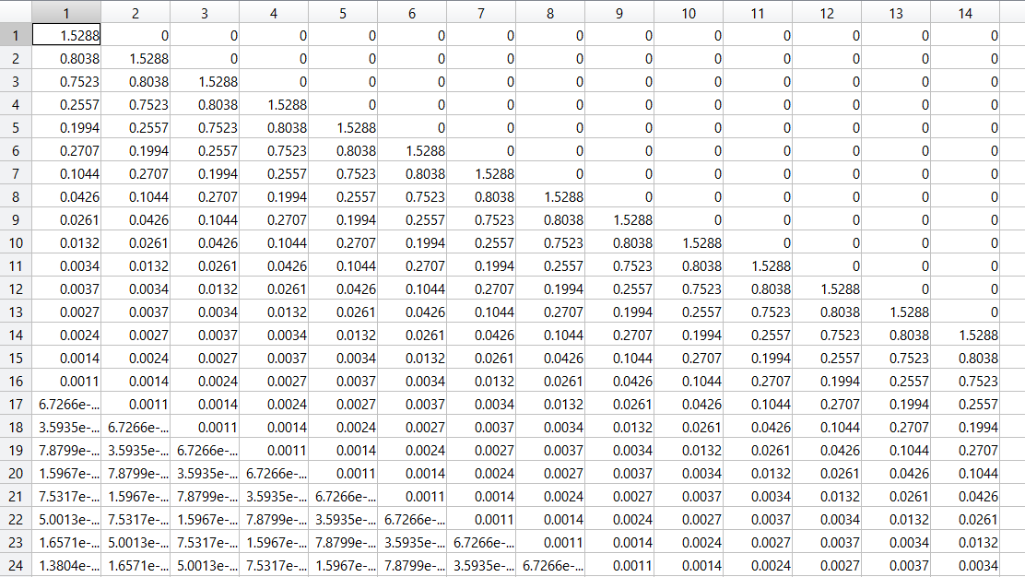

Slide 23
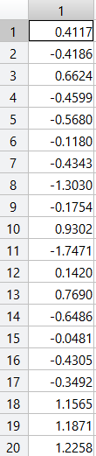
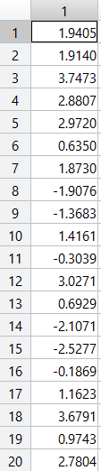
Add effect of AWGN channel
Get Received signal
Generate random noise with zero mean and one variance.
Calculate received signal by this equation Y=HX+N.
Result in MATLAB:
Result in MATLAB:
.
.
.
.
.
.
.

Slide 24
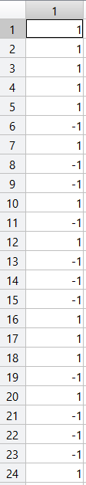
Estimate transmitted signal
Result in MATLAB:
Equalize channel effect by multiply the received signal by inverse of channel matrix.
Make decision for each bit using threshold voltage equals (0) to get estimated (transmitted) signal
Calculate BER vs Eb/No
Change value of Eb/No from -15 to 0 .
Calculate BER for each change .
Values of BER
.
.
.

Slide 25
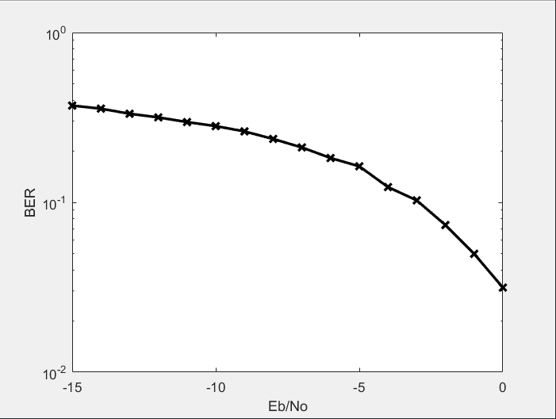
Draw relation between BER and Eb/No.
The value of BER decrease as Eb/No increase.

Slide 26
Repetition Code

Slide 27
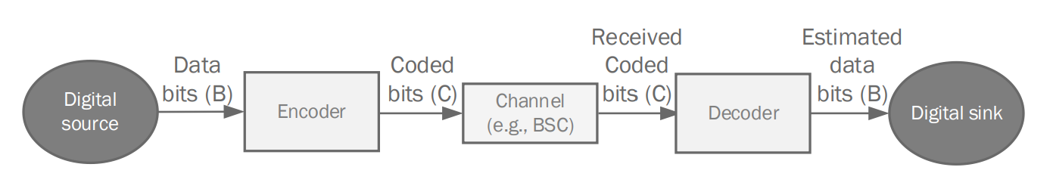
Steps of process
Generate information (transmitted) bits with length N.
Repeat information bits L times.
See effect of BSC channel.
Make decision for each bit to get received bits.
Compute BER.
See effect of bit flipping probability on BER.
b ➔ block length
c ➔ coded length

Slide 28


Generate information (transmitted) bits
Generate a sequence of bits which consists of 0’s and 1’s.
Result in MATLAB:
For N=1000
.
.
.
Repeat information bits L times
Calculate coding rate of repetition code ( r=$\frac{N}{C}$).
Repeat each bit L times ( L=$\frac{1}{r}$) to get sequence of samples.
Result in MATLAB:
For C=5000
.
.
.

Slide 29


See effect of BSC channel
Pass Sequence of sample through BSC channel .
generates the output sample sequence based on the Independent channel and parameter.
Result in MATLAB:
Channel effect:
.
.
.
Output sample sequence:
.
.
.

Slide 30

Make decision for each bit to get received bits
Make decision for each L bits using threshold voltage equals (L/2) to get received bits .
Result in MATLAB:
Received bits
.
.
.
Compute BER for p=0.5

Slide 31
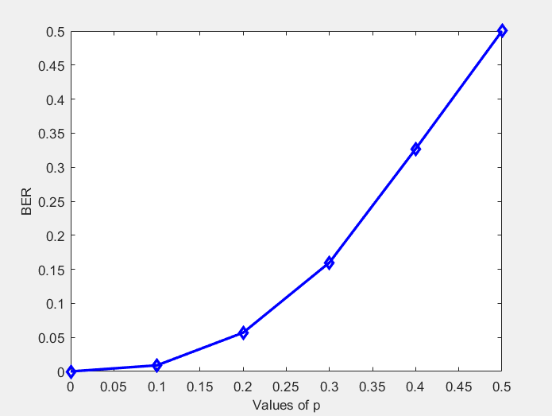
See effect of bit flipping probability on BER
Change the channel parameter from 0 to 0.5 .
Calculate BER for each change .
Result in MATLAB:
Draw relation between BER and P.
BER increases as channel parameter increases because when p is large value , random numbers which equal or smaller than p are large so there are large number of ones XOR with signal so there is high effect of flipping on signal.

Slide 32
Convolutional code

Slide 33
Steps of process
Generate input bits .
Encode information bits based on a given Generator polynomial.
See effect of BSC channel .
Decode received coded bits into estimated data bits by Viterbi algorithm.
Compute BER.
See effect of bit flipping probability on BER.

Slide 34
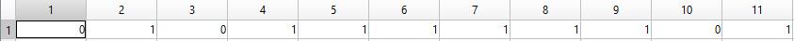


Generate input bits
Generate a sequence of bits which consists of 0’s and 1’s.
Result in MATLAB:
.
.
.
Encode information bits
Pass input bits through m shift registers.
Number of encoded bits = m* length of msg .
Result in MATLAB:
.
.
.

Slide 35


See effect of BSC channel
Pass Sequence of sample through BSC channel .
generates the output sample sequence based on the Independent channel and parameter.
Result in MATLAB:
.
.
.
Decode received coded bits into estimated data bits
Decode received bits using vitdec function .
Result in MATLAB:
.
.
.

Slide 36
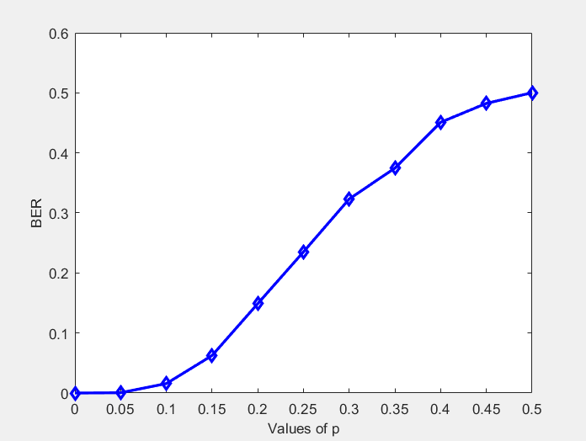
Compute BER
Compute BER for p=0.5
See effect of bit flipping probability on BER
Change the channel parameter from 0 to 0.5 .
Calculate BER for each change .
Result in MATLAB:
BER increases as channel parameter increases because when p is large value , random numbers which equal or smaller than p are large so there are large number of ones XOR with signal so there is high effect of flipping on signal.

Slide 37
Polar Code

Slide 38
Steps of process
Generate input bits .
Encode information bits by polarization transformation.
See effect of BSC channel .
Decode received coded bits into estimated data bits by Successive Cancellation.

Slide 39
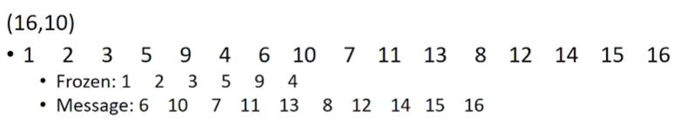
Generate input bits
N=2^n
Message : m of length K bits
Form a vector U of length N bits as follows:
Find N-K least reliable (worst) channels from reliability sequence
Set Ui for those N-K channels to zero (called frozen positions)
m:remaining K bits of U (called message positions)
Example on reliability sequence for N=16
Result in MATLAB:
Message bits
Input bits

Slide 40
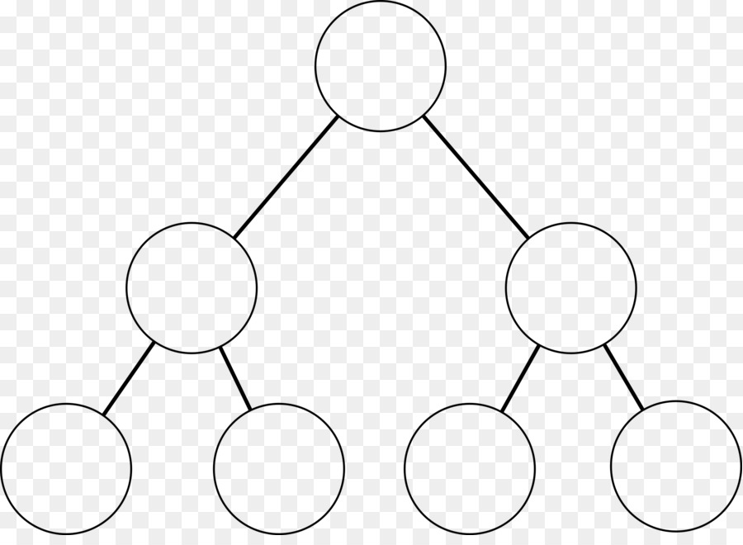
encoder
Binary tree representation
Depth n
U1 = [X1+X2 X2]
U2 = [X3+X4 X4]
L = [U1 U2]
L= [X1+X2+X3+X4 X2+X4 X3+X4 X4]
L
U1
U2
X1
X2
X3
X4

Slide 41
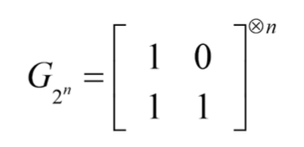
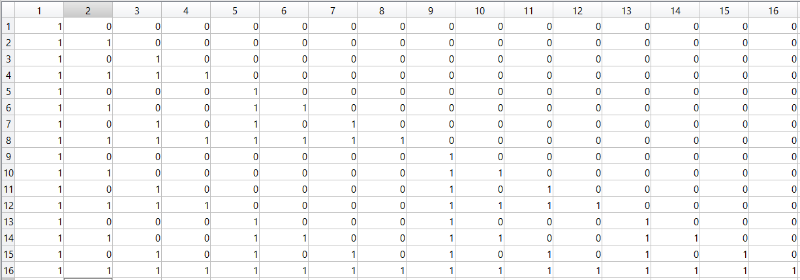

encoder
$G_{N}$: N*N matrix , Kronecker product of 2*2 kernel.
Binary tree representation
Depth n
$U^{(N)}$= U * $G_{N}$ : evaluated on tree with u at bottom and $U^{(N)}$ at top
Result in MATLAB:
Generator Matrix
Encoded bits

Slide 42
BSC channel
take the sample sequence passing through the channel.
generates the output sample sequence based on the Independent channel and parameter.
Result in MATLAB :
for p =0.5 :
Channel Effect
Received bits

