Slide 1
MSVC C++20 Standard Library Progress Update
Mahmoud Saleh Principal Software Engineering Manager, MSVC Libraries

Slide 2
Welcome
MSVC implementation of C++ Standard Library
What is it?
Our transition to open source development
Why?
How?
License
Progress update
C++20 implementation status report
Feature highlights and demos
Call to action

Slide 3
MSVC implementation of C++ Standard Library
a.k.a. STL
Implements the C++ Standard Library for Microsoft Windows
Designed for MSVC toolset and released with Visual Studio
Works with MSVC Compiler chain (cl.exe, c1xx.dll, c2.dll)
Also, supports Clang and EDG compiler
C++ Standards Compliant
Completed implementation of all features in C++17 and earlier
C++20 features are currently under development
And, now open source as well
https://github.com/microsoft/STL

Slide 4
Why did we choose to open source the STL?
Get closer to our customers and the C++ community
No need to wait for VS release to see/try latest features and bug fixes
Easier to receive and faster to respond to feedback
More eyes → improved code quality
We can now more easily contribute our features to the community
Helps make C++ better
One example: <charconv>; and more to come
Can help accelerate feature development
Especially as C++ Standards are getting bigger
Accepting contributions
Open license: allows integrating features from compatible-license C++ codebases

Slide 5
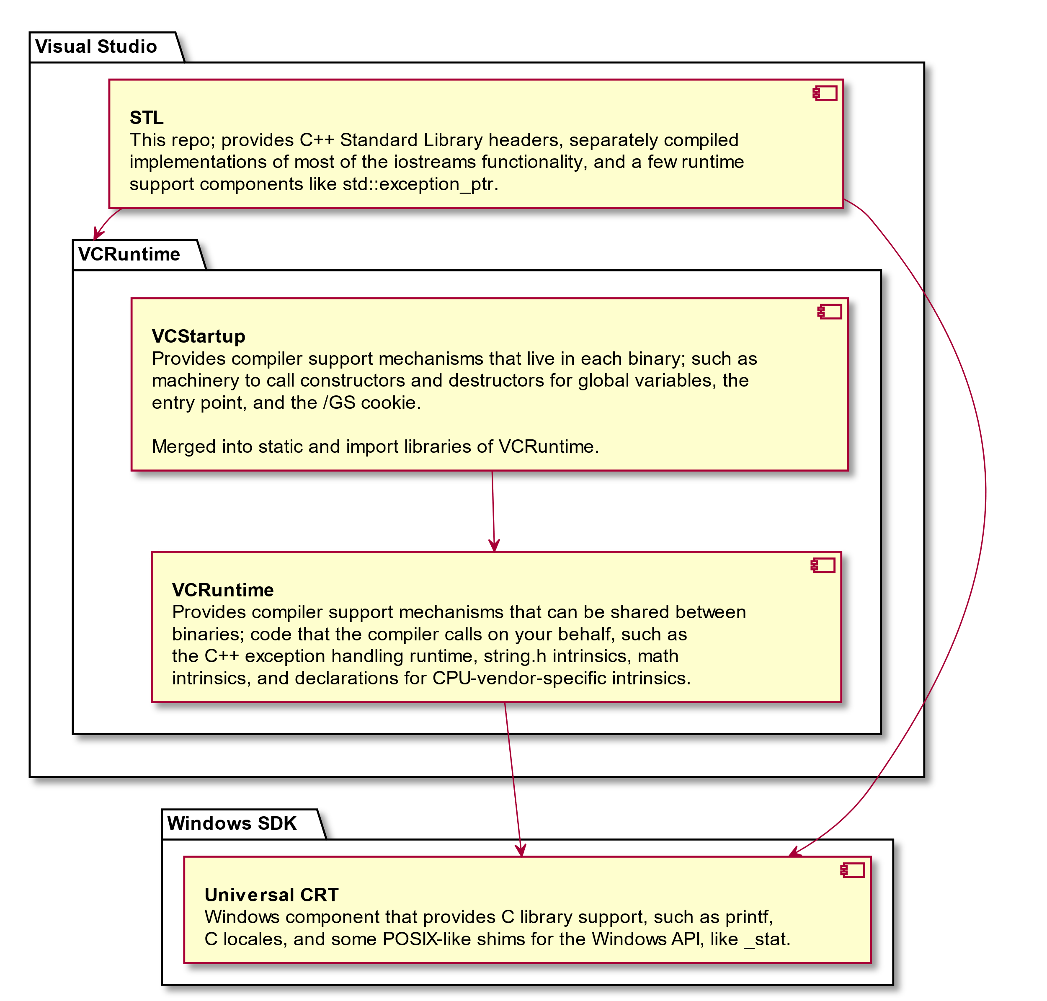
GitHub repo: What have we open sourced?

Slide 6
GitHub repo bring up: What’s been done?
Jun 2019: Stakeholders agreed to open source STL
Work started to clean code and add CMake build scripts
Sep 2019: Completed code cleanup and migrated to GitHub
GitHub repo open for business
STL internal development moved to open source
Created CMake build scripts
Oct 2019: Set up CI with Azure Pipelines
Initially, only checking that sources are clang-format’ed
Jan 2020: Test infrastructure bring up started
Mar 2020: Testing and CI infrastructure
Added test suites using LLVM lit as test harness
Created VM scale sets

Slide 7
GitHub repo bring up: What’s next?
We have a Roadmap: https://github.com/microsoft/STL/wiki/Roadmap
What’s next
Migrate all existing bugs to GitHub
Complete build system migration to CMake
Create comprehensive contribution guidelines
Finish C++20 feature and LWG issues implementation (our main target)
Automate ingestion of GitHub code into Visual Studio releases

Slide 8
Open source license
We use Apache-2.0 WITH LLVM-exception
https://github.com/microsoft/STL/blob/master/LICENSE.txt
An open license
Same license as LLVM project used in clang and libc++
For maximum compatibility and code portability
Comes at a cost
Incompatible with some other licenses
We may not accept contributions if coming from more restrictive license

Slide 9
https://github.com/microsoft/STL/blob/master/LICENSE.txt
---- LLVM Exceptions to the Apache 2.0 License ----
As an exception, if, as a result of your compiling your source code, portions
of this Software are embedded into an Object form of such source code, you
may redistribute such embedded portions in such Object form without complying
with the conditions of Sections 4(a), 4(b) and 4(d) of the License.
In addition, if you combine or link compiled forms of this Software with
software that is licensed under the GPLv2 ("Combined Software") and if a
court of competent jurisdiction determines that the patent provision (Section
3), the indemnity provision (Section 9) or other Section of the License
conflicts with the conditions of the GPLv2, you may retroactively and
prospectively choose to deem waived or otherwise exclude such Section(s) of
the License, but only in their entirety and only with respect to the Combined
Software.

Slide 10
C++20 Standard Library feature progress
STL repo changelog shared at https://github.com/microsoft/STL/wiki/Changelog
Includes
Features implemented and bugs fixed
GitHub repo bring up progress
Shows the VS update each change is (or will be) merged into
Does not include features implemented prior to GitHub transition; i.e. before VS 2019 16.5.
However, we’re keeping track of those features at https://docs.microsoft.com/en-us/cpp/overview/visual-cpp-language-conformance

Slide 11
https://github.com/microsoft/STL/wiki/Status-Chart

Slide 12
Library Features Progress: VS 2019 16.0 – 16.4
VS Update | Std | Paper | Feature Title
VS 2019 16.4 | C++17 | P0067R5 | Elementary String Conversions
VS 2019 16.4 | C++20 | P1754R1 | Rename Concepts To standard_case
VS 2019 16.3 | C++20 | P0487R1 | Fixing operator>>(basic_istream&, CharT*)
VS 2019 16.3 | C++20 | P0616R0 | Using move() In <numeric>
VS 2019 16.3 | C++20 | P0758R1 | is_nothrow_convertible
VS 2019 16.3 | C++20 | P0898R3 | Standard Library Concepts
VS 2019 16.3 | C++20 | P0919R3 | Heterogeneous Lookup For Unordered Containers
VS 2019 16.2 | C++20 | P0020R6 | atomic<float>, atomic<double>, atomic<long double>
VS 2019 16.2 | C++20 | P0463R1 | endian
VS 2019 16.2 | C++20 | P0482R6 | Library Support For char8_t
VS 2019 16.2 | C++20 | P0600R1 | [[nodiscard]] For The STL, Part 1
VS 2019 16.2 | C++20 | P0653R2 | to_address()
VS Update | Std | Paper | Feature Title
VS 2019 16.2 | C++20 | P0754R2 | <version>
VS 2019 16.2 | C++20 | P0771R1 | noexcept For std::function's Move Constructor
VS 2019 16.1 | C++20 | P0318R1 | unwrap_reference, unwrap_ref_decay
VS 2019 16.1 | C++20 | P0457R2 | starts_with()/ends_with() For basic_string/basic_string_view
VS 2019 16.1 | C++20 | P0458R2 | contains() For Ordered And Unordered Associative Containers
VS 2019 16.1 | C++20 | P0646R1 | list/forward_list remove()/remove_if()/unique() Return size_type
VS 2019 16.1 | C++20 | P0769R2 | shift_left(), shift_right()
VS 2019 16.1 | C++20 | P0887R1 | type_identity
VS 2019 16.0 | C++20 | P0550R2 | remove_cvref
VS 2019 16.0 | C++20 | P1164R1 | Making create_directory() Intuitive
VS 2017 15.7 | C++20 | P0777R1 | Avoiding Unnecessary decay
VS 2017 15.7 | C++20 | P0972R0 | noexcept For <chrono> zero(), min(), max()
Internal development prior to moving to GitHub

Slide 13
Library Features Progress: VS 2019 16.5
VS Update | Std | Paper | Feature Title | Contributor | GitHub
VS 2019 16.5 | C++20 | P0325R4 | to_array() | chbarto | GH-9
VS 2019 16.5 | C++20 | P0340R3 | SFINAE-Friendly underlying_type | SuperWig | GH-11
VS 2019 16.5 | C++20 | P0356R5 | bind_front() | NathanSWard | GH-13
VS 2019 16.5 | C++20 | P1651R0 | bind_front() Should Not Unwrap reference_wrapper | patch | patch
VS 2019 16.5 | C++20 | P0439R0 | enum class memory_order | AFFogarty | GH-17
VS 2019 16.5 | C++20 | P0553R4 | <bit> Rotating And Counting Functions | chbarto | GH-25
VS 2019 16.5 | C++20 | P0556R3 | <bit> ispow2(), ceil2(), floor2(), log2p1() | chbarto | GH-26
VS 2019 16.5 | C++20 | P1355R2 | Narrow Contract For ceil2() | patch | patch
VS 2019 16.5 | C++20 | P0595R2 | is_constant_evaluated() | jenya/stl | GH-156
VS 2019 16.5 | C++20 | P0631R8 | <numbers> Math Constants | SuperWig | GH-29
VS 2019 16.5 | C++20 | P0655R1 | visit<R>() | NathanSWard | GH-31
VS 2019 16.5 | C++20 | P0738R2 | istream_iterator Cleanup | miscco | GH-35
VS 2019 16.5 | C++20 | P0767R1 | Deprecating is_pod | crackedmind | GH-36
VS 2019 16.5 | C++20 | P0966R1 | string::reserve() Should Not Shrink | NathanSWard | GH-42
VS 2019 16.5 | C++20 | P1209R0 | erase_if(), erase() | SuperWig | GH-55
VS 2019 16.5 | C++20 | P1227R2 | Signed std::ssize(), Unsigned span::size() | miscco | GH-56
VS 2019 16.5 | C++20 | P1357R1 | is_bounded_array, is_unbounded_array | miscco | GH-58
VS 2019 16.5 | C++20 | P1612R1 | Relocating endian To <bit> | AdamBucior | GH-61
VS 2019 16.5 | C++20 | P1690R1 | Refining Heterogeneous Lookup For Unordered Containers | cpplearner | GH-338
VS 2019 16.5 | C++20 | P1902R1 | Missing Feature-Test Macros 2017-2019 | stl | GH-339

Slide 14
Library Features Progress: VS 2019 16.6
VS Update | Std | Paper | Feature Title | Contributor | GitHub
VS 2019 16.6 | C++20 | P0122R7 | <span> | miscco | GH-4
VS 2019 16.6 | C++20 | P1024R3 | Enhancing span Usability | patch | patch
VS 2019 16.6 | C++20 | P1085R2 | Removing span Comparisons | patch | patch
VS 2019 16.6 | C++20 | P1394R4 | Range Constructor For span | patch | patch
VS 2019 16.6 | C++20 | P1872R0 | span Should Have size_type, Not index_type | patch | patch
VS 2019 16.6 | C++20 | P0202R3 | constexpr For <algorithm> And exchange() | bion | GH-6
VS 2019 16.6 | C++20 | P0357R3 | Supporting Incomplete Types In reference_wrapper | AdamBucior | GH-14
VS 2019 16.6 | C++20 | P0619R4 | Removing C++17-Deprecated Features In C++20 | miscco | GH-28
VS 2019 16.6 | C++20 | P0879R0 | constexpr For Swapping Functions | bion | GH-38
VS 2019 16.6 | C++20 | P0883R2 | Fixing Atomic Initialization | t-minat/AdamBucior | GH-336
VS 2019 16.6 | C++20 | P0935R0 | Eradicating Unnecessarily Explicit Default Constructors | miscco | GH-41
VS 2019 16.6 | C++20 | P1006R1 | constexpr For pointer_traits<T*>::pointer_to() | AdamBucior | GH-46
VS 2019 16.6 | C++20 | P1165R1 | Consistently Propagating Stateful Allocators In basic_string's operator+() | ArtemSarmini | GH-53
VS 2019 16.6 | C++20 | P1423R3 | char8_t Backward Compatibility Remediation | miscco | GH-59
VS 2019 16.6 | C++20 | P1645R1 | constexpr For <numeric> Algorithms | Neargye | GH-337

Slide 15
Library Features Progress: VS 2019 16.7 (ongoing)
VS Update | Std | Paper | Feature Title | Contributor | GitHub
VS 2019 16.7 | C++20 | P0476R2 | <bit> bit_cast | chbarto | GH-22
VS 2019 16.7 | C++20 | P0674R1 | make_shared() For Arrays | AdamBucior | GH-33
VS 2019 16.7 | C++20 | P0718R2 | atomic<shared_ptr<T>>, atomic<weak_ptr<T>> | AdamBucior | GH-34
VS 2019 16.7 | C++20 | P1023R0 | constexpr For std::array Comparisons | t-giwein | GH-49
VS 2019 16.7 | C++20 | P1115R3 | erase()/erase_if() Return size_type | SuperWig | GH-555
VS 2019 16.7 | C++20 | P1956R1 | <bit> has_single_bit(), bit_ceil(), bit_floor(), bit_width() | chbarto | GH-554
VS 2019 16.7 | C++20 | P1964R2 | Replacing boolean With boolean-testable | cacarter | GH-559
VS 2019 16.7 | C++20 | P1976R2 | Explicit Constructors For Fixed-Extent span From Dynamic-Extent Ranges | miscco | GH-557
VS 2019 16.7 | C++20 | P2091R0 | Fixing Issues With Range Access CPOs | cacarter | GH-563
VS 2019 16.7 | C++20 | P2102R0 | Making "Implicit Expression Variations" More Explicit | cacarter | GH-561
VS 2019 16.7 | C++20 | P2116R0 | Removing tuple-Like Protocol Support From Fixed-Extent span | miscco | GH-556

Slide 16
Library Features Progress: What’s Left?
Status | Std | Paper | Title | GitHub
missing | C++20 | P0019R8 | atomic_ref | GH-2
missing | C++20 | P0053R7 | <syncstream> | GH-3
missing | C++20 | P0339R6 | polymorphic_allocator<> | GH-10
missing | C++20 | P0355R7 | <chrono> Calendars And Time Zones | GH-12
missing | C++20 | P0408R7 | Efficient Access To basic_stringbuf's Buffer | GH-15
missing | C++20 | P0415R1 | constexpr For <complex> (Again) | GH-16
missing | C++20 | P0466R5 | Layout-Compatibility And Pointer-Interconvertibility Traits | GH-18
missing | C++20 | P0475R1 | Guaranteed Copy Elision For Piecewise Construction | GH-19
missing | C++20 | P0528R3 | Atomic Compare-And-Exchange With Padding Bits | GH-23
missing | C++20 | P0551R3 | Thou Shalt Not Specialize std Function Templates! | GH-24
missing | C++20 | P0586R2 | Integer Comparison Functions | GH-560
missing | C++20 | P0591R4 | Utility Functions For Uses-Allocator Construction | GH-20
missing | C++20 | P0608R3 | Improving variant's Converting Constructor/Assignment | GH-27
missing | C++20 | P0645R10 | <format> Text Formatting | GH-30
missing | C++20 | P0660R10 | <stop_token> And jthread | GH-32
Partial 16.0 | C++20 | P0768R1 | Library Support For The Spaceship Comparison Operator <=> | GH-64
missing | C++20 | P0784R7 | Library Support For More constexpr Containers | GH-37
Status | Std | Paper | Title | GitHub
Partial 16.3 | C++20 | P0811R3 | midpoint(), lerp() | GH-65
Partial 16.6 | C++20 | P0896R4 | <ranges> | GH-39
missing | C++20 | P0912R5 | Library Support For Coroutines | GH-40
missing | C++20 | P0980R1 | constexpr std::string | GH-43
missing | C++20 | P1001R2 | execution::unseq | GH-44
missing | C++20 | P1004R2 | constexpr std::vector | GH-45
missing | C++20 | P1007R3 | assume_aligned() | GH-47
missing | C++20 | P1020R1 | Smart Pointer Creation With Default Initialization | GH-48
missing | C++20 | P1032R1 | Miscellaneous constexpr | GH-50
missing | C++20 | P1065R2 | constexpr INVOKE | GH-51
missing | C++20 | P1135R6 | The C++20 Synchronization Library | GH-52
missing | C++20 | P1208R6 | <source_location> | GH-54
missing | C++20 | P1285R0 | Improving Completeness Requirements For Type Traits | GH-57
missing | C++20 | P1502R1 | Standard Library Header Units | GH-60
missing | C++20 | P1614R2 | Adding Spaceship <=> To The Library | GH-62
missing | C++20 | P1771R1 | [[nodiscard]] For Constructors | GH-63
missing | C++20 | P1831R1 | Deprecating volatile In The Standard Library | GH-558
ETA for completion is early 2021

Slide 17
C++20 Standard Library Highlights
VS 2019 16.1: C++20 associative contains, string starts/ends_with
VS 2019 16.2: C++20 library support for char8_t
VS 2019 16.3: C++20 heterogeneous unordered lookup
VS 2019 16.4: C++17 <charconv> complete 😸
VS 2019 16.5: C++20 erase[_if], is_constant_evaluated
VS 2019 16.6: C++20 constexpr algorithms, <span>, <ranges> (partial)

Slide 18
C++20: contains() for Ordered and Unordered Associative Containers
https://wg21.link/P0458R2
Implemented in VS 16.1
Adds new member function, contains() to associative container
Checks whether a given element exists in the container
Replaces complex boilerplate code similar to this:
if (my_map.find(key) != my_map.end()) {/* key found, do something */ }
Or, even less obvious and inefficient alternative:
if (my_map.count(key)) { /* key found, do something */ }
With this much simpler version:
if (my_map.contains(key)) { /* . . .*/ }

Slide 19
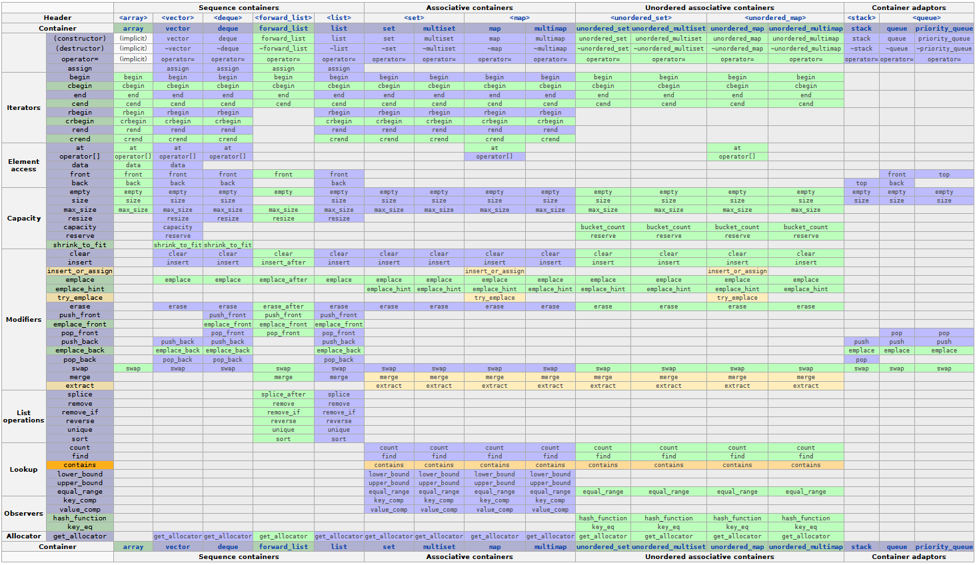
Table from cppreference.com Licensed under Creative Commons Attribution-Sharealike 3.0 Unported License (CC-BY-SA) and by the GNU Free Documentation License (GFDL)
Permalink: https://en.cppreference.com/mwiki/index.php?title=cpp/container&oldid=105942

Slide 20
C++20: contains() for Ordered and Unordered Associative Containers
DEMO

Slide 21
C++20: String Prefix and Suffix Checking
https://wg21.link/P0457R2
Implemented in VS 2019 16.1
Adds new member functions, starts_with and ends_with to basic_string and basic_string_view
Checks whether a string starts with a given prefix or ends with a given suffix, respectively
Simplifies those commonly used string functions, similar to other programming languages such as Java or Python

Slide 22
C++20: String Prefix and Suffix Checking
DEMO

Slide 23
C++20: char8_t: A type for UTF-8 characters and strings
https://wg21.link/P0482R6
Implemented in VS 2019 16.2
Introduces a new fundamental type: char8_t
does not alias with any other type
New char8_t based specializations :
atomic, numeric_limits, hash, char_traits, basic_string, and basic_string_view.
New type aliases:
u8streampos, u8string, and u8string_view
filesystem::path now be constructed with UTF-8 strings while the u8path factory functions are deprecated

Slide 24
C++20: char8_t: A type for UTF-8 characters and strings
DEMO

Slide 25
C++20: heterogeneous unordered lookup
https://wg21.link/P0919R3
Implemented in VS 2019 16.3
Patched with https://wg21.link/P1690R1
Patch implementation contributed by S. B. Tam (cpplearner): GH-341
Merged into VS 2019 VS 16.5
Adds heterogeneous lookup support to unordered associative containers
Eliminates the need to create temporary key object when a different (but compatible) type is provided as a key to a lookup function
Improves compatibility between ordered and unordered associative containers

Slide 26
C++20: heterogeneous unordered lookup
DEMO

Slide 27
C++17: Elementary string conversions
https://wg21.link/P0067R5
Implementation completed in VS 2019 16.4: C++17 “Final Boss”
Adds high performance, locale-independent, non-throwing, numeric/string conversion functions
std::from_chars()
std::to_chars()
For in-depth coverage, including performance benchmarks, watch Stephan T. Lavavej’s “Floating-Point ＜charconv＞: Making Your Code 10x Faster With C++17's Final Boss”: https://www.youtube.com/watch?v=4P_kbF0EbZM

Slide 28
C++17: Elementary string conversions
DEMO

Slide 29
C++20: Adopt Consistent Container Erasure from Library Fundamentals 2
https://wg21.link/P1209R0
Implementation contributed by Daniel Marshall (SuperWig): GH-236
Merged in VS 2019 16.5
Adds two new functions
std::erase()
std::erase_if()
Deprecates the functions with same names in std::experimental
Can be less error-prone than using remove/remove_if

Slide 30
C++20: Adopt Consistent Container Erasure from Library Fundamentals 2
DEMO

Slide 31
C++20: std::is_constant_evaluated()
https://wg21.link/P0595R2
Implementation contributed by Jennifer Yao (MSVC) and Stephan T. Lavavej (MSVC): GH-353
Merged in VS 2019 16.5
Adds a new library function in std:: namespace
constexpr bool is_constant_evaluated() noexcept;
Enable developers to provide alternative implementations of functions at compile time in case the run time implementation is not evaluated as a constant expression by the compiler

Slide 32
C++20: std::is_constant_evaluated()
DEMO

Slide 33
C++20: constexpr for <algorithm> and <utility>
https://wg21.link/P0202R3
Implementation contributed by Billy O’Neal (MSVC): GH-425
Merged in VS 2019 16.6
Add constexpr modifiers to functions in <algorithm> and <utility> headers
Does not break existing code
Focuses on algorithms
Containers and iterators are deferred to a separate proposal

Slide 34
C++20: constexpr for <algorithm> and <utility>
DEMO

Slide 35
C++20: <span>
https://wg21.link/P0122R7
Implementation contributed by Michael Schellenberger Costa (miscco): GH-142
Merged in VS 2019 16.6
Introduces a new type, std::span, and a new header, <span>
Provides a non-owning, non-configurable view over a contiguous sequence of objects
Conceptually, a pointer and a count of the elements accessible via that pointer
Designed as a value type – cheap to construct, copy and move
Not an iterator - no increment, decrement, or dereferencing operations
std::span is similar to, but not the same as gsl::span
gsl::span provides additional runtime checking guarantees for memory bounds safety.
Additionally, gsl::span works with C++14 and C++17
For more details on gsl::span, read GSL 3.0.0 release: https://devblogs.microsoft.com/cppblog/gsl-3-0-0-release/

Slide 36
C++20: <span>
DEMO

Slide 37
C++20: <ranges>
https://wg21.link/P0896R4 (The One Ranges Proposal)
Implementation contributed by Casey Carter (MSVC)
Work in progress (merged across various VS 2019 updates)
The ranges library provides components for dealing with homogeneous sequences of elements
Introduces a new namespace, std::ranges, and a new header, <ranges>
Provides concepts, adaptors, algorithms, and factories
Implemented based on Standard Library Concepts (P0898R3).
More details about ranges with concepts: https://devblogs.microsoft.com/cppblog/c20-concepts-are-here-in-visual-studio-2019-version-16-3/

Slide 38
C++20: <ranges>
[X] WG21-P0898R3 "Standard Library Concepts" (VS 16.3)
[X] Iterator machinery in <xutility> (VS 16.4)
WG21-P1207R4's changes to weakly_incrementable
WG21-P1754R1's concept renaming.
[X] Range machinery in <xutility> (GH-82)
CPOs: c?r?(begin|end), c?data, empty, size (WG21-P1523R1 changes)
WG21-P1035R7's range_XXXX_t composed aliases
WG21-P1474R1 changes to contiguous_iterator
[X] Update "old" range types (GH-95)
[X] More iterator machinery in <xutility> (GH-329)
[X] Functional machinery (GH-385)
[X] Misc range concepts (GH-389)
WG21-P1870R1 safe_range
Relax copyability requirement of view concept (Partially implements WG21-P1456R1 "Move-Only Views"
[X] Fix various issues with Range Access CPOs (investigation for WG21-P2091R0) (GH-432)
[X] Algorithm machinery in <xutility> (GH-565)
WG21-P2106R0 generic algorithm result types
[X] LWG-3326 "enable_view has false positives" (GH-588)
[X] insert iterators (GH-589)
[WIP] Iterator adaptors, old and new:
[X] WG21-P1871R1 Append "_for" to the name disable_sized_sentinel (GH-607)
[WIP] Range adaptor machinery
[ ] Range <algorithm>s
[ ] Range factories in <ranges>
[ ] Range adaptors *_view
[ ] Special <memory> range algorithms
[ ] Define __cpp_lib_ranges

Slide 39
C++20: <ranges>
DEMO

Slide 40
Call to Action
Learn about MSVC STL and C++20 features on STL GitHub repo
https://github.com/microsoft/STL
Active development == latest features
Try out the latest C++20 features using VS 2019 updates
Download at: https://visualstudio.microsoft.com/vs/preview/
File bugs
STL bugs/features issues → https://github.com/microsoft/STL/issues
VS issues / general questions → https://developercommunity.visualstudio.com
Contribute code
https://github.com/microsoft/STL/pulls

Slide 41
Resources
STL GitHub Repo:
https://github.com/microsoft/STL
MSVC C++ Standard Library Reference:
https://docs.microsoft.com/en-us/cpp/standard-library/cpp-standard-library-reference?view=vs-2019
This presentation and sample code used in demos:
https://github.com/msalehmsft/VirtualCpp

Slide 42
Thank You!

