Slide 1
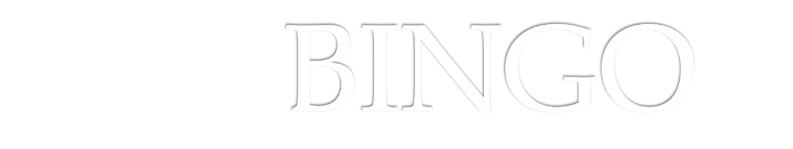
Eng. Mohammed Arnaoty
DR: Mohamed el Ramly
Course : Software Engineering
Group : 3,4 IT Department

Slide 2
Team Names
Mahmoud Mohamed Gamal 20120363
Amr Abo El-Aila 20120256
Mahmoud Hamdy Sayed 20120352
Amr Sameh Raafat 20120260

Slide 3
Objective of the Project
The goal of the project is to implement a board game known as Bingo. The game should be simple and fast. The final product is going to be integrated in the Main GUI application. It will allow players to play against others.

Slide 4
Objective of the Project
  The game will be played in a server-client fashion, where one device starts the game as a server. Other players send join requests to the server. The server can accept up to only 4 requests per game, that’s number of players can’t exceed 4.

Slide 5
Requirements
  Each player starts the game by setting his 25 numbers. As the game proceeds, each player choose a number from 1 to 25 and the system delete this number at other players’ devices . System delete a letter from bingo if the player got 5 deleted numbers in the same row or column or diagonal . The winner is the player who end the bingo word first.

Slide 6
Software Requirements Specifications
There are two types of Requirement
Functional Requirement :-
Non Functional Requirement :-

Slide 7
Functional Requirement
Create server:
Join server
Set the board
Starting the game
Get number
Update cell
Check row
Check column
Check diagonal
Update board
Check winner
Exchange turns
Show winner

Slide 8
Non Functional Requirement
Professional GUI

Slide 9
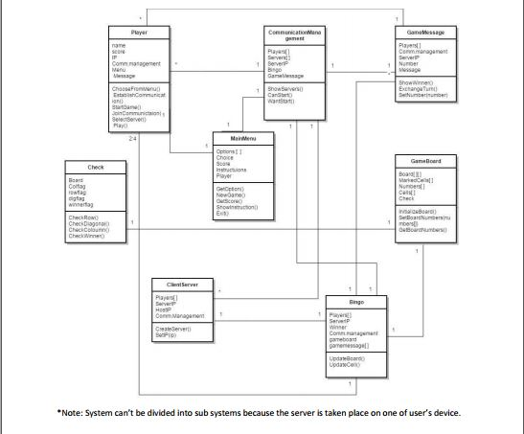
Software Design Specification

Slide 10
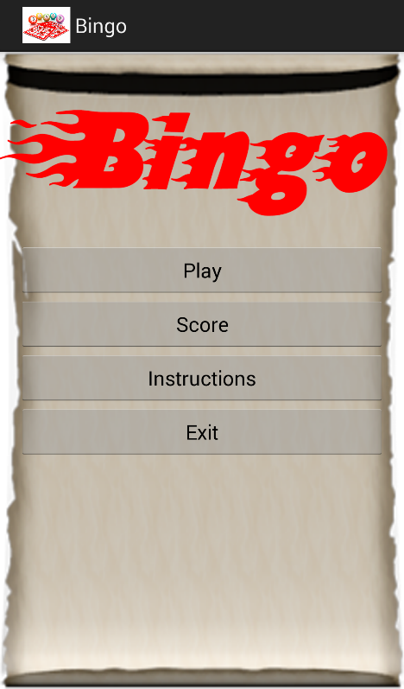
Demo of the system Implementation
The Demo will be
shows live

Slide 11
Problem and Challenges Faced The Team in project
Problems:
  Miss understanding of project objectives
  Time
Challenges:
  Deliver the tasks on time

Slide 12
Lessons From This project
Every thing at the beginning is difficult
Give everything its value and never give up
Learn how to develop an android application
SDLC
How to use github

Slide 13


