Slide 1

Final Project

Slide 2

Introduction
What is the Problem?
Briefly explain the challenge of identifying used car fuel type based on available data.
Mention the significance of fuel type prediction for car buyers, sellers, and environmental analysis.

Slide 3
Analysis
Exploratory Data Analysis (EDA)
﻿
Explain the importance of EDA in understanding the data.
Bullet points with key findings from EDA:
Distribution of features (e.g., histograms for price, mileage)
Relationships between features and fuel type (e.g., scatterplots for price vs. mileage colored by fuel type)
Identify potential outliers or missing values
﻿
﻿
Data Cleaning and Preprocessing
﻿
Importance of cleaning and preparing data for machine learning.
Steps involved:
Handling missing values (e.g., imputation or removal)
Dealing with outliers (e.g., capping or removal)
Encoding categorical features (e.g., using LabelEncoder for the model, manufacturer)

Slide 4
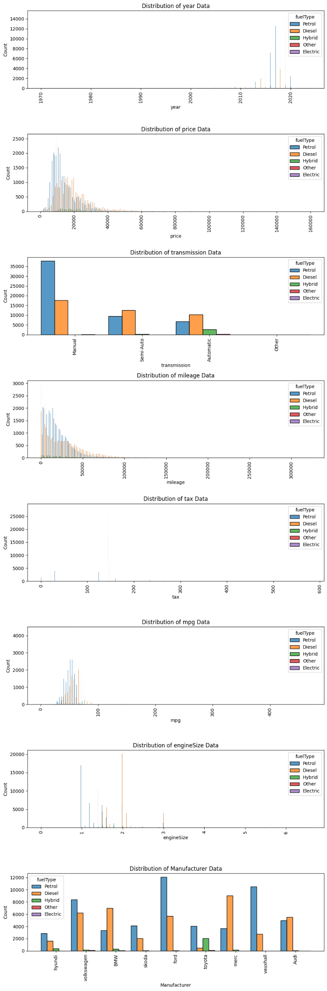
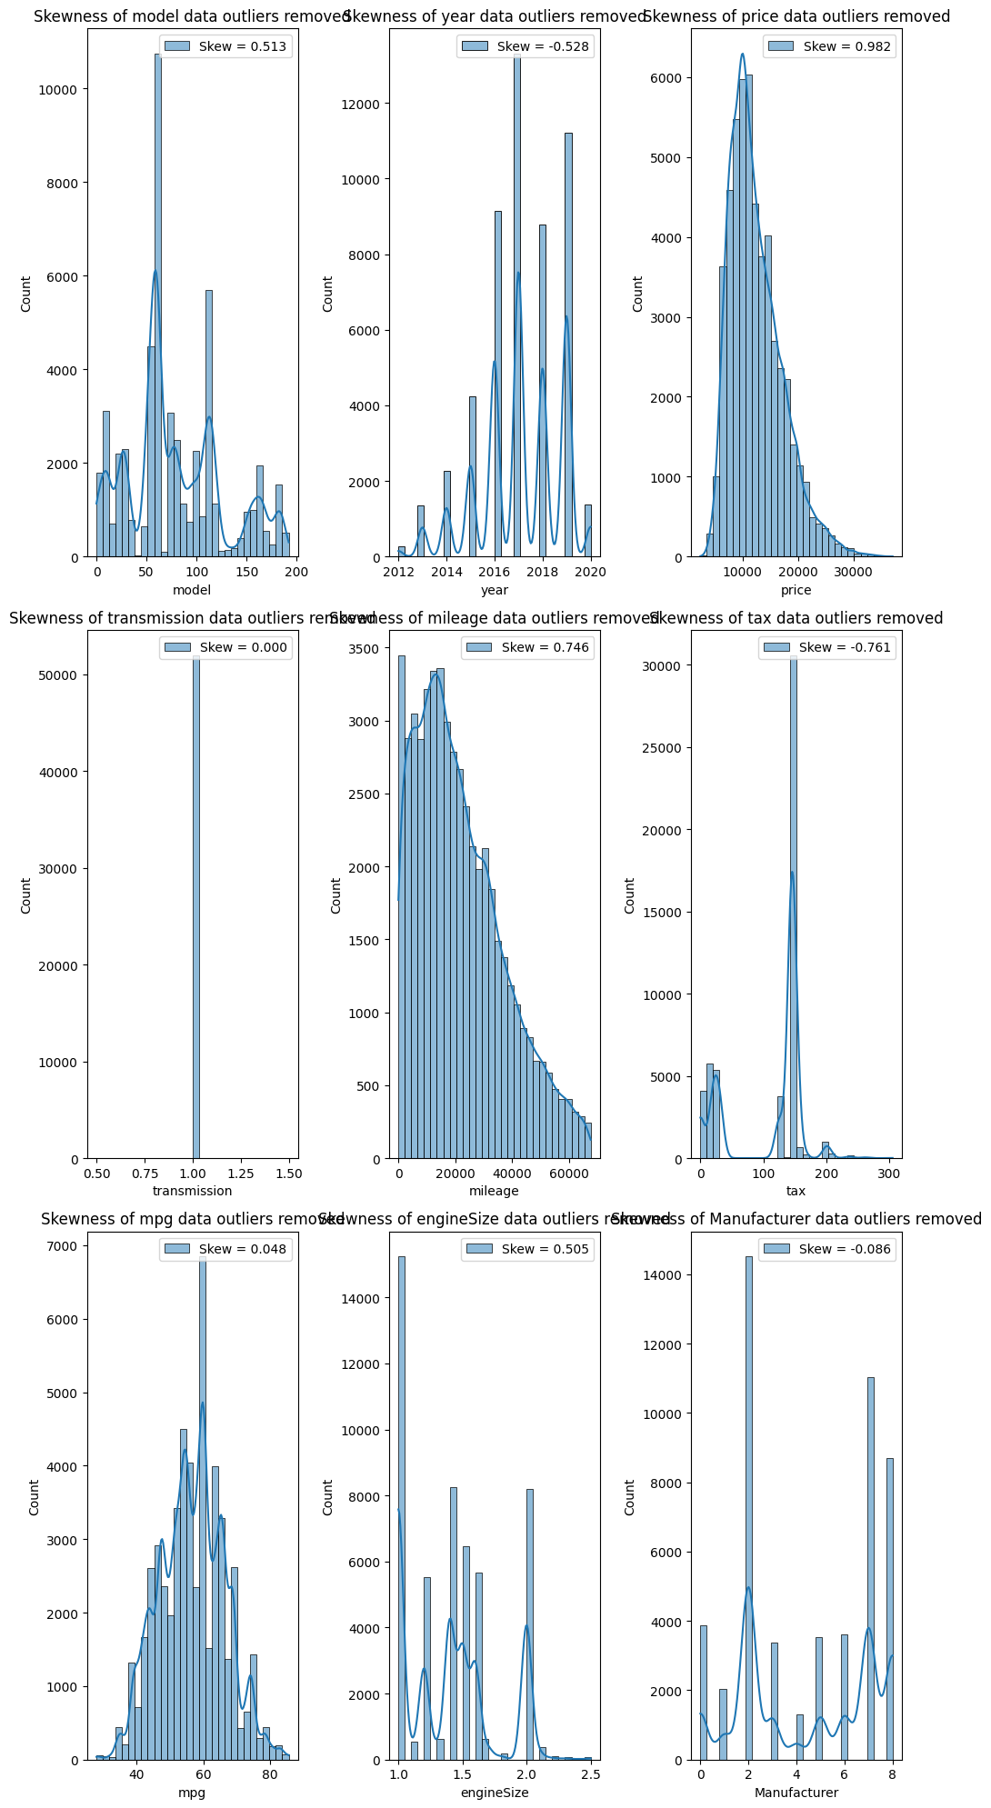

Slide 5
Modeling
﻿
Machine Learning Model Selection
﻿
Various machine learning algorithms are suitable for classification tasks (brief overview).
Explain the rationale behind choosing specific algorithms for this project (e.g., Logistic Regression, Random Forest)
﻿
Model Training and Evaluation
﻿
Explain the process of training machine learning models.
Splitting data into training and testing sets.
Evaluation metrics: Accuracy, Precision, Recall, F1-score (brief explanation of each)
﻿
Model Comparison and Selection
﻿
Compare the performance of different models based on evaluation metrics.
Highlight the best-performing model and explain the reasoning behind its selection.
﻿
﻿

Slide 6
Model Comparison and Selection
﻿
Highlight the best-performing model and explain the reasoning behind its selection.
LogisticRegression | SVC | RandomForest | GradientBoosting | AdaBoost | KNeighbors
0.961624 | 0.989997 | 0.997115 | 0.995287 | 0.817736 | 0.995191

Slide 7
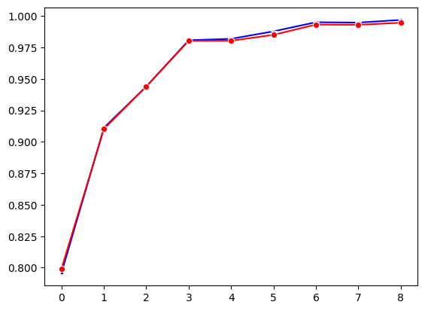
RandomForestClassifier
model_score
RFC Train Model Score : 0.9632986269747758
RFC Test Model Score : 0.9173655862267962

