Slide 1
SwiftRoute
AI-Assisted Last-Mile Logistics & Parcel Delivery Platform
A full-stack system inspired by Bosta & DHL
Merchants ship → AI optimises routes → couriers deliver → customers track
Every automated decision explains its reasoning

Slide 2
The Problem
▸ Last-mile delivery is the most expensive, least-optimised leg of the supply chain.
▸ Cairo: dense congestion, landmark-based addresses, cash-on-delivery everywhere.
▸ Small merchants coordinate couriers manually by phone — no routing, no ETAs, no proof.
▸ The OR/ML techniques that could fix this are locked in proprietary black boxes.

Slide 3
What We Built (at a glance)
▸ Multi-role platform — Admin, Courier, Merchant portals + public no-login tracking.
▸ AI route optimiser — k-means clustering + 6 TSP techniques, benchmarked.
▸ Explainable ML suite — 5 slices: ETA, forecasting, neural router, personas, NLP + assistant.
▸ Trust layer — SHA-256 hash-chained custody + GIS proof of delivery.
▸ Street-following routes — real OSRM geometry, simulated traffic, road closures.
▸ 74 automated tests; deployable one-click on a free tier.

Slide 4
The Big-Picture Pipeline
▸ Merchant drops a pin on the map → shipment created.
▸ Parcel lands at its hub (at_warehouse).
▸ AI optimiser: k-means clusters → TSP sequence → OSRM street geometry + ETA.
▸ Courier delivers with photo + GPS → hash-chain custody + GIS proof.
▸ Customer follows a live public tracking timeline.
▸ The optimiser and every model expose their reasoning throughout.

Slide 5
Architecture
▸ Flask application factory + blueprints (main, auth, admin, courier, merchant, tracking, api).
▸ SQLAlchemy ORM — SQLite zero-config by default, PostgreSQL via one DATABASE_URL.
▸ routing/ = optimizer + street_router; ml/ = predictive layer; audit.py = custody + GIS.
▸ Front-end: Jinja2 + Bootstrap 5 + Leaflet maps + Chart.js dashboards.
▸ Security: PBKDF2 hashing, CSRF on every form, role_required decorator, open-redirect guard.

Slide 6
The Optimisation Engine — 4 Steps
▸ Vehicle routing is NP-hard — we decompose it into tractable sub-problems.
▸ 1) Assign — each parcel belongs to its hub.
▸ 2) Cluster — k-means gives each courier a zone; capacity-aware (Bike 3 / Moto 5 / Car 10 / Van 15).
▸ 3) Sequence — solve the TSP order with a selectable technique.
▸ 4) Geometry + ETA — OSRM real-street paths, cached, straight-line fallback.

Slide 7
Six TSP Techniques
▸ FIFO — as received: the baseline to beat.
▸ Nearest Neighbour — fast greedy heuristic.
▸ 2-opt — un-cross edges; the default (best quality/speed balance).
▸ Or-opt — adds segment relocation; highest quality.
▸ Christofides (NetworkX) — proven 1.5×-optimal guarantee for metric TSP.
▸ Simulated Annealing (NetworkX) — metaheuristic escaping local optima.

Slide 8
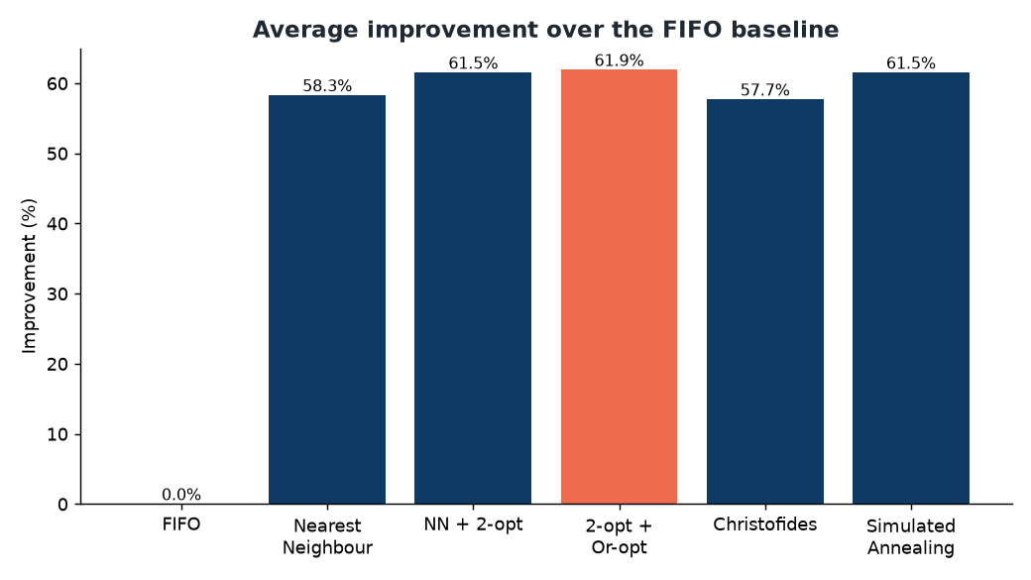
⭐ WOW: Benchmarked, Not Asserted
▸ Reproducible harness; brute-force exact optimum for size ≤ 8.
▸ Optimised routes cut total distance ~60–62% vs naive FIFO.
▸ Or-opt lands ~0.1% from the exact optimum — in milliseconds; 2-opt & SA < 1%.
▸ Design defended by data, not opinion.

Slide 9
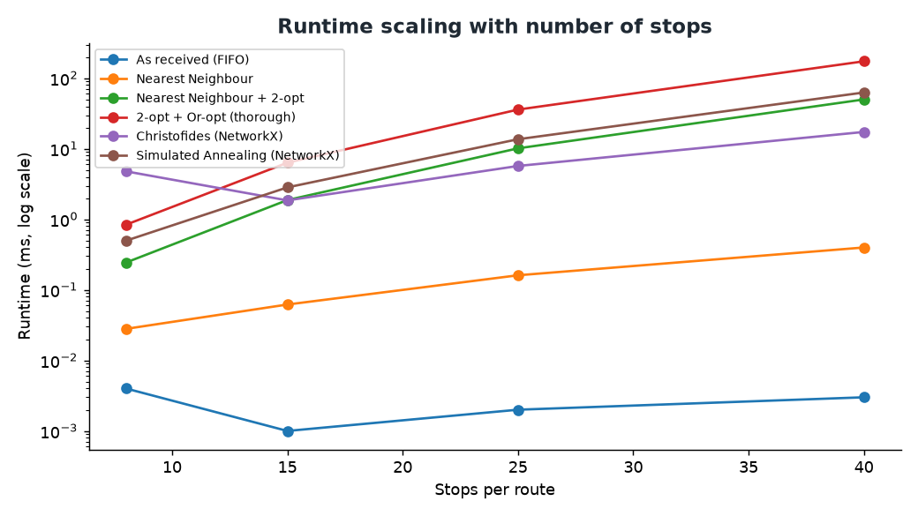
⭐ WOW: Optimality & Speed
▸ On solvable instances 2-opt & SA stay < 1% above optimal; Christofides ~9% but guaranteed.
▸ 2-opt gives the best quality/speed balance; runtimes scale gently.

Slide 10
⭐ WOW: Live Traffic & Road Closures
▸ Routes coloured green → amber → orange → red by congestion.
▸ Deterministic time-of-day + day-of-week model (rush-hour curve, Friday lightest for Cairo).
▸ Honest engineering: no fake live feed — clearly labelled simulated in the UI.
▸ Closures are first-class: the optimiser re-routes around them; un-avoidable legs flagged dashed red.
▸ Smart split: store expensive geometry, compute cheap traffic fresh at render time.

Slide 11
⭐ WOW: Dispatch-Time Planning
▸ “Is Friday morning faster than Tuesday 6pm?” — now answerable.
▸ traffic_factor_at() scales each leg's ETA by the traffic when the courier actually reaches it.
▸ compare_strategies() ranks techniques by makespan (when the last parcel lands), then distance.
▸ Preview is pure estimation — instant, offline, no DB writes; only dispatch persists.

Slide 12
The ML Suite — 5 Slices
▸ All pure numpy / scikit-learn — no torch, no GPU, trains in seconds; deploys on a free tier.
▸ 1) ETA + forecasting 2) feedback + audit + GIS 3) NLP notes + assistant.
▸ 4) learning-to-route neural policy 5) courier-behaviour personas.
▸ Trained on a seeded, reproducible synthetic history (~5.8k deliveries / 180 days).
▸ Guiding principle: every model explains itself.

Slide 13
Slice 1 — ETA & Demand Forecasting
▸ Gradient-boosted trees: drop-off ETA (MAE ~2.7 min, R² ~0.94), pickup ETA (MAE ~1.3 min).
▸ Late-risk classifier: AUC ~0.82 (5-fold CV, 72% better than mean baseline).
▸ SeasonalTrendForecaster: trend + weekly seasonality + 95% band, MAPE ~14%.
▸ TreeContributionExplainer gives exact additive ‘why’ per prediction — no black box.

Slide 14
Slice 2 — Trust & Audit
▸ Chain of custody: every handoff SHA-256 hash-linked to the previous — tamper-evident.
▸ verify_chain() recomputes and detects tampering.
▸ GIS proof: haversine geofence confirms delivery within radius of the destination.
▸ Feedback/drift monitor: predicted-vs-actual log, weekly drift flags, calibration + Brier score.

Slide 15
Slice 3 — NLP Notes + Assistant
▸ Hybrid analyser: lexicon/regex + TF-IDF one-vs-rest logistic regression (10-tag taxonomy).
▸ Generalises to unseen phrasing (“the vase can shatter” → fragile), with exact token reasoning.
▸ Extracts time windows (“between 6 and 9 pm” → 18:00–21:00) and target floor.
▸ Assistant: DB retrieval always works + optional local LLM that only phrases the facts.

Slide 16
Slice 4 — Learning-to-Route (Neural)
▸ Pure-numpy pointer-network policy; linear-softmax attention over unvisited stops (7 features).
▸ Trained with REINFORCE + a greedy-rollout baseline (self-critical / Kool-style).
▸ Key insight: greedy collapses to nearest-neighbour — the win is best-of-N sampled rollouts.
▸ Result: ~5% shorter than NN, ~1.5–2% gap to 2-opt; per-step feature reasoning.

Slide 17
Slice 5 — Courier-Behaviour Personas
▸ Simulated GPS traces → stop detection (idle / delivery / break by dwell time).
▸ 7 engineered features → k-means into 4 personas: Efficient / Steady / Idle-prone / At-risk.
▸ Validated: silhouette 0.36, ARI 0.99 vs ground-truth archetypes.
▸ z-score reasoning + productivity score — fleet insight with no new hardware.

Slide 18
Hardest Difficulties We Solved
▸ Behaviour bug: dwell measured from arrival ping, not within-run span — fixed all-idle misclassification.
▸ Hash chain vs SQLite: timestamps must be naive UTC or the chain won't re-verify after round-trip.
▸ Explainer precision: walk trees in float32 to match sklearn's leaf selection exactly.
▸ Config trap: a global ~/.env DATABASE_URL hijacked the app → made config project-local.
▸ Deploy bug: AUTO_INIT_DB=true parsed as false → no tables → 500 on login.

Slide 19
Key Engineering Decisions
▸ Explainability first — every model returns signed, human-readable reasoning.
▸ Deploy-anywhere — light deps only; every heavy library/network call has a fallback.
▸ Additive schema — new features = new tables or simulation; create_all upgrades old DBs cleanly.
▸ Reproducible — everything seeded (seed=42).
▸ Key-less philosophy (OSRM + Nominatim); map-pin addressing beats landmark geocoding.

Slide 20
Quality & Validation
▸ 74 automated tests — lifecycle, optimiser, ML, audit, NLP, router, behaviour.
▸ Tests run offline (ROUTING_PROVIDER=straight).
▸ Models validated against baselines with cross-validation — honest, not lucky-split.
▸ Reproducible benchmark harness with exact-optimum ground truth.

Slide 21
Impact & Future Work
▸ Impact: an open, explainable alternative to proprietary logistics black boxes on minimal infra.
▸ Real operational data + a live traffic feed.
▸ Hard time windows (VRPTW) + multi-day tours; live mid-trip re-routing from real GPS.
▸ Full attention/transformer router on capable hardware; mobile app + OTP-verified handoffs.

Slide 22
Thank You / Demo
Try it: Merchant creates a shipment → Admin optimises → Courier delivers → track publicly.
Demo: admin@swiftroute.app / courier1@swiftroute.app / merchant1@swiftroute.app
Questions & discussion.

