Slide 1
✓
Ta2keed تأكيد
The AI agent that confirms, de-risks and ships cash-on-delivery orders for Egyptian social-commerce shops — without a human in the loop.
DM in → order confirmed → deposit verified → courier booked
88 h
25% → 9%
53,859 EGP
returned to the owner / month
COD refusal rate
monthly impact (projected)
Agents at Work 2026 · Mahmoud Gamal · github.com/MahmoudJimmey/Ta2keed
Notes:
Ta2keed means 'confirmation'. One sentence: it replaces the person who sits in the DMs all day confirming COD orders, and it stops the refusals that eat the shop's margin.

Slide 2
THE SME WE BUILT FOR
Instagram & WhatsApp shops that live on cash-on-delivery
Why this segment
Pilot profile
Nour Boutique (نور بوتيك)
Huge
Social commerce is how most small Egyptian brands sell — no website, no checkout, just DMs.
• Women's fashion, sells only via Instagram, Facebook & WhatsApp DMs
• ~600 orders / month, almost all cash-on-delivery
• 1 person answers DMs, confirms, books the courier
• ~9 min of manual handling per order
• ~25% of parcels refused at the door
• Each refusal costs ~120 EGP (shipping + return) and a week of stock
Cash-first
COD dominates, so the shop carries the risk of every order until the courier collects.
Painful
Refusals, fake transfer screenshots and slow replies are the #1 complaints of these owners.
Underserved
Global tools (Shopify bots, US chatbots) don't speak Egyptian Arabic or InstaPay.
Pilot numbers live in data/store.json → economics; this deck regenerates from them (python -m scripts.make_slides).
Ta2keed · Agents at Work 2026
2 / 14
Notes:
Replace the pilot profile with the real shop you talked to, and its real numbers. Judges score measurable impact for a real SME.

Slide 3
THE WORKFLOW WE REPLACED
From 9 minutes of copy-paste per order to zero
BEFORE — a person does this for every order
AFTER — Ta2keed does it, 24/7
Read messy DM, ask for size / colour / address
3 min
Understands Egyptian Arabic, Franco & voice notes; asks only what's missing
Copy order into a sheet or notebook
1.5 min
Writes the order to the database + CSV/Excel export
Call / message to confirm the order
2 min
Sends a clear order summary; customer just replies "OK"
Chase InstaPay screenshot, check it by eye
1.5 min
Reads the receipt, checks amount, recipient, status & re-use
Book courier, send tracking to customer
1 min
Books Bosta and sends tracking automatically
Absorb refused parcels (~1 in 4)
120 EGP each
Scores refusal risk and asks risky orders for a deposit first
Human time per order: 9 min → 0 min (owner only reviews the daily digest)
Ta2keed · Agents at Work 2026
3 / 14

Slide 4
HOW THE AGENT WORKS
One conversation, eight autonomous steps
1
Understand
2
Complete
3
Upsell
4
Score risk
Arabic / Franco / voice → items, size, colour, name, phone, address, zone
Asks for only the missing field, pushes for building & floor
Offers a matching item at a small discount
Explainable COD-refusal score with reasons
5
Deposit
6
Verify
7
Ship
8
Report
Risky orders pay 100 EGP via InstaPay / Vodafone Cash
Auto receipt checks, then owner taps ✅ (money arrived)
Books Bosta, sends tracking & amount due
Live dashboard, CSV, Telegram daily digest
Safe by design: a deterministic state machine owns prices, deposits and shipments. The (optional) LLM only reads text and images — a prompt can't make an order free.
Ta2keed · Agents at Work 2026
4 / 14
Notes:
Amber steps 4-6 are the money-protecting part — that's what differentiates this from a chatbot.

Slide 5
AFTER THE ORDER IS CONFIRMED
Every parcel tracked; customer pinged only when it matters
Picked up
In transit
Out for delivery
Delivered
dashboard only
dashboard only
🔔 customer notified
🔔 customer notified
Failed attempt
Refused / returned
+24 h
+14 days
Customer: "when should we come back?" Reply goes to the owner as a reschedule.
Silent to the customer. Owner alerted. Customer history updated, so next time a deposit is required.
Rating 1-5. A low rating triggers an apology and an instant owner alert.
Personal reorder offer + discount code. Repeat order reuses the saved address.
Owner on WhatsApp: instant alerts only for problems, plus a 21:00 daily summary (orders, cash collected, refusals, ratings, repeat orders). Answers summary / deliveries / pending commands on demand.
Courier: Bosta webhook or any courier or own driver via one endpoint. Refusal rate becomes measured, not estimated.
Ta2keed · Agents at Work 2026
5 / 14
Notes:
Key point for judges: fewer messages, not more. 4 courier updates -> 2 customer messages. And every refusal makes the risk engine smarter for that shop.

Slide 6
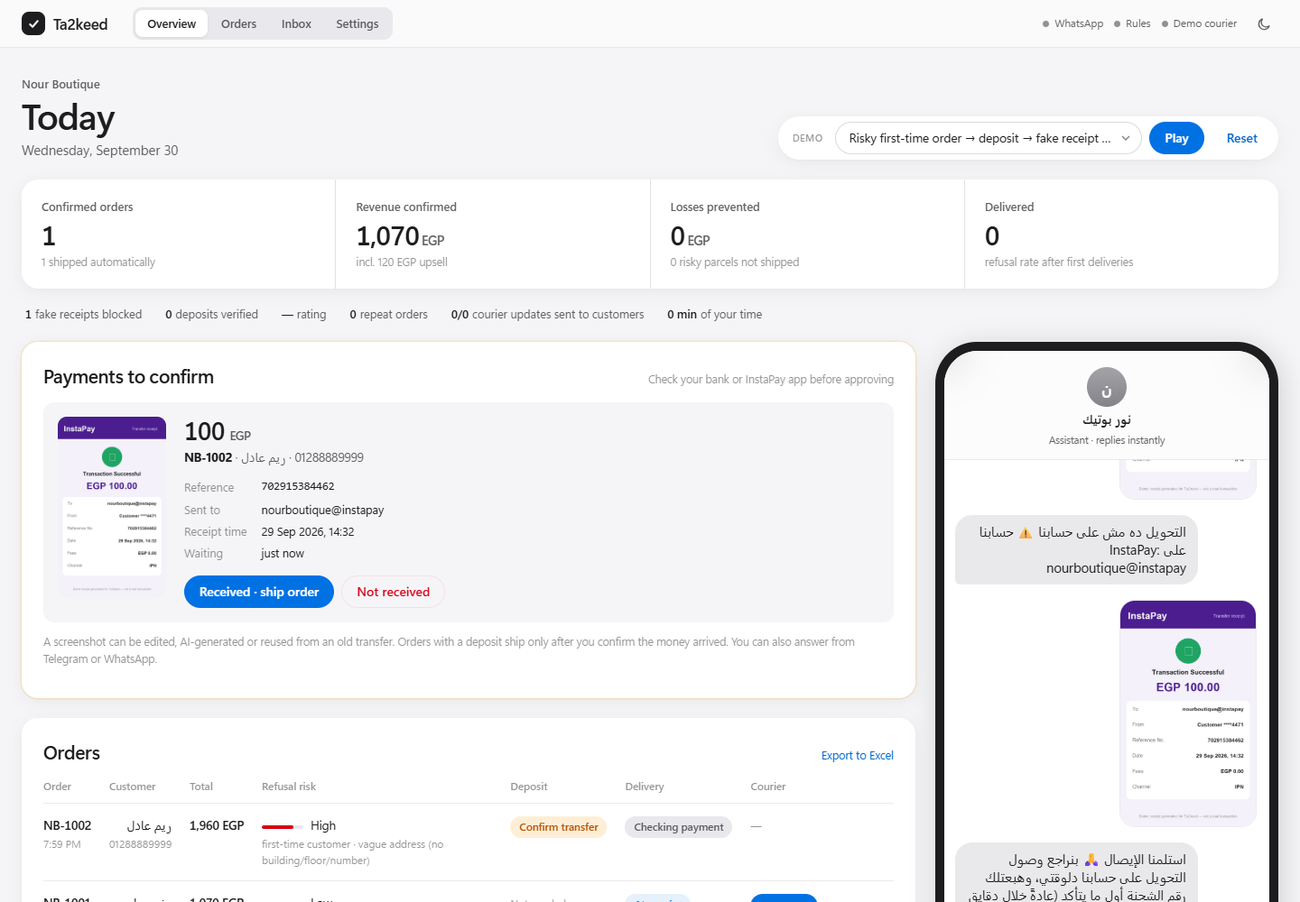
DOES IT WORK?
A live agent: 5 real conversations, one tap from the owner
Measured in the demo run
Conversations handled
5
Orders auto-confirmed & shipped
5
Risky orders flagged
2
Fake receipts blocked
1
Deposits verified
1 (100 EGP)
Risky parcels NOT shipped
1 (saved 125 EGP)
Upsells accepted
1/5 (+120 EGP)
Delivered / cash collected
1 (950 EGP)
Courier updates → customer msgs
4 → 5
Rating · repeat orders
5.0 · 1
Owner taps (deposit confirmed)
1
Runs in < 5 min with no API keys (./run.sh → ▶ Play demo) · 71 automated tests
Ta2keed · Agents at Work 2026
6 / 14
Notes:
Numbers on the right are produced by the agent's own event log (/api/impact), not typed by hand.

Slide 7
MEASURED BUSINESS IMPACT
53,859 EGP per month for a 600-order shop
DOES IT WORK?
TIME SAVED
COST SAVED
REVENUE GENERATED
✓ Live
88 h / mo
15,696 EGP
38,163 EGP
WhatsApp / Telegram / web chat, courier booking, receipt checks — end to end
600 orders × 9 min no longer done by hand ≈ half a full-time job
Staff time 3,960 EGP + refused-parcel losses avoided 11,736 EGP
Upsell 10,080 EGP + after-hours orders 16,200 EGP + saved orders 11,883 EGP
Refusal rate 25% → 8.7%
≈ 98 fewer refused parcels every month
53,859 EGP
total monthly impact (cost saved + new revenue)
Projection from the pilot baseline (slide 9 lists every assumption). Measured counters come from the agent's event log.
Ta2keed · Agents at Work 2026
7 / 14

Slide 8
WHERE THE MONEY COMES FROM
Monthly impact breakdown
Reading the chart
■ Cost saved — time the owner gets back
■ Cost saved — outbound + return fees on parcels that would have been refused
■ New revenue — upsells, DMs answered at 2 AM, and orders the deposit turns into real sales
Biggest single lever: the deposit gate. It only asks the ~30% riskiest orders for 100 EGP, so good customers never feel friction.
Ta2keed · Agents at Work 2026
8 / 14

Slide 9
WHY THIS AGENT, NOT A CHATBOT
Built for the Egyptian market and for money-safety
🗣️
Speaks the customer's language
💳
Local payment rails
Egyptian Arabic, Franco-Arabic, Arabic-Indic digits, voice notes, Egyptian areas → shipping zones
InstaPay & Vodafone Cash deposits: auto fraud checks (wrong account, low amount, reused) + owner taps ✅ on Telegram/WhatsApp before anything ships
🛡️
Can't be talked into losses
🔍
Explainable decisions
Prices, totals, deposits and shipments are code, not LLM output — prompt-injection test included
Every risk score lists its reasons; every action is logged and visible to the owner
🔕
Talks less, not more
🧩
New shop in minutes
Customers get only delivery highlights; owners get only problems + one daily summary
Catalogue, upsell pairs, zones, fees and deposit policy live in one store.json file
Ta2keed · Agents at Work 2026
9 / 14

Slide 10
HOW WE MEASURED
Every number is traceable
Measured by the agent (event log)
Pilot baseline used for the monthly projection
• orders created / confirmed / auto-shipped
• risky orders flagged and their reasons
• deposits verified, fake receipts blocked
• risky parcels stopped before shipping + fees saved
• upsells offered vs accepted, upsell revenue
• after-hours orders, human minutes spent
Live at /api/impact and on the dashboard.
Orders / month | 600
Manual minutes / order | 9
Staff cost / hour | 45 EGP
Baseline refusal rate | 25%
Refusal rate with deposit | 4%
Share of orders flagged risky | 30%
Loss per refused parcel | 120 EGP
Average basket | 540 EGP
Gross margin | 45%
Upsell acceptance used | 17% (capped at 25%)
Conservative by design: upsell rate is blended with a 15% prior and capped; only half of saved orders are counted as sales.
Ta2keed · Agents at Work 2026
10 / 14

Slide 11
WHAT'S NEXT
From hackathon to a product SMEs hire on Wesam
750 EGP
72×
< 1 day
suggested price / month
return on price for the pilot shop
to onboard a new shop
Less than one refused parcel a day
Pays for itself in the first ~day
Edit store.json, connect WhatsApp number
Roadmap
Now
WhatsApp + Telegram + web, Bosta, receipt checks, delivery tracking, follow-ups, daily summary
Next 30 days
Pilot with 3 real shops; calibrate risk weights on their order history
Then
Instagram DM channel, Shopify/WooCommerce sync, courier status → auto follow-ups
Scale
List on Wesam's marketplace so any Egyptian SME can hire it in one click
Ta2keed · Agents at Work 2026
11 / 14

Slide 12
SEE IT YOURSELF
Run it in under five minutes
Judge quick-start
5 demo scenarios
git clone https://github.com/MahmoudJimmey/Ta2keed
cd Ta2keed
./run.sh # Windows: run.bat
# open http://localhost:8000 → ▶ Play demo
pytest -q # 71 tests
1. Messy Franco/Arabic order → upsell → confirmed → shipped
2. Risky first-time order → deposit → fake receipt caught → owner confirms real transfer → shipped
3. Customer with 3 past refusals → deposit required → customer cancels (return fee saved)
No API keys, no accounts, no database server.
Optional .env adds LLM, WhatsApp, Telegram, Bosta.
4. Customer asks questions first (shipping, sizes) then orders
5. Full journey: order → courier updates (highlights only) → delivered → rating → reorder
Ta2keed · Agents at Work 2026
12 / 14

Slide 13
HONEST LIMITATIONS
What could go wrong — and how we handle it
Rules miss an unusual message
Falls back to the LLM when configured; always asks instead of guessing; owner sees every order
Fake receipts get more sophisticated
Checks recipient, amount, status, duplicate reference & image hash; then the OWNER confirms the money arrived in the bank app before shipping (AI-made or recycled screenshots can't pass)
Deposit annoys good customers
Only the riskiest ~30% are asked; trusted repeat buyers get a lower score automatically
Risk weights are generic
Transparent weights; calibrate on each shop's own delivered/refused history
WhatsApp API needs Meta approval
Telegram + web chat work today; WhatsApp webhook is implemented and ready
Ta2keed · Agents at Work 2026
13 / 14

Slide 14
Every COD order confirmed, de-risked, shipped.
No human in the loop. No new app for the customer. Just WhatsApp.
88 h
15,696 EGP
38,163 EGP
time saved / month
cost saved / month
new revenue / month
github.com/MahmoudJimmey/Ta2keed
Mahmoud Gamal · Agents at Work 2026

