Slide 1
MFSDA

Slide 2
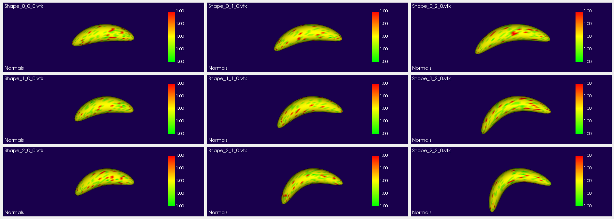
Synthetic Data 2 covariates: Time (T) and Group (G)
T1
T2
T3
G1
G2
G3

