Slide 1


WEEK 2 · DATA SCIENCE FOUNDATIONS
AML Transaction Analysis
Exploratory Data Analysis & Domain Research
Dataset: IBM Synthetic AML Dataset — HI-Small variant
Financial Crime Compliance · Technical Walkthrough

Slide 2
01 · DATASET
Dataset Overview
~5.08M
TRANSACTIONS
10 days simulated
11
COLUMNS
raw schema fields
HI-Small
VARIANT
high illicit ratio · small
▪ Source: IBM Transactions for Anti-Money Laundering (Kaggle) — synthetic banking data.
▪ HI-Small variant chosen for a high illicit ratio + small size — fast iteration within a 2-day timeline.
▪ Schema: Timestamp, From Bank, Account, To Bank, Account.1, Amount Received, Receiving Currency, Amount Paid, Payment Currency, Payment Format, Is Laundering.
AML Transaction Analysis · Financial Crime Compliance
2

Slide 3
02 · PREPARATION
Data Cleaning Summary
✓ Timestamp cast to datetime; bank IDs cast to string type.
✓ Built combined Sender_ID / Receiver_ID (Account + Bank) — caught 4 account-string collisions across different banks that raw Account alone would have missed.
✓ Removed 9 exact duplicate rows (~0.0002% of data).
✓ No missing values; no negative or zero transaction amounts found.
WHY THE COMBINED ID MATTERS
Account numbers are only unique within a bank. Keying on Account alone silently merges different real-world entities — a data-integrity risk before any modelling begins.
4 collisions resolved
AML Transaction Analysis · Financial Crime Compliance
3

Slide 4
03 · CLASS BALANCE
Extreme Class Imbalance
5,073,159
LEGITIMATE (99.898%)
the overwhelming majority
5,177
LAUNDERING (0.102%)
roughly 1 in 980 transactions
KEY IMPLICATION
Accuracy is a meaningless metric here — a model predicting “never launder” scores 99.9%.
Any future model must be evaluated on precision and recall, not accuracy.
AML Transaction Analysis · Financial Crime Compliance
4

Slide 5
04 · OUTLIERS
Outlier Analysis
IQR method · log-transformed · per payment format
Payment Format
Outlier %
AMOUNT IS A WEAK SIGNAL
17%
of transactions flagged as amount-outliers globally.
But the laundering rate inside the outlier set ≈ the overall laundering rate. Amount alone is NOT a strong laundering signal.
Bitcoin
16.8%
ACH*
5.3%
Cheque
5.1%
Cash
3.4%
Credit Card
2.9%
Wire
2.5%
Reinvestment
0.2%
Outlier vs overall laundering rate is nearly identical across every format.
AML Transaction Analysis · Financial Crime Compliance
5

Slide 6
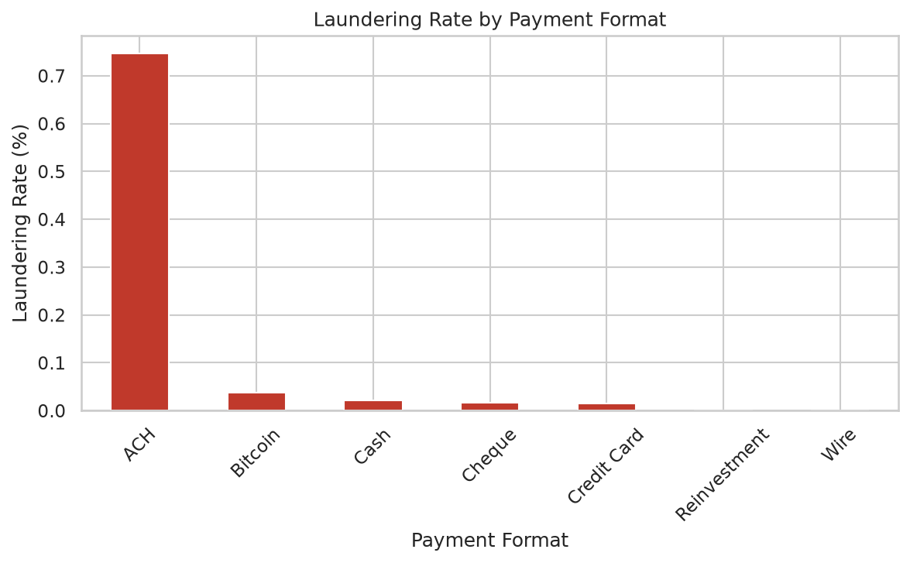
05 · STRONGEST FINDING
Payment Format Is the Strongest Signal
0.746%
ACH LAUNDERING RATE
20–47× higher than any other format
▪ ACH carries ~87% of all laundering cases (4,483 of 5,177) on just ~11% of volume.
▪ Wire and Reinvestment: 0% laundering in this dataset.
AML Transaction Analysis · Financial Crime Compliance
6

Slide 7
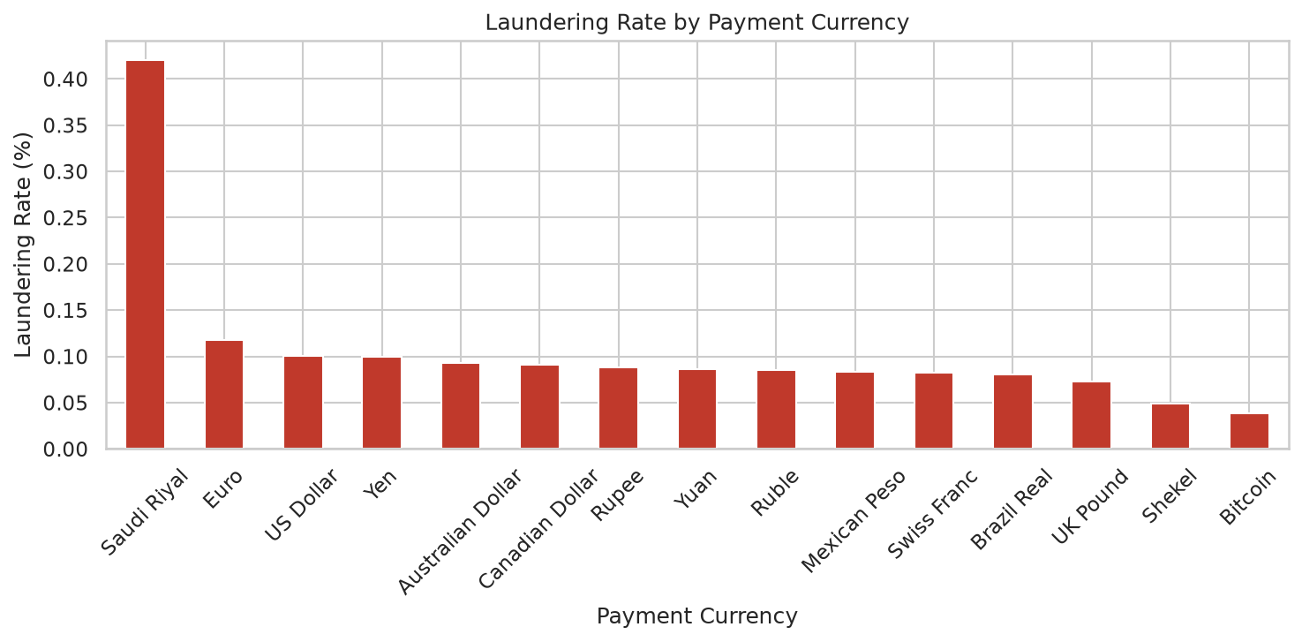
06 · CURRENCY RISK
Currency Risk Concentration
0.416%
SAUDI RIYAL
~4× the next currency (Euro, 0.117%)
▪ USD, Yen, Aussie/Canadian Dollar, Yuan, Rupee, Ruble, Mexican Peso all cluster in a tight 0.08–0.10% band.
▪ Shekel and Bitcoin sit lowest (~0.04–0.05%).
AML Transaction Analysis · Financial Crime Compliance
7

Slide 8
07 · ENTITY RISK
Bank Concentration Risk
up to 27%
PEAK BANK-LEVEL RATE
low volume · ~91 transactions
Not confirmed
STATUS
flagged for further validation
INTERPRETATION
A small number of sending banks show very high laundering rates — but on tiny volumes, so the estimates are fragile.
Suggests entity-level risk scoring as a complement to transaction-level rules.
AML Transaction Analysis · Financial Crime Compliance
8

Slide 9
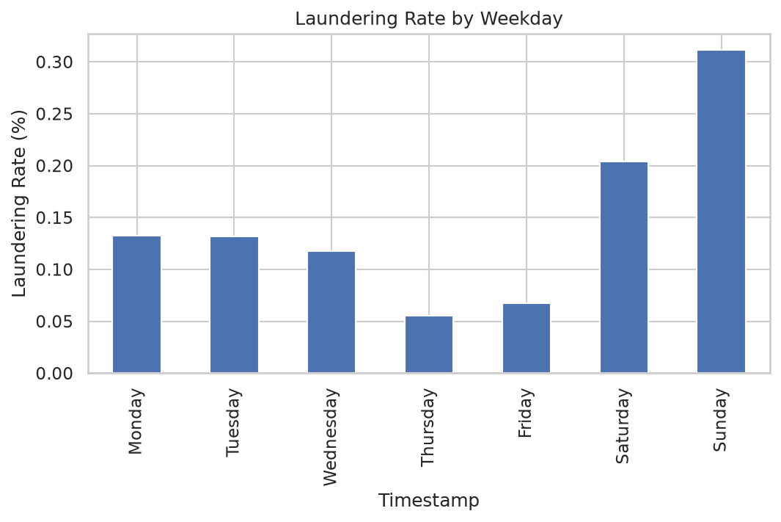
08 · TEMPORAL
Time Patterns: The Weekend Effect
▪ Laundering rate highest on Sunday (~0.30%) and Saturday (~0.20%) vs weekdays (~0.10–0.13%).
▪ Intraday peaks around midday hours (11:00–16:00).
▪ Business implication: weekend monitoring may need adjusted staffing and thresholds.
AML Transaction Analysis · Financial Crime Compliance
9

Slide 10
09 · DOMAIN RESEARCH
Six Money-Laundering Typologies
Typology
Definition
How it appears in transaction data
Fan-Out
One source pushes funds to many recipients
1 sender → many receivers
Fan-In
Many sources funnel into one account
many senders → 1 receiver
Layering
Funds moved through chained intermediaries
long sequential hops
Circular / Cycle
Funds return to the origin account
closed loop in the graph
Smurfing / Structuring
Large sums split into sub-threshold amounts
many small, similar transfers
Pass-through
Account receives and forwards near-identical sums
in ≈ out, short dwell time
AML Transaction Analysis · Financial Crime Compliance
10

Slide 11
10 · GROUND TRUTH
Typologies in the Labeled Data
Parsed HI-Small_Patterns.txt — 370 labeled laundering attempts across 3,209 transaction rows.
Pattern (dataset label)
Count
Maps to general typology
CYCLE
54
Circular / Cycle
8
REAL PATTERN TYPES
CYCLE is the single most common — motivating graph / cycle-based features.
GATHER-SCATTER
51
Fan-In → Fan-Out
BIPARTITE
49
Smurfing / Structuring
FAN-OUT
48
Fan-Out
SCATTER-GATHER
44
Fan-Out → Fan-In
STACK
43
Layering
RANDOM
41
Mixed / noise
FAN-IN
40
Fan-In
AML Transaction Analysis · Financial Crime Compliance
11

Slide 12
11 · PROPOSAL
Feature Engineering Framework
1
Transaction-level
Payment-format encoding · currency risk score · threshold-proximity flags
2
Account / Profile
Total sent/received · turnover ratio · account age · dominant format
3
Peer / Network
In/out-degree · cycle detection · betweenness · PageRank
4
Time-level
Hour of day · weekend flag · velocity · burstiness · time since prior
PRIORITY BUILD ORDER
Payment format + currency risk → in/out-degree → time features → graph / cycle features
AML Transaction Analysis · Financial Crime Compliance
12

Slide 13
12 · BUSINESS IMPACT
False Positives vs False Negatives
~$20
COST PER FALSE POSITIVE
analyst review time
~$10,000+
COST PER FALSE NEGATIVE
conservative · per missed case
Scenario @ 90% recall / 1% FP rate
Volume
Aggregate cost
RECOMMENDATION
Prioritize recall over precision.
Missed cases cost more in aggregate, even though false positives are far more numerous.
Missed cases (FN)
~518
~$5.18M
False alerts (FP)
~50,732
~$1.01M
AML Transaction Analysis · Financial Crime Compliance
13

Slide 14
13 · SYNTHESIS
Key Takeaways & FCC Connection
▸ Transaction amount alone is a weak signal — payment channel, currency, and network structure are far stronger indicators.
▸ Class imbalance demands recall-oriented evaluation, not accuracy.
▸ Weekend activity and the ACH channel deserve elevated monitoring priority.
▸ Graph-based features (degree, cycles) directly target the most common real typology (CYCLE).
NEXT STEPS
Implement Tier 1–2 features · validate bank-level findings · extend to HI-Medium.
AML Transaction Analysis · Financial Crime Compliance
14

Slide 15
14 · CAVEATS
Limitations
⚠ Synthetic dataset — exact rates (e.g. ACH 0.746%) reflect simulator design and may not transfer directly to real-world data. Directional patterns are more trustworthy than precise percentages.
⚠ Low-volume bank findings need further validation before operational use.
⚠ Analysis limited to HI-Small — 10 days, ~5M transactions.
AML Transaction Analysis · Financial Crime Compliance
15

