Slide 1

Test Summary Report – OrangeHRM (Manual Testing Phase)
Project Name: OrangeHRM
Testing Type: Manual Testing
Test Phase: Phase 1 – Manual Execution
Test Period: [12 April 2025]
Tester Name: []

Slide 2
Manual Execution Metrics
Total Planned Test Cases
21
Total Executed Test Cases
21
Test Case Coverage %
100%
Total Passed Test Cases
17
Total Failed Test Cases
4
Total Reported Bugs
4
Remarks
Issues found in leave request approvals and payroll modules.

Slide 3
Bug Summary
Severity
Count
Description
High
1
Critical issue in leave approval process affecting daily operations.
Medium
2
Issues in payroll and performance review management.
Low
1
Minor display issue in employee records view.

Slide 4
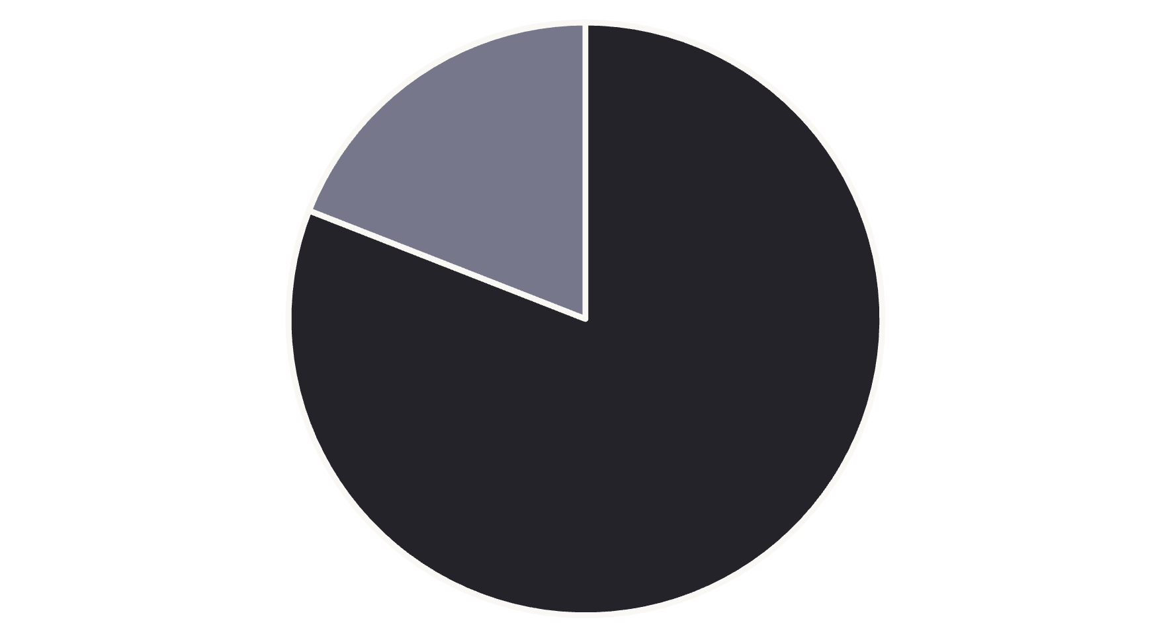
Test Case Status Distribution
Passed
Failed
The chart illustrates the distribution of test case results from the manual testing phase. With 17 passed test cases and 4 failed test cases, the system demonstrates an 81% success rate in the initial testing phase.

Slide 5



Observations
Stable Functionality
Login/logout and employee records functionalities were stable.
Problem Areas
Defects were mainly found in leave request approvals and payroll modules.

Slide 6
Recommendations
Implement Additional Testing
Conduct Retesting
Prioritize High-Severity Fixes
Retest leave request and payroll modules after bug fixes.
Consider automated testing for critical modules to prevent regression issues.
Prioritize fixing the high-severity defect in leave approvals.

Slide 7
Module Status Overview
Stable Modules
Modules Requiring Attention
Login/Logout System
Leave Request Approvals
Employee Records Management
Payroll Processing
User Authentication
Performance Review Management
Dashboard Interface
Employee Records Display

Slide 8
Conclusion
OrangeHRM appears to be mostly stable and reliable. However, attention is needed to resolve the identified defects, particularly those affecting leave approvals and payroll tasks, to enhance user experience.
The manual testing phase has successfully identified key areas for improvement while confirming the stability of core functionalities. With a focused approach to addressing the identified issues, particularly in the leave approval and payroll modules, the OrangeHRM system can achieve greater reliability and user satisfaction.

