Slide 1
Statistics
ENG.Mahmoud rAgab

Slide 2
Why Statistics ?
It helps us understand the past, make good decisions in the present and enables us to anticipate the future
Using mathematics we can predict the number of students in a class, but using statistics we can measure the quality of students and predict which colleges they will attend

Slide 3
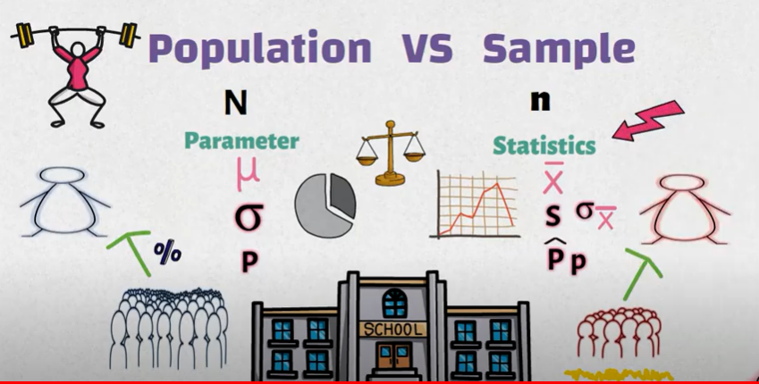

Slide 4
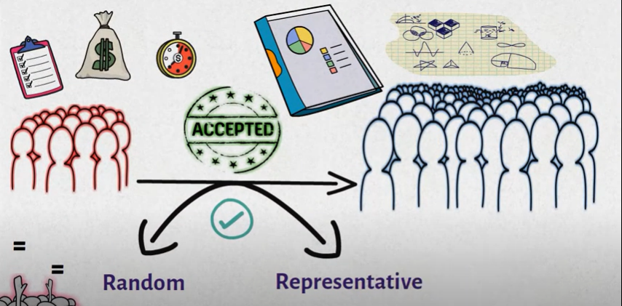

Slide 5
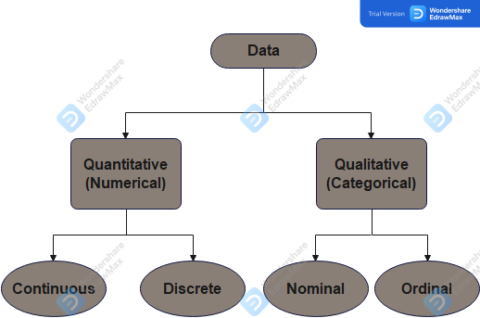
data types ?

Slide 6
ID | Name | Age | Gander | Level | Courses | Grade
S01 | Ahmed | 48 | M | 1 | 1 | 23.5
S02 | Ali | 22 | M | 1 | 3 | 50
S03 | Mona | 23 | F | 2 | 2 | 34
S04 | Nada | 27 | F | 3 | 1 | 25
S05 | Amr | 32 | M | 4 | 4 | 78.5
S06 | Aya | 36 | F | 2 | 3 | 52

Slide 7
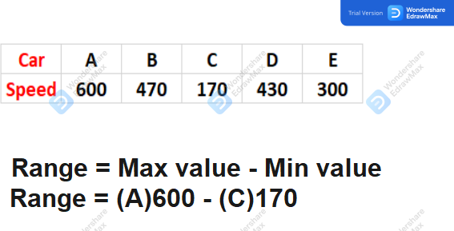
Range

Slide 8
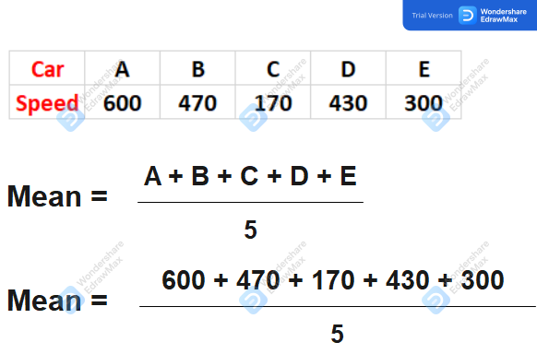
Mean

Slide 9
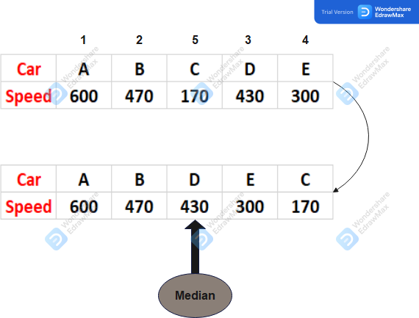
Median

Slide 10
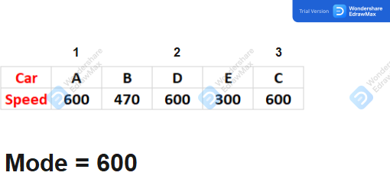
Mode

Slide 11
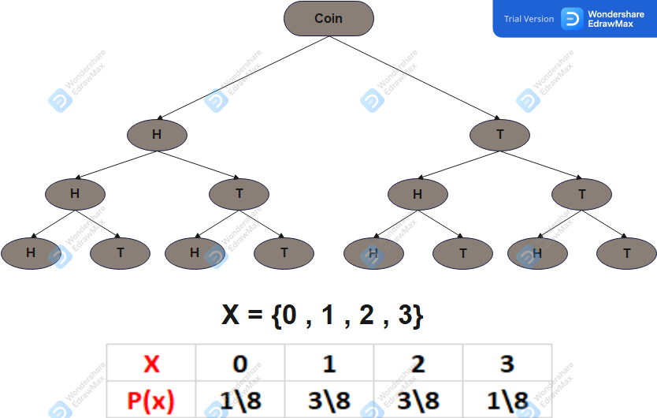
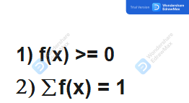
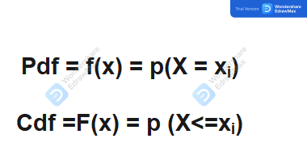
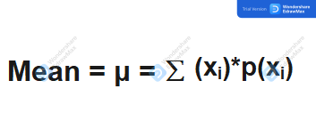
random variable
Expresses a complete category in dataset

Slide 12
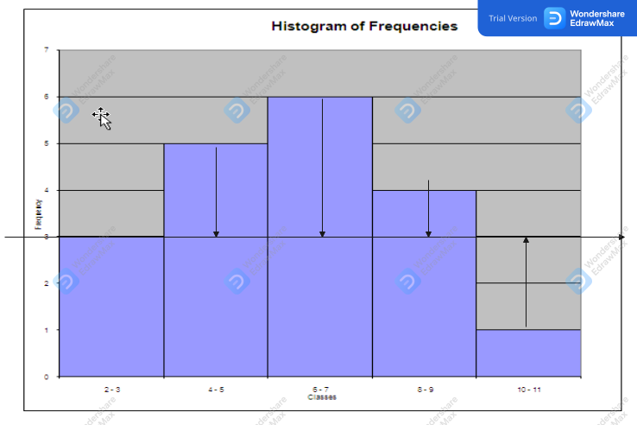
variance

Slide 13
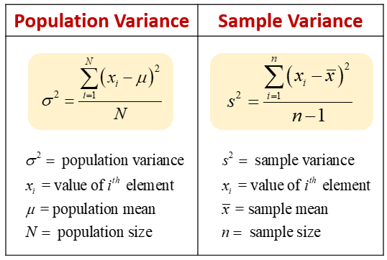

Slide 14
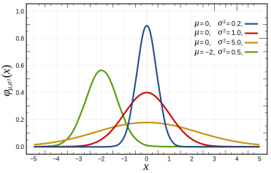
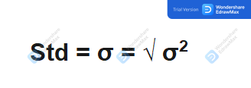
Standard Deviation

Slide 15
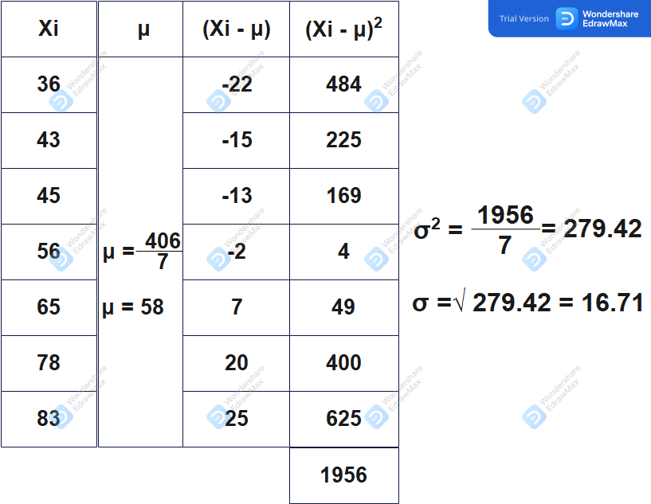

Slide 16

any questions ?

