Slide 1
AMIT GRADUATION PROJECT PWM_DRAWER
NAME: MAHMOUD SABER ABOUBAKR AHMED

Slide 2
Table of Contents
1. Introduction
2. Aim of the Project
3. Components
4. Flow Chart

Slide 3
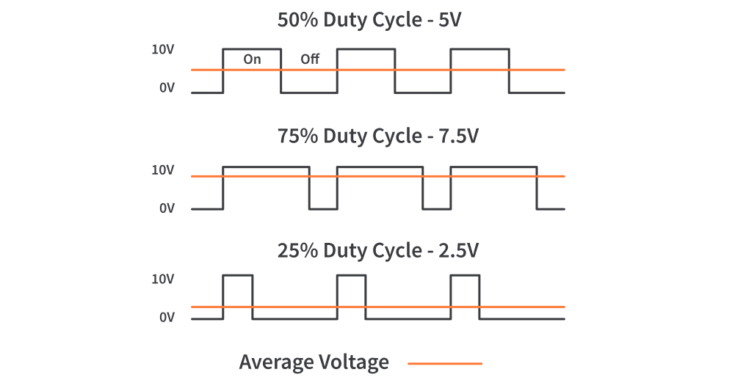
Introduction
Pulse Width Modulation is a technique used to control analog devices, using a digital signal. This technique can be used to output an analog-like signal from a digital device, like a microcontroller. We can control motors, lights, actuators, and more using the generated PWM signal.

Slide 4
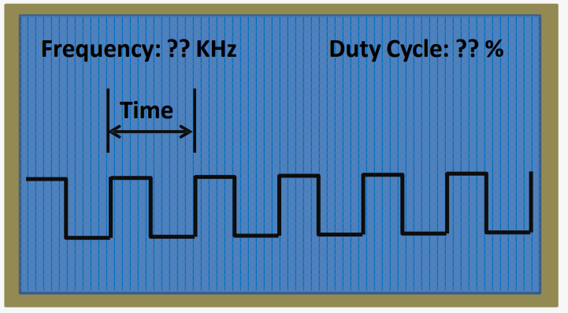
Aim of the Project
PWM drawer works as a mini oscilloscope that is responsible for printing the frequency and the waveform of the generated PWM signal.
The generated wave came from two sources, external sources (e.g. generated PWM from other MCs), or internal source of the Microcontroller of the project itself.

Slide 5
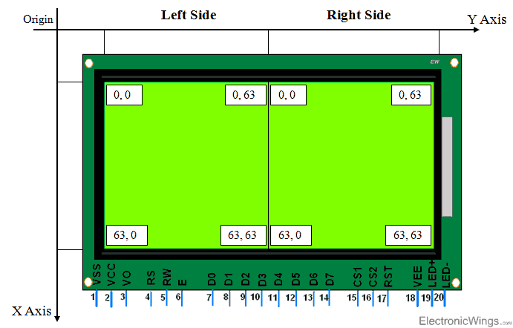
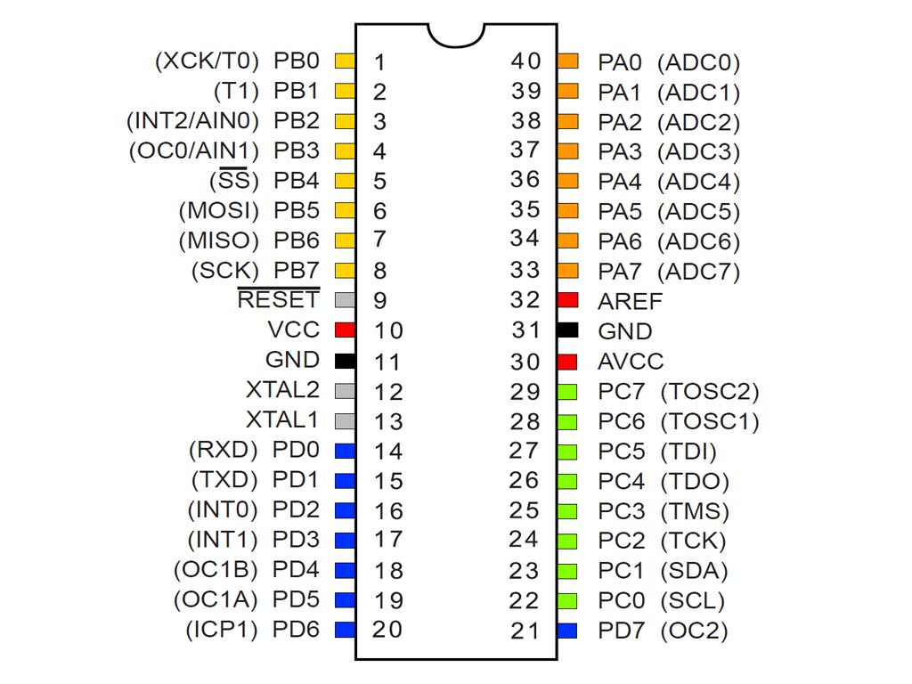
Components
128 X 64 Graphical LCD
ATMega32

Slide 6
Flow Chart (A)
ADC Initialization
PWM Initialilization
UART Communication intialization
ADC Initialization: it is important to manipulate the value of the signal, it is working as a sensor that measure a specific value.
I have used AVCC with external capacitor at AREF pin with prescaler 16 so the frequency will be 62.5 KHZ

Slide 7
(A)
PWM initialization is the major topic, that we want to represent its values on the Graphic LCD.
I have used non-inverting mode so I can show the duty cycle is like the signal, and the signal will be predictable.
And the Prescaler here is one so there will be fixed periodic time
I want to show the value of the duty cycle it will be also the percentage of the adc signal, so I will give it to the OCR0.
OCR0= (d*100)/1024 >> OCR0= (d*0.09765)+0.5;
d is the value of adc signal and should be divided by 1024 because the size of adc register is 10 bits.

Slide 8
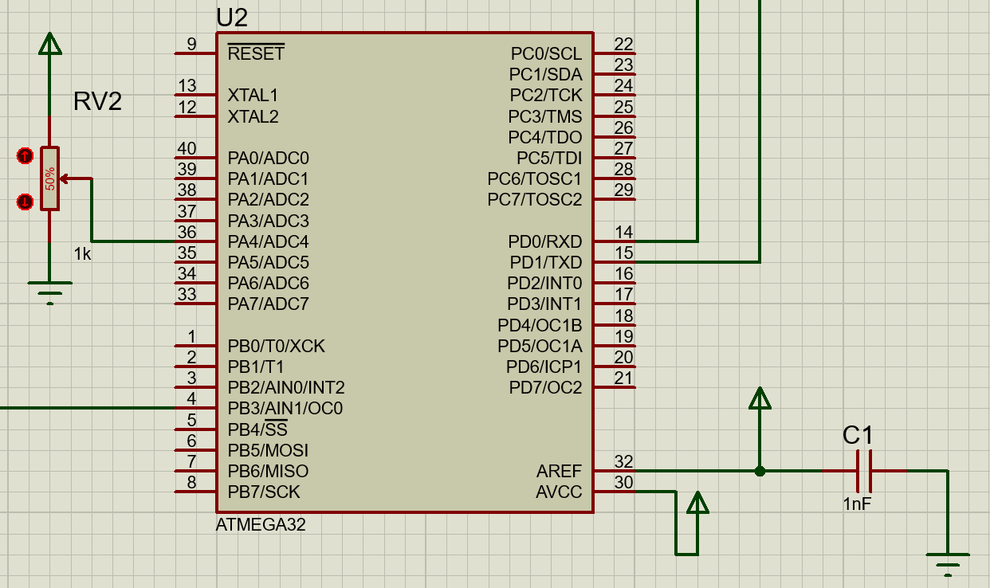
(A)
UART Communication is used to send the value of the pwm signal to another microcontroller.
Here is the number of bits is 8 bits of data.
The frequency of the microcontroller is 1MHZ so the value of the UBRR is 6.

Slide 9
Flow Chart (B)
ICU Initialization
ICU: is used to calculate the time period of the signal.
GLCD initialization
GLCD_Alphabets
Each alphabet, number or symbol has specific five codes, so I have collected all its in one .c file to use it.
There is no prescaler here.
Graphical LCD is applied with multiple functions to represent the data on it.
For example, A has the follow codes 0x7E, 0x11, 0x11, 0x11, 0x7E.

Slide 10
(B)
UART Communication
used to receive the value of the pwm signal to another microcontroller.
DISPLAY
Functions
There are float numbers in our calculations, so I should have a function to convert float numbers to string to represent it on the GLCD this function called floatToString.
In Display function I have calculate the value of Frequency=F_CPU/(256*prescaler); prescaler is equal one.
Here is the number of bits is 8 bits of data.
The frequency of the microcontroller is 1MHZ so the value of the UBRR is 6.
I git the value of time with the ICU. And the value of the duty cycle with UART_receivechar();
Then I have displayed also the shape of the signal.

Slide 11
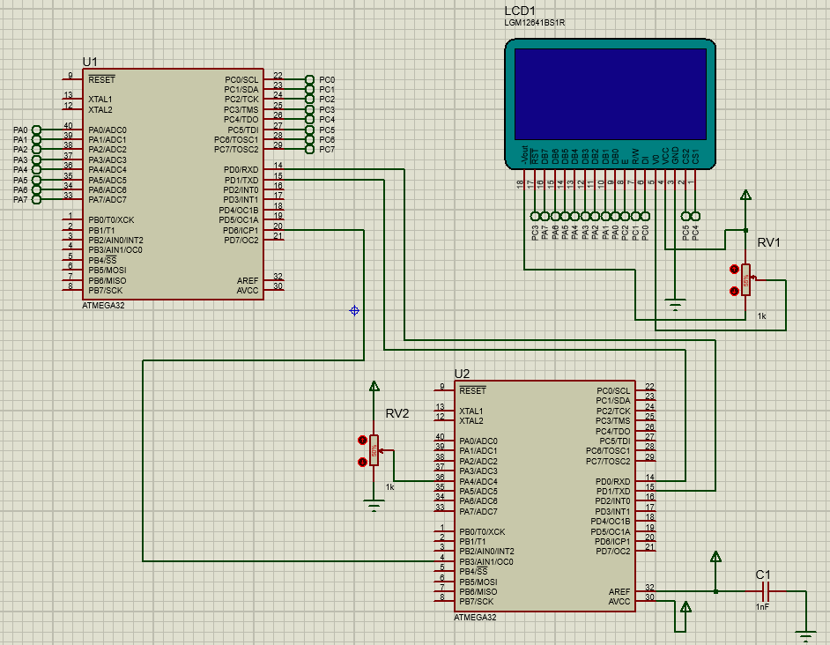

Slide 12
Thank you
Any Questions?

