Slide 1

Statistical Analysis For Price CARS

Slide 2
Agenda :
01
02
03
Introduction
Data Cleansing and EDA
Univariant, Bivariant and Multivariant Analysis.

Slide 3
Introduction :
- Data cleansing and Exploratory Data analysis In order to prepare Data for further investigations.
- Recognizing patterns and relations between Data features.
- Deeper Analysis & extracting all data available.
- Understanding patterns and Features affecting Real Estate Price.

Slide 4
Data Cleansing and EDA :
- Found that There is Numerical Data treated as a string so I fixed them by removing non numerical characters and change the type of them to float
- Found Some Null Values so I Checked the percentage and then dropped them as they were meager
- Checked Statistical Analysis Using describe() to found that if there are Outliers in data and I found That Those are legit and Normal
- Add New Column called Profit Calculated as (MSRP – Invoice)

Slide 5

Univariant Analysis

Slide 6
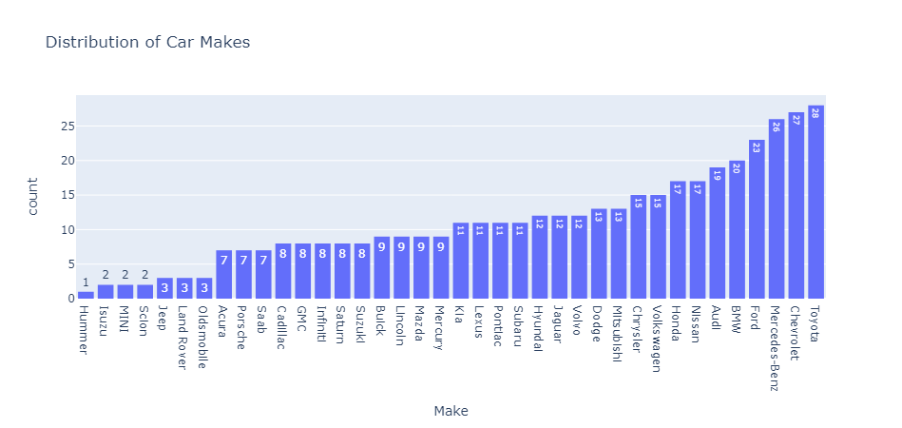
what is the Distribution Of Make?
Toyota : 28
Chevrolet : 27
Mercedes-Benz : 26

Slide 7
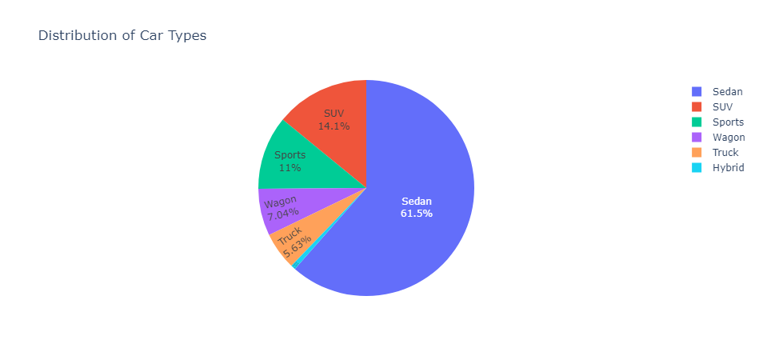
What is the Distribution Of Type?
Sedan : 262
SUV : 60
Sports : 47
Wagon : 30
Truck : 24
Hybrid : 3

Slide 8
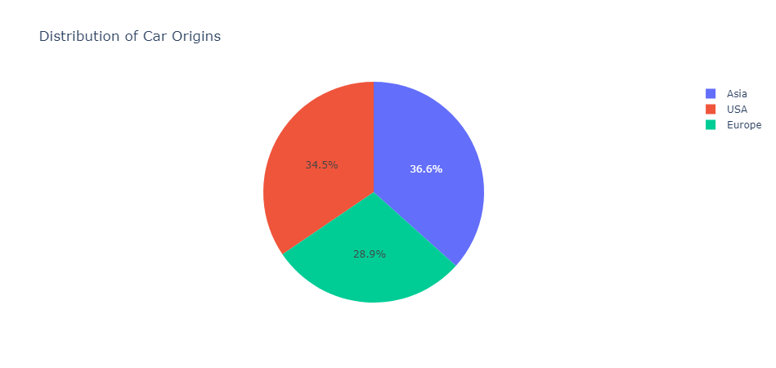
What is the Distribution of Origin?
Asia : 156
USA : 147
Europe : 123

Slide 9
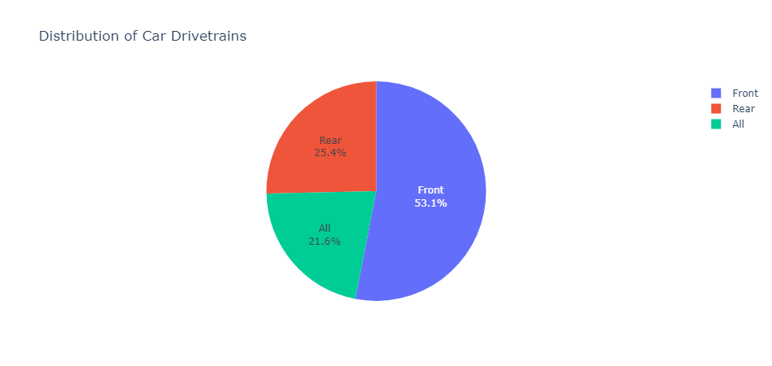
What is the Distribution of Drivetrain?
Front : 226
Rear : 108
All : 92

Slide 10
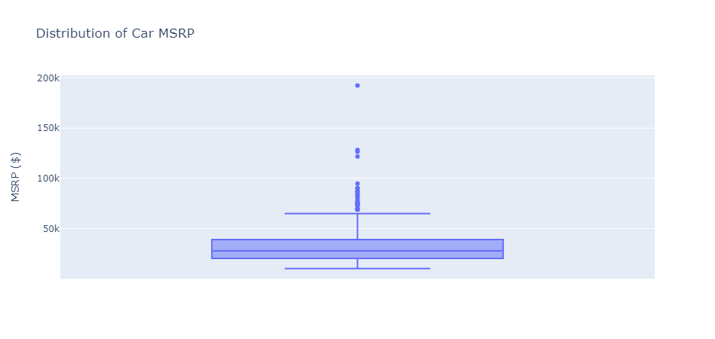
What is the Distribution of MSRP?

Slide 11
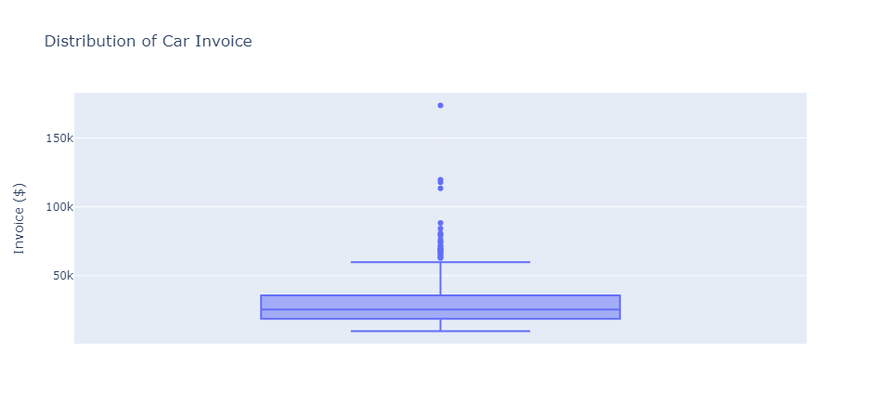
What is the Distribution of Invoice?

Slide 12
Bivariant Analysis

Slide 13
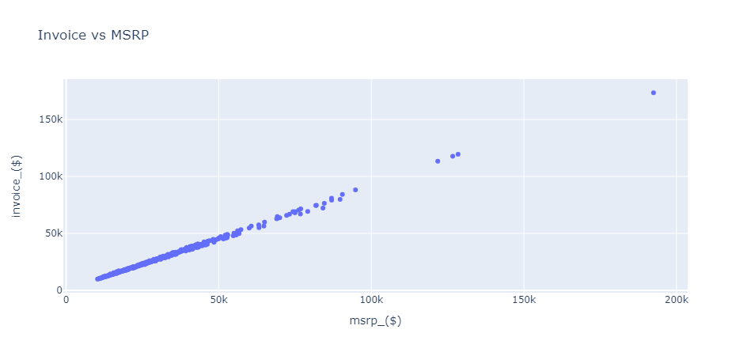
How does Invoice relate to MSRP ?

Slide 14
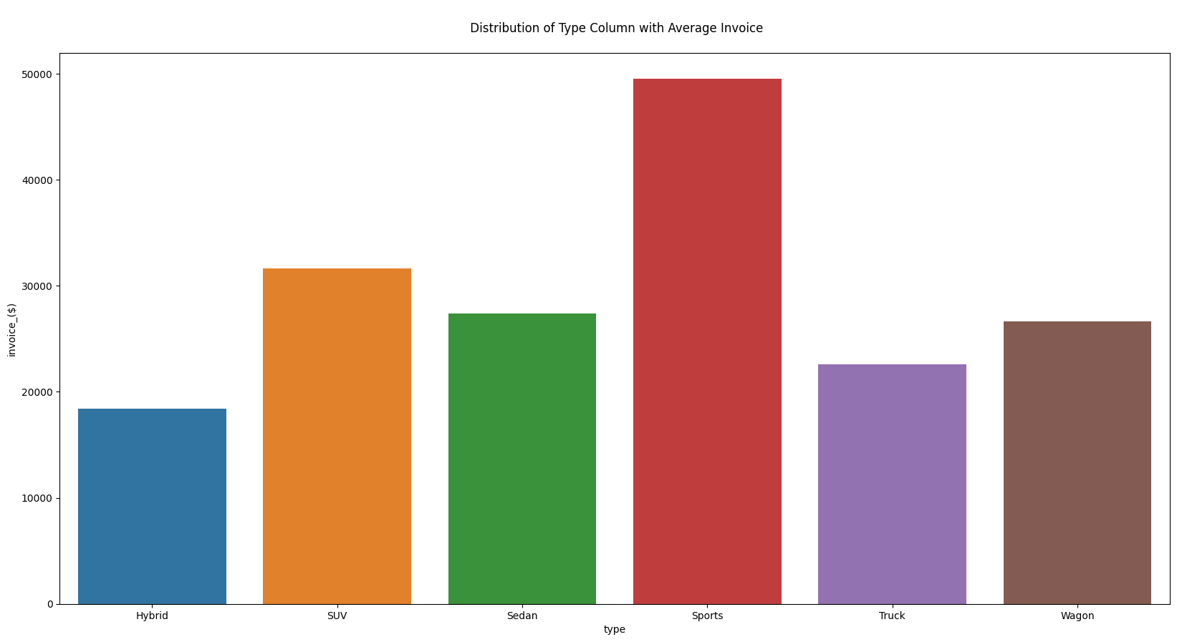
How does the invoice price vary across different types of vehicles?

Slide 15
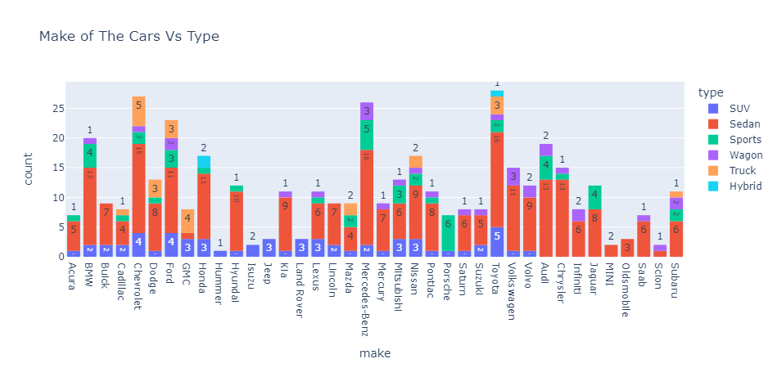
How does the manufacturers vary across different types of cars ?

Slide 16
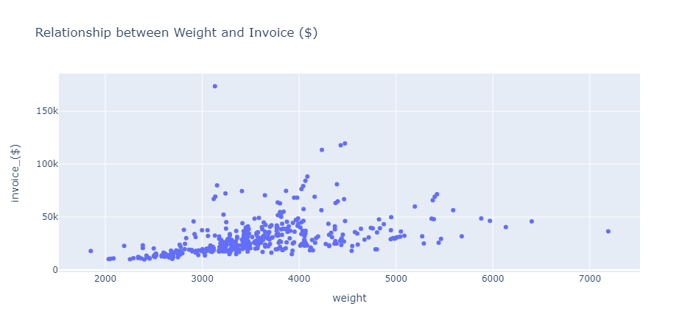
How would you show the relationship between a car's weight and its invoice amount?

Slide 17
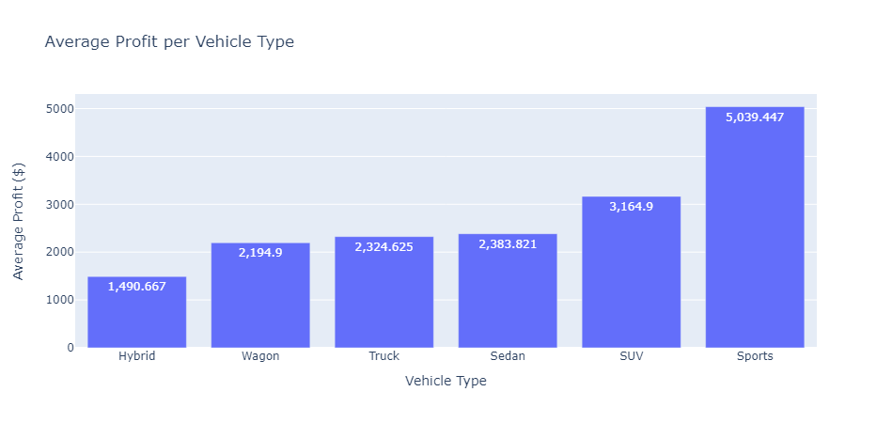
How can you visualize the average profit for each vehicle type ?

Slide 18
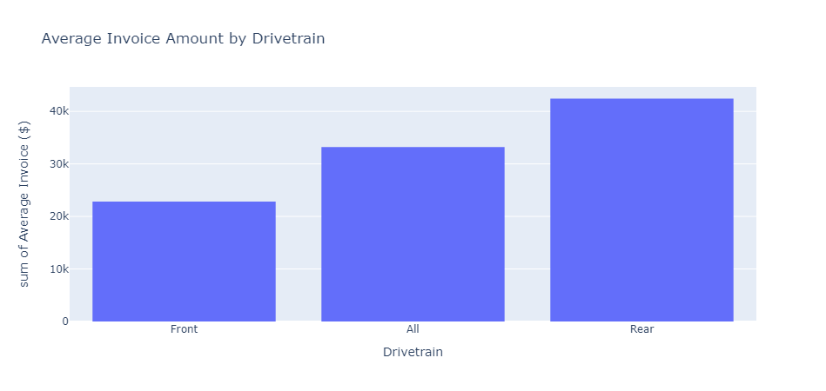
What is the average invoice amount distribution across different drivetrain types?

Slide 19
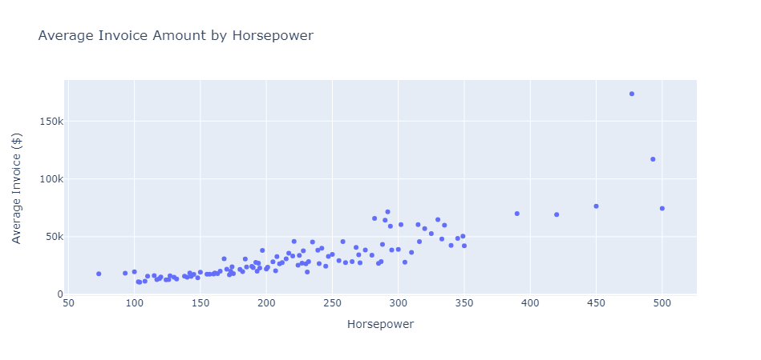
How does the average invoice amount vary with horsepower ?

Slide 20
Multivariant Analysis

Slide 21
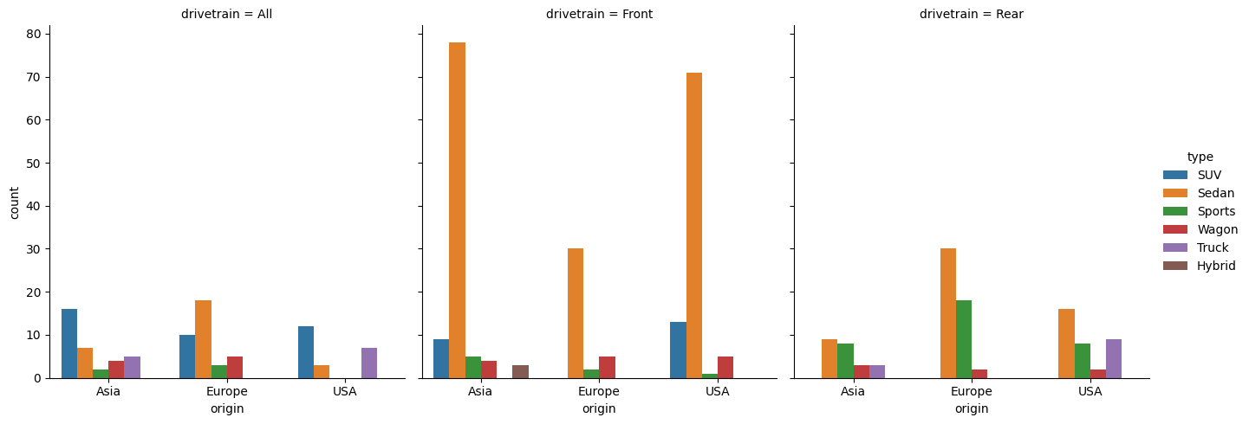
How does the distribution of vehicle types vary across different origins and drivetrains ?

Slide 22
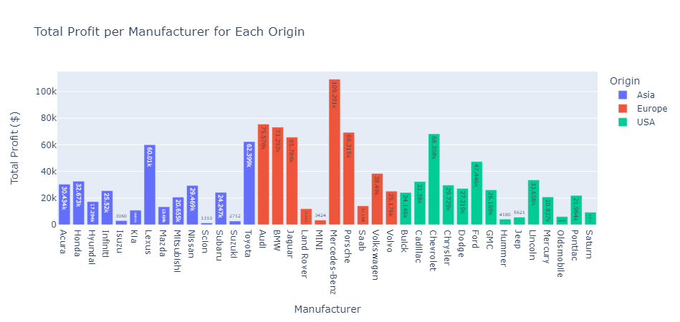
Total profit per manufacturer for each origin ?
European manufacturers such as Mercedes-Benz and BMW are top profit generators, with profits around $109.3k and $92.8k, respectively.
Asian manufacturers like Toyota and Kia also show substantial profits, especially Toyota at around $60.0k..
Among American manufacturers, Chevrolet and Ford lead with significant profits of approximately $67.2k and $47.4k, respectively.0.

Slide 23
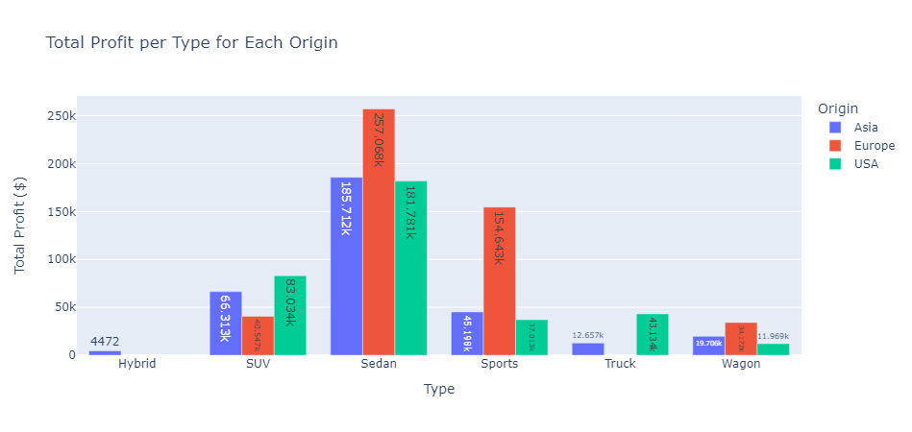
Total profit per type for each origin ?
Sedans are the most profitable vehicle type across all origins, with Europe leading at approximately $257.7k.
SUVs from Asia show notable profitability at around $66.3k, while Sports cars from Europe also generate significant profit at approximately $154.6k.
Hybrids and Trucks generate the least profit across all origins.

Slide 24
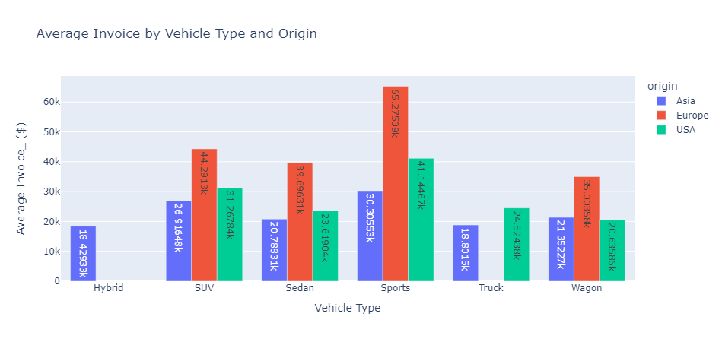
How do Invoice, Origin, and Type of vehicle relate?
Sports cars have the highest average invoice price, particularly those from Europe, averaging around $65.3k.
SUVs from Europe also have a high average invoice price of approximately $44.3k..
Hybrid vehicles, regardless of origin, have the lowest average invoice prices, with Asian hybrids averaging around $18.2k.

Slide 25
Thanks
Do you have any questions?

