Slide 1
FreeRTOS Course (Day 3)
By Mahmoud Elsheemy

Slide 2
The problem of synchronization
Two tasks are trying to utilize the same resource
could be variable, hardware resource
We need to ensure mutual exclusion
Task 1
Task 2
Resource

Slide 3
Synchronization problem example
X
10
Task 1
Task 2
.
.
.
Y = read(X)
Y = read(X)
Y = Y + 2
Y = Y + 10
write(Y,X)
write(Y,X)
Memory
What will be the value stored in X

Slide 4
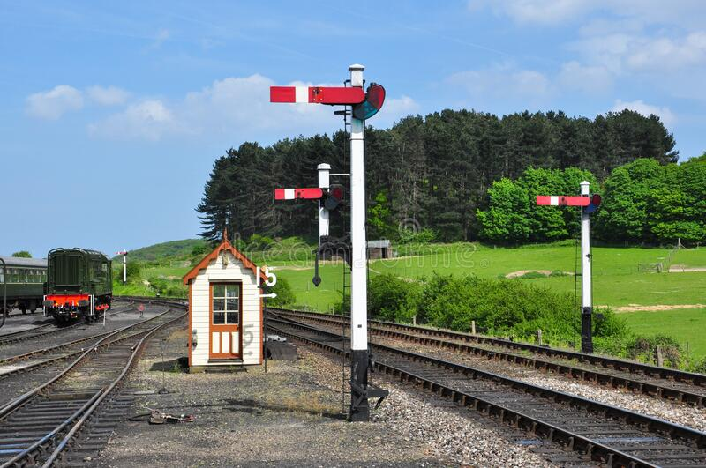
Introduction to Semaphores

Slide 5
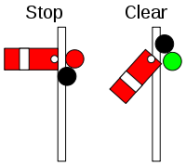
Introduction to Semaphores
Flag that indicates whether a resource is consumed or not
If this flag is 0 then it means that the resource is being consumed, the task requesting to access the resource will be blocked till resource is available
If the flag is 1 or more then it means that the resource is available for consumption.

Slide 6
Semaphores in FreeRTOS
Define a semaphore:
SemaphoreHandle_t xSemaphore;
Create a semaphore (Binary Semaphore):
void vSemaphoreCreateBinary( SemaphoreHandle_t xSemaphore );
Create a semaphore (Counting Semaphore):
SemaphoreHandle_t xSemaphoreCreateCounting( UBaseType_t uxMaxCount, UBaseType_t uxInitialCount );
Semaphore take:
BaseType_t xSemaphoreTake( SemaphoreHandle_t xSemaphore, TickType_t xTicksToWait );
Semaphore give:
BaseType_t xSemaphoreGive( SemaphoreHandle_t xSemaphore );

Slide 7
Synchronization problem with Semaphores
Task 1
Task 2
X
10
xSemaphoreTake(sem)
xSemaphoreTake(sem)
.
.
.
Y = read(X)
Y = read(X)
Y = Y + 2
Y = Y + 10
write(Y,X)
write(Y,X)
Memory
xSemaphoreGive(sem)
xSemaphoreGive(sem)
Now, what will be the value stored in X ?

Slide 8
Let’s Do some coding

