Slide 1
FreeRtos Course (Day 1)
By: Mahmoud Elsheemy

Slide 2
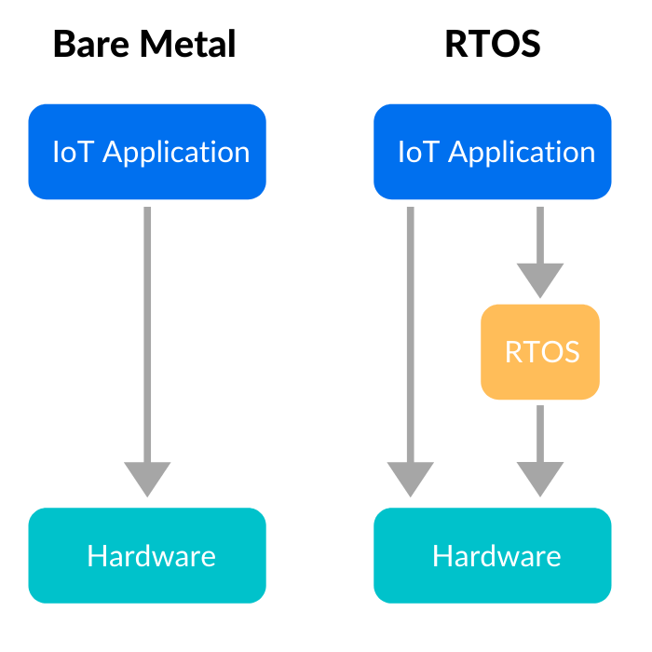
RTOS vs Bare-Metal Architecture

Slide 3
Bare-Metal Architecture (super loop)
Super loop contains the program flow:
Input
Processing
Output
Delay
Any system can be designed by a super loop
System is not deterministic
Hard to maintain
Hard to design a whole system inside the super loop

Slide 4
Bare-Metal Architecture Example
check_brakes()
check_doorlock()
check_oil()
Measure_speed()

Slide 5
Real-Time Operating System (RTOS)
Break down the main program into set of tasks.
Each task has a periodicity and a priority.
There is a scheduler that switches between the tasks.
Deterministic.
Easy to design (modular design) , easy to maintain.
It’s the programmer task to have a good design before implementation.

Slide 6
RTOS example
Scheduler switch between tasks
Each task has a priority and a periodicity
Check_brakes()
Check_oil()
Check_door()
Check_radio()
Scheduler

Slide 7
Let’s Implement RTOS in our code!

Slide 8
Introduction to FreeRTOS
Market leading cross platform RTOS kernel for microcontrollers and small microprocessors
Simple API
FreeRTOS offer RTOS implementation for any microcontroller
Download your microcontroller FreeRTOS files from here https://www.freertos.org/a00104.html

Slide 9
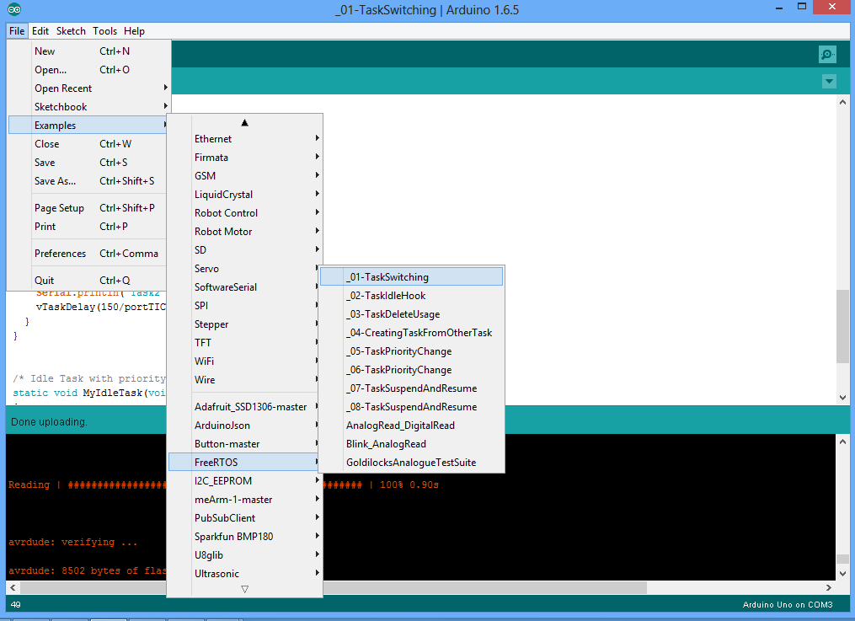
FreeRTOS in arduino

