Slide 1
FreeRTOS Course (Day 2)
By Mahmoud Elsheemy

Slide 2
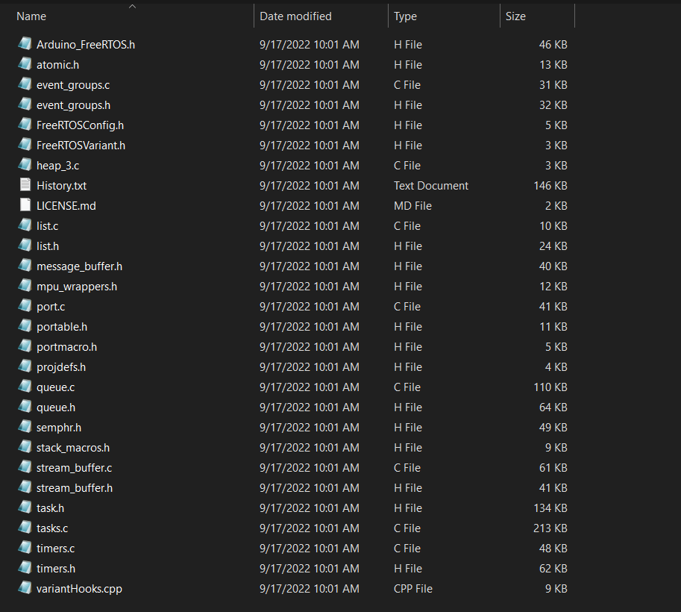
FreeRTOS files

Slide 3
FreeRTOS – Create a task
BaseType_t xTaskCreate( TaskFunction_t pvTaskCode, const char * const pcName, unsigned short usStackDepth, void *pvParameters, UBaseType_t uxPriority, TaskHandle_t *pxCreatedTask );
pvTaskCode: pointer to the function (function name)
pcName: descriptive name to the task (could be NULL)
usStackDepth: size of task’s stack
pvParameters: parameters to the task function (could be NULL)
uxPriority: The priority of the task
pxCreatedTask: handle to the task (could be NULL)

Slide 4
FreeRTOS other functions
void vTaskStartScheduler( void );
API function to start a scheduler
void vTaskDelay( TickType_t xTicksToDelay );
API function that blocks a task

Slide 5
How task is created (How FreeRTOS deal with memory)
Stack
Task 3 Stack
TCB
Task 2 Stack
Heap
Task 3
Task 2
TCB
Task 1
Static
Task 1 Stack
TCB

Slide 6
Let’s create two tasks
Task one that writes date on LCD
Task two that writes time on LCD
Let’s see what happens

Slide 7
Task state life cycle
Running
Suspend
Block
Dispatched
Suspended
Ready
Blocked
Suspend
Event
Resume
Suspend

Slide 8
Task Scheduling
Ready Queue
Running
5
4
3
2
1
Scheduler

Slide 9
Task Scheduling
Ready Queue
Running
1
5
4
3
2
Scheduler

Slide 10
Types of Task Scheduling
Preemptive Scheduling
Non-preemptive Scheduling

