Slide 1



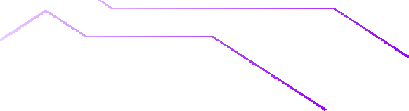







Strings in C++
Welcome to week 4

Slide 2




Outline
01
What are
Strings?
02
Syntax
03
Built in
Functions
05
Session problems
06
Collection of Sources
04
ASCII

Slide 3













What are strings?
01

Slide 4
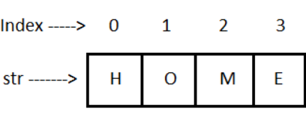
WHAT ARE STRINGS?
A string is an array of characters (letters-
numbers-symbols – any text).
It can consist of a single character, word,
line, or paragraph.

Slide 5
Syntax
02

Slide 6
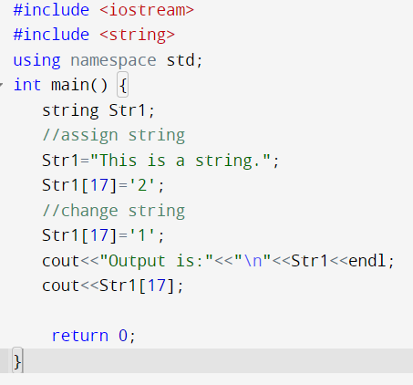

Syntax
Strings automatically handle memory allocation and resizing, reducing the risk of buffer overflows or memory leaks.

Slide 7






Built-in Functions
String functions and operators make common operations easier to perform:
Concatenation.
Searching.
Substrings.

Slide 8
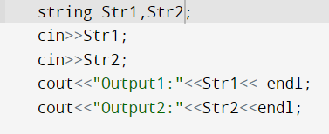

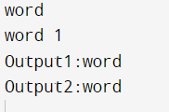

cin
getline()
cin: Can only display a single word.
It takes cin as a first parameter and string variable as a second parameter
Input Strings

Slide 9
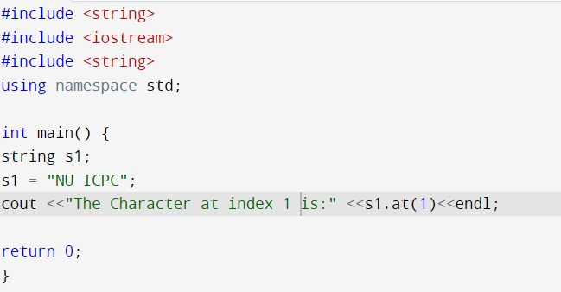
Accessing operators
Access characters using at() or [] operator
The at() function takes an argument pos representing the position of the character you want to access. It returns the character at that position.
Time Complexity O(1)

Slide 10
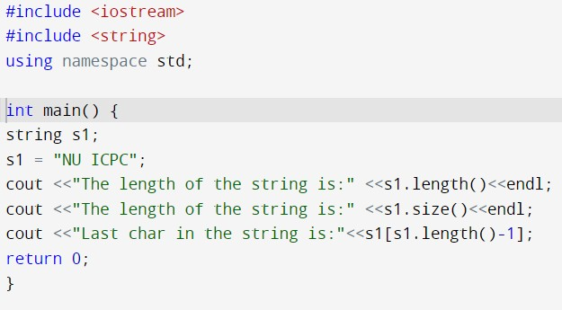
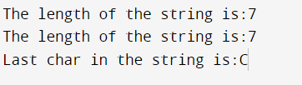
Length and size
Length() , size()
functions return the number of characters in the string. They does not include the null character ('\0') at the end of the string.
Time Complexity O(1)

Slide 11
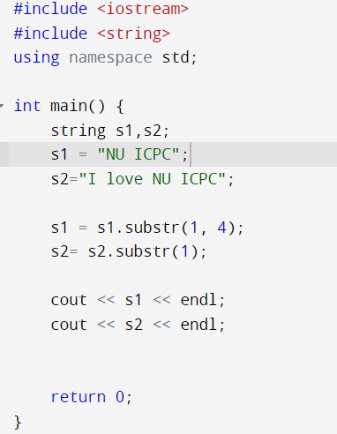
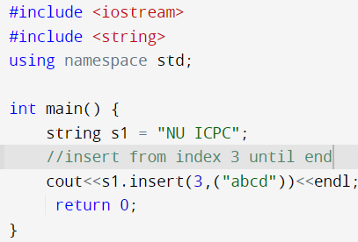


Built-in Functions
substr()
std::string
insert()
std::string
It is used to extract a substring from a given string. It allows you to specify a starting position and an optional length for the substring you want to extract.
Insert(): is used to insert substring at certain index Insert(pos, substring)
S1.substr(pos,length)
Time Complexity O(n)
Time Complexity O(n+m)

Slide 12
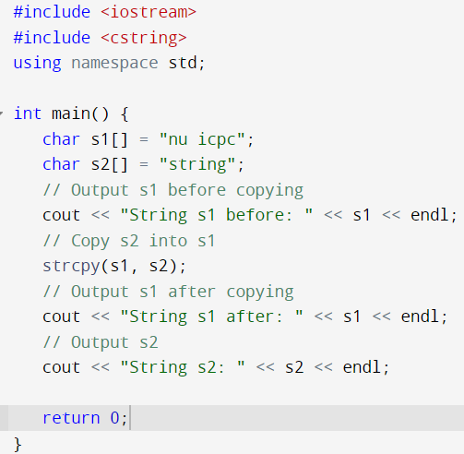
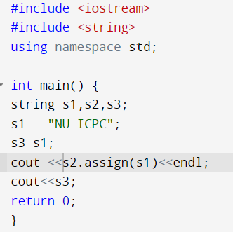


Built-in Functions
assign()
std::string
strcpy( )
standard library
Time Complexity O(n)
*The strcpy() string function copies one string into another string and returns the newly copied string.
Time Complexity O(n)

Slide 13
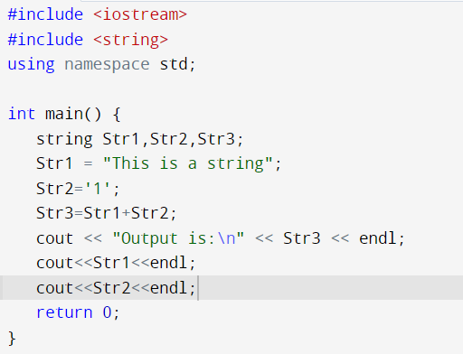
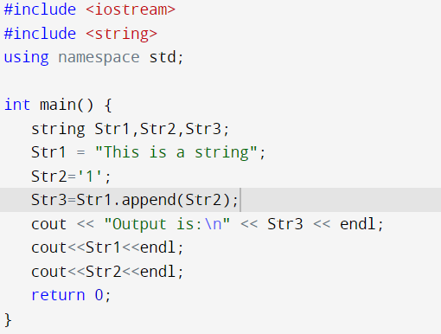
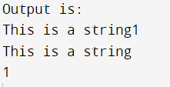
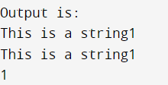
Built-in Functions
concatenation (+)
Append ()
Time Complexity O(n)
+ operator creates a new
string result
Time Complexity O(m)
The append function modifies the original string Str1 by adding Str2 to the end
Notes :
The append function is generally faster and more efficient compared to the + operator.
We can not concatenate string with integer. We just can concatenate values with the same datatypes

Slide 14
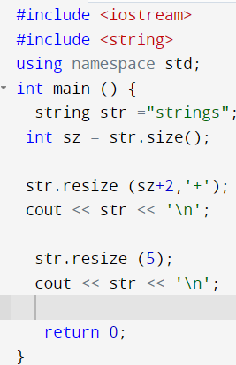
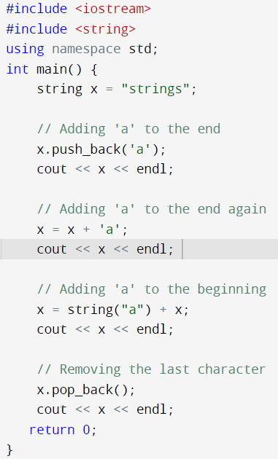
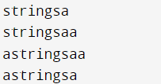

Built-in Functions
resize()
std::string
pop_back(), push_back()
std::string
Time Complexity O(N)
Time Complexity O(1)
*resize (size n);
*resize (size n, char c);

Slide 15
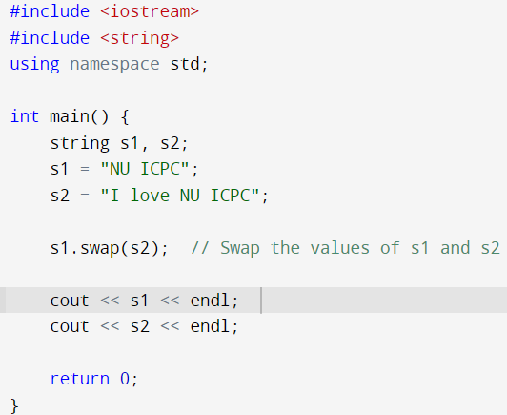
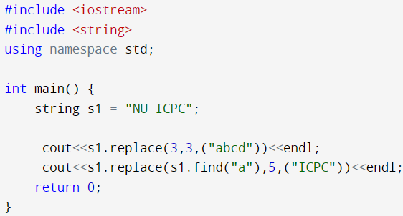


Built-in Functions
swap()
std::string
Replace()
std::string
S1.replace(position, replacement
size, what I want to add)
Time Complexity O(1)
Time Complexity O(n+m)

Slide 16
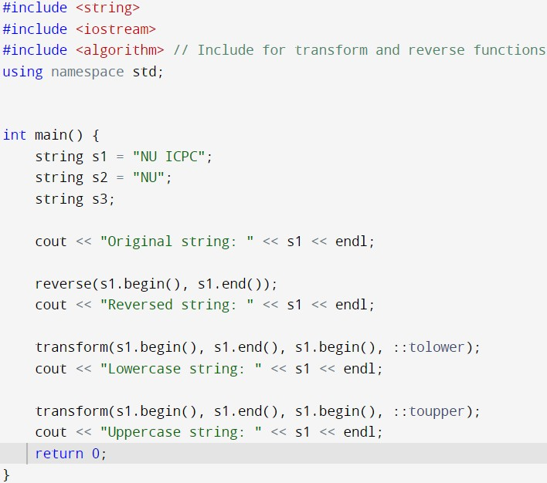
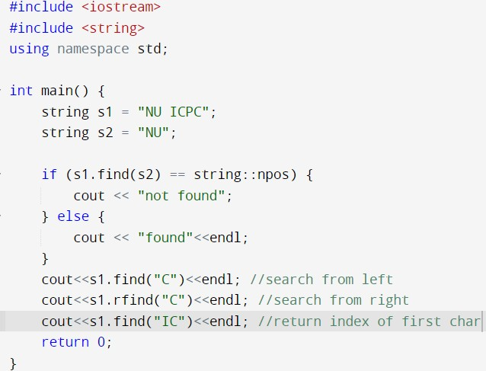

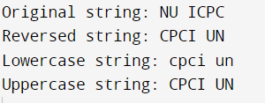
Built-in Functions
reverse(), tolower() , toupper()
find() ,rfind()
Time Complexity O(n)

Slide 17
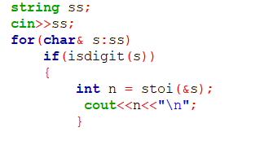
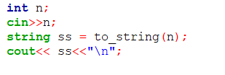
stoi()
to_string()
Time Complexity O(N)
Conversion from and
to Strings

Slide 18
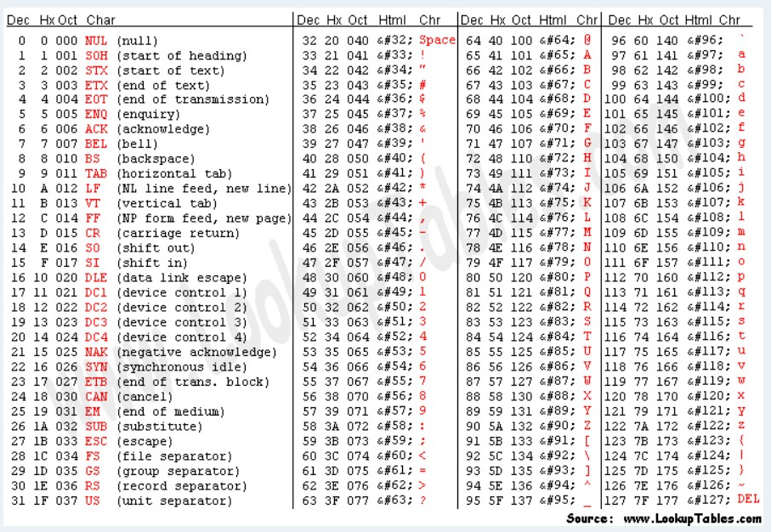
ASCII table is reference charts that show the numeric values assigned to different characters like letters, numbers, and symbols.
https://www.asciitable.com/
Ascii Table

Slide 19



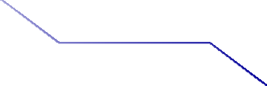







Solving Time !

Slide 20


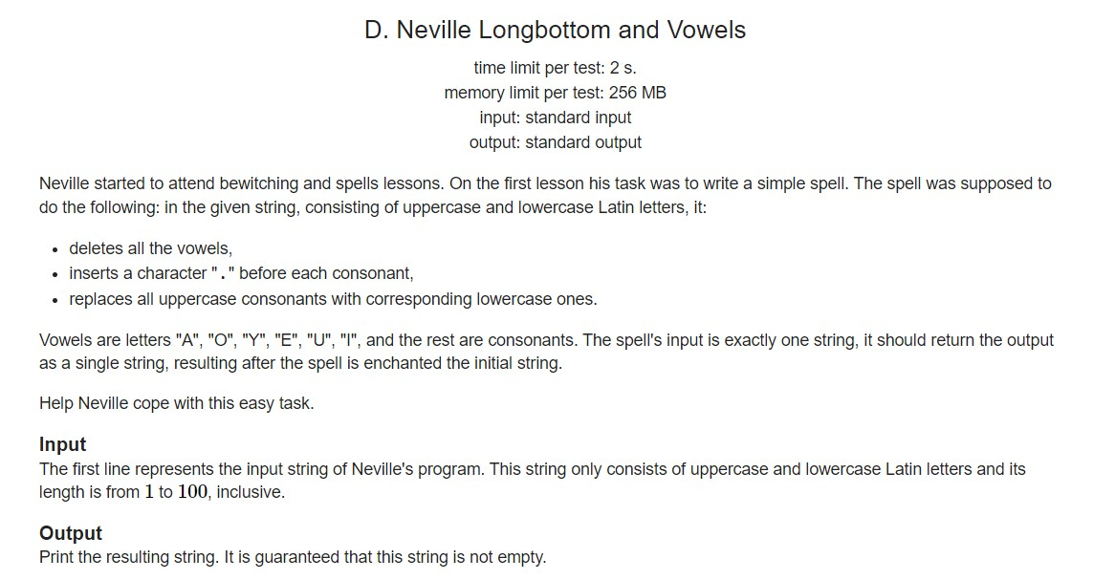






Problem 1

Slide 21



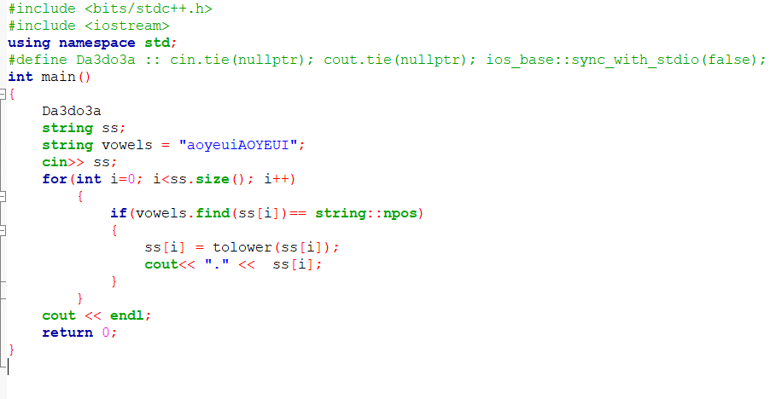



Solution

Slide 22






Collection of Sources
https://youtu.be/lvYd_cAnl94?si=NUN0CwxXp4TOf0LR
https://icpcnu.notion.site/ICPC-NU-HUB-399c2a710af9452aaa6f0a5adbcc5564
https://www.scaler.com/topics/c/string-functions-in-c/
https://www.javatpoint.com/cpp-strings
https://www.w3resource.com/cpp-exercises/string/index.php
https://www.w3schools.com/cpp/cpp_strings.asp
https://www.simplilearn.com/tutorials/cpp-tutorial/cpp-string

Slide 23
















Thanks!
Do you have any questions?
CREDITS: This presentation template was created by Slidesgo, and
includes icons by Flaticon, and infographics & images by Freepik
Wish you a week full of accepted

