Slide 1
Astronaut food.in space
Prepared By: Oubai Nasrallah 170501633. Mahmoud Zain Sabto 180501448. Salem Zeidan 190501142. Razan Abusabrah 190501492. Mohammed Saber 170501596.

Slide 2
Eating in Space
Space food is a type of food product created and processed for consumption by astronauts during missions to outer space. The food has specific requirements of providing balanced nutrition for individuals working in space while being easy and safe to store, prepare, and consume in the machinery-filled weightless environments of crewed spacecraft.
In recent years, space food has been used by various nations engaging on space programs as a way to share and show off their cultural identity and facilitate intercultural communication. Although astronauts consume a wide variety of foods and beverages in space, the initial idea from The Man in Space Committee of the Space Science Board in 1963 was to supply astronauts with a formula diet that would supply all the needed vitamins and nutrients.

Slide 3
Types of foods and proteins
kinds of Condiments,
Space travelers eat three meals a day: breakfast, lunch, and dinner. Nutritionists guarantee the nourishment space explorers eat gives them an adjusted supply of vitamins and minerals. Calorie prerequisites vary for space explorers. For occasion, a little lady would require as it were around 1,900 calories a day, whereas an expansive man would require approximately 3,200 calories. A space explorer can select from numerous sorts of nourishments such as natural products, nuts, shelled nut butter, chicken, meat, fish, sweets, brownies, etc. Accessible drinks incorporate coffee, tea, orange juice, natural product punches, and lemonade.
Condiments, such as ketchup, mustard and mayonnaise, are provided. Salt and pepper are available but only in a liquid form. This is because astronauts can't sprinkle salt and pepper on their food in space. The salt and pepper would simply float away. There is a danger they could clog air vents, contaminate equipment or get stuck in an astronaut's eyes, mouth or nose.

Slide 4
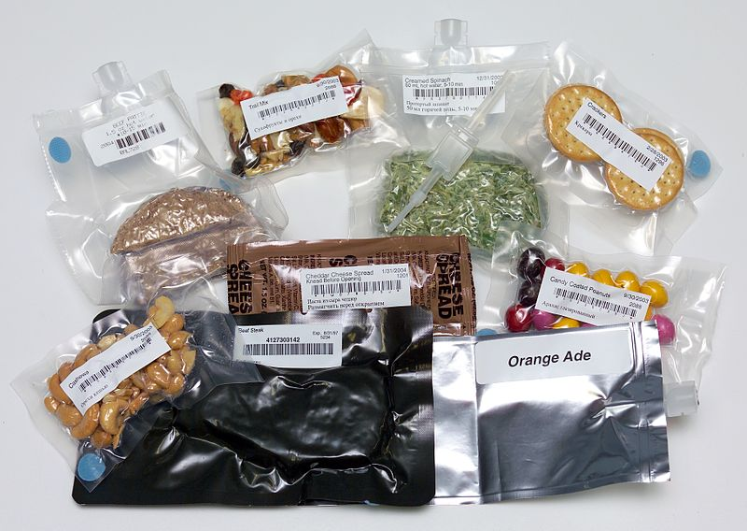
Meals in space

Slide 5
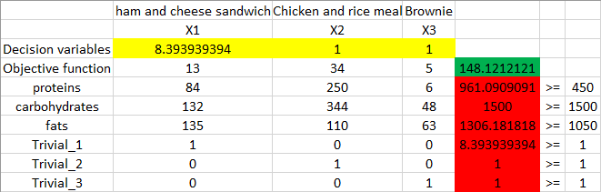
real-life example:- first attempt:
Meals | Proteins calories | Carbohydrates calories | Fats calories
1 ham and cheese sandwich | 84 | 132 | 135
Chicken and rice meal | 250 | 344 | 110
1 Brownie | 6 | 48 | 63
after we run the linear program with these constraints, the results are not satisfying: we can see that the programs suggests making 8.4 Ham and cheese sandwiches! and only 1 meal of Chicken and rice and 1 Brownie, and there is a huge excess amount of proteins and fats!, we can also observe that the program did that just to satisfy the carbohydrates constraint.

Slide 6
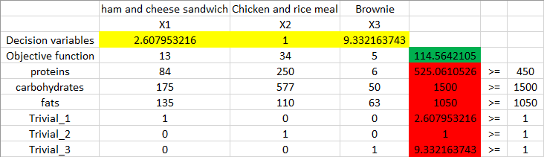
second attempt:
Meals | Proteins calories | Carbohydrates calories | Fats calories
1 ham and cheese sandwich | 84 | 175 | 135
Chicken and rice meal | 250 | 577 | 110
1 Brownie | 6 | 50 | 63
after we run the linear program with these constraints, the results are more sensible: the program suggests making 2.6 units of Ham and cheese sandwiches, 1 meal of Chicken and rice, and 9.3 units of Brownies, but we also observed that there are 75 extra calories of the required protein, 75 calories is not a lot we can just subtract them from each meal, and they shouldn't affect the original outcome too much.

Slide 7
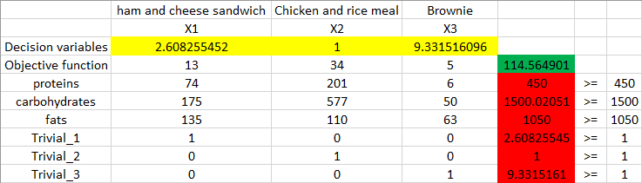
third attempt:
Meals | Proteins calories | Carbohydrates calories | Fats calories
1 ham and cheese sandwich | 74 | 175 | 135
Chicken and rice meal | 201 | 577 | 110
1 Brownie | 6 | 50 | 63
after running the linear program multiple times to determine the right amount of proteins, carbohydrates, and fats, the program suggests making 2.6 units of Ham and cheese sandwiches, 1 meal of Chicken and rice, and 9.3 units of Brownies.

Slide 8
Wouldn't be better if there are 3 different menus to choose from, 1 for breakfast and another for lunch and another for diner?
DISCUSSION QUESTION
Yes, usually astronauts choose more than 3 meals, and the meals are separated into categories of breakfast, lunch, and dinner, and all meals from the same category have the same nutrition value, so astronauts can choose what they want to eat and combine it with different meals throughout the day, but the same analysis that we did before must be done to all meals, they also get to choose snacks like M&Ms and nuts and drinks.

Slide 9
What about the rest of the nutrition's?
Most vitamins become without a benefit after a certain amount of time, and the conditions in space are much harsher than earth (radiation), so some vitamins have a short lifetime, the solution is that problem is that NASA sends food supplements for the astronauts (food supplements are artificially made, they are not extracted from the actual source, so they have different combinations and different characteristics, and can withstand different environments).

Slide 10
Why is it so important to do all this, and why not send an excess amount of food?
As an astronaut, your time is really valuable, so, wasting time trying to cook something or deciding what you want to do with the ingredients and measuring how much you should eat is a waste of time, so all of this work is left for people on earth to do it (NASA workers), and it is an extra advantage to have the food pre-made from earth so that the astronauts can be sure of its quality, the last thing that an astronaut wants to worry about is having a stomach ache and being put out of commission to recover and waste time. astronauts already have an extra amount of food and water and supplies that are stored in case of imagines, and it is not a wise decision to send extra food, because every kilogram costs approximately $20062 to send to space, the extra capacity of the space shuttle can be used to send other important things like machines and electronics.

Slide 11
Why not grow food in space?
To grow food in space you need a lot of resources, light, water, soil, time, ETC, and in the end, all of what the plants are doing is extracting nutrition and vitamins from the soil, so, essentially what you are doing is just sending inedible vitamins to space (soil). although it is worth mentioning that soil is sent to space to do research on plant growth in space, and there are some attempts to produce food in space but it is really challenging and it is not efficient enough.

Slide 12
Isn't 9 Brownies a lot for one person to eat?
The Brownies in our example are not that heavy (full of fat and sugar like the typical ones we get in supermarkets), they are only 119 calories each, and the person that we are trying to fulfill his-her calorie requirements, requires 3000 calories a day, the normal person only requires around 2200 calories a day, but it is only an example.

Slide 13
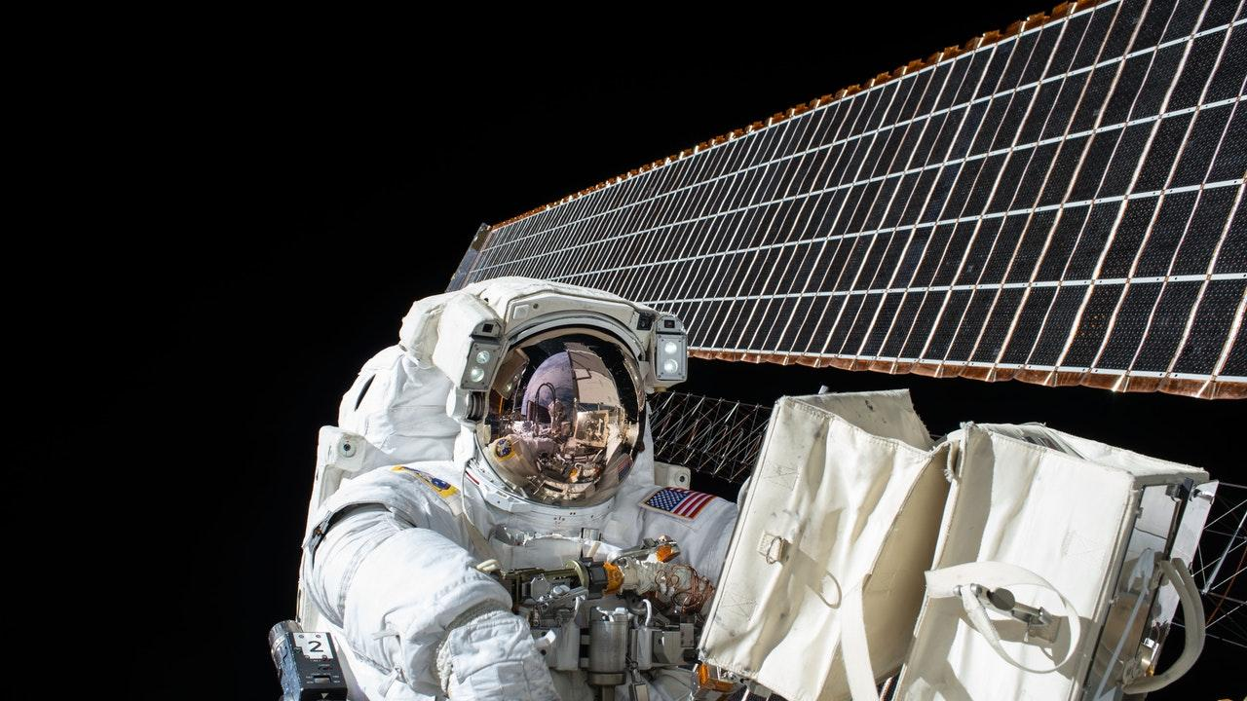

Slide 14
References
https://www.nasa.gov/audience/foreducators/stem-on-station/ditl_eating
https://www.columbiatribune.com/news/20180925/ask-scientist-how-much-does-it-cost-to-feed-astronauts#:~:text=So%20just%20how%20much%20does,%249%2C000%20to%20%2418%2C000%20per%20pound.
https://www.nationalgeographic.com/science/2018/10/news-spaceports-cosmodromes-maps-world-space-week/

