Slide 1
HTML & CSS Review
August 27th, 2019

Slide 2
Agenda
Slack Access
Course Content
Course Software
Quick HTML / CSS Review
Git Repo Access
CIS Linux Access

Slide 3
Syllabus
Download class material below….
https://cislinux.hfcc.edu/~crbanks1

Slide 4
Slack
Let’s set this up now.
cis-222-cb.slack.com
Or use the link at
https://cislinux.hfcc.edu/~crbanks1

Slide 5
Questions
?

Slide 6
Course Content
HTML & CSS (brief review)
Good Programming Practice
Git
PHP
MySQL
Relational Databases
Interacting with MySQL via PHP
Security
XML vs JSON

Slide 7
Course Software
Text Editor
FTP Client
Web Browser
Git Client
MySQL Client (later)
Flash Drive or H Drive
Slack

Slide 8
Questions
?

Slide 9
HTML Anatomy
<tag attribute1=“value1” attribute2=“value2” >Inner Content</tag>
Example:
<a href=“http://google.com” style=“color:red;” >Google</a>
Attribute Names
Attribute Values
Opening Tag (Element)
Text to Display
Closing Tag

Slide 10
HTML Anatomy
Most tags need closure
<p>Text goes in here before closure.</p>
Some tags do not need closure
<br>
Nesting is always important
More information:
http://www.w3schools.com/html/html_attributes.asp

Slide 11
Basic HTML 5 Structure
<!DOCTYPE html> <html> <head> <meta charset="UTF-8"> <title>Title of the document</title> </head> <body> Content of the document...... </body> </html>

Slide 12
Questions
?

Slide 13
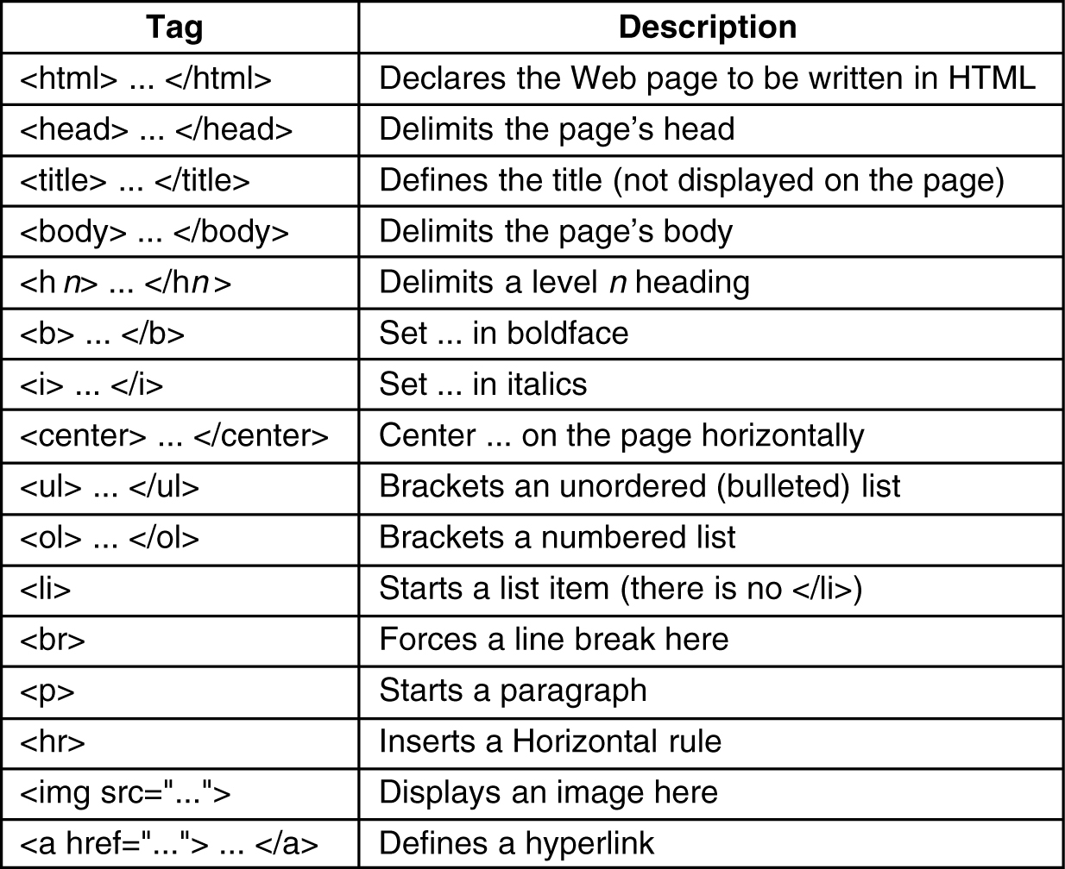
Common HTML Tags

Slide 14
Div && Span
Both are used to group data for CSS formatting
Div
Groups block level information
Affects its children and the whitespace around them
Isolates the block with line breaks like the p tag
Imagine a box around the data
Span
Groups inline level information
Affects only the stuff
Does not add line break or change visual formatting
Imagine a selection of text in a document

Slide 15
Questions
?

Slide 16
CSS
CSS is used to add style or animation to a document
The functionality of CSS has really improved in the last few years
Styles can be applied to…
Tags (a, p, br, div, span,)
Tags are preexisting elements that are part of the HTML standard.
IDs
IDs are unique names assigned to a single specific element
IDs are represented in CSS using the hash character before the name (#)
No two IDs should share the same name.
Classes
Classes are non-unique names used to identify element(s).
Classes are represented using a period before the class name (.)

Slide 17
CSS Inheritance
Inheritance is the process by which properties are passed from parent to child elements even though those properties have not been explicitly defined by other means. Certain properties are inherited automatically, and as the name implies, a child element will take on the characteristics of its parent with regards to these properties.
For example, if a div element has a font-size of 20px then, any children will also inherit that font-size value. This of course is assuming no other font-size changes have been defined.

Slide 18
Where Does CSS Go?
CSS can be inline, internal, or external. We will almost always use external in this class.
Inline
Goes right inside the tag you are going to modify
<a id=“link1” style=“font-size:20px;” >
Internal
Gets style tags and goes in the same file you are modifying
<style>#link1 {font-size:20px; }</style>
External
Works like internal but goes in a separate file
Can be used with multiple pages or files
Do not include style tags
Use a link tag to include the file

Slide 19
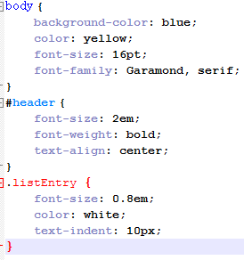
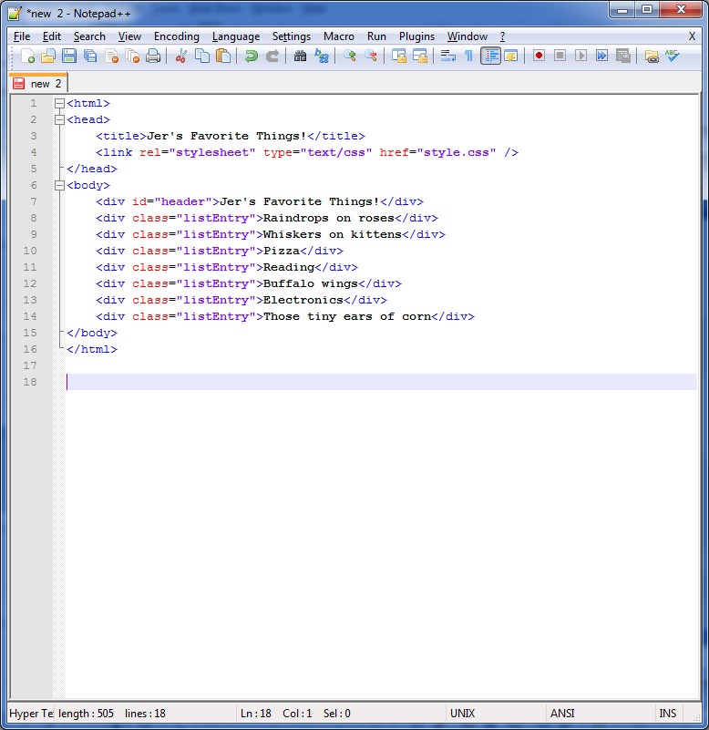
External CSS Example
Stylesheet: style.css
Webpage: cssDemo.html

Slide 20
Questions
?

Slide 21
Understanding a VCS Repo
Working on files on your local computer and uploading them to a web server like this is one thing. But to save the files in git, you must also save them to the Git server.
Common actions with a code repo are commit, push, pull. Do not worry if this is confusing, or you don’t quite get it at first.
Try to think of it like this. Committing code is like wrapping it up in a little package. You can commit many times, but they are still here; your code packages are still local. A push is when you send all current packages to the git server. When you pull, you are updating your code with any commits (packages) other people have made since your last pull.

Slide 22
Setting Up A Project
Log into https://gitlab.hfcc.edu/users/sign_in
Find your CIS-222 project and select it
Switch the link generator from SSH to HTTPS
Copy the link
Use the link to create a project in PhpStorm or Gitkracken
Raise your hand if you get stuck or when you finish

Slide 23
Developing The Page
Open your git repo and create an html file. Name it something like index.html or class1.html. Then make sure you add the following to it.
Doctype
Head
Title (Something like HTML Demo)
Link a CSS file
Body
A heading
Your name
At least one paragraph tag
Add about a sentence of text to your p tag
A link to any other web page
Contact information
Raise your hand if you get stuck or when you finish

Slide 24
Uploading The File
If you are using Notepad++ open filezilla. If you are in PhpStorm, lets setup the connection. Below is your connection information. Once you are connected, upload your file.
Host: cislinux.hfcc.edu
Port: 22
Your HFC username and pass.
Raise your hand if you get stuck or when you finish.

Slide 25
Viewing The Webpage
Open any browser and navigate to your page using an address like the one below.
https://cislinux.hfcc.edu/~username/path/to/file/filename.html
Raise your hand if you get stuck or when your page has loaded.

Slide 26
Questions
?

Slide 27
Let's Try It!
Now we are going to commit and push the HTML and CSS files we just created.

Slide 28
Homework 1
Homework 1 will be assigned Thursday
Homework one will consist of creating a basic file that contains some HTML, CSS, and PHP.
Then we will upload the file to the CIS Linux server.
Then we add a link to the file in the comments.
Then the file will need to be pushed to git.
~99% of work in this class will be completed this way!

Slide 29
Next Session
Finish any outstanding environment setup.
Lecture: Ch. 1 – Introduction to PHP

