Slide 1
Pattern Recognition Project

Slide 2
Agenda
Introduce our team
Project introduction
Preprocessing steps
Regression models & Result
Classification models & Result

Slide 3
Team members
Mahmoud Salama Mohamed AbdelRahman
Eman Ibrahim Yusuf Sam
Rwan Sameh Helmy AbdEllatef
Mirna Gamil Abdo Habib
Eman Mansour AbdElhaleem Bren

Slide 4
Project introduction
This data set is about players in a football ,It includes the name, personal data, position, and abilities of all players .
This data set contains 14,364 instances (players), each of them has 92 attributes.
The project implement in two Milestone ( Regression & Classification )

Slide 5
Prepossessing Steps
Drop not important column & columns Which null values > 50%.
Split to the position column of player in 3 position in 3 columns.
Apply LabelEncoder Transformer on Categorical columns .
Remove “/” from work rate column and apply divide operator after convert it to numerical data such as (high/mid) = (3/2) .
Apply MinMaxScaler Transformer on columns if need.
Remove “+” from columns and apply plus operator if need such as 50+2 = 52.

Slide 6
Prepossessing Steps
Fill the null values by mean
Remove the out layers by interquartile range
Select the feature which have correlation > 50% in regression

Slide 7
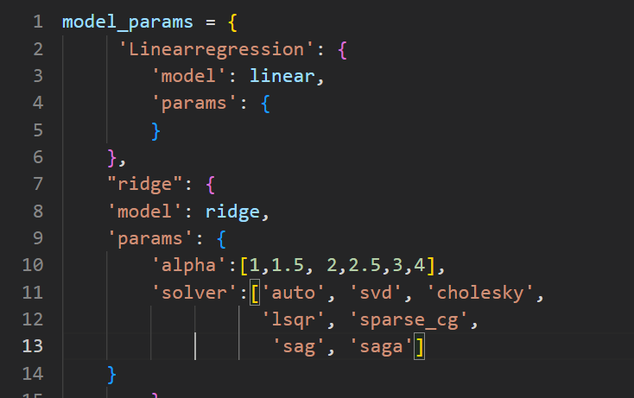
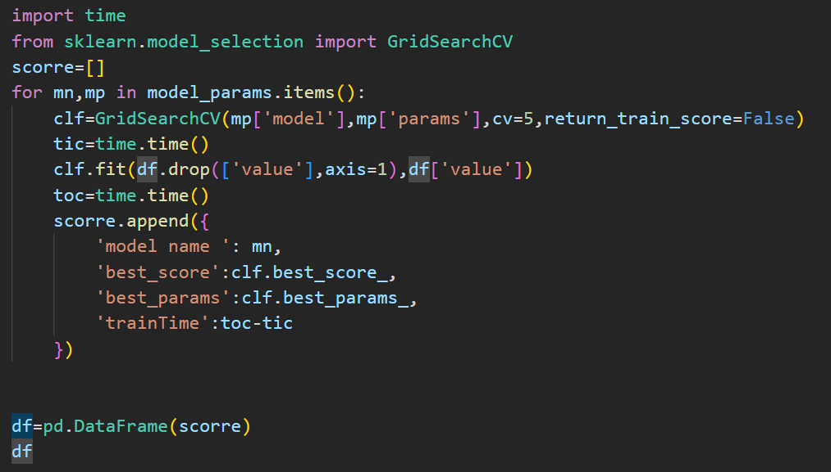
Regression models & Result
By using GridSearchCV to get best model with best hyper parameters

Slide 8
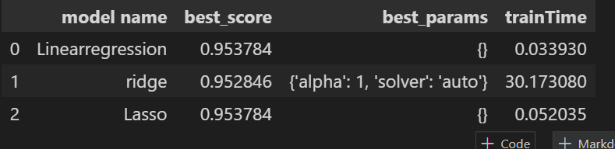
Output of the previous step

Slide 9
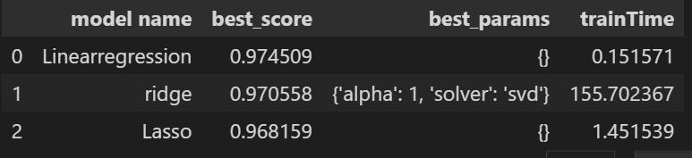
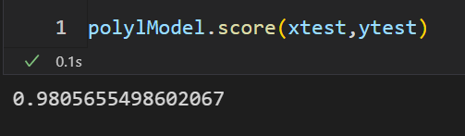
Regression models & Result

Slide 10
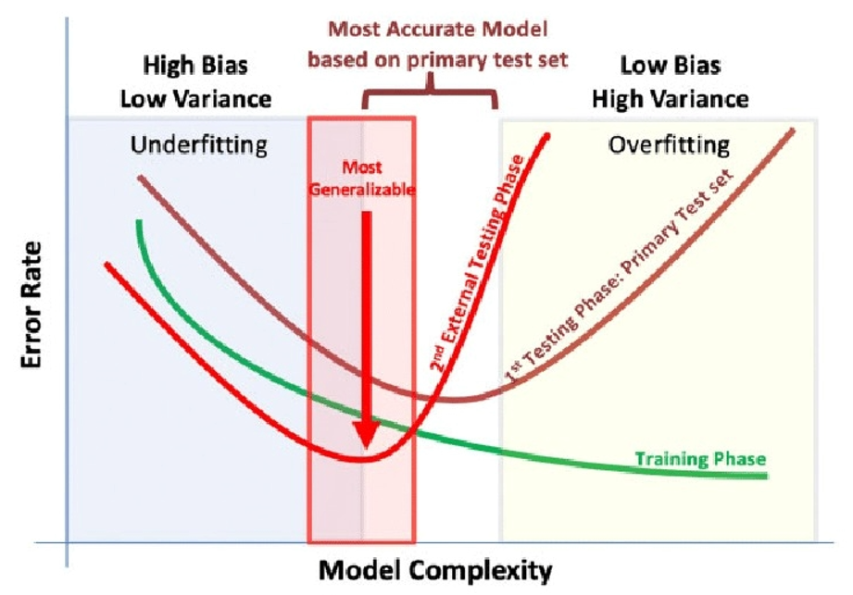
Degree effect in polynomial
2

Slide 11
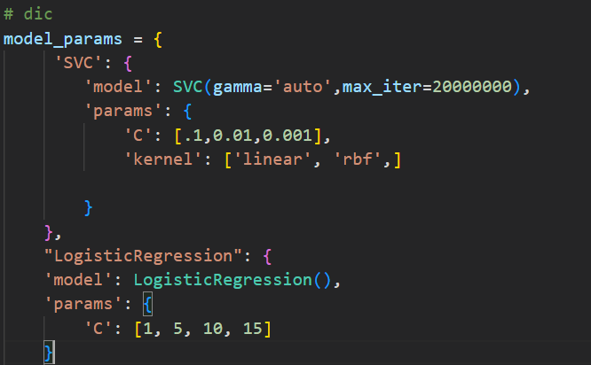
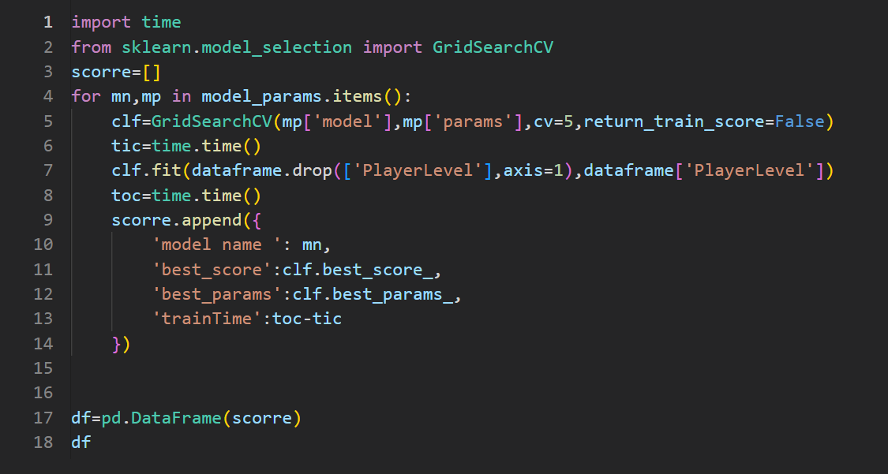
Classification models & Result
By using GridSearchCV to get best model with best hyper parameters

Slide 12
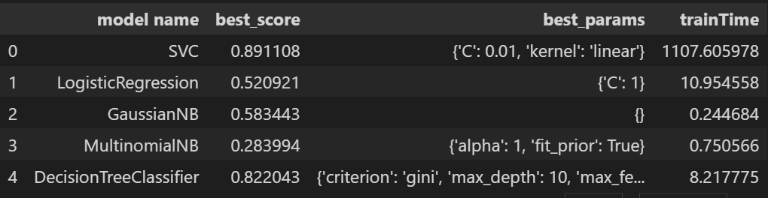
Output of the previous step

Slide 13
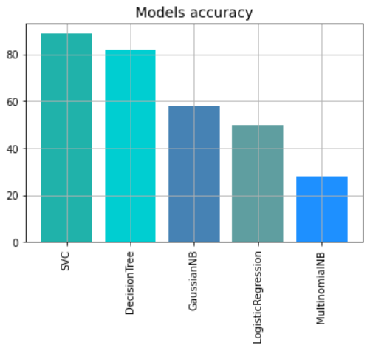
Models Accuracy histogram

Slide 14
Finally
Any Questions ?
Thank you

