Slide 1



Amazon Sales Report Analysis
MAHMOUD EMAD
June 2024

Slide 2

Data Cleaning
Loaded the dataset and inspected the first few rows to understand its structure.
Checked data types and identified potential issues.
Detected and treated outliers in numerical columns.
Handled missing values.

Slide 3

Exploratory Data Analysis (EDA)
Generated summary statistics for numerical and categorical variables.
Visualized the distribution of key features.
Price
Quantity

Slide 4
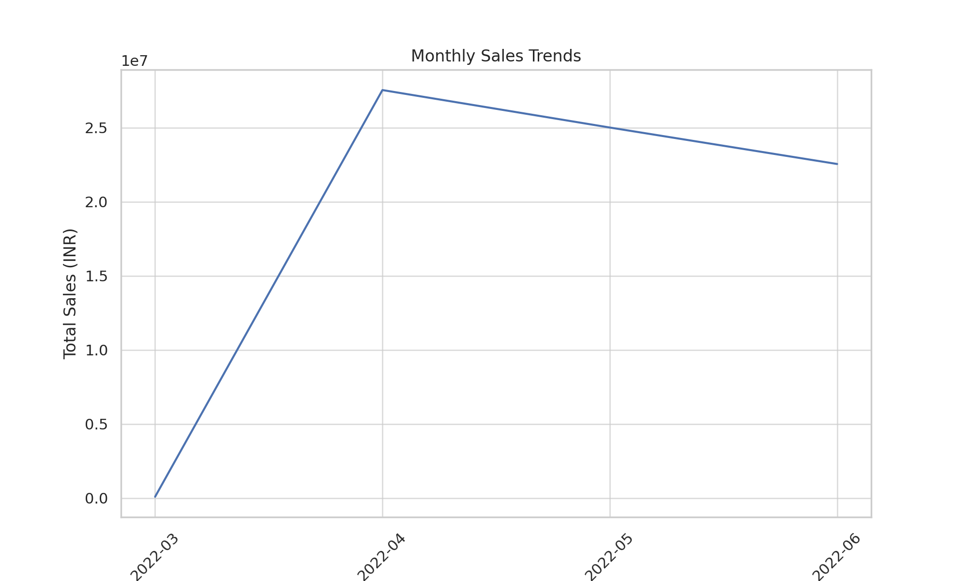
Monthly Sales Trends
The chart shows the trend of total sales over time from April to July 2022.
There is a sharp increase in sales from April to May, peaking at over INR 25 million.
Sales slightly decline but remain strong in June, with a further drop observed in July.
This trend can help identify seasonal sales patterns and plan future strategies.

Slide 5
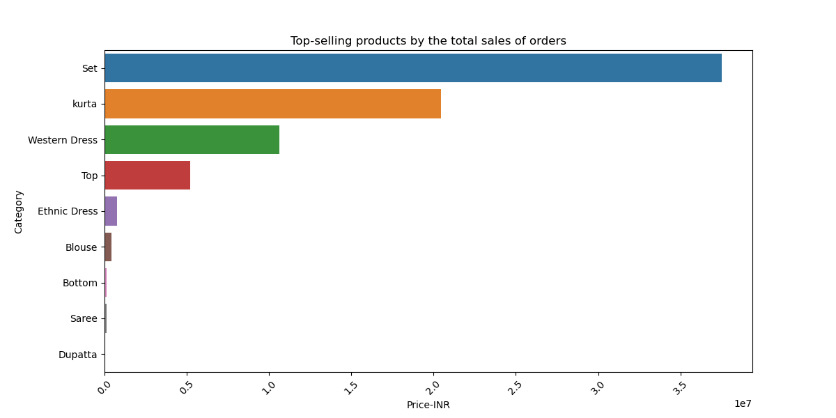
Top-Selling Categories
The chart depicts the top-selling product categories by total sales in INR.
'Set' is the leading category, with sales surpassing INR 35 million.
Kurta and Western Dress are also top performers, indicating popular fashion choices.
Categories like Top, Ethnic Dress, and Blouse show notable sales, reflecting diverse customer preferences.

Slide 6
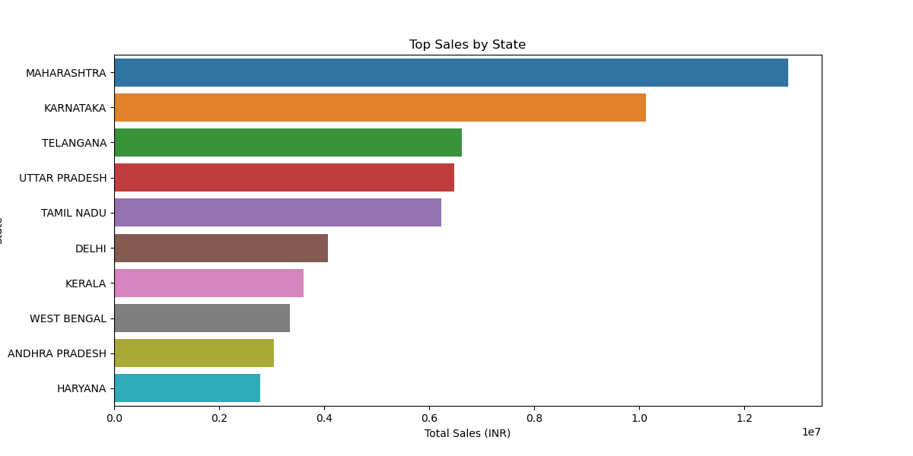
Top Sales by State
The chart shows the total sales in INR across different states.
Maharashtra leads with the highest sales, exceeding INR 12 million.
Karnataka and Telangana follow with significant sales figures.
States like Uttar Pradesh, Tamil Nadu, and Delhi also show strong sales performance, highlighting key markets.

Slide 7
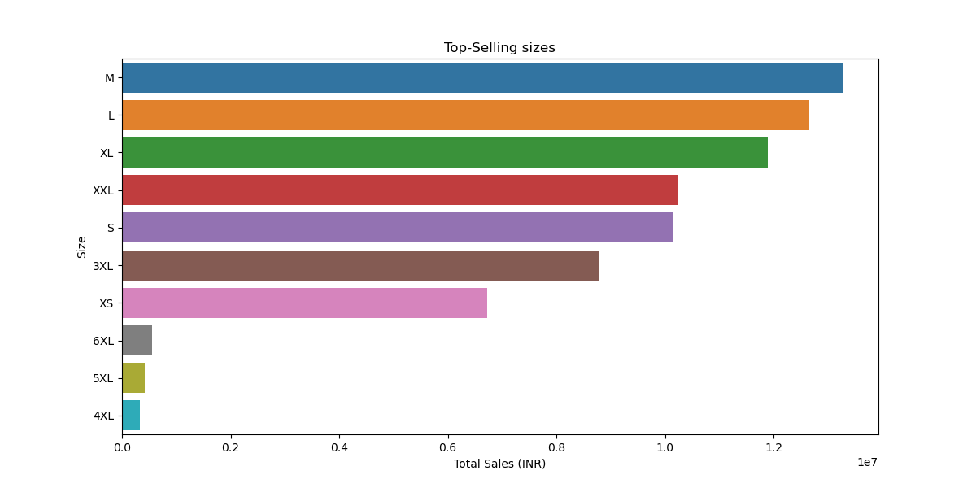
Top-Selling Sizes
The chart illustrates the sales distribution across different sizes.
Medium (M) and Large (L) sizes have the highest sales, each around INR 12 million.
Sizes XL and XXL also perform well, showing customer demand for a variety of sizes.
Small (S) and 3XL sizes show significant sales, ensuring a broad size range is available to customers.

Slide 8
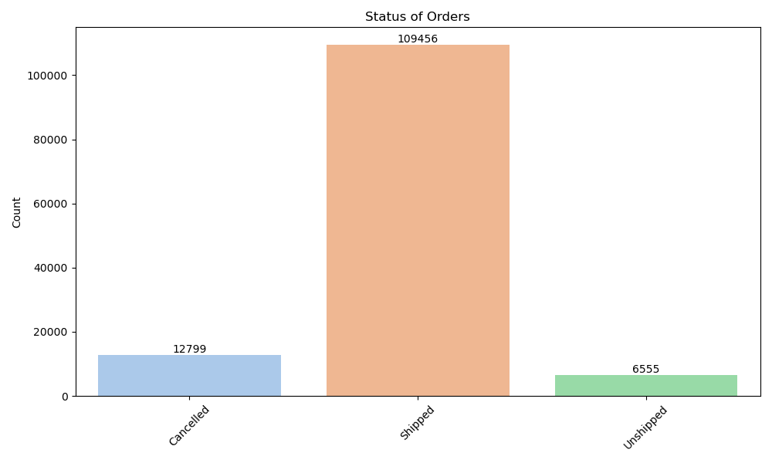
Status of Orders
The chart illustrates the status of orders in three categories: Cancelled, Shipped, and Unshipped.
The majority of orders, 109,456, are shipped, indicating efficient processing and dispatch.
A smaller portion of orders, 12,799, are cancelled, which might be due to various customer or logistical reasons.
The smallest segment, 6,555 orders, remains unshipped, highlighting areas for potential process improvement.

Slide 9
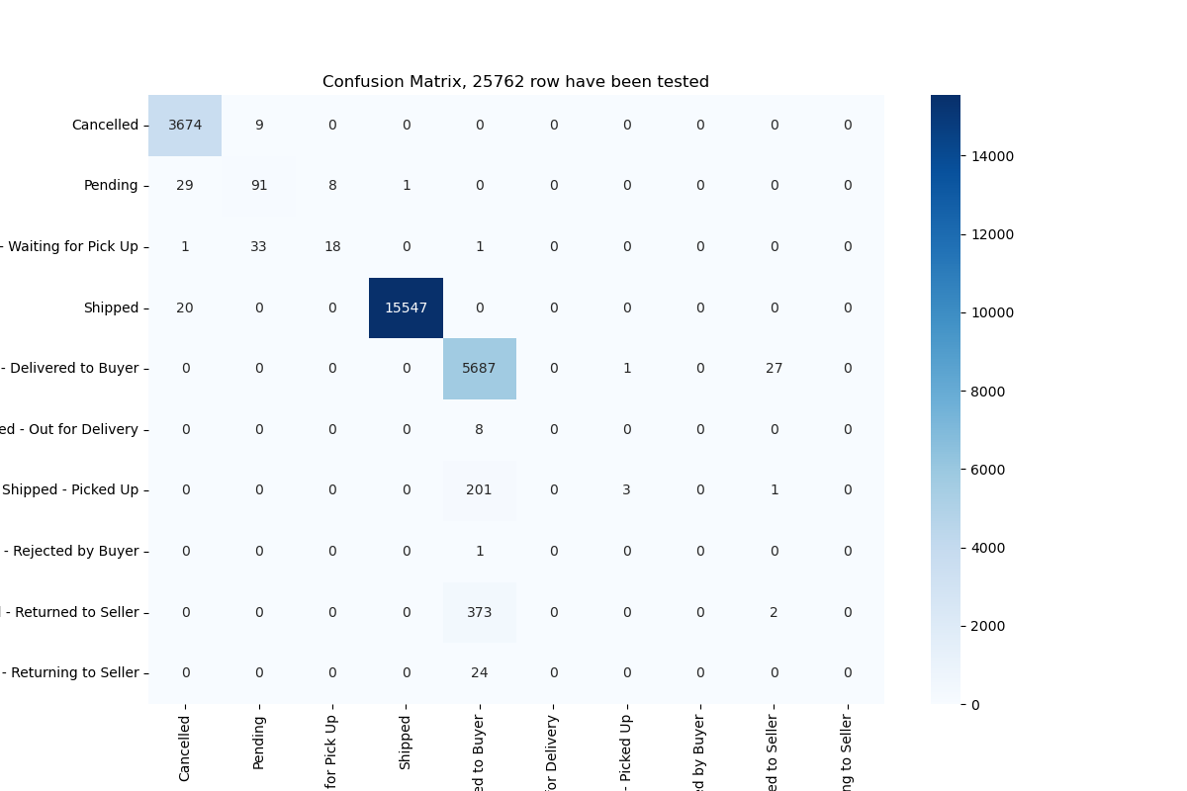
Predictive Modeling
Built models to predict 'Status’ of the order
Logistic Regression
Random Forest
Evaluated the models using accuracy, precision, and recall.
Visualized confusion matrices to understand model performance.

Slide 10
Predictive Modeling
The confusion matrix presents the performance of the model in predicting order statuses, with a total of 25,762 rows tested.
The majority of orders are accurately classified as 'Shipped' (15,547) and 'Delivered to Buyer' (5,687).
'Cancelled' orders (3,674) are also accurately predicted with minimal misclassification.
Few misclassifications are observed in categories like 'Pending,' 'Waiting for Pick Up,' and 'Shipped - Picked Up,' indicating areas for model improvement.
This matrix helps in understanding the accuracy and areas for enhancement in order status predictions.

Slide 11
Key Findings and Insights
The majority of orders are successfully shipped, indicating an efficient delivery process.
Medium (M) and Large (L) sizes are the most purchased, indicating common size preferences among customers.
Top-selling product categories are 'Sets' and 'Kurtas'.
High sales volumes in states like Maharashtra and Karnataka.

Slide 12
Recommendations
A notable number of orders are cancelled, suggesting potential areas for improving customer satisfaction or order processing.
Ensuring stock availability for top-sizes can enhance customer satisfaction.
Focus on top-selling categories to boost sales further.
Optimize inventory in high-demand regions to improve fulfillment rates.
Analyze customer feedback to enhance product offerings.
Consider promotional strategies in low-sales regions.

Slide 13
Thank You !

